Slide 1
Urgent Care Growth in the Post-Pandemic World
Alan A. Ayers, MBA, Macc
President, Experity Consulting
Senior Editor, The Journal of Urgent Care Medicine

Slide 2
2019-2022 Volume Trends
Total visits up approx. 18% from 2019 (38 vpd vs. 31 vpd)
COVID test or diagnosis approx. 34% of visits (13 vpd)
Non-COVID visits approx. 73% of 2019 levels (23 vpd)

Slide 3
Pre-Pandemic Concerns
Market Saturation
Commoditization
Case Rate Reimbursement
Acuity Degradation
Telemedicine

Slide 4
COVID-19 Learnings
Adapt quickly to meet patient needs
Achieve greater efficiency in operations
Throughput facilitated by technology
Innovative thinking to seize opportunities
Realized our place in the healthcare ecosystem

Slide 5
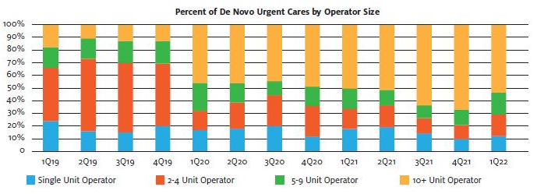
Pandemic and Post-Pandemic Growth
Influx of new sources of investment capital
Provider cash on hand
Change in de novo rooftop growth engine
”Corporation”
  25% of UCs owned by PE
  Project >10% rooftop growth
”Hospitalization”
  40% of UCs owned by hospitals
  20% of hospital UCs in JVs
  Growth to 45% by 2026

Slide 6
Post-Pandemic Growth Theses
Healthcare resiliency (vs. consumer discretionary)
  Attractive to investors
  Attractive to landlords
COVID patient retention
  Pandemic utilization up >25%
  66% intend to return vs. 75% pre-COVID
  Average patient returns 1.7 to 2.1x/year
Consolidation
  30% of UCs are independents (1-2 centers)
  40% of UCs are “chains” (11+ centers)
  PE sponsors and hospitals account for 75% of transactions
  Hospitals/health systems on a local level
  PE-backed platforms merging with one another
New geographies (urban, rural health clinics)
  17% of US counties have population to support a UC but don’t yet have one

Slide 7
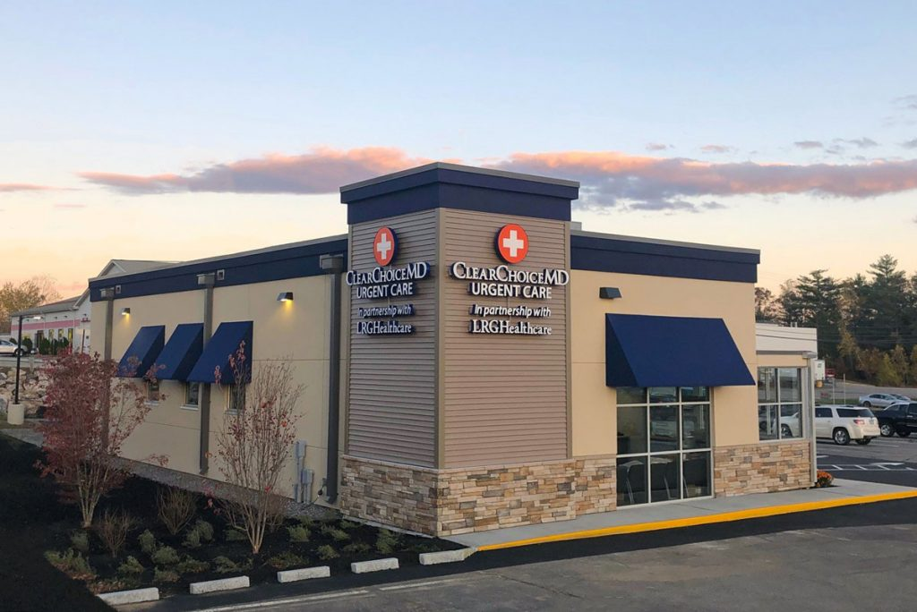
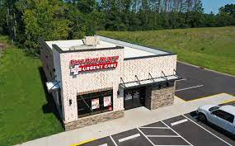
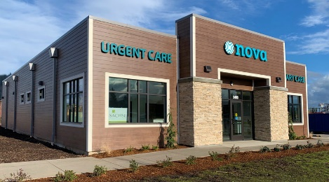
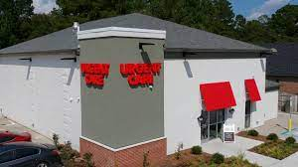
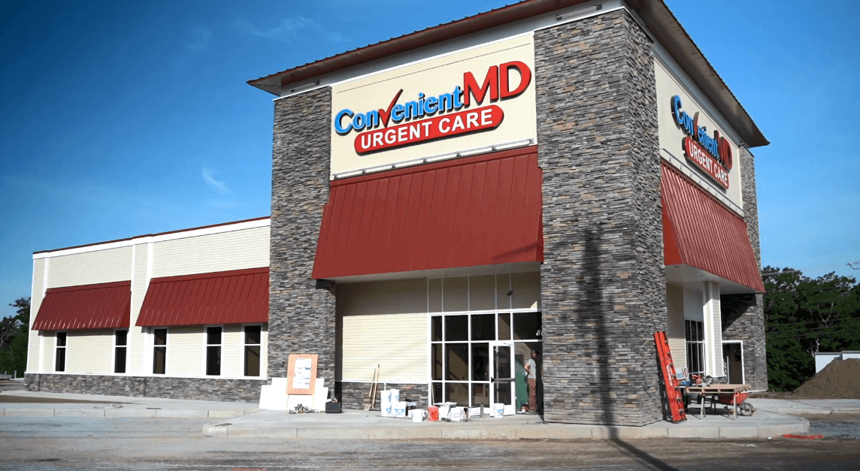
Post-Pandemic Growth Theses
Stand-alone buildings drive marketing and patient experiences:
Greater visibility than an in-line strip or medical office building
The building itself becomes a brand identifier
Control over signage — both permanent and temporary
Exclusive parking
Standardized flow and operational processes across sites
Perceptions of higher quality

Slide 8
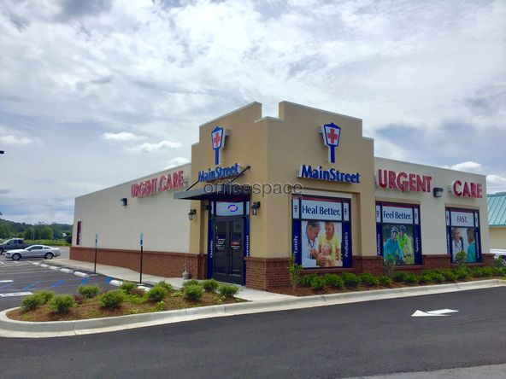
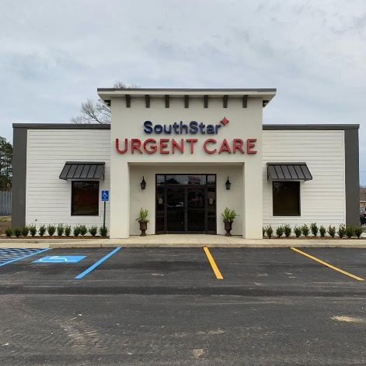
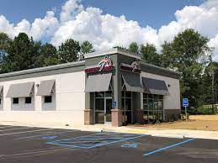
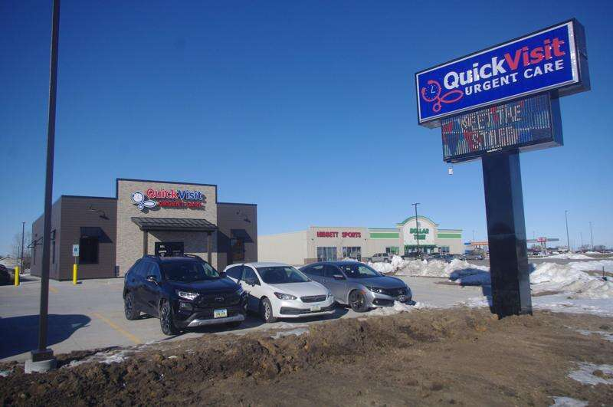
Post-Pandemic Growth Theses
To facilitate mass testing, vaccination, and treatment of contagion:
Drive-through capabilities
Parking lot triage
Exterior access to controlled exam rooms
Wait in vehicle vs. waiting room

Slide 9
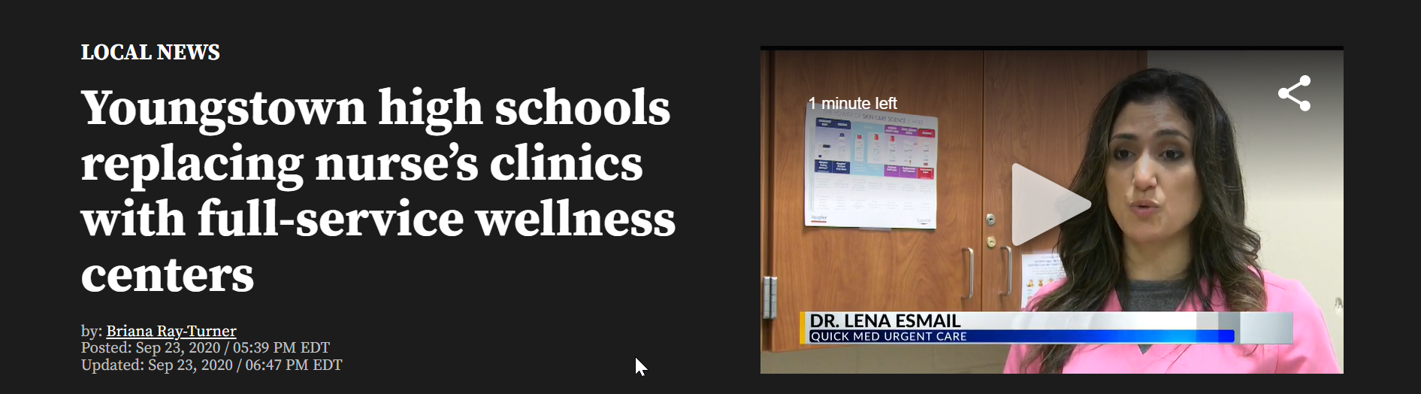
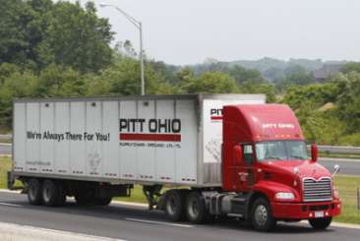
Realizing Scale Economies
New patient populations:
Medicaid expansion/privitization
ACOs/population health/value-based care
In-school clinics
New service lines:
Occupational medicine
Behavioral health (issues)
Dermatology vs. aesthetics
Orthopedics/physical therapy
Suboxone
IV hydration

Slide 10
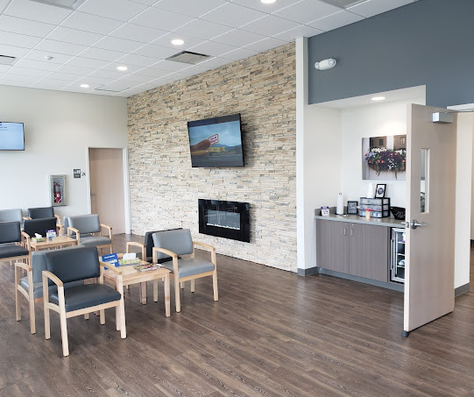
Post-Pandemic Growth Theses
Patients per hour per provider
  Volume-driven business
    Flow-through margin of incremental visits
    Skeletal labor as a fixed cost
    Problem of adding incremental provider capacity
  Leverage labor as the greatest expense
  Staff according to patient per hour expectation
  Pace arrivals according to staff capacity
  Eliminate non-value added tasks to increase efficiency
More locations in a market valued more per center
  Scale economies are local
    Staffing bench flexibility
    Mass marketing
  Payer leverage — network effect
Value-engineering the delivery model

Slide 11


Efficient
Cheap

Slide 12
Convergence of UC and Primary Care
Specialist
Emergency Department
Driven by a growing shortage of primary care providers relative to an aging and increasingly comorbid population
Parallel line of business
  Separate contracts (Tax ID)
  Scheduled appointments vs. walk-in
  Dual flow; different throughput measures
  Distinct providers
Standard definitions needed as to what capabilities constitute primary care in an urgent care setting
Complexity of Illness
Primary
Care
Urgent
Care
Acuity of Illness

Slide 13
Primary Care is Day-to-Day Healthcare
General Family Practice
General Pediatric Primary Care
General and Focused Internal Medicine
Primary Care by a Specialist for a Chronic Condition
Concierge Primary Care on a Subscription Basis
Direct Primary Care On-Site at an Employer
Community-Oriented Primary Care (including FQHCs)
Primary Care by an OB/GYN for Pregnant Women
Primary Care for a Workers Compensation Injury
Fee for
Service
Capitation
Cash
Risk

Slide 14
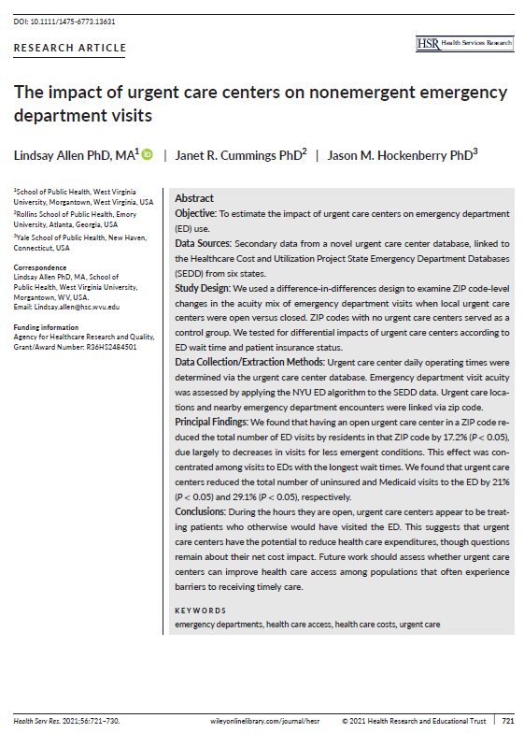
Urgent Care Impact on Nonemergent ER Visits
When urgent care is present in a ZIP code, it;
Reduces Medicaid utilization of the ED by 30%
Effect is magnified by a factor of 10 when the ED has long wait times
Greatest cost savings of UC (vs. ED visits) is with Medicaid and uninsured populations.
The ”new drivers” of UC revenue would be:
A shortage of local PCP access
Longer-than-average wait times at the local ED
A prevalence of Medicaid populations
Adequate reimbursement of UC visits by Medicaid

Slide 15

Threats: Telemedicine
Utilization during the pandemic up 10x from 1% to 10% of patients
Only 25% who used telemedicine for a UC-type condition would use it again
Only 20% of telemedicine users would seek telemedicine from a local urgent care
Telemedicine is a scale business – the brick-and-mortar adds no value
Pushed by payers and employers for years yet inconsistent with consumer behavior
Urgent care’s value proposition must be it’s brick-and-mortar

Slide 16
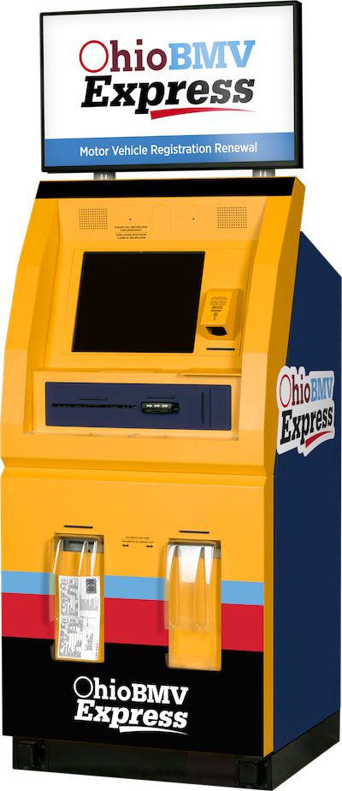
Evolution of Bureaucratic “Service”

Slide 17
Threats: Test and Treat
Long-term strategy to transform pharmacists into providers
Reduces medical practice to a rapid lab test
Walgreens, CVS, Walmart and Kroger control many state Rx boards
Theranos small-sample technology was fraudulent, the business case was not
Urgent care excluded from vaccine distribution, Paxlovid dispensing
Barriers to in-office dispensing must be eliminated in all 50 states

Slide 18
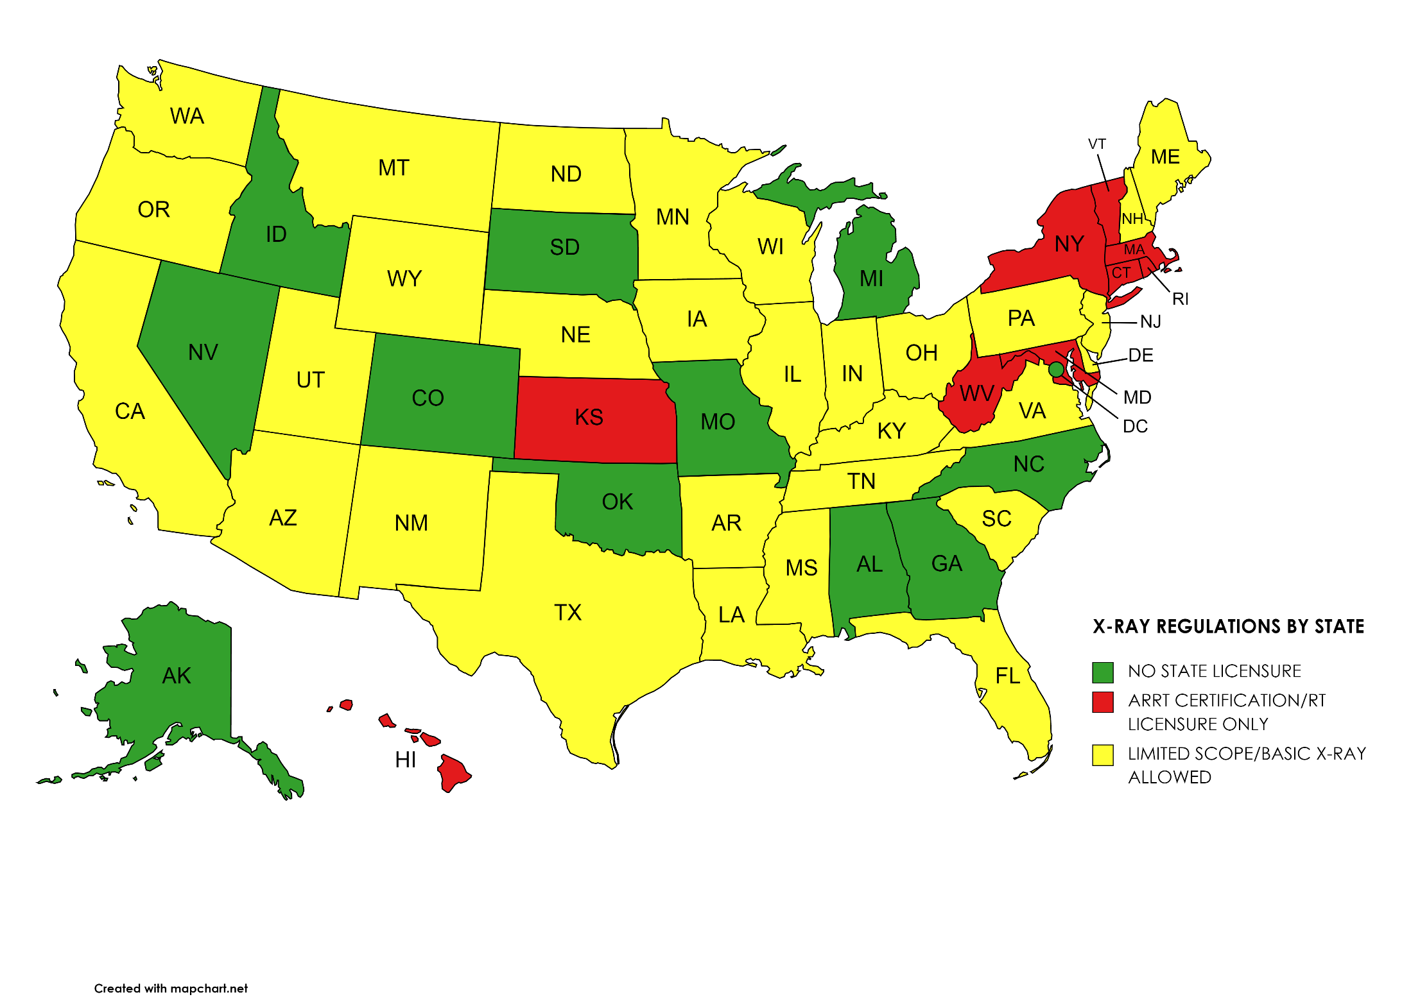
Staffing Challenges and Wage Inflation

Slide 19
California Limited Scope X-Ray Certification
State | Regulatory Authority (URL) | Full RT License | Limited Scope License | Limited Scope Procedures
California | California Department of Health, Radiologic Health Branch (RHB) https://www.cdph.ca.gov/Programs/CEH/DRSEM/Pages/RHB.aspx https://govt.westlaw.com/calregs/Document/IC369D8F05A2011EC8227000D3A7C4BC3?viewType=FullText&originationContext=documenttoc&transitionType=CategoryPageItem&contextData=(sc.Default) | AART Certification or Equivalent | Limited Permit X-Ray Technician School Diploma Pass state-approved radiology safety and limited scope exams | Limited scope permit required for each area: Chest Dental Extremeties Leg-podriatic Skull Torso-skeletal DEXA

Slide 20

Embarking on Your Own Growth Journey
Endemic COVID impact on long-term volumes
Reduced working capital needs
Availability of desirable retail
Data-driven approach to site selection
Hyper-targeted marketing (geofencing)

Slide 21
Thank you for your time.
For more information
Email: Alan.Ayers@ExperityHealth.com
Phone: (614)519-1221
Website: AlanAyersUrgentCare.com

