Slide 1

Triage Bootcamp
Alan A. Ayers, MBA, Macc
President, Experity Consulting
Senior Editor, The Journal of Urgent Care Medicine

Slide 2
tri·age /trēˈäZH/
noun
(in medical use) the assignment of degrees of urgency to wounds or illnesses to decide the order of treatment of a large number of patients or casualties. "a triage nurse"
verb
2. assign degrees of urgency to (wounded or ill patients). "victims were triaged by paramedics before being transported to hospitals“
Is this term even appropriate for urgent care?

Slide 3
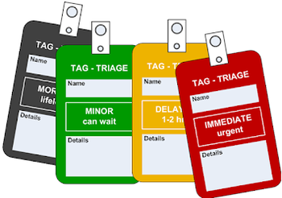
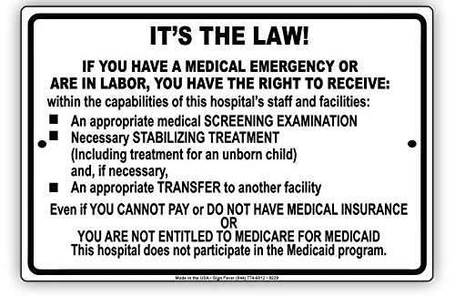
Triage Implications
Clinical Outcomes
Legal/Compliance
Flow/Throughput
Wait Times
Patient Experience
Team Experience

Slide 4
Patient Touchpoints in an Urgent Care
Find an Urgent Care Center
“Get in Line” at the Facility
Register at the Front Desk
Clinical Intake
Physical Exam
Diagnostic Testing
Medical Decision Making
Referral, Rx and Discharge
Patient Follow-up
Billing/Collections
Patient Feedback

Slide 5

Leveraging the Wisdom of the Crowd
Large crowds are collectively smarter than individual experts.
Today’s objective: design the “ideal” urgent care “triage” process.

Slide 6
Activity #1
What Activities Constitute Urgent Care Triage?

Slide 7
Activity #2
List Urgent Care Triage Best Practices

Slide 8
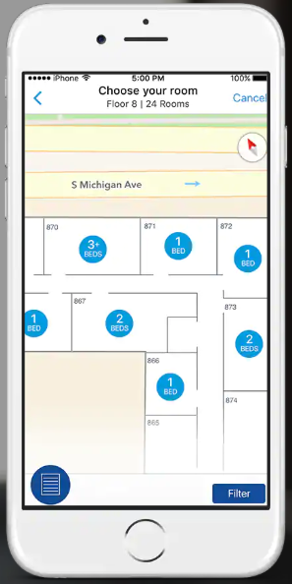
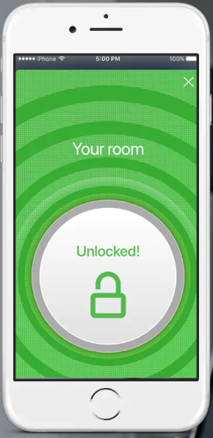
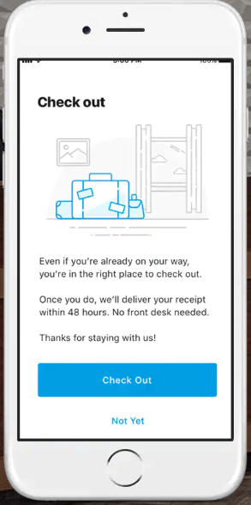
Reducing Friction in Routine Transactions
Friction – steps, obstacles, and unnecessary effort required for consumers to obtain what they want.
Goal is to make products and services faster, more convenient and more accessible.
Loyal customers, trained in your processes, can’t imagine going anywhere else.
Staff can focus on more value-added activities.

Slide 9
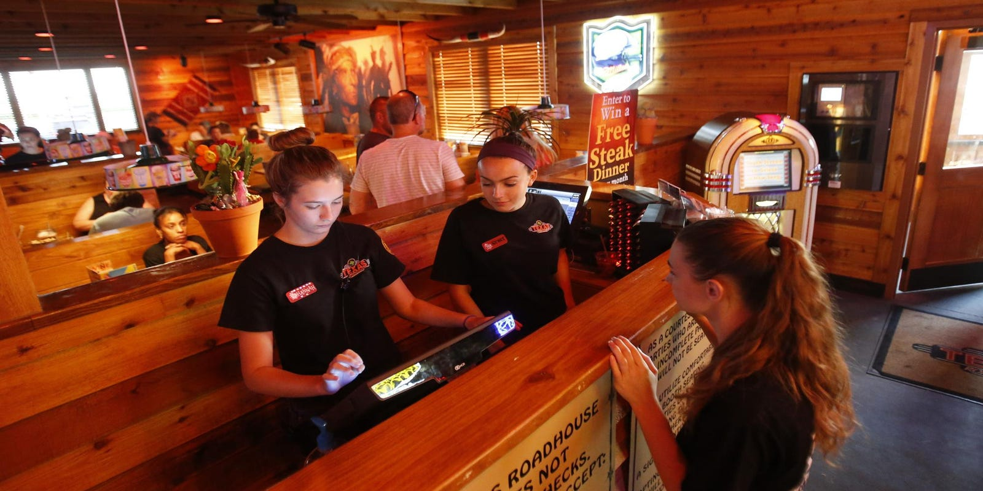

Queuing System

Slide 10

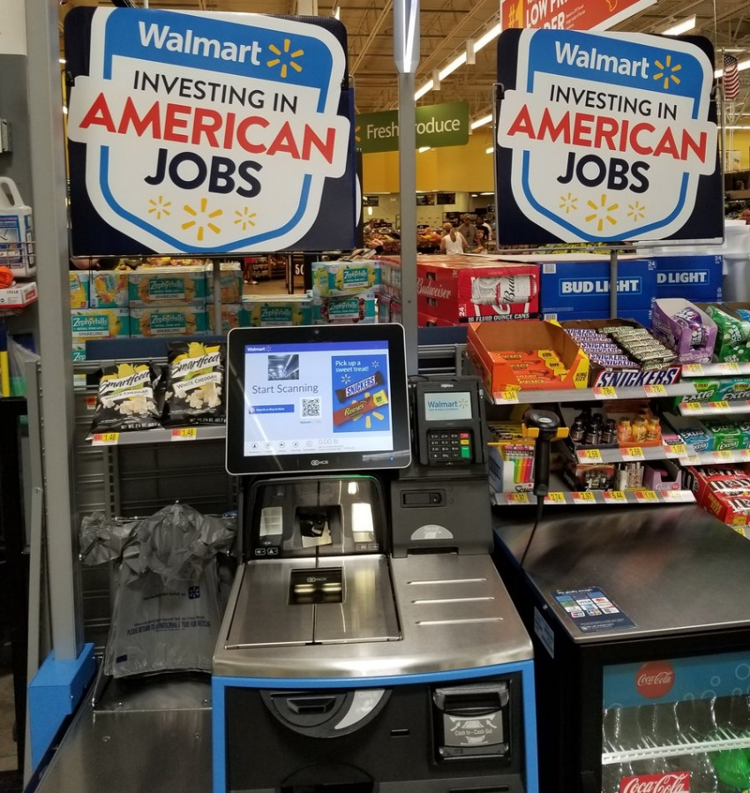
Functional Shifting

Slide 11
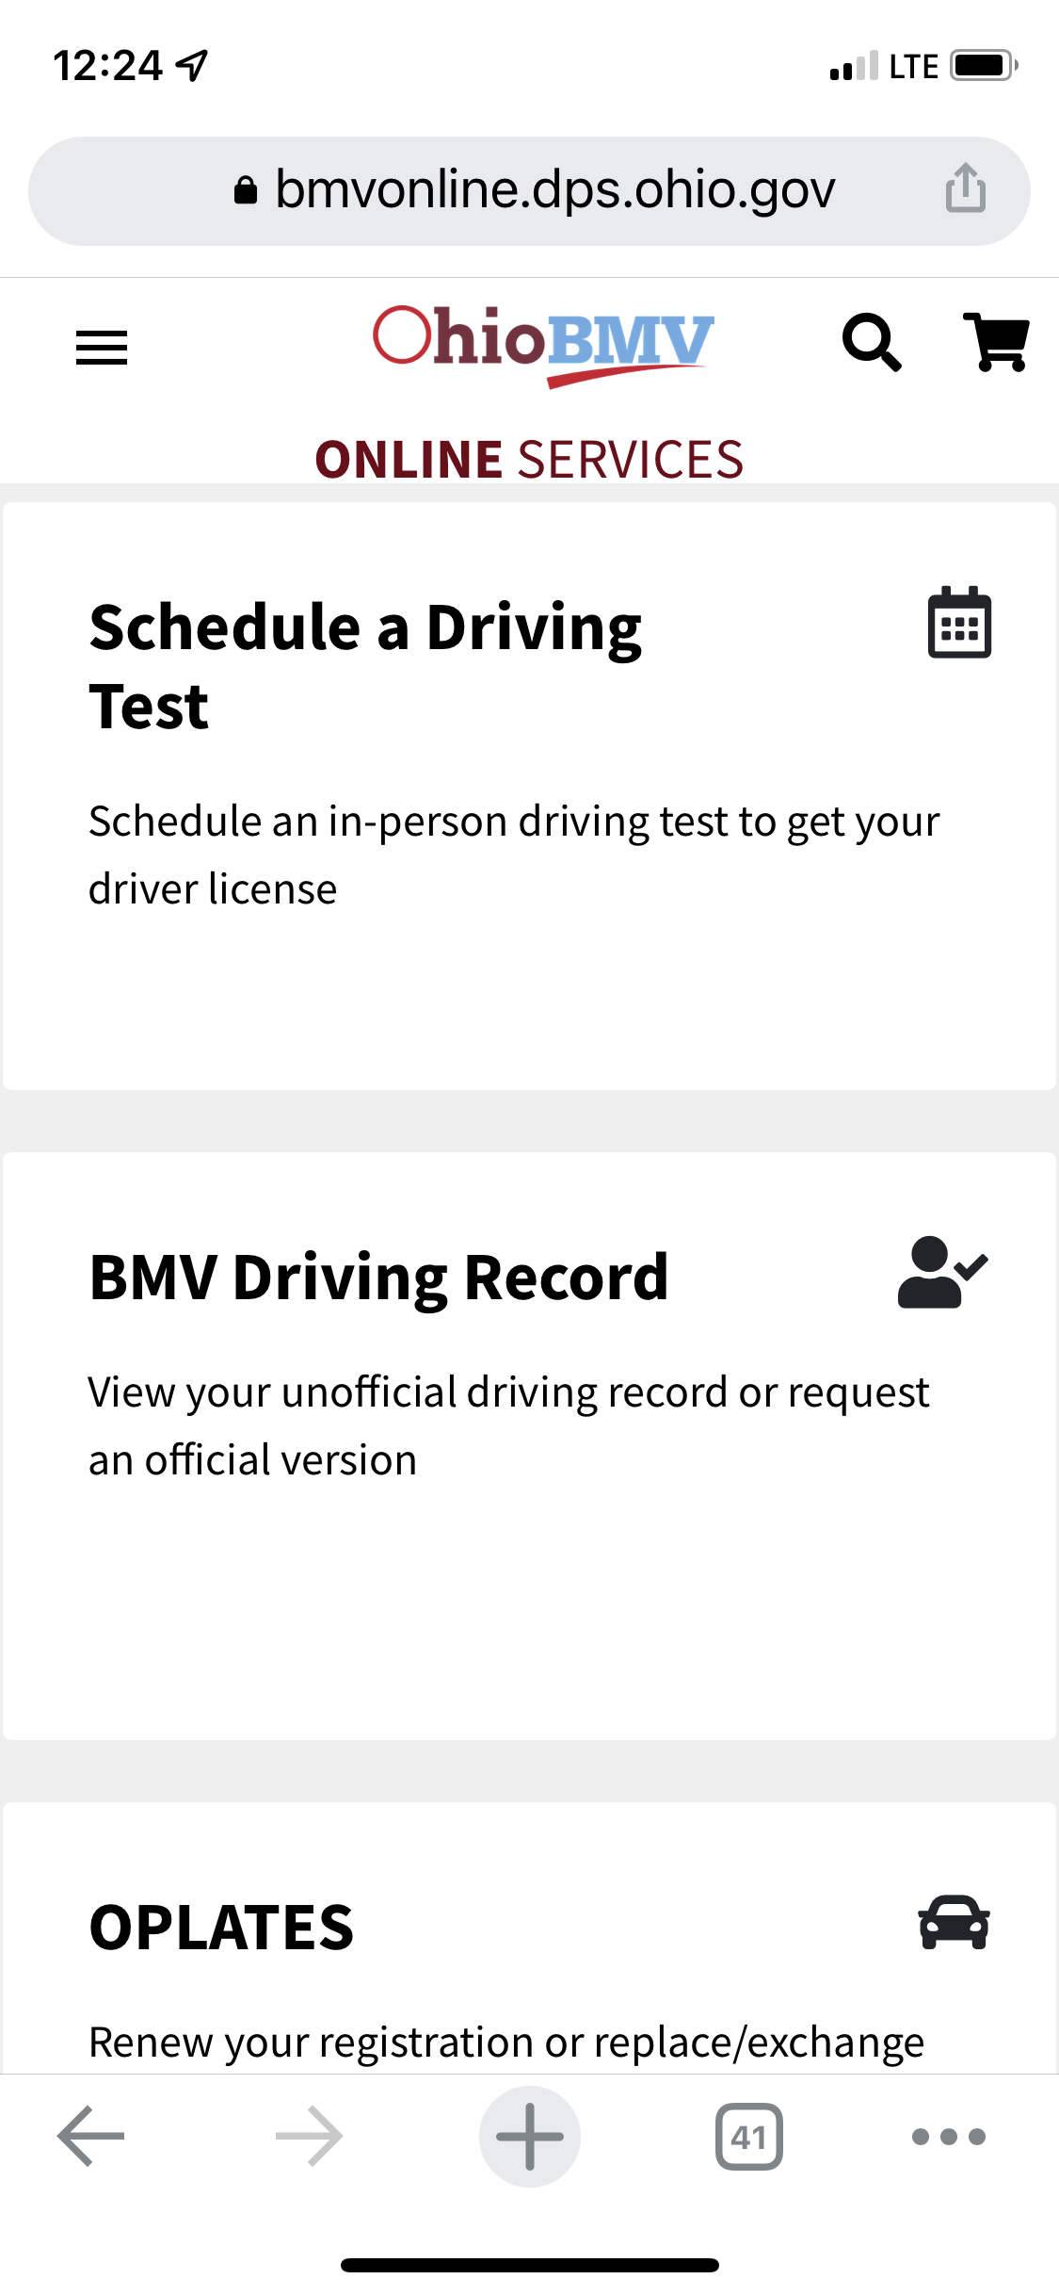
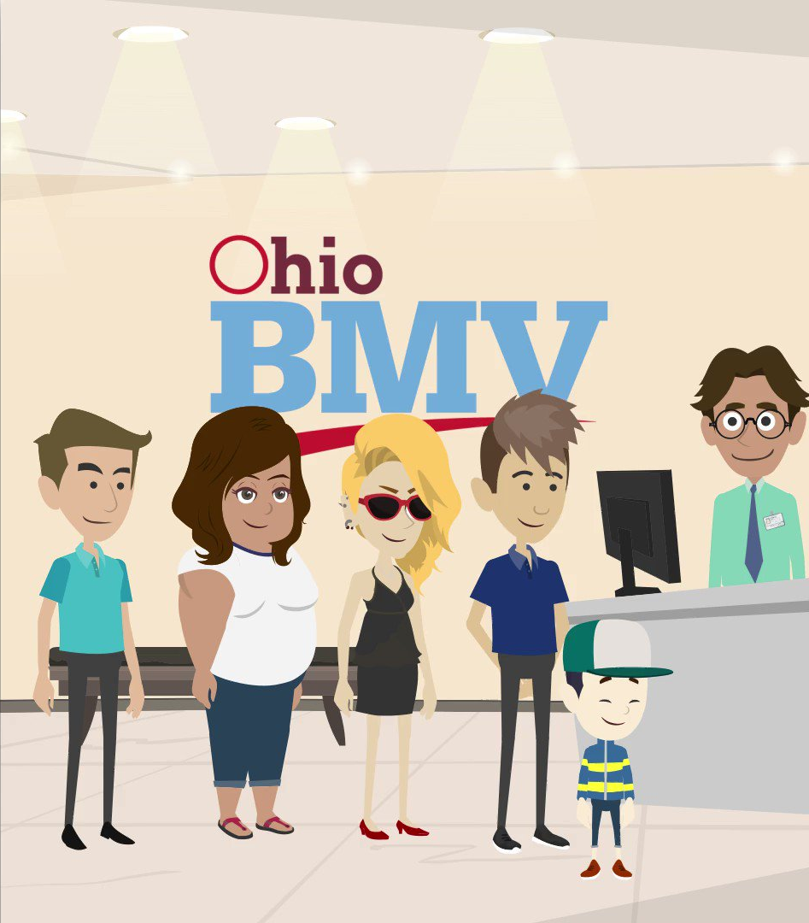
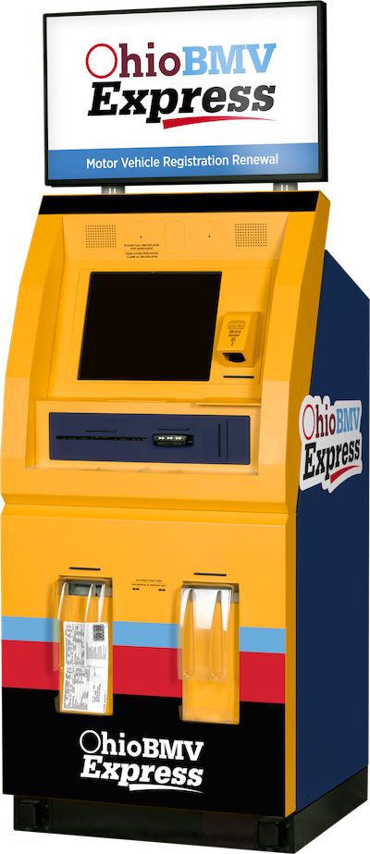
Evolution of Bureaucratic “Service”

Slide 12
Activity #3
Develop the “Ideal” Urgent Care Triage Process

Slide 13
Activity #4
Summarize “Take Home” Learnings and Best Practices

Slide 14
Thank you for your time.
For more information
Email: Alan.Ayers@ExperityHealth.com
Phone: (614)519-1221
Website: AlanAyersUrgentCare.com

