Slide 1

A Strategic Marketing Approach to Creating Value for Investors, Employees, and Patients

Slide 2
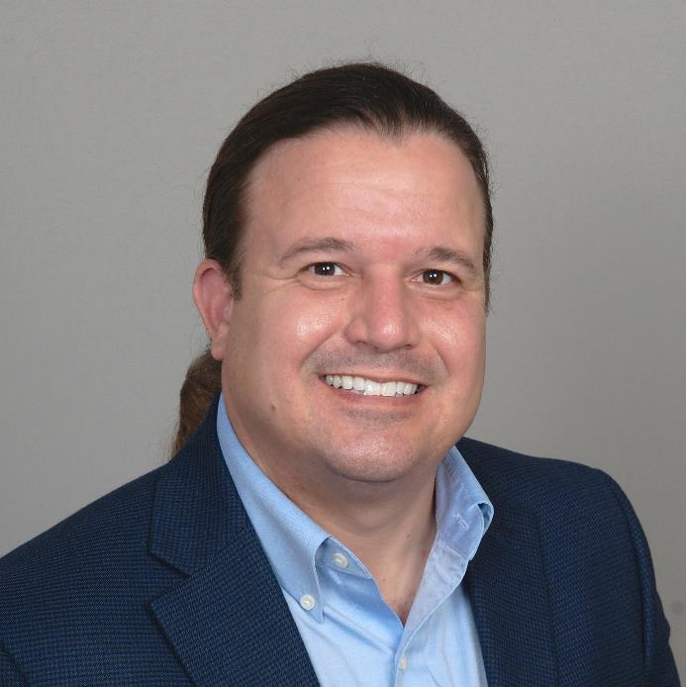
Today’s Speaker
Alan Ayers
President, Experity Network
Senior Editor, The Journal of Urgent Care Medicine

Slide 3
Urgent Care Trends Driving Change
After 25 years the industry is showing signs of maturity
Saturation in desirable suburban markets
Commoditization in the mind of consumers
Degradation of acuity driven by “case rate” and productivity measures
Consolidation of regional platforms; M&A on a local level
Services expansion leveraging existing patients and locations
Growth in new markets, new populations, and new services

Slide 4
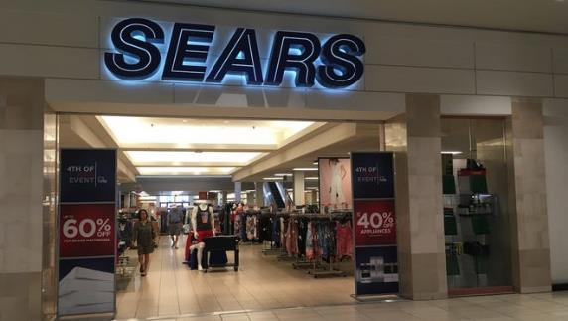
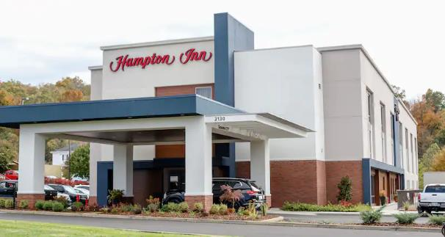
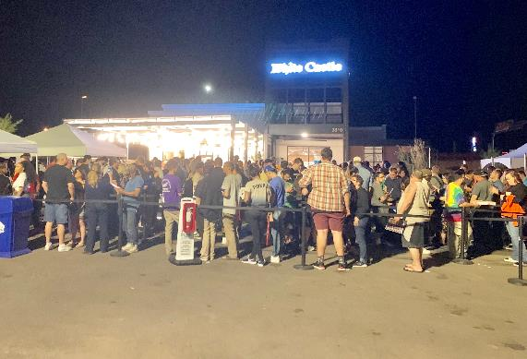
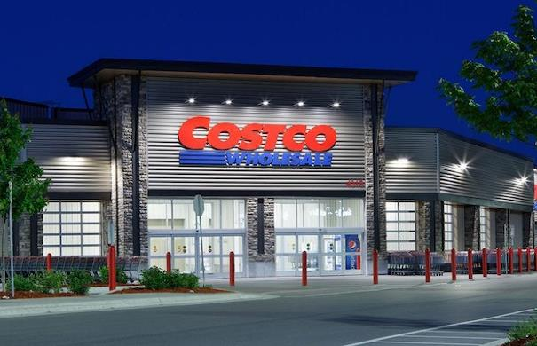
The Power of a “Brand”

Slide 5
The Power of a “Brand” (cont’d)
Authentic
Differentiated from other providers in all aspects of the patient experience
Relevant
Focused on what’s most important to patients
Consistent
Patients know exactly what to expect, every time, and the brand delivers
Excellent
Better quality, better service, better place to work, better value than competing options

Slide 6
How Brands Add Value
Simplify patient decision-making processes
Create an emotional attachment with patients
Define the culture and focuses the efforts of team members
Gain and protect market share from competitors
Reduce risk and increase valuation for owners and stakeholders

Slide 7
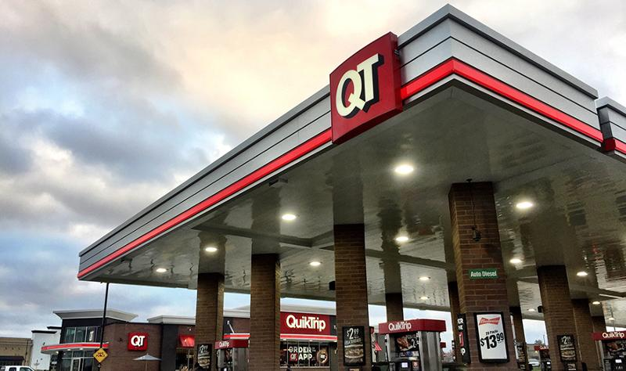
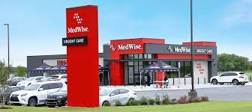
Opposite of a Brand:
Commodity
Exact same outcomes as other providers​
Not differentiated from other providers in service​
No emotional connection or customer loyalty​
People buy on price
A-Plus Locations
Attractive Facilities
Competitive Price
Customer Focus
Top-Notch Employees

Slide 8
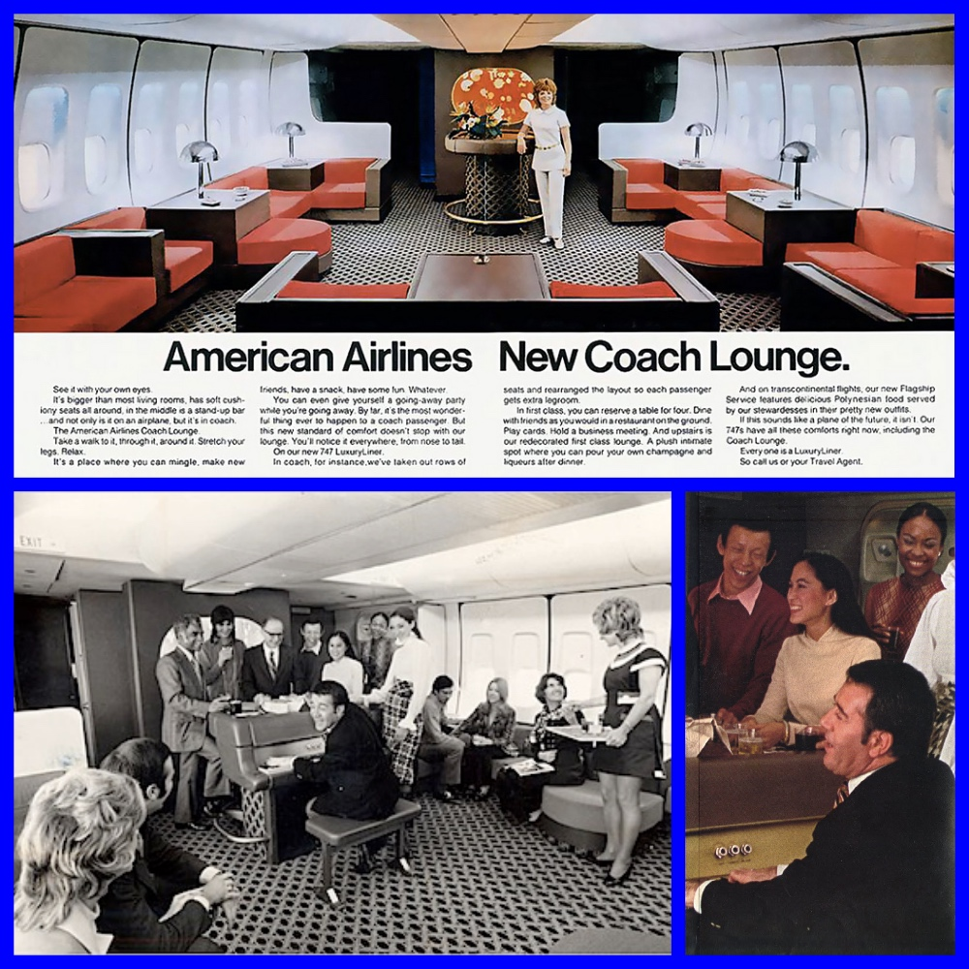
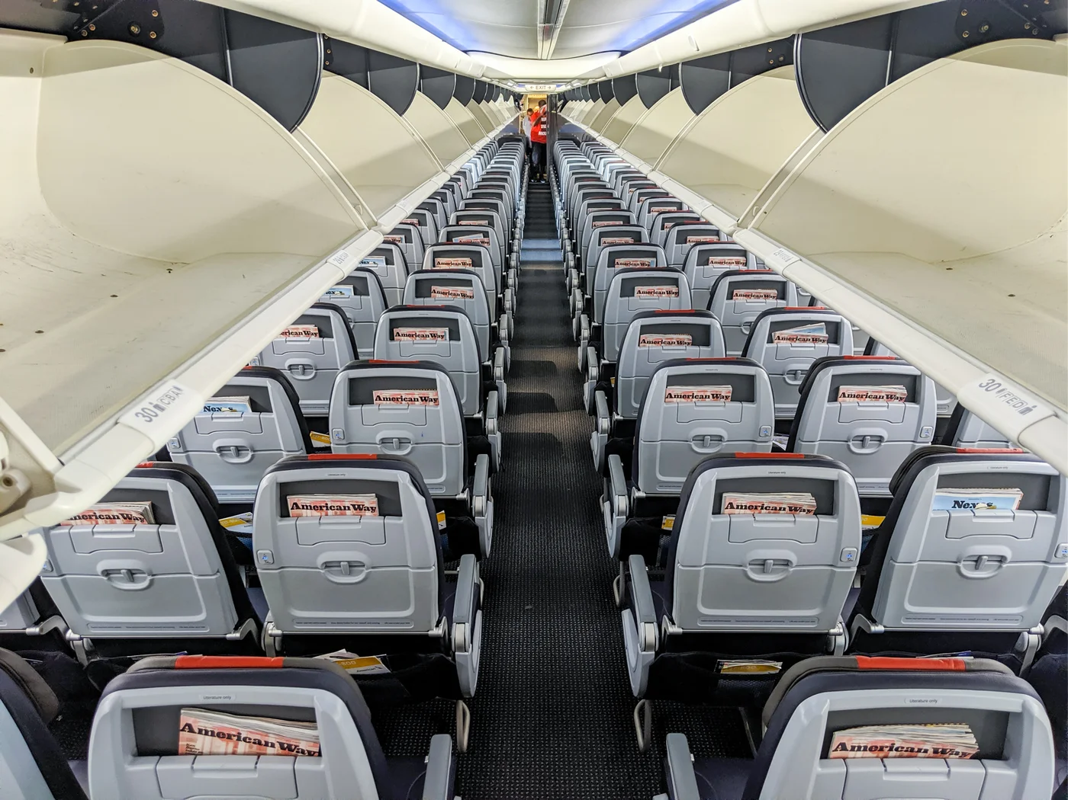



Avoid Commoditizing Your Brand

Slide 9
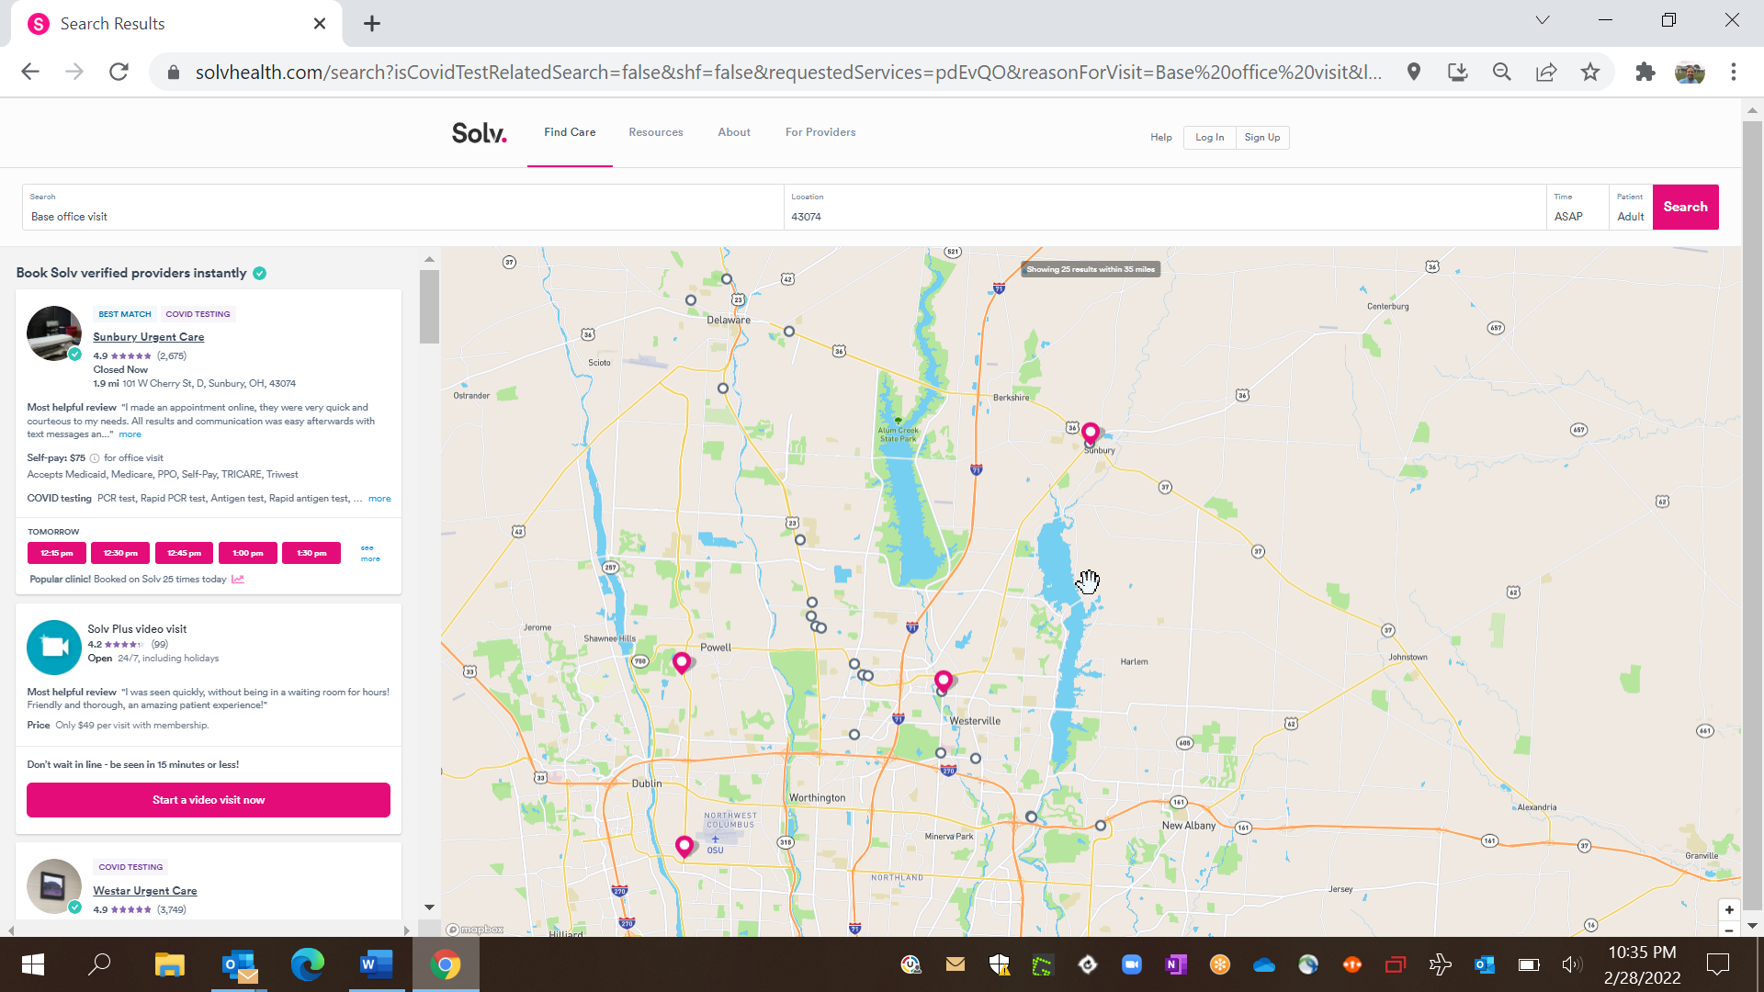
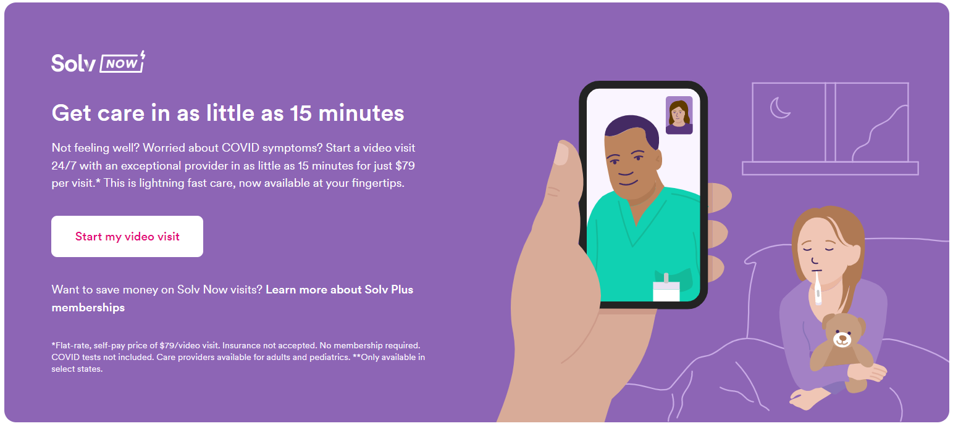
Marketplaces Commoditize Brands

Slide 10
Expanding Your Brand Footprint: People

Slide 11
Scarcity of Medical Labor
104,400 openings for MAs are projected every year from 2020-2030
In 2019 there was an 8.5% shortage of x-ray techs and in 2020 the number of RTs taking the ARRT exam fell by 7.8%
By 2025 there will be a shortage of 200,000 RNs and 29,400 NPs
By 2032 there will be a shortage of 122,000 physicians

Slide 12
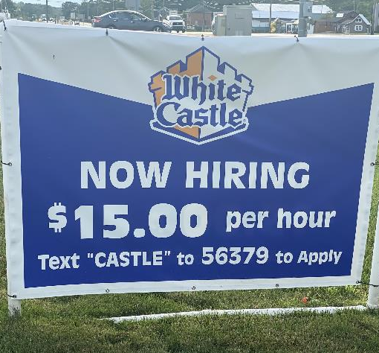
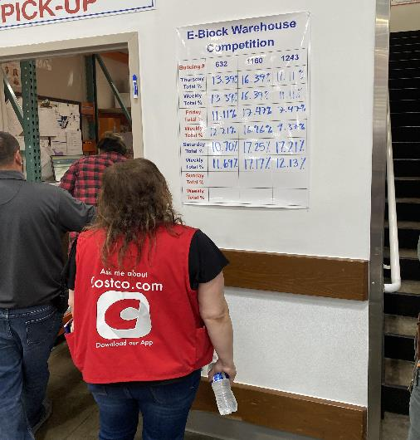
Winning Employer Brands
White Castle:
Bonuses paid since 1935; profit sharing since 1949
10% turnover for managers (40 hr. workweek) vs. fast food industry 130-150%
25% of employees >10 yrs.
2,160 inductees to the “25 year club”
Costco:
$17.00/hr. starting wage
Full medical/dental, 401(k), profit sharing after 180 days
“Extra checks” 2x/year for high productivity
94% employee retention

Slide 13
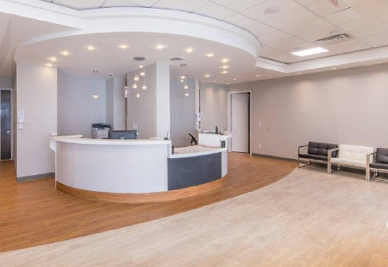

Branded Patient Experience Destinations
Scalable and predictable operating model:​
Repeatable (process-driven, standardized operating procedures, facilitated by technology)​
Consistent (every day, every patient, every provider, every site)​
Measurable (KPI focused with incentives)​
Accountable (team-oriented with shared values and culture)

Slide 14
Expanding Your Brand Footprint:
New Locations

Slide 15
Endemic COVID will lift overall center volumes
  Less acute strains: 3-in-1 test, Rx antiviral availability
  Accelerated volume ramp-up reduces working capital needs
  Higher volumes are equivalent to a “year-round flu”
  Incremental visits drive productivity; flow to the bottom line
Operators are sitting on “COVID cash”
  Poor investment options
    Rising interest rates, stock market volatility, low real estate cap rates
  Borrowing is cheap
    Low interest rates, high inflation
No Better Time to Open ​
New Centers​

Slide 16
No Better Time to Open ​
New Centers​
Strong retail sites have opened
Multi-location footprints bring a higher valuation
  Existing centers benefit from new center additions
  Scale economies in marketing and staffing bench
  Payer leverage
Retain pandemic business gains
  New patients introduced by COVID testing
  Retain hard-to-find staff
Race to establish brand in rural and other underserved markets

Slide 17
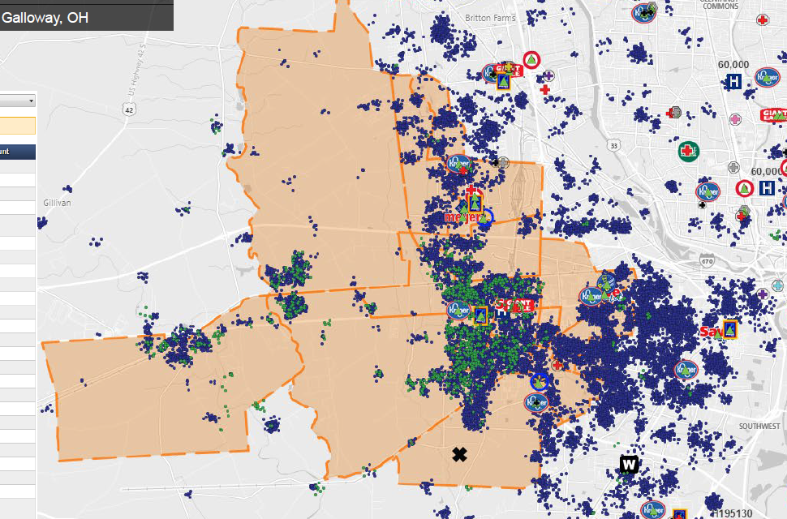
Leveraging the Power of Data

Slide 18
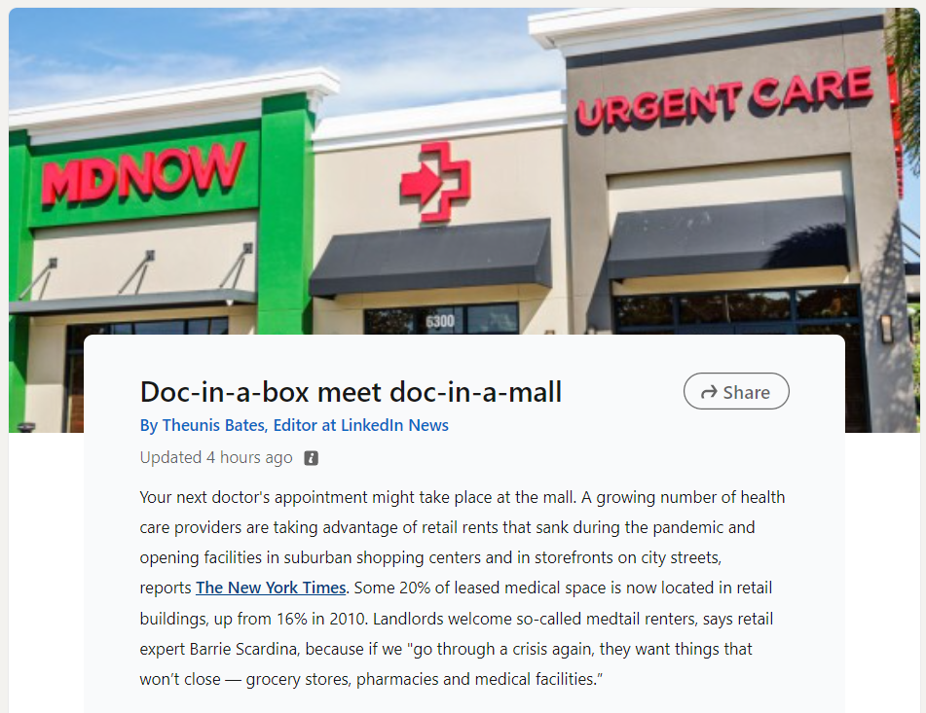
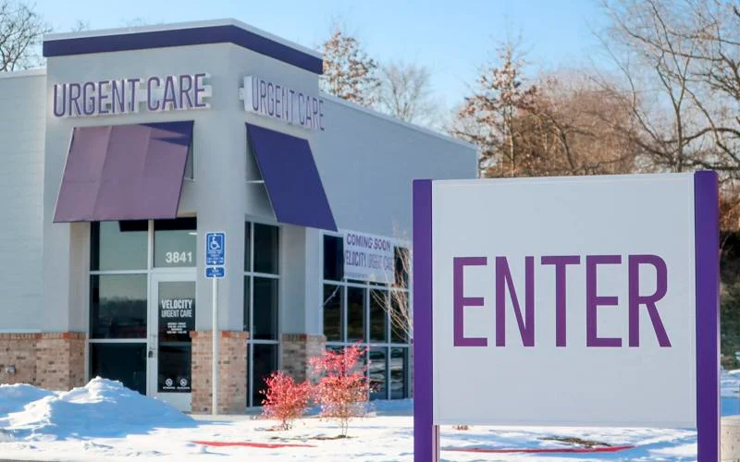
New Perspectives on Real Estate

Slide 19
Expanding Your Brand Footprint:
New Services

Slide 20
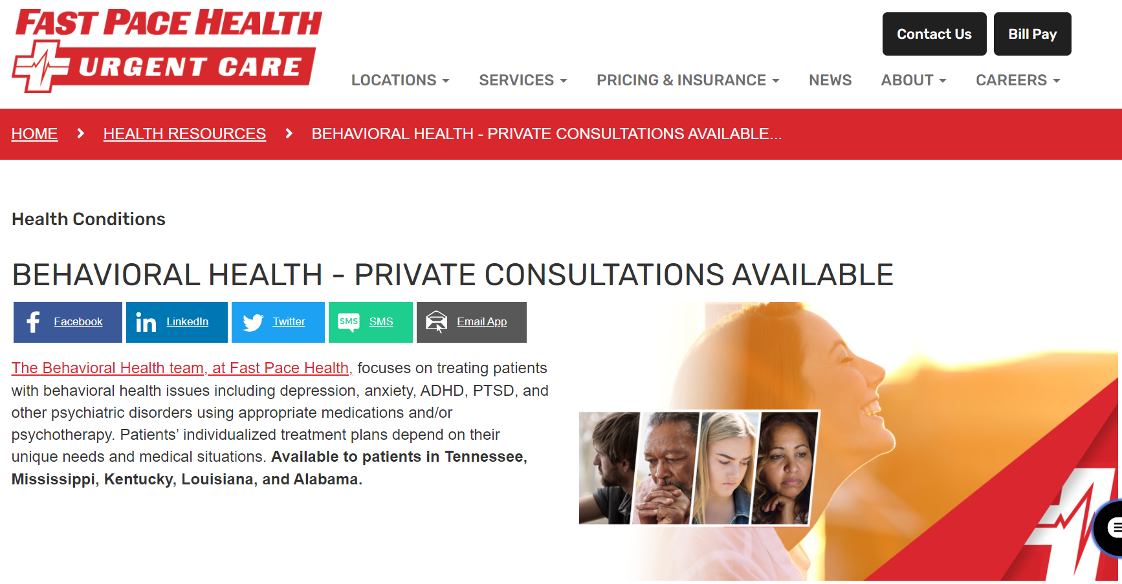
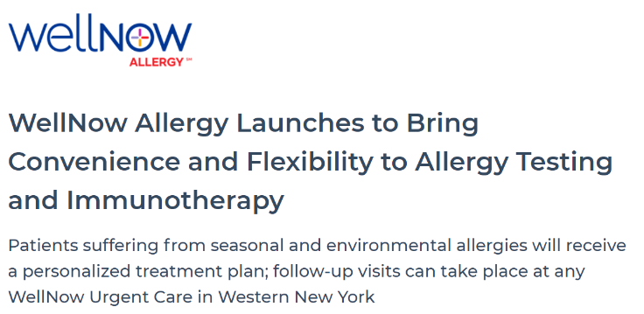
Growth Opportunities:
New Services
Rural health
Specialty services
  Allergy/Immunotherapy
  Behavioral Health
  Orthopedics
  Dermatology
  Physical Therapy
Primary Care
Occupational medicine
Telemedicine

Slide 21
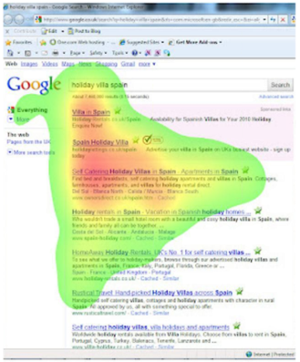
Growth Opportunities:
Online Marketing
Shift in ad spending from grassroots and traditional media to digital
Hyper-targeted digital tactics
  Geofencing/geotargeting campaigns
  Audience attribute campaigns
  Pay-per-click, re-marketing, display ads
  Quantity and quality of reviews
  Loyal patients have little to no “marketing” cost
  Patients trust centers with more positive reviews
  Reviews drive “top of page” Google results

Slide 22
Thank You!
Notes:
Thank you all and have a great day!

