Slide 1
Urgent Care Growth in the Post-Pandemic World
Alan A. Ayers, MBA, Macc
President, Experity Consulting
Senior Editor, The Journal of Urgent Care Medicine

Slide 2
2019-2022 Volume Trends
Total visits up approx. 16% from 2019 (36 vpd vs. 31 vpd)
COVID test or diagnosis approx. 30% of visits (11 vpd)
Non-COVID visits approx. 80% of 2019 levels (25 vpd)

Slide 3
Pre-Pandemic Concerns
Market Saturation
Commoditization
Case Rate Reimbursement
Acuity Degradation
Telemedicine → AI

Slide 4
Urgent Care Trends
Reviewed data from
Between 2009-2022
60,461,379 visits
Across 47 states
This data was captured from our Experity platform, and as such, all data has gone through the same workflows
Notes:
Some of these might be shocking, others validating, but either way they demonstrate that massive shifts have been taking place in the Urgent Care industry
We wanted to take a moment to discuss wht
Necessity is the mother of invention --- and you will see how there is an increased need for visibility and access to data in order to manage your practice and patient care

Slide 5
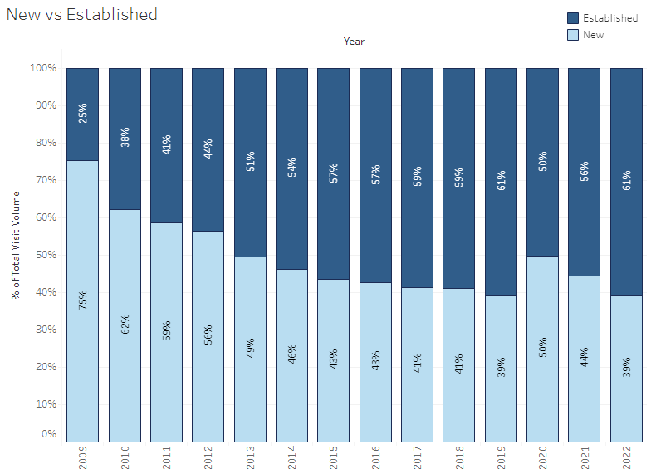
Normalization of Established Patients

Slide 6
Reduced E/M and Procedure Codes per Visit

Slide 7
Derm Procedures and Non-Surgical Ortho

Slide 8
Shift in Provider Type

Slide 9
Radiology

Slide 10
COVID-19 Learnings
Adapt quickly to meet patient needs
Achieve greater efficiency in operations
Throughput facilitated by technology
Innovative thinking to seize opportunities
Realized our place in the healthcare ecosystem

Slide 11
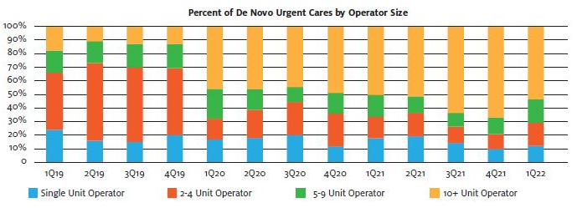
Pandemic and Post-Pandemic Growth
Influx of new sources of investment capital
Provider cash on hand
Change in de novo rooftop growth engine
”Corporation”
  25% of UCs owned by PE
  Project >10% rooftop growth
”Hospitalization”
  40% of UCs owned by hospitals
  20% of hospital UCs in JVs
  Growth to 45% by 2026

Slide 12
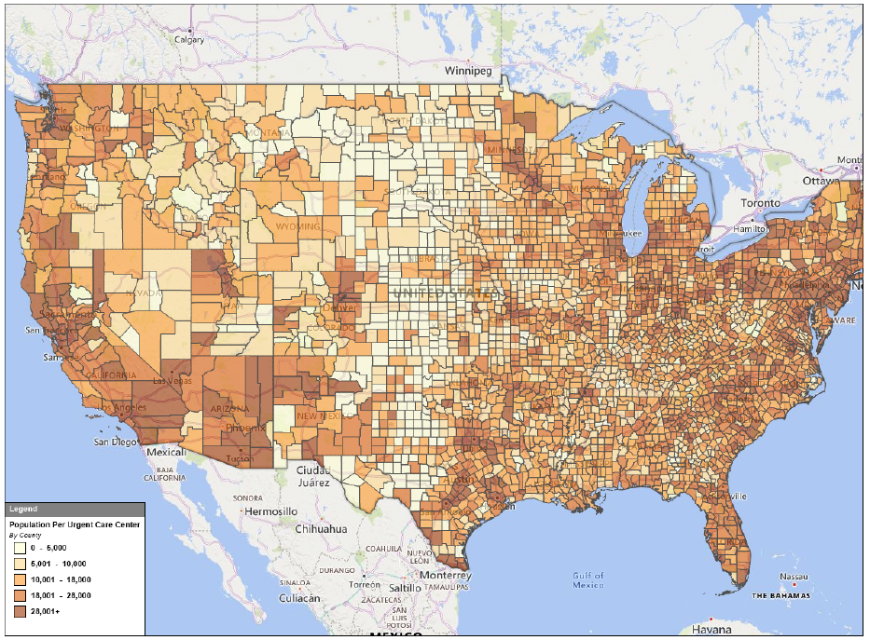
Post-Pandemic Growth Theses
Healthcare resiliency (vs. consumer discretionary)
  Attractive to investors
  Attractive to landlords
COVID patient retention
  Pandemic utilization up >25%
  66% intend to return vs. 75% pre-COVID
  Average patient returns 1.7 to 2.1x/year
Consolidation
  30% of UCs are independents (1-2 centers)
  40% of UCs are “chains” (11+ centers)
  PE sponsors and hospitals account for 75% of transactions
  Hospitals/health systems on a local level
  PE-backed platforms merging with one another
New geographies (urban, rural health clinics)
  17% of US counties have population to support a UC but don’t yet have one

Slide 13
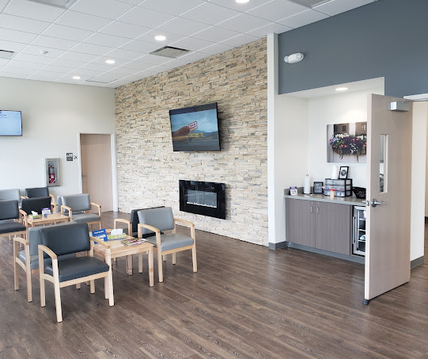
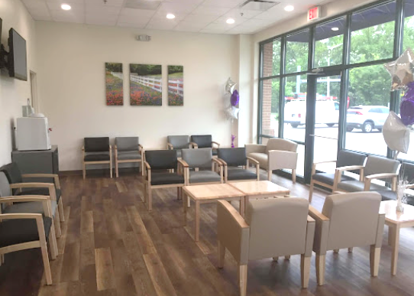
Post-Pandemic Growth Theses, cont’d.
Patients per hour per provider
  Volume-driven business
    Flow-through margin of incremental visits
    Skeletal labor as a fixed cost
    Problem of adding incremental provider capacity
  Leverage labor as the greatest expense
  Staff according to patient per hour expectation
  Pace arrivals according to staff capacity
  Eliminate non-value added tasks to increase efficiency
More locations in a market valued more per center
  Scale economies are local
    Staffing bench flexibility
    Mass marketing
  Payer leverage — network effect
Value-engineering the delivery model

Slide 14
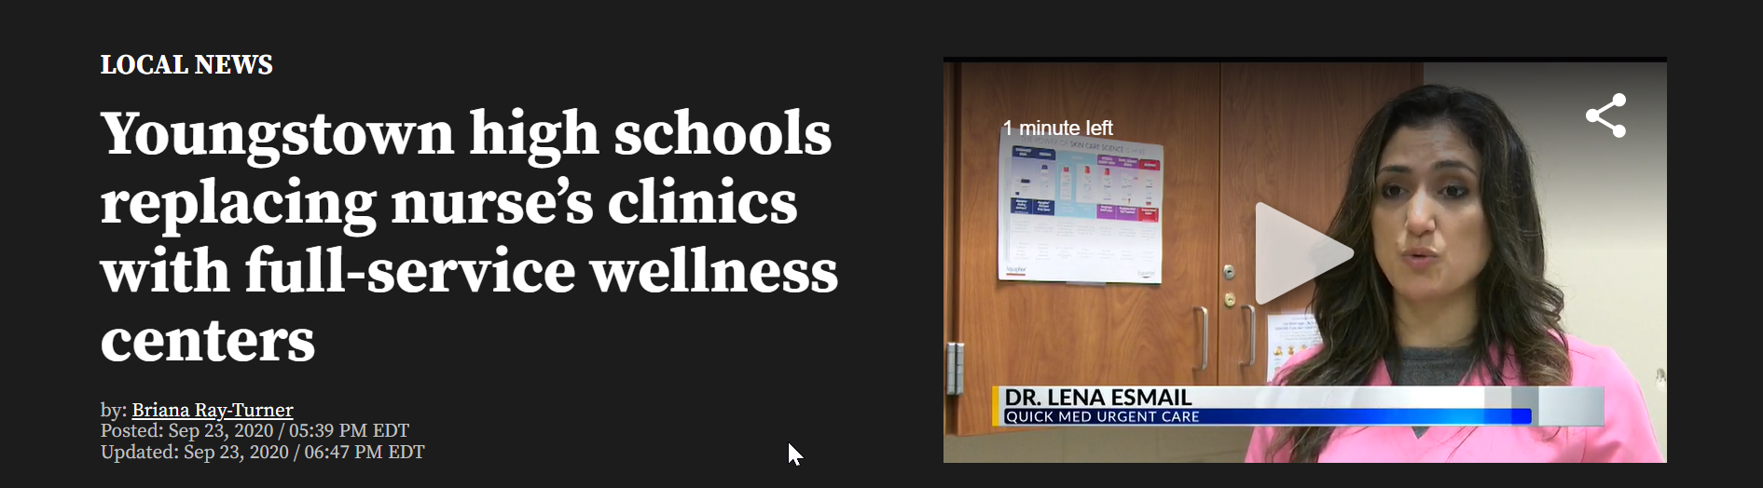
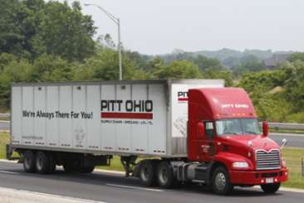
Post-Pandemic Growth Thesis, cont’d.
New patient populations:
Medicaid expansion/privitization
ACOs/population health/value-based care
In-school clinics
New service lines:
Occupational medicine
Behavioral health (issues)
Dermatology vs. aesthetics
Orthopedics/physical therapy
Suboxone
IV hydration

Slide 15

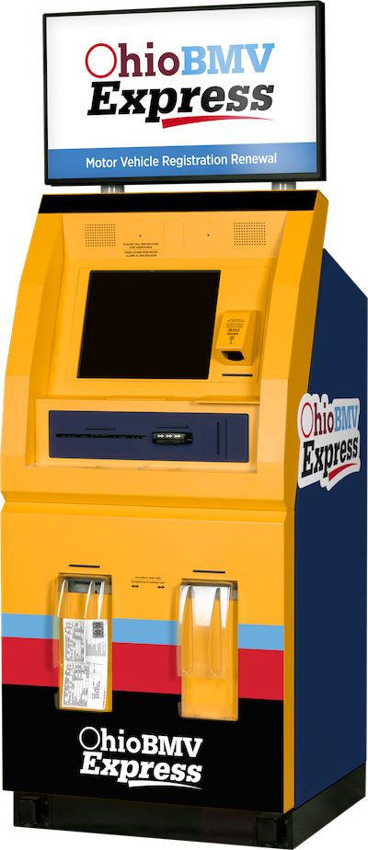
Functional Shifting

Slide 16

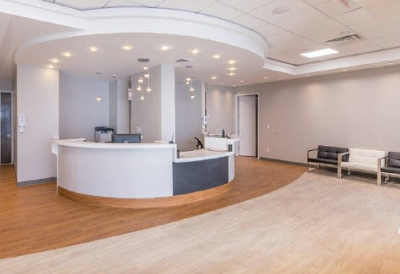
Repeatable (process-driven, standardized operating procedures, facilitated by technology)​
Consistent (every site, every patient, every provider, every day)​
Measurable (KPI focused)​
Accountable (team-oriented with shared values and culture)
Predictable (driven by long-term planning)
Creating a branded patient experience destination

Slide 17
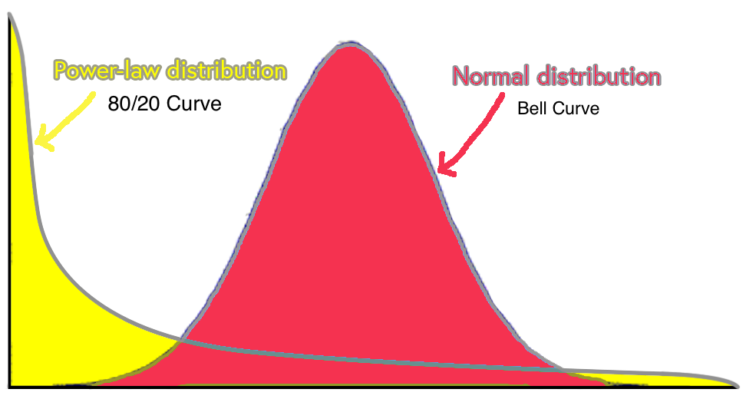
Number of UC Locations
EBITDA Margin (High to Low)

Slide 18
Convergence of UC and Primary Care
Driven by a growing shortage of primary care providers relative to an aging and increasingly comorbid population
Parallel line of business
Separate contracts (Tax ID)
Scheduled appointments vs. walk-in
Dual flow; different throughput measures
Distinct providers
Standard definitions needed as to what capabilities constitute primary care in an urgent care setting
Specialist
Emergency Department
Complexity of Illness
Primary
Care
Urgent
Care
Acuity of Illness

Slide 19
Primary Care is Day-to-Day Healthcare
Fee for
Service
General Family Practice
General Pediatric Primary Care
General and Focused Internal Medicine
Primary Care by a Specialist for a Chronic Condition
Concierge Primary Care on a Subscription Basis
Direct Primary Care On-Site at an Employer
Community-Oriented Primary Care (including FQHCs)
Primary Care by an OB/GYN for Pregnant Women
Primary Care for a Workers Compensation Injury
Capitation
Cash
Risk

Slide 20
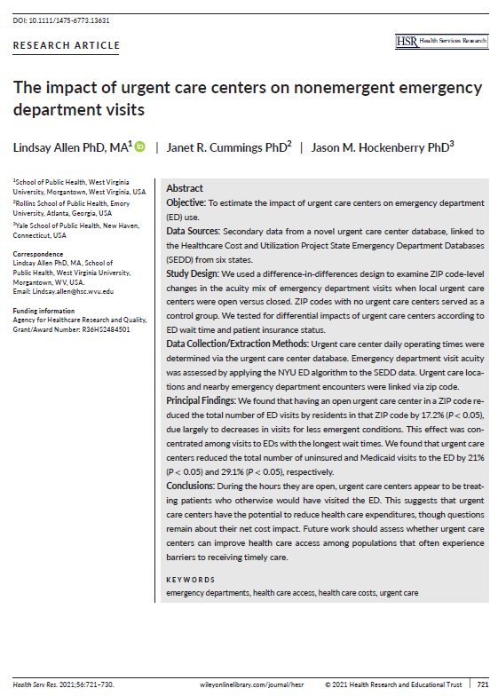
Urgent Care Impact on Nonemergent ER Visits
When urgent care is present in a ZIP code, it;
Reduces Medicaid utilization of the ED by 30%
Effect is magnified by a factor of 10 when the ED has long wait times
Greatest cost savings of UC (vs. ED visits) is with Medicaid and uninsured populations.
The ”new drivers” of UC revenue would be:
A shortage of local PCP access
Longer-than-average wait times at the local ED
A prevalence of Medicaid populations
Adequate reimbursement of UC visits by Medicaid

Slide 21

Threats: Telemedicine
Utilization during the pandemic up 10x from 1% to 10% of patients
Only 25% who used telemedicine for a UC-type condition would use it again
Only 20% of telemedicine users would seek telemedicine from a local urgent care
Telemedicine is a scale business – the brick-and-mortar adds no value
Pushed by payers and employers for years yet inconsistent with consumer behavior
Urgent care’s value proposition must be it’s brick-and-mortar
Exceptions: primary care rechecks, load balancing, provider call-offs

Slide 22
Threats: Test and Treat
Long-term strategy to transform pharmacists into providers.
Reduces medical practice to a rapid lab test (no hands-on physical exam).
Walgreens, CVS, Walmart and Kroger control most state Rx boards – 39 states now enable test and treat.
Theranos technology was fraudulent, the business case was not. Theranos paved the road legislatively.
Urgent care excluded from COVID vaccine distribution, Paxlovid dispensing.
Barriers to in-office dispensing must be eliminated in all 50 states.

Slide 23
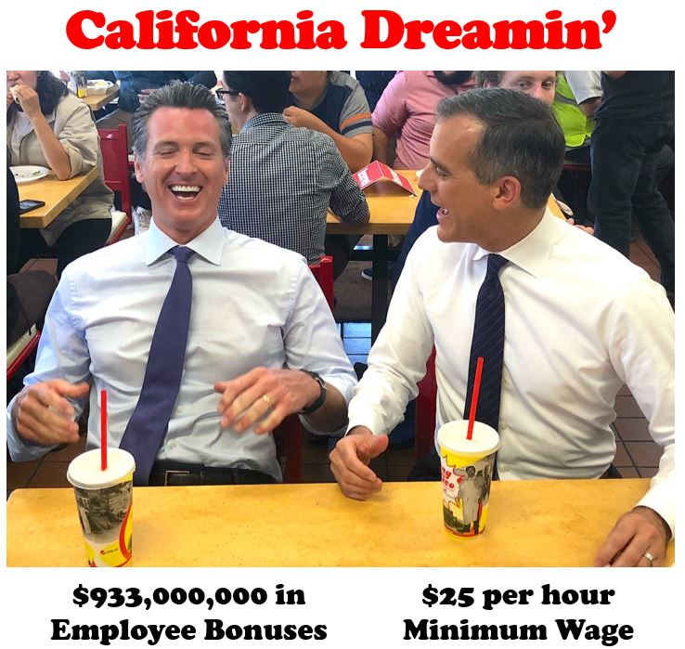
Staffing Challenges and Wage Inflation

Slide 24

Now is the time to add new centers
Endemic COVID will lift overall center volumes
  Less acute strains: 3-in-1 test, Rx antiviral availability
  Accelerated volume ramp-up reduces working capital needs
  Higher volumes are equivalent to a “year-round flu”
  Incremental visits drive productivity; flow to the bottom line
Operators are sitting on “COVID cash”
  Poor investment options
    Rising interest rates, stock market volatility, low real estate cap rates
  Borrowing is cheap
    Low interest rates, high inflation
Hyper-targeted marketing (geo-fencing)
No Better Time to Open ​New Centers​

Slide 25
Now is the time to add new centers, cont.
Strong retail sites have opened
Multi-location footprints bring a higher valuation
  Existing centers benefit from new center additions
  Scale economies in marketing and staffing bench
  Payer leverage
Retain pandemic business gains
  New patients introduced by COVID testing
  Retain hard-to-find staff
Race to establish brand in rural and other underserved markets
No Better Time to Open ​New Centers​

Slide 26
Thank you for your time.
For more information
Email: Alan.Ayers@ExperityHealth.com
Phone: (614)519-1221
Website: AlanAyersUrgentCare.com

