Slide 1
A Strategic Marketing Approach to Creating Value for Investors, Employees, and Patients

Slide 2
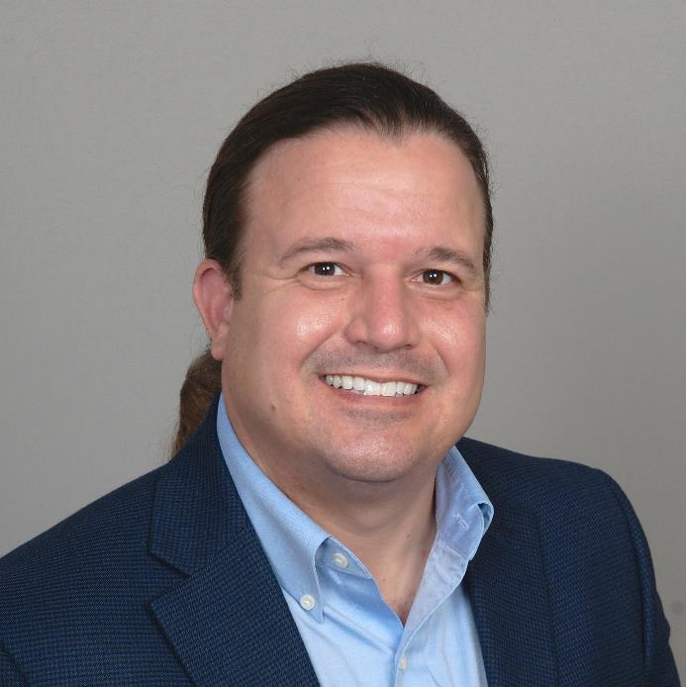
Alan Ayers
President, Experity Network
Senior Editor, The Journal of Urgent Care Medicine

Slide 3
Urgent Care Trends Driving Change
After 25 years the industry is showing signs of maturity
Saturation in desirable suburban markets
Commoditization in the mind of consumers
Degradation of acuity driven by “case rate” and productivity measures
Consolidation of regional platforms; M&A on a local level
Services expansion leveraging existing patients and locations
Growth in new markets, new populations, and new services

Slide 4
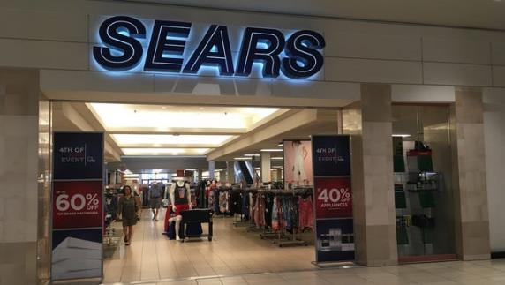
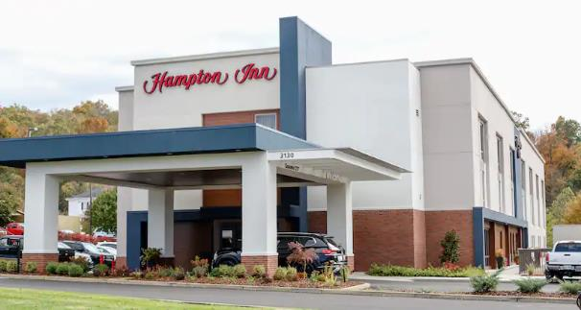
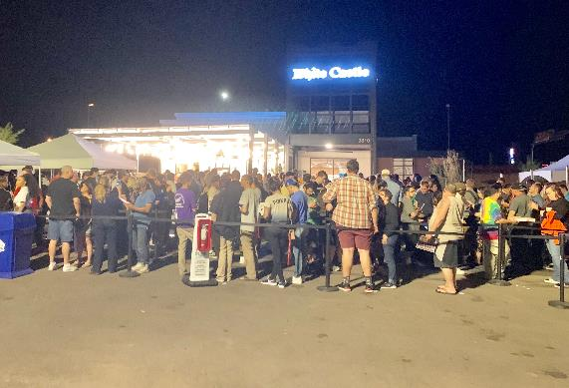
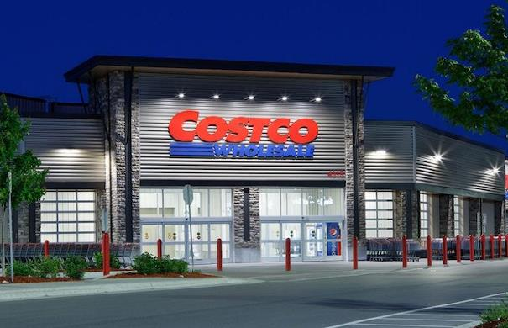
The Power of a “Brand”

Slide 5
The Power of a “Brand” (cont’d.)
Authentic – differentiated from other providers in all aspects of the patient experience
Relevant – focused on what’s most important to patients
Consistent – patients know exactly what to expect, every time, and the brand delivers
Excellent – better quality, better service, better place to work, better value than competing options

Slide 6
How Brands Add Value
Simplifies patient decision-making processes
Creates an emotional attachment with patients
Defines the culture and focuses the efforts of team members
Gains and protects market share from competitors
Reduces risk and increases valuation for owners and stakeholders

Slide 7
Expanding Your Brand Footprint: People

Slide 8
Scarcity of Medical Labor
104,400 openings for MAs are projected every year from 2020-2030
In 2019 there was an 8.5% shortage of x-ray techs and in 2020 the number of RTs taking the ARRT exam fell by 7.8%
By 2025 there will be a shortage of 200,000 RNs and 29,400 NPs
By 2032 there will be a shortage of 122,000 physicians

Slide 9
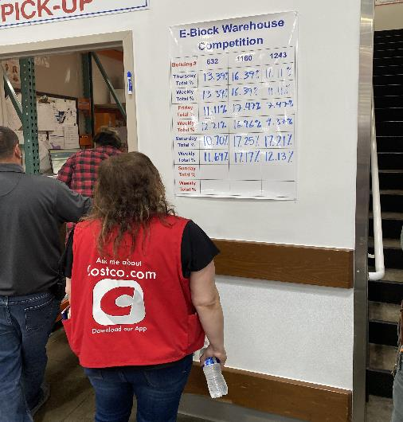
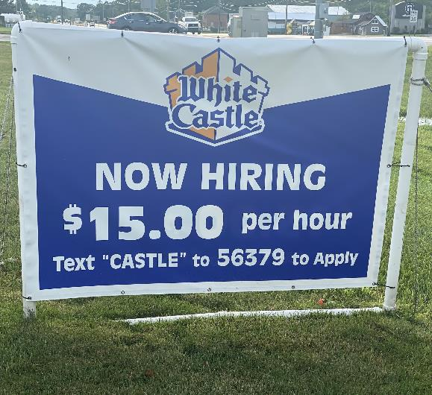
Winning Employer Brands
$17.00/hr. starting wage
Full medical/dental, 401(k), profit sharing after 180 days
“Extra checks” 2x/year for high productivity
94% employee retention
Bonuses paid since 1935; profit sharing since 1949
10% turnover for managers (40 hr. workweek) vs. fast food industry 130-150%
25% of employees >10 yrs.
2,160 inductees to the “25 year club”

Slide 10
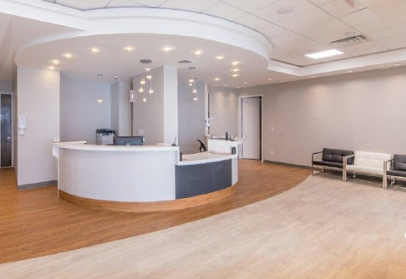
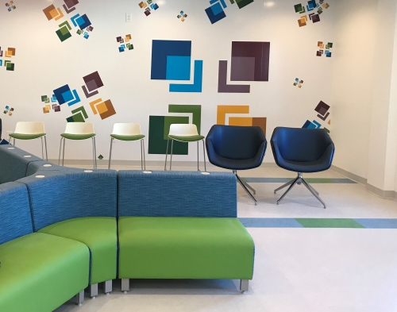
Branded Patient Experience Destination
Scalable and predictable operating model:
Repeatable (process-driven, standardized operating procedures, facilitated by technology)
Consistent (every day, every patient, every provider, every site)
Measurable (KPI focused with incentives)
Accountable (team-oriented with shared values and culture)

Slide 11
Expanding Your Brand Footprint:
New Locations

Slide 12
No Better Time to Open New Centers
Endemic COVID will lift overall center volumes
  Less acute strains: 3-in-1 test, Rx antiviral availability
  Accelerated volume ramp-up reduces working capital needs
  Higher volumes are equivalent to a “year-round flu”
  Incremental visits drive productivity; flow to the bottom line
Operators are sitting on “COVID cash”
  Poor investment options
    Rising interest rates, stock market volatility, low real estate cap rates
  Borrowing is cheap
    Low interest rates, high inflation

Slide 13
New Centers (cont’d.)
Strong retail sites have opened
Multi-location footprints bring a higher valuation
  Existing centers benefit from new center additions
  Scale economies in marketing and staffing bench
  Payer leverage
Retain pandemic business gains
  New patients introduced by COVID testing
  Retain hard-to-find staff
Race to establish brand in rural and other underserved markets

Slide 14
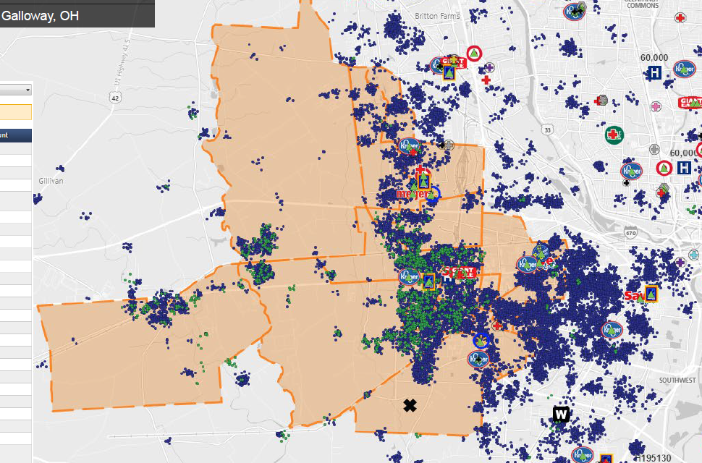
Leveraging the Power of Data

Slide 15
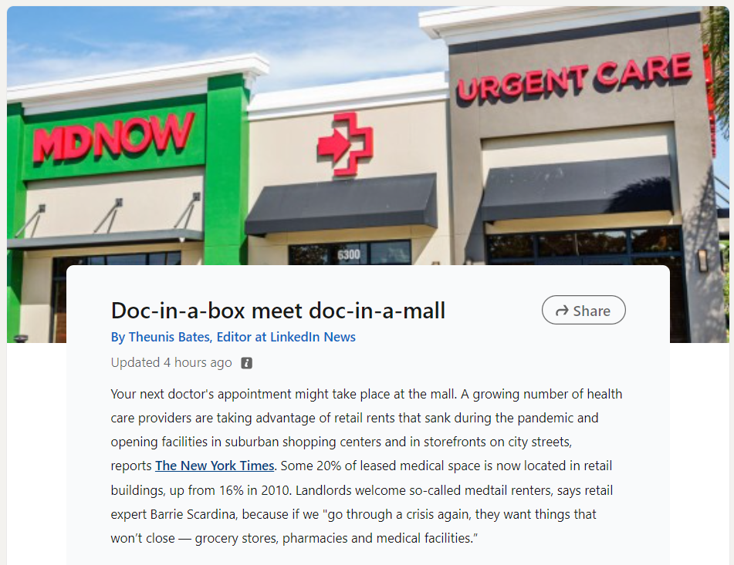
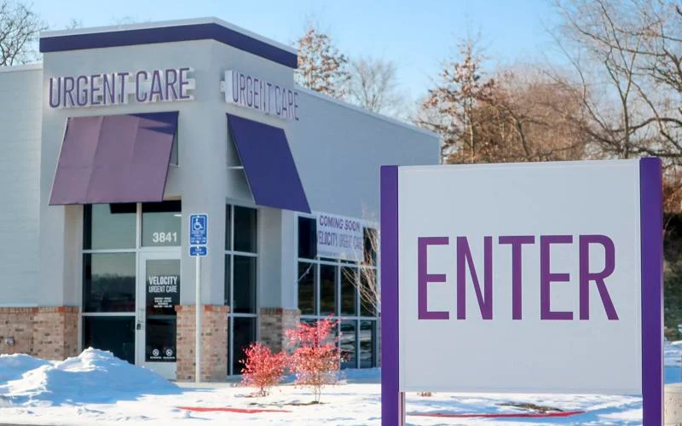
New Perspectives on Real Estate

Slide 17

Scan to rate this session

