Slide 1
Western Regional Urgent Care Conference
Operational Differentiators
Alan A. Ayers, MBA, MAcc
President, Experity Consulting

Slide 2
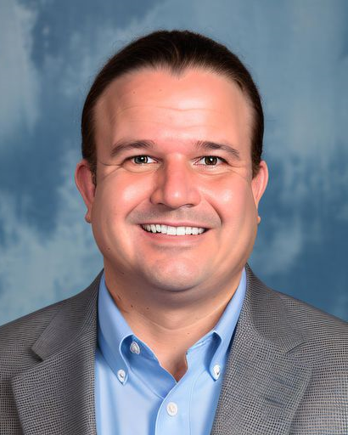
Alan Ayers, MBA, MAcc
President, Experity Consulting
Alan Ayers has ~17 years’ experience in strategic planning, business development, clinical operations, sales/marketing and customer service for urgent care, occupational medicine, and primary care facilities.
Currently, Ayers serves as President of Experity Consulting, responsible for helping clients identify and cultivate new revenue streams while supporting the company's strategic growth initiatives. Ayers has consulted with independent, PE-backed, and hospital-affiliated platforms representing well over 1,000 units. He has also served as an expert witness in landlord-tenant litigation involving urgent care.
From 2017 to 2021, while still part of Experity, Ayers served as Chief Executive Officer of Velocity Urgent Care, a venture of Sentara Healthcare, growing the company from 7 to 15 locations building a complete operating and administrative infrastructure, assembling leadership and management teams, migrating systems, optimizing the staffing model, acquiring the hospital's occ med practice, and implementing a values-based culture. In 2020, Velocity Urgent Care became the leading provider of COVID19 test services in its markets.
A prolific and award-winning writer, Ayers is Senior Editor of The Journal of Urgent Care Medicine (JUCM), and has contributed hundreds of original articles, blog entries and presentations on urgent care-related subjects. In 2018 he was co-author of The Health Care Executives’ Guide to Urgent Care and Freestanding EDs, Second Edition.
Ayers has served as Chief Operating Officer of OhioHealth Urgent Care and spent eight years in executive positions at Concentra including VP of Corporate Development responsible for acquisitions, divestitures, de novos, relocations, and major renovations.
For eight years, Ayers served the Board of Directors of the national Urgent Care Association (UCA), providing expertise and guidance on emerging issues; identifying market and regulatory trends; defining content, planning educational programs, and speaking at industry events. In 2019, he received UCA’s prestigious Lifetime Membership Award.
Ayers graduated Phi Beta Kappa from the University of North Carolina, has an MBA from the University of Mississippi, and a Masters of Accounting from The Ohio State University graduating first in his class.

Slide 3
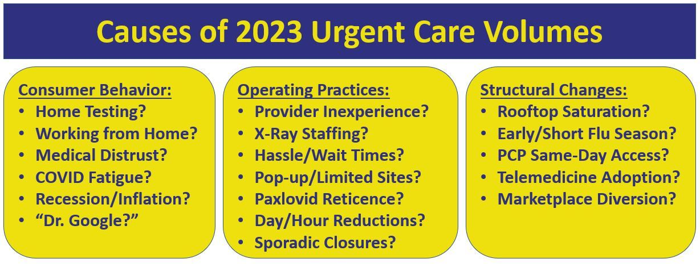
Drivers of the Post-COVID Lull in Visits

Slide 4
Staying the Course
Successful operators adapted to COVID but did not change their fundamental business focus.
 | “COVID Care” | “Urgent Care”
Strategic Focus | Must “bootstrap” operations back to pre-COVID performance with reduced revenues. | High-volume COVID testing augmented but did not replace “core” urgent care services.
Operating Hours | Reduced total hours of operations, particularly on weekends, due to staffing challenges. | Maintained “regular” operating hours.
Clinical Capabilities | “Downsized” services to focus on high-volume COVID19 testing. Turned away “higher touch” patients including those who may need an x-ray. | Retained full capabilities including laceration repair and non-surgical ortho. Found ways to assure x-ray was always available (PRN, on-call, travel RT).
Clinical Staffing | Recruited “green” NPs with limited experience in procedures and uncomfortable with moderately acute patients. Attrition of rad techs without backfill leading to no x-ray during most hours of operation. Remained siloed in job duties. | Maintained “regular” staffing models (augmenting w/agencies when required) despite hiring difficulties and wage inflation. “Team” approach--cross-trained MAs to cover front desk. Providers willing to do MA work (i.e. intake, vitals, rapid tests).
Marketing | Discontinued grassroots marketing to focus on SEO and AdWords for “COVID test near me.” | Continued marketing “core” services during the pandemic w/early return to grassroots marketing.
Occ Med | Discontinued sales of occupational medicine including maintenance of previous accounts. | Utilized rapid COVID testing as a way to establish new employer relationships.

Slide 5
Degradation of Acuity in Urgent Care
Confuses patients as to services offered
Makes urgent care more dependent on flu seasonality
Reduces value proposition of urgent care to payers
Makes urgent care less competitive vs. other options

Slide 6

Operational Success Factors**
Putting the patient first.
Recruiting staff who really cares.
Promoting a strong work-life balance.
Focus on building a fun, engaging culture.
**Okay, but who says they don’t do these things?

Slide 7
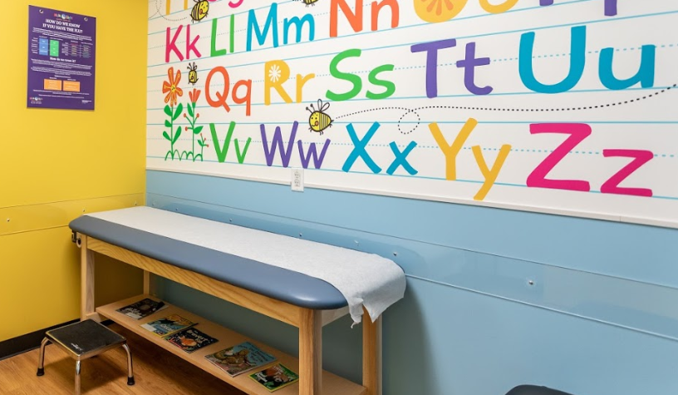
Pediatric Focus
Urgent care has always appealed to time-strapped “soccer moms.”
Peds is one of the fastest growing segments of urgent care with 13% year-over-year growth since 2019 (National UC Realty).
“Mom” focused. “Brand halo” is better care and patient experience for kids with “kid-friendly” aesthetics.
Staffed by pediatricians (30-50%) and FNPs.
Focus on geographies with (starter) housing growth but limited access to pediatricians.
Close 1-3 hours later than competitors (9pm-11pm). Will accept new patients up until closing time (100% of calls).
“Front door” referral coordination for continuity of care with pediatric specialists. Coordination with PCPs including priority phone line for physicians.
Grassroots marketing with school preceptors and community liaisons going “wherever moms are.”

Slide 8
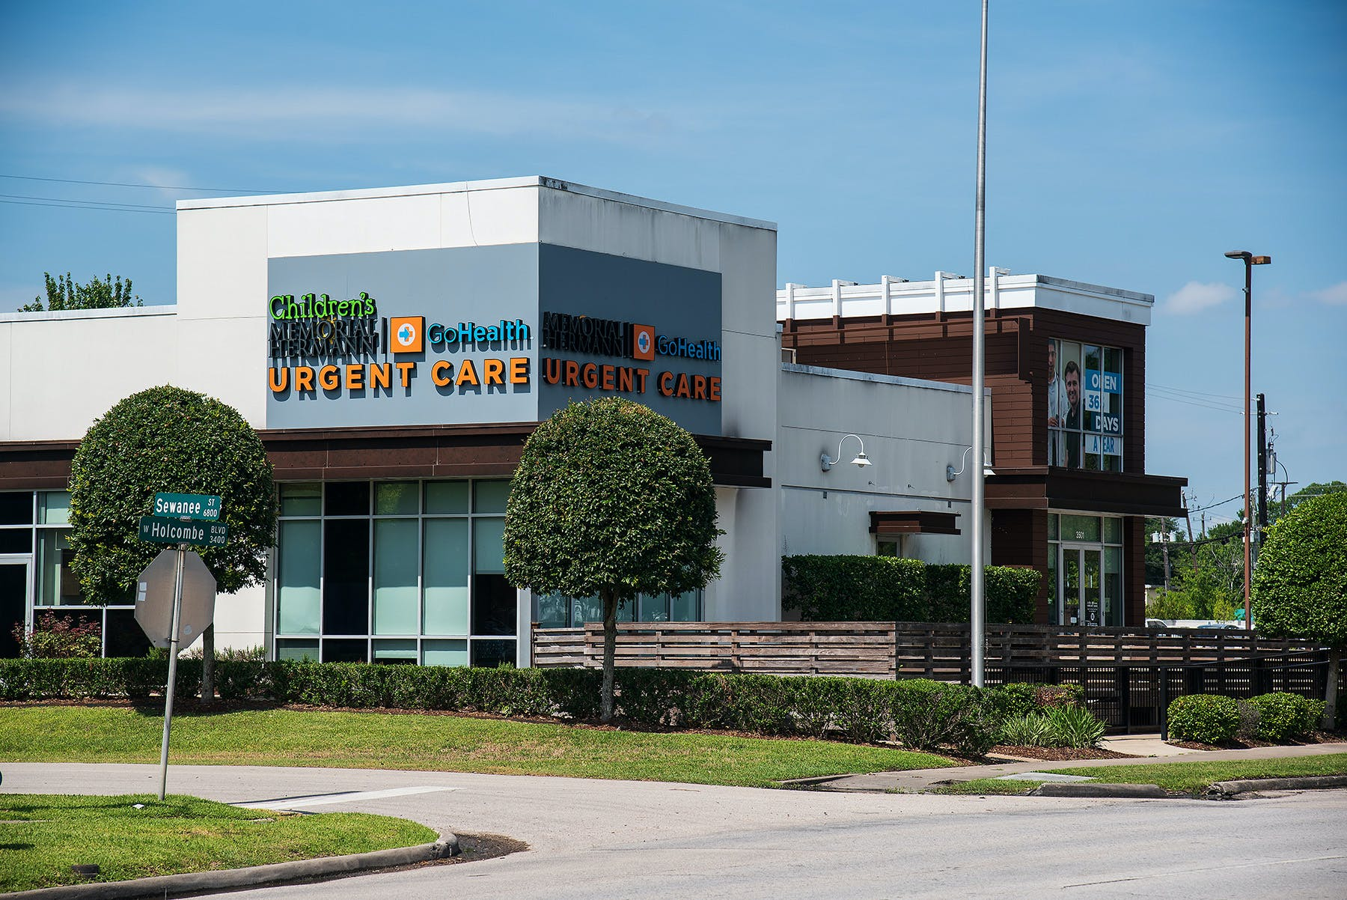
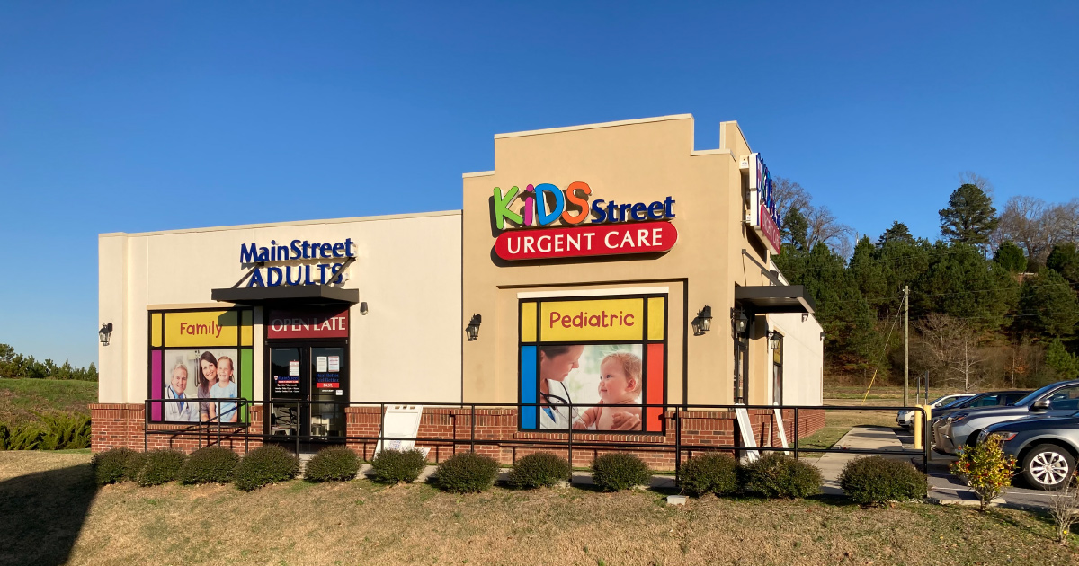
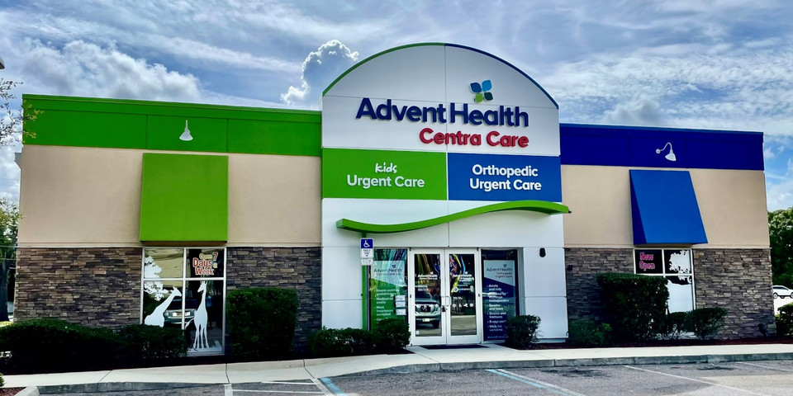
Pediatric Urgent Care Wins Marketshare from Existing Players
Co-branding examples—split waiting room but common back-office and shared staff.

Slide 9
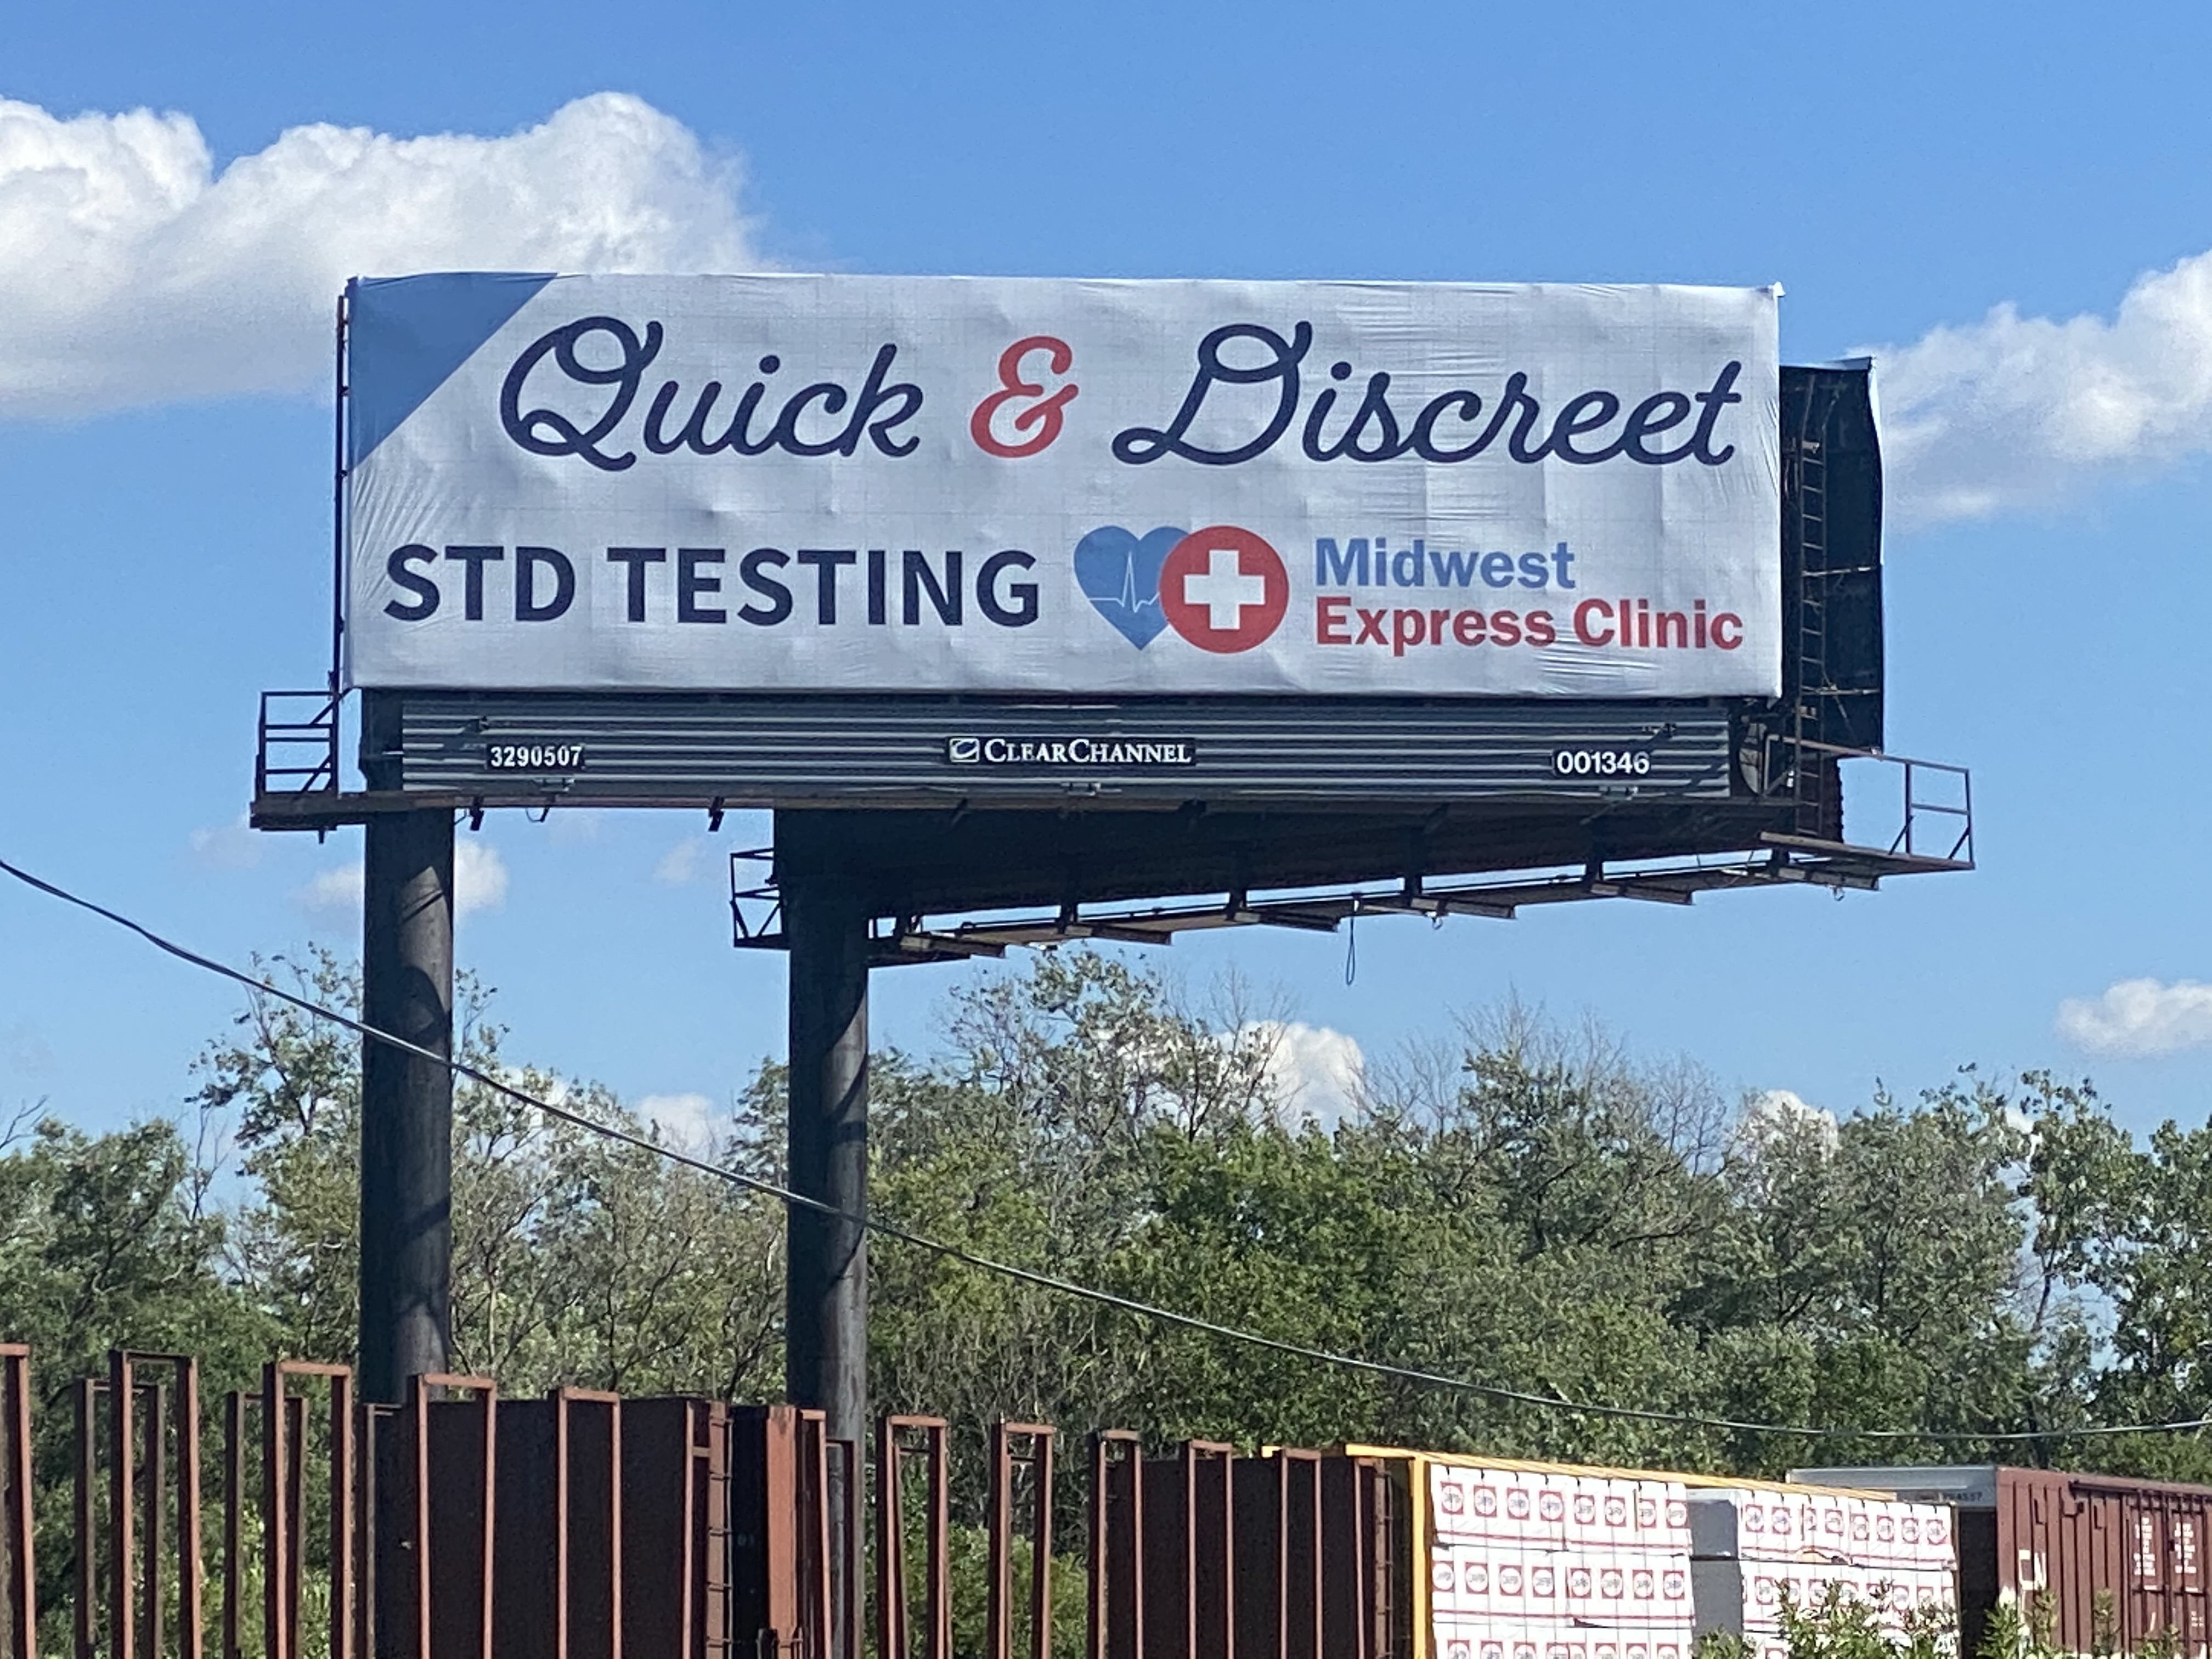
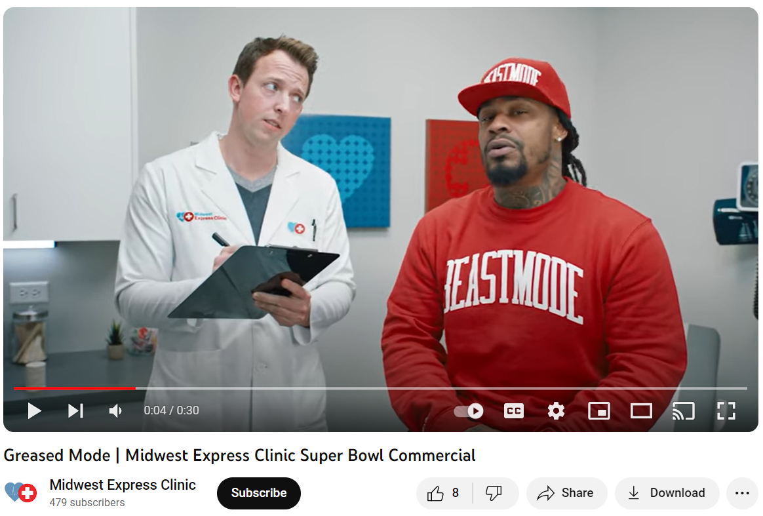
Marketing and Advertising
Emphasis on guerilla and grassroots tactics versus a “digital only” strategy.
Deployed grassroots marketing (community liaisons) before anyone else including community events.
“Guerilla” tactics like handing out flyers door-to-door and at a “temporarily closed” competitor.
Outreach to school districts—athletic directors, school nurses, and special needs departments.
“Get in front of moms”—moms groups, social media, family events—focus on opinion leaders.
Return to conventional advertising media like direct mail, billboards and TV advertising (SuperBowl).
Re-branding to become more contemporary and better stand out.

Slide 10
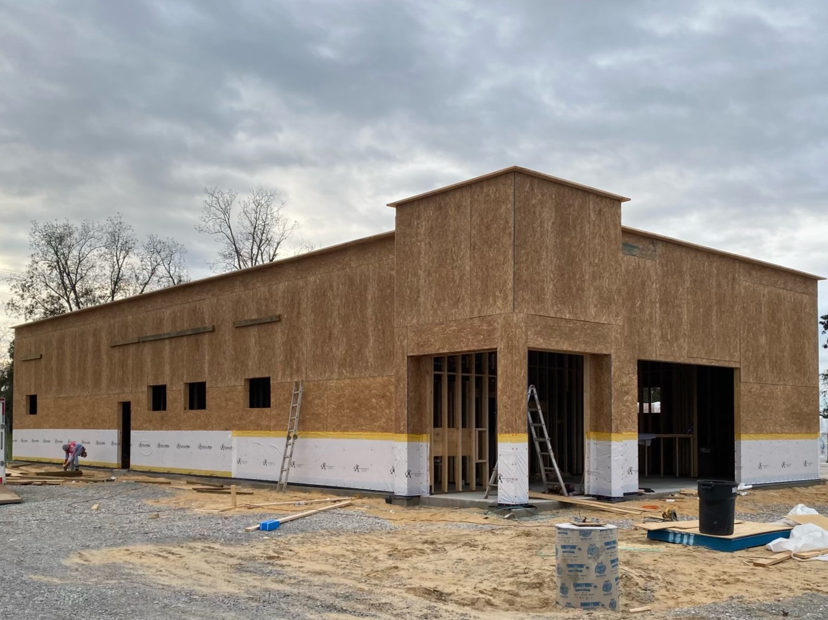
Opportunistic Relocation + Rooftop Growth
Continuing to pursue long-term growth despite economic challenges.
Took advantage of lease terms to relocate to larger and/or more visible space.
Took advantage of the lull in commercial real estate to add new sites.
Considered the long-term urgent care viability of sites vs. short-term COVID traffic.
Considered long-term population trends including pandemic shifts in population growth.

Slide 11
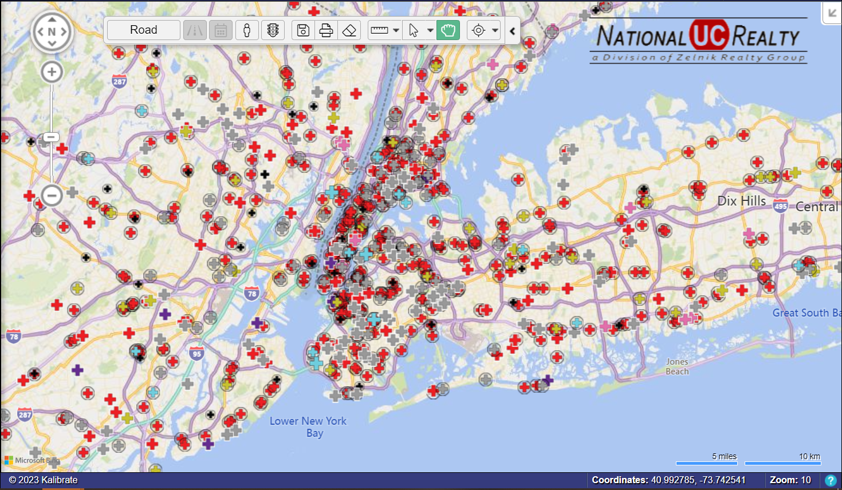
Center Closures: Separating the Wheat from the Chaff
Competition an issue in over-saturated markets
    “A/B” location is even more essential
    Out-position, out-execute, out-market the competition
Industry still showing positive net rooftop growth
Anecdotal closures
    Primarily “D-F” grade sites
    Poorly positioned centers could survive during COVID spike in demand
    Historically closures occur every year
    Simple “catch up” from the past four years

Slide 12
Intangibles and Operational Practices
Highly involved owners and managers aware of what’s going on in the centers.
Leadership time in centers (constant rotation) observing processes, asking questions, seeing what needs improvement and willing to roll up sleeves and work the floor as needed.
Fully staffing x-ray including cross-training staff or augmenting with staffing agencies (~25% of urgent care days lost due to no x-ray technician).
Flexible staffing—balance schedule by shifting people among sites (vs. rigidity of teams anchored to only one site).
Paying attention to Google reviews and using reviews for accountability and continual improvement.
Online check-in/eRegistration including use of queuing to pace and level throughput.

Slide 13
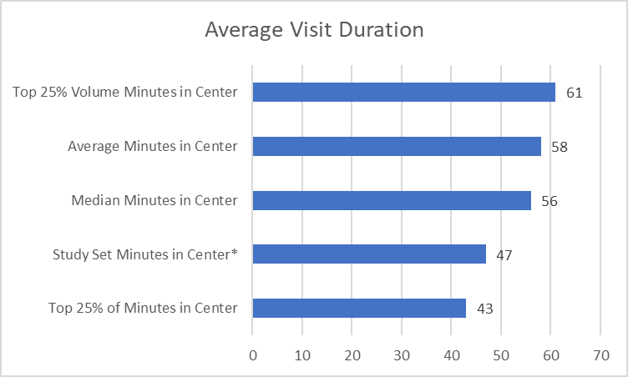
Duration of Visit
Study set visit duration is 11 minutes shorter than average.
California average: 64 minutes.
*80th Percentile, Experity Data

Slide 14
Turning Patients Away?
The last 2-3 patients of the day could account for >10% of daily volume.
Question is “how late can I come in tonight?” <for a sore throat, for a jammed finger>
Turn-aways occurred despite leadership commitment—”we don’t turn any patients away.”
Variations in responses include:
    “We close at 8pm but last patient accepted at 7:00pm.”
    “Depends on what you’re coming in for.”
    “Depends on how many we have waiting when you get here.”
    “We’re full up in the back so unless it’s a drug screen you’ll have to call back tomorrow.”
    “We start cleaning at 7:30 so if you can’t make it by then we may not be able to see you.”
    “Our x-ray tech is out until Thursday so you’ll need to wait until then if you need any imaging.”
    “Our x-ray machine is broken so I suggest you try calling other urgent cares in the area.”

Slide 15
Secret Shopping: Evening Turn-Aways
~40% of calls in “secret shopping” were turned away the last hour of the day
Type of Business | Geographic Region | % Turned Away
Enterprise Urgent Care | Midwest | 0%
Ultra-Enterprise Urgent Care | South | 20%
Ultra-Enterprise Urgent Care | Southwest | 20%
Mid-Market Urgent Care | Midwest | 40%
Enterprise Urgent Care | Southeast | 40%
Ultra-Enterprise Urgent Care | Midwest | 50%
Ultra-Enterprise Urgent Care | West | 100%
Mid-Market Peds Urgent Care | Mid-Atlantic | 0%
Enterprise Peds Urgent Care | Southwest | 0%
Phone calls made August, 2023.

Slide 16
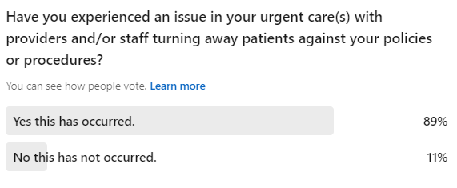
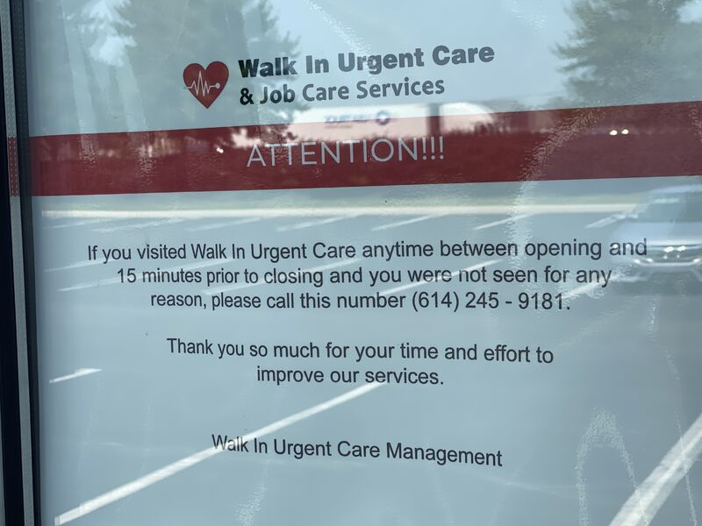
Do you know what visits you’re missing?
Closing early/opening late
Locking doors mid-shift
Slowing/manipulating queuing velocities/capacities
Queuing fake patients
Triaging at the front desk
Telling patients to “Come back tomorrow…”
Sending patients to the ER who could be treated within the clinic
Under-representing scope of services offered on phone
This is occurring at current, post-COVID volumes…far from “burnout” or “unsafe” levels.
LinkedIn Survey, August, 2023.

Slide 17
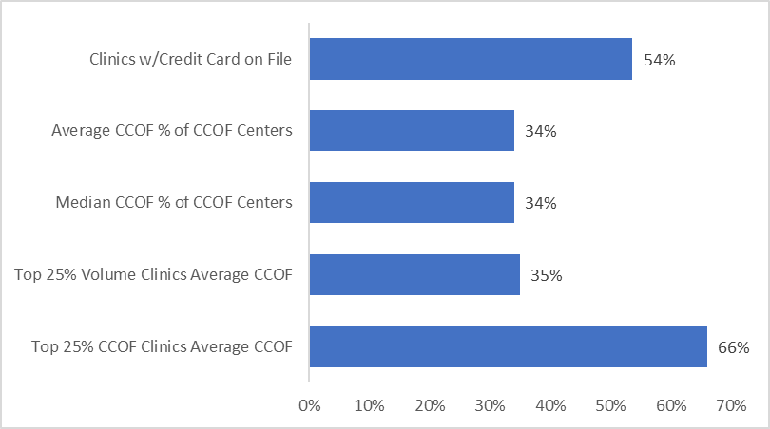
Credit Card on File
New CFPB rules limit credit reporting of medical debt <$500.
Collections agencies can no longer hit credit report (FICO score) for medical debt <$500.
Does not apply to revolving consumer loans (i.e. credit cards) or medical “purchases” made on them.
Last line of defense against “zero EOBs” due to deductible, co-insurance, or ineligibility is the front desk.
Front desk will also need to step up efforts to collect prior balances prior to patient being seen.
Experity Data

Slide 18
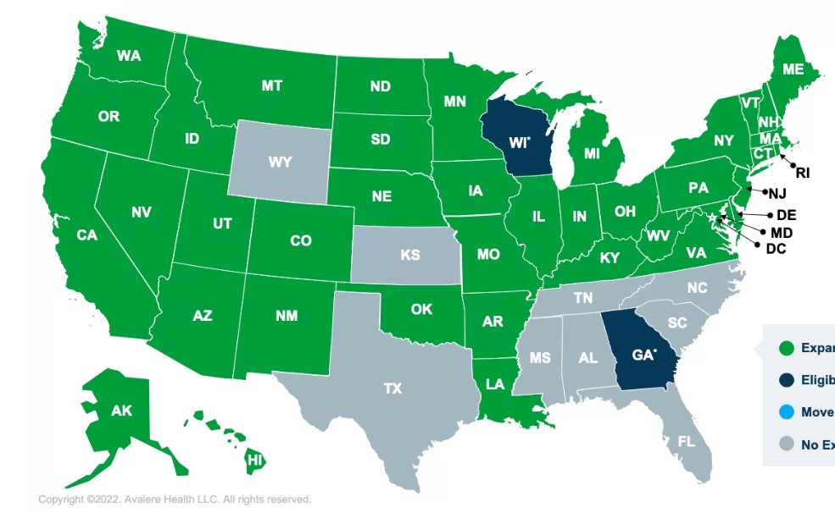
Medicaid Participation
States that have expanded and privatized Medicaid open urgent care to new populations.
75% of urgent care centers are billing Medicaid visits
Of centers that accept Medicaid, it’s an average of 13% of visits
Of the study set, Medicaid represents 18% of visits
Considerations:
Excess capacity in the center (volume < productivity).
Medicaid covered lives in the center’s trade area.
Average reimbursement under straight and managed Medicaid.
BUCA requirements including straight Medicaid enrollment.

Slide 19
Summary of Operational Differentiators
Strong operators who are highly involved, aware and visible in clinics.
Maintained full “urgent care” capabilities and hours through the pandemic.
Creatively staffing x-ray during all shifts, even when short-handed.
Accepts patients up until posted closing hours with short visit times.
Accepts all insurance including Medicaid to serve local covered lives.
Pediatric focus appealing to “mom” as the decision-maker.
Aggressive community marketing w/grassroots focus on schools.
Brand conscious including conventional brand-building advertising.
Follows population growth patterns for opportunistic rooftop growth.

