Slide 1
Agile and Patient-Centric Urgent Care in a Hyper-Competitive Marketplace
Alan A. Ayers, MBA, MAcc
President, Experity Consulting

Slide 2
Urgent Care Growth Trends

Slide 3
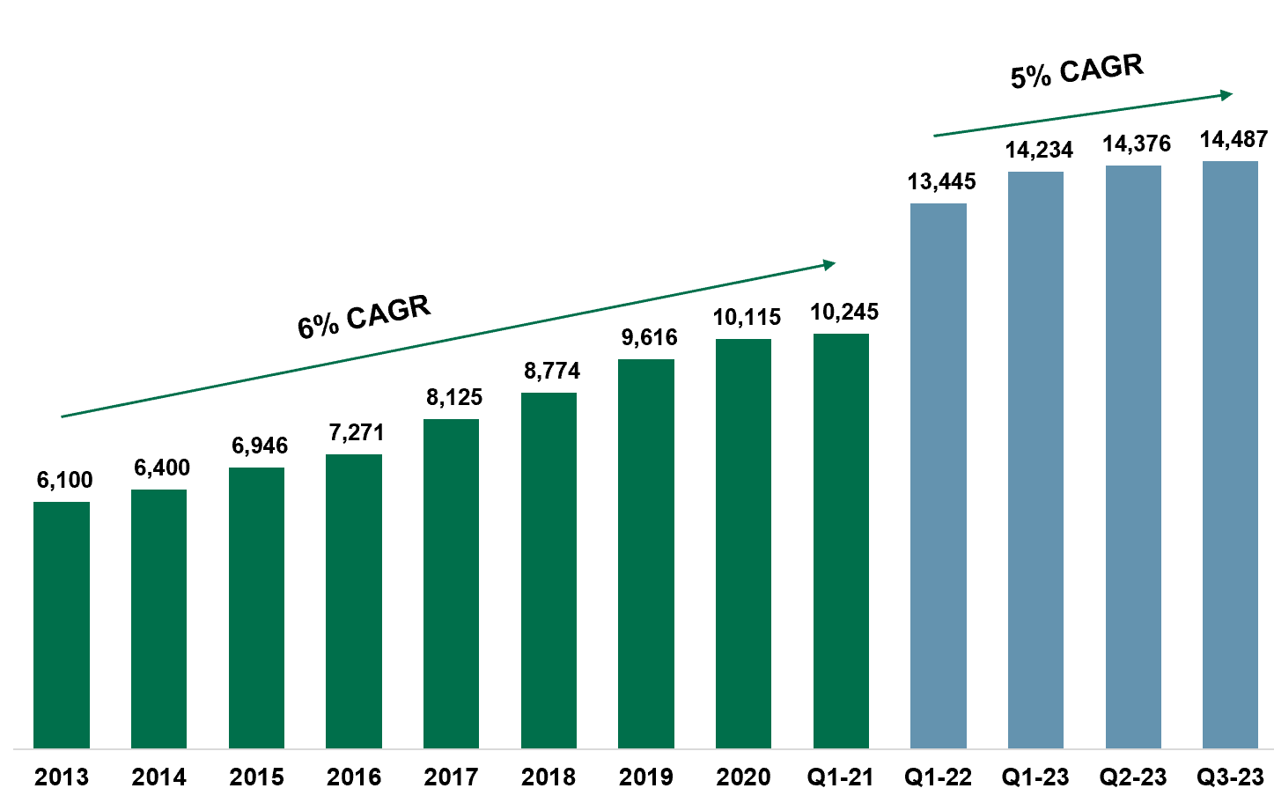
Urgent Care Growth Rates
Growth Engines
Physician Entrepreneurs
Local Multi-Site Scaling
Hospital Operators
(Medical Group vs. Joint Venture)
Regional/Super-Regional Platforms

Slide 4
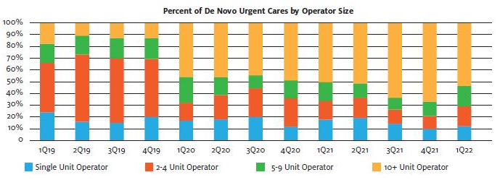
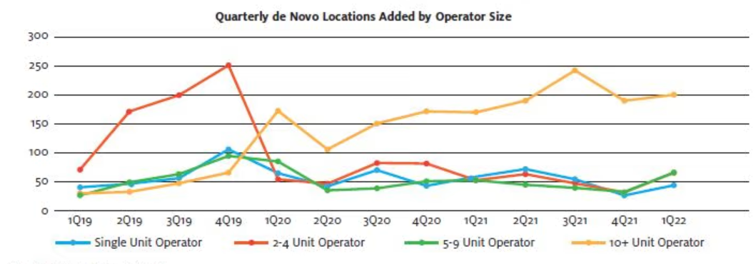
Pandemic and Post-Pandemic Growth
New investor activity has slowed
Provider and PE cash on hand
Interest rates and wage inflation
De novo growth engines
”Corporatization”
  25% of UCs owned by PE
  Project >10% rooftop growth
”Hospitalization”
  40% of UCs hospital-affiliated
  20% of hospital UCs in JVs
  Growth to 45% by 2026

Slide 5
Urgent Care Headwinds and Tailwinds
Pre-Pandemic Concerns
Saturation
Commoditization
Case Rate Contracts
Acuity Degradation
Hospital Referrals
Telemedicine → AI
COVID-19 Response
Adapted quickly to patient needs
Improved operational efficiency
Drove throughput w/technology
Innovative thinking to seize opportunities
Realized our place in the healthcare ecosystem
Post-COVID Hangover
High-Volume COVID Testing
Shift to Digital Marketing
Operating at Capacity
Staff Shortages/Burnout
X-Ray Availability
Novice NP Skillset
Wage Inflation
Reimbursement Challenges
Private Equity Investment Theses
Arbitrage
Multiple Expansion
Cash Flow
Revenue and EBITDA Growth

Slide 6
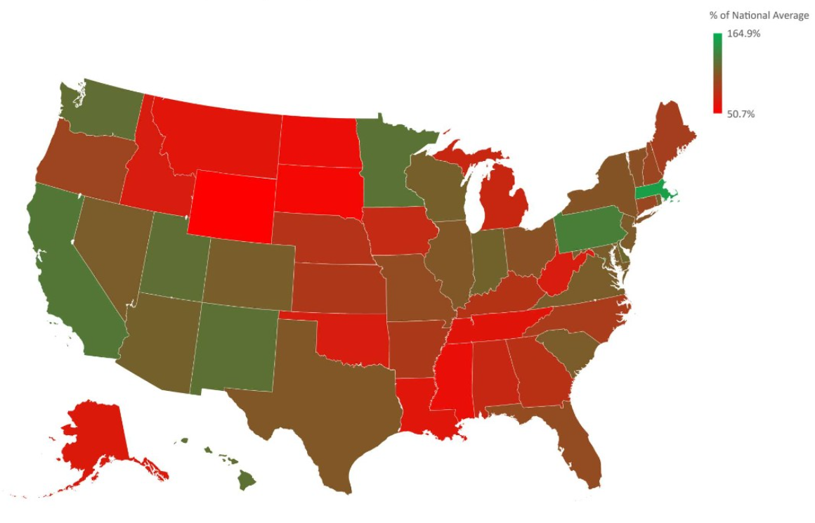
Post-COVID Growth Theses
Healthcare resiliency (vs. consumer discretionary)
  Attractive to investors and landlords
COVID patient retention
  66% intend to return vs. 75% pre-COVID
  Average patient uses UC 1.7 to 2.1x/year
Consolidation
  30% of UCs are independents (1-2 centers)
  40% of UCs are “chains” (11+ centers)
  75% of transactions are by PE and hospitals
  Hospitals/health systems on a local level
  PE-backed platforms merging with one another
New geographies (urban, rural health clinics)
  17% of US counties have population to support a UC but don’t yet have one

Slide 7
Post-COVID Growth Theses, cont’d.
New Patients
  Millions introduced to urgent care during the pandemic, 2/3 of which will return
New Locations
  Rooftop expansion continues, although more corporate, less hospital activity
  Resurgence of independent operators
New Geographies
  Shift from the affluent suburbs to underserved rural and urban markets
  Strategic real estate – intercepting, flanking and boxing in competitors

Slide 8
Post-COVID Growth Theses, cont’d.
New Payers
  Medicaid expansion and privatization
  Value-based care and population health
New Services
  Specialist services
  Occupational medicine
  Behavioral health
  Primary care
  Specialty urgent care

Slide 9
Opportunistic COVID Business Challenges

Slide 10
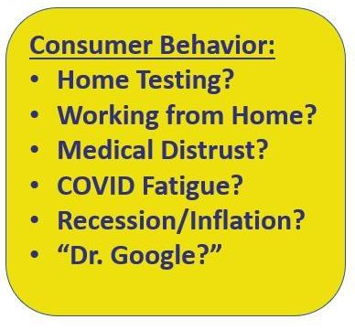
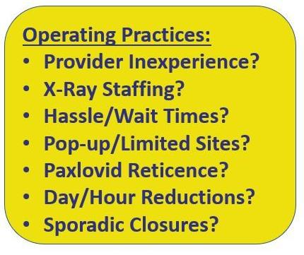
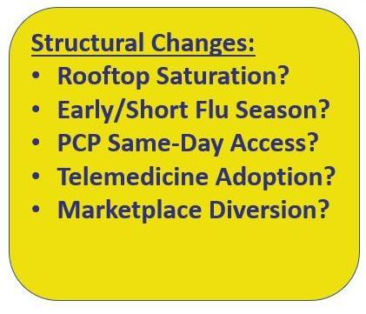
Post-COVID Hangover: Structural Changes?

Slide 11
 | “COVID Care” | “Urgent Care”
Strategic Focus | Must “bootstrap” operations back to pre-COVID performance with reduced revenues. | High-volume COVID testing augmented but did not replace “core” urgent care services.
Operating Hours | Reduced total hours of operations, particularly on weekends, due to staffing challenges. | Maintained “regular” operating hours.
Clinical Capabilities | “Downsized” services to focus on high-volume COVID19 testing. Turned away “higher touch” patients including those who may need an x-ray. | Retained full capabilities including laceration repair and non-surgical ortho. Found ways to assure x-ray was always available (PRN, on-call, travel RT).
Clinical Staffing | Recruited “green” NPs with limited experience in procedures and uncomfortable with moderately acute patients. Attrition of rad techs without backfill leading to no x-ray during most hours of operation. Remained siloed in job duties. | Maintained “regular” staffing models (augmenting w/agencies when required) despite hiring difficulties and wage inflation. “Team” approach--cross-trained MAs to cover front desk. Providers willing to do MA work (i.e. intake, vitals, rapid tests).
Marketing | Discontinued grassroots marketing to focus on SEO and AdWords for “COVID test near me.” | Continued marketing “core” services during the pandemic w/early return to grassroots marketing.
Occ Med | Discontinued sales of occupational medicine including maintenance of previous accounts. | Utilized rapid COVID testing as a way to establish new employer relationships.

Slide 12
Urgent Care Economics: Basic Revenue Equation
Revenue = Volume x Rate
Rate = Reimbursement
  Some discretion in coding and services provided
  Rates largely set by BUCA payers (UC as an economic “price taker”)
  Case rates equalize reimbursement across visits
    but…may also reduce level of service.
Volume = Daily Visits
  Controllable factors: real estate, marketing, patient ratings
  Non-Controllable factors: flu/COVID incidence, weather, market saturation

Slide 13
Urgent Care Economics: Staffing as a Fixed Cost
Variable costs—incurred only if a patient is seen
    Supplies
    Lab tests
    X-ray over-reads
    EMR
Operating Costs
  Fixed costs—incurred if no patients seen (levered across all patients)
  Labor, benefits, and payroll taxes are >75% of operating costs
  Center cannot operate without a skeletal crew (labor functions as a fixed cost)

Slide 14
Urgent Care Economics: Volume-Driven Business
Once labor cost is covered, each incremental visit flows to the bottom line
Profitability is maximized by leveraging fixed costs across greater revenue
KPI is patients per staff member per hour
  Providers: 4 patients/hour
  Medical Assisting: 2 patients/hour
  Front Desk: 4 patients/hour
Most urgent care centers are operating well below capacity

Slide 15
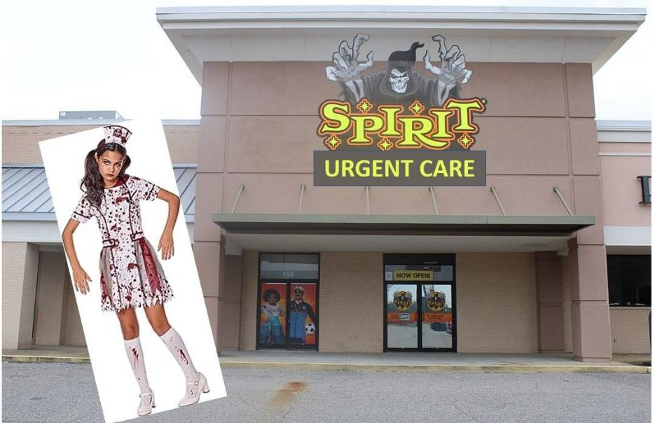

Slide 16
Urgent Care Economic Considerations
Volume depends on strength, timing and duration of flu season
Prices are set by health insurance companies
High proportion of costs are subject to wage inflation
Excess labor capacity due to minimum staffing models
Excess labor capacity due to “on demand” ebb/flow (vs. appointments)
Excess labor capacity due to incremental labor problem

Slide 17
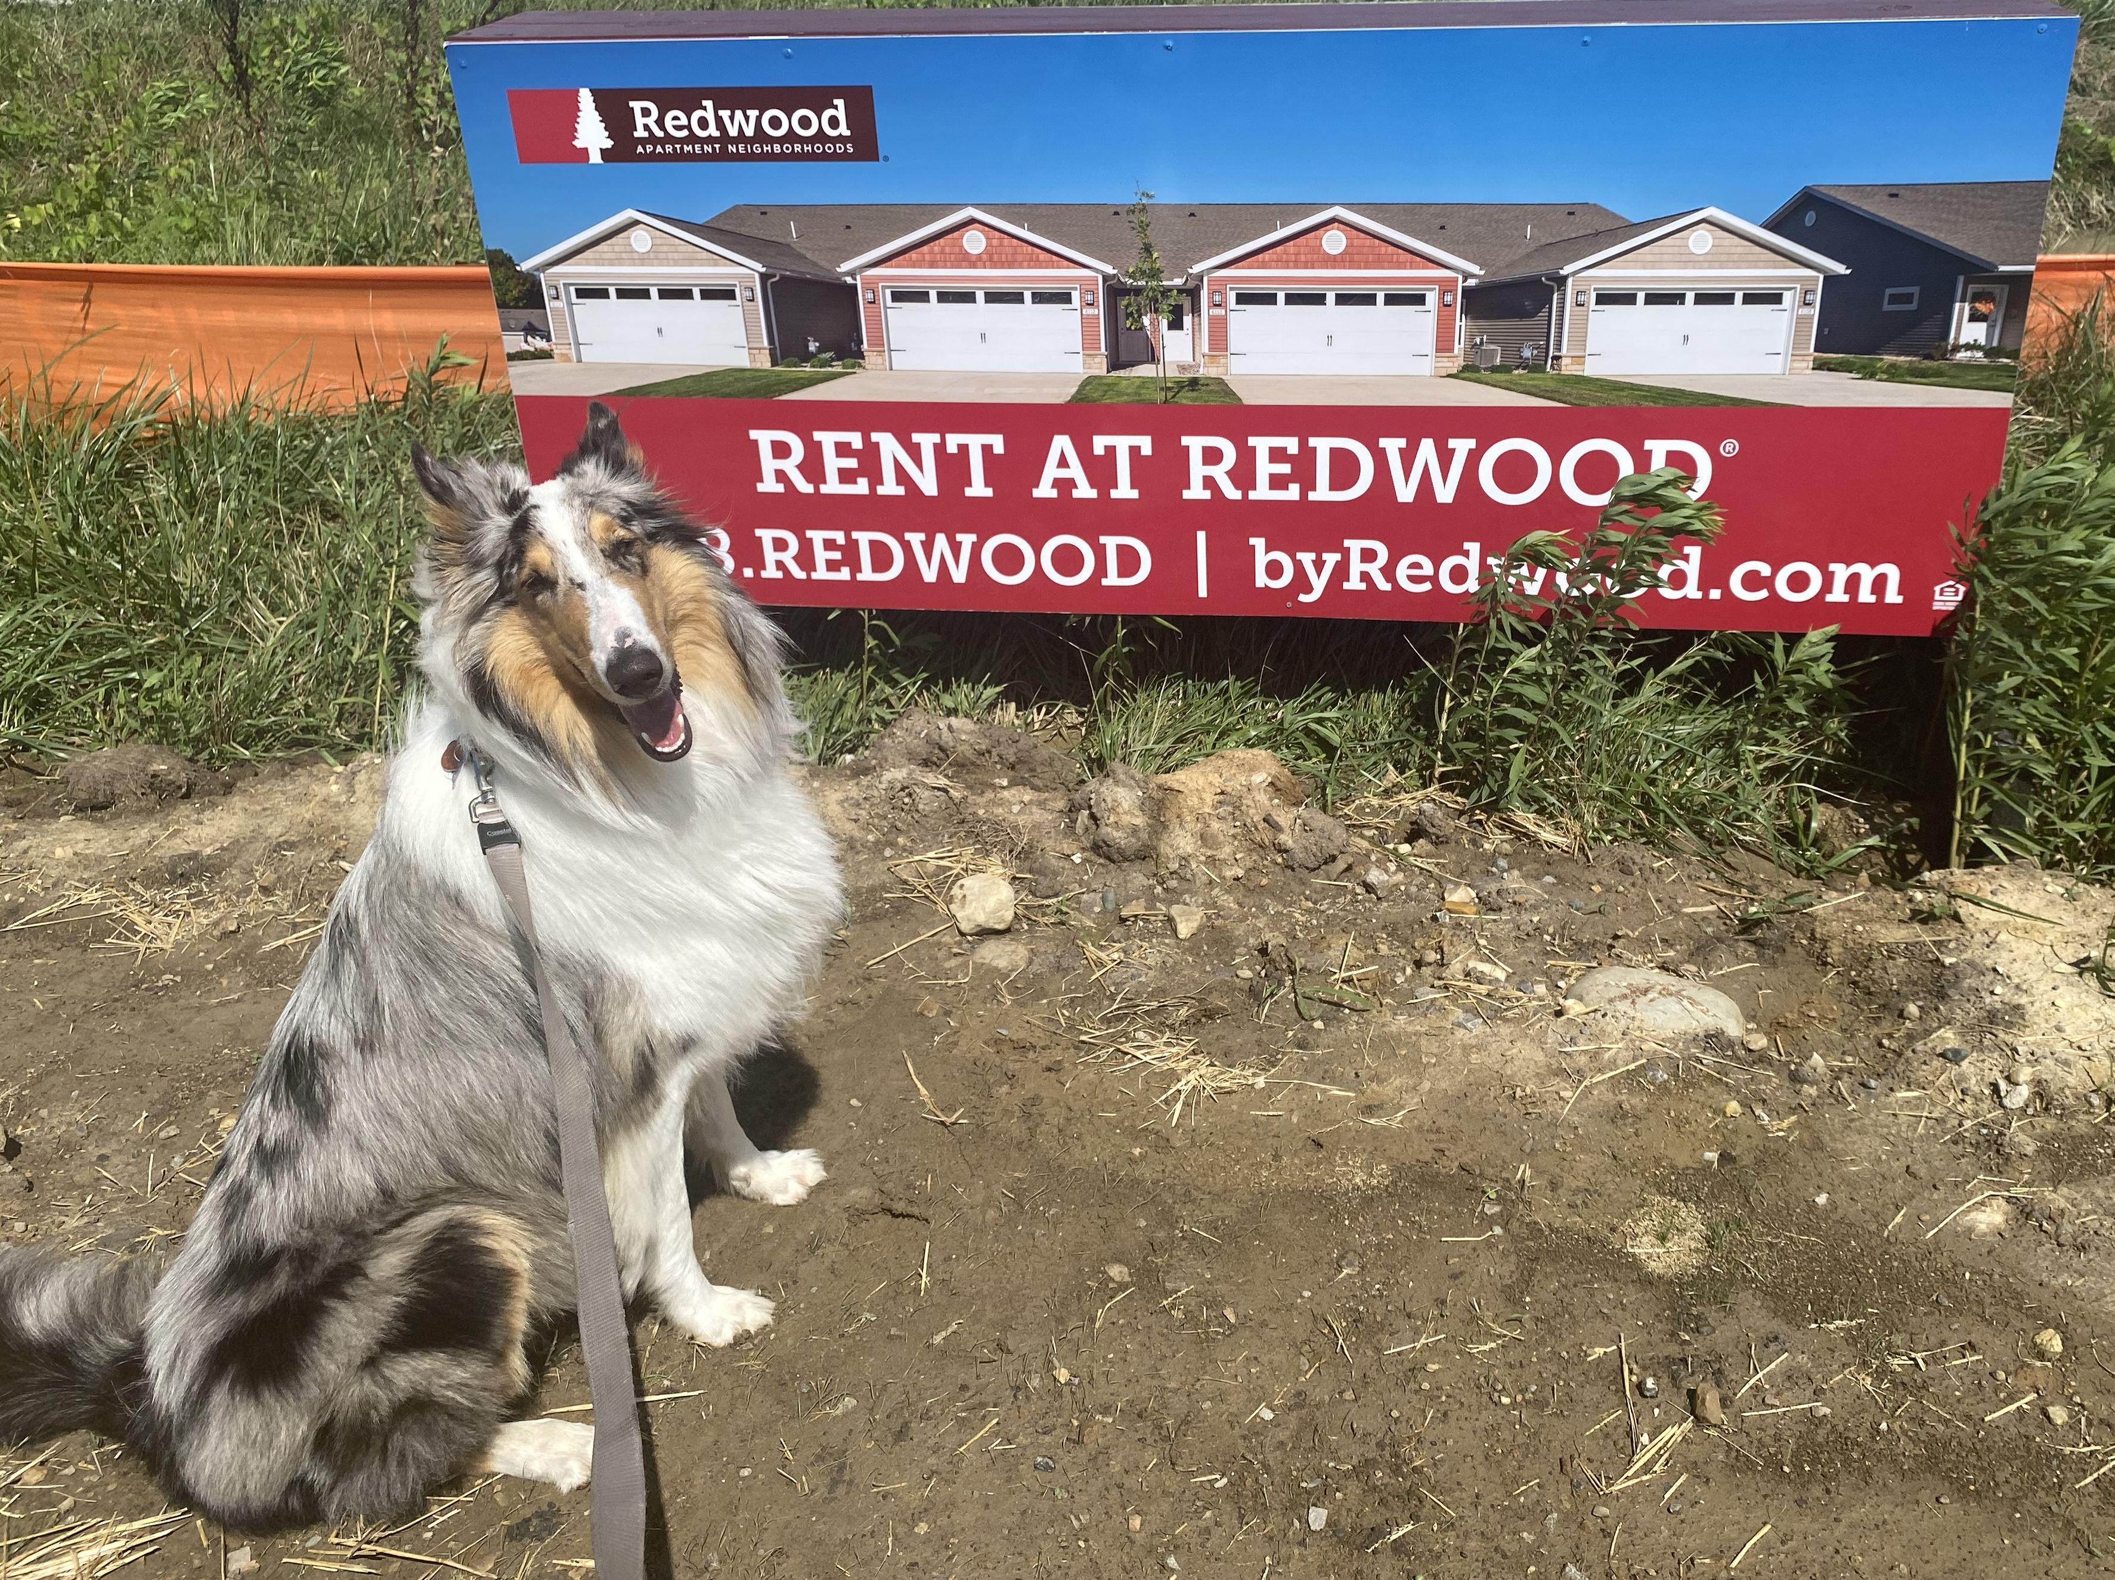
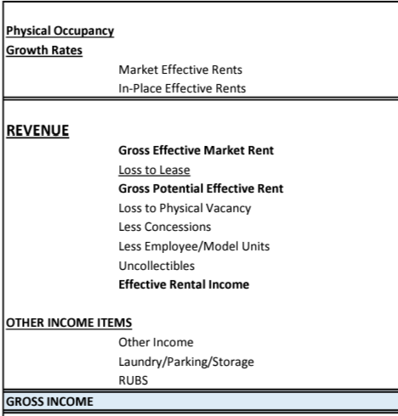
URGENT CARE MUST ADDRESS ITS CAPACITY PROBLEM
Potential Revenue = Contracted Rate x Capacity
If financials started with capacity…
Contracted Rates
Actual Collections
NRPV Collections
LOSS TO Labor Productivity
Bad Debt
Drug Screens,
Flu Shots,
Ancillary Services

Slide 18
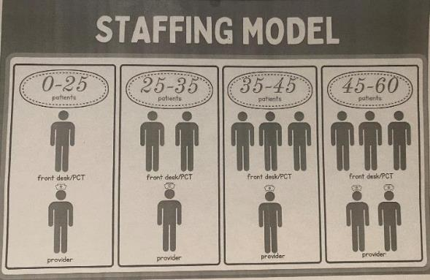
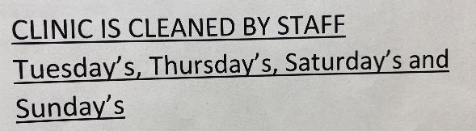
Lean Operations Start w/Labor
Patients register themselves (eReg)
Front desk “special projects” during off-hours (marketing, denials)
Cross-training front/back office
Providers do their own MA work

Slide 19
Primary Care and Beyond

Slide 20
Convergence of Urgent and Primary Care
Parallel line of business
Separate contracts (Tax ID)
Scheduled appointments vs. walk-in
Dual flow; different throughput measures
Distinct providers
Standard definitions needed as to what capabilities constitute primary care in an urgent care setting
Specialist
Emergency Department
Complexity of Illness
Primary
Care
Urgent
Care
Acuity of Illness

Slide 21
Urgent Care
Transactional
Acute
Episodic/Referral
Focus on Chief Complaint
Walk-in/Same Day
Case Rate/Facility-Based Contracts Lab/X-Ray/Vaccines as Overhead
Emergency Medicine and Primary Care Specialties
Primary Care
Relational
Chronic
Longitudinal/Follow-up
Focus on Wellness/Prevention
Scheduled Appointments
Fee-for-Service: New (Annual Wellness Physicals) vs. Established (Rechecks)
Pediatrics, Family Medicine, Internal Medicine

Slide 22
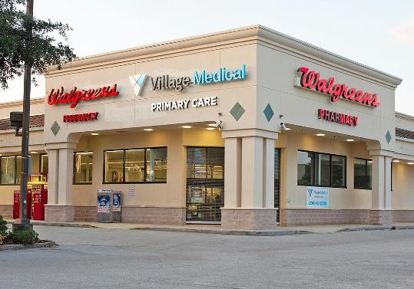
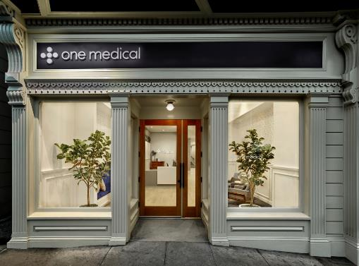
Primary Care
Parallel but separate line of business
Separate Tax ID
Separate providers
Separate payer contracts
  Participation in managed care “risk”
  Capitation for carrying the chart
Scheduled appointments vs. on-demand
Defined as:
  Annual wellness exams
  Re-checks on chronic issues
  Preventive services
Requires connectivity to specialists and facilities
Everything else is “urgent care”

Slide 23
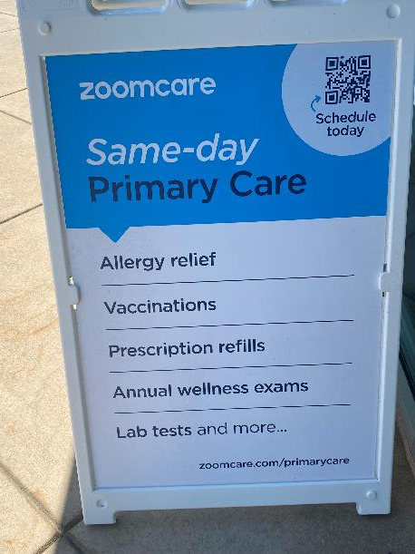
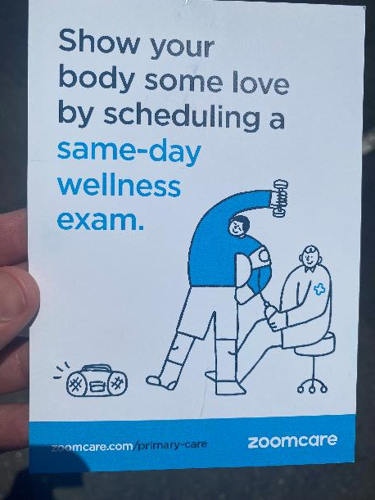
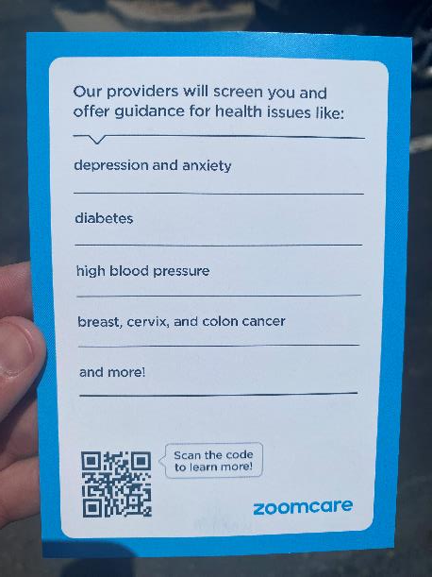
Primary Care in the Urgent Care Setting
Urgent care without capability; primary care without connectivity.

Slide 24
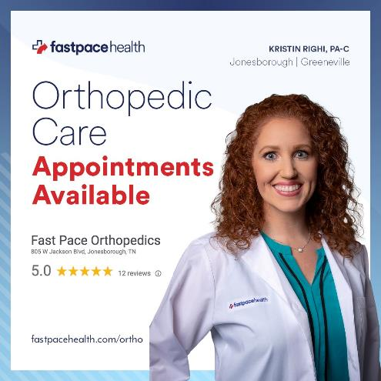
Specialist Services
Integrated behavioral health, dermatology, orthopedics, allergy
vs.
--Behavioral health urgent care
--Orthopedic urgent care
--Dermatology urgent care
--GI urgent care

Slide 25
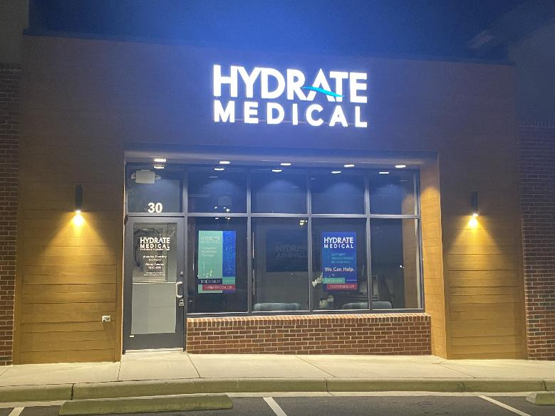
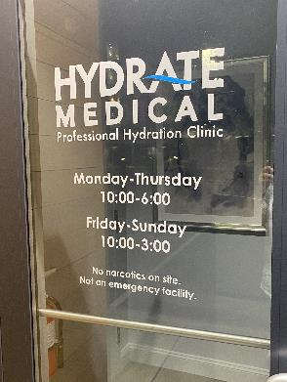
IV SERVICES
Medical Hydration*
Vanity/Vitamin Blends
Ketamine
Hydration for Hangover or Endurance
Pharmaceutical Infusions
*Required per UCA Certification

Slide 26
Summary of Operational Differentiators
Strong operators who are highly involved, aware and visible in clinics.
Maintained full “urgent care” capabilities and hours through the pandemic.
Creatively staffing x-ray during all shifts, even when short-handed.
Accepts patients up until posted closing hours with short visit times.
Accepts all insurance including Medicaid to serve local covered lives.
Pediatric focus appealing to “mom” as the decision-maker.
Aggressive community marketing w/grassroots focus on schools.
Brand conscious including conventional brand-building advertising.
Follows population growth patterns for opportunistic rooftop growth.

Slide 27

Contact Information
Alan A. Ayers, MBA, MAcc
alan.ayers@experityhealth.com
(614) 519-1221 Cell/Text
http://www.alanayersurgentcare.com
https://www.linkedin.com/in/alanayers/

