Slide 1
Developing an Urgent Care Business Plan Model for Success
Alan Ayers, MBA, MAcc
President, Experity Consulting

Slide 2
What is Urgent Care?
Broad spectrum of illness, injury and disease
Licensed medical provider on-site during all hours of operation
X-ray available during all hours of operation
Laboratory services including point-of-care testing, collection and send-out
EKG read and interpret during all hours of operation
Ability to provide minor procedures on-site (I&D, laceration repair, splinting)
AED, oxygen, ambubag/oral airway, ability to call 911
7-day hours of operation, minimum daily hours (removed from UCA criteria)

Slide 3
Urgent Care vs. Primary Care
Urgent Care
Transactional
Acute
Episodic/Referral
Focus on Chief Complaint
Walk-in/Same Day
Case Rate/Facility-Based Contracts Lab/X-Ray/Vaccines as Overhead
Emergency Medicine and Primary Care Specialties
Primary Care
Relational
Chronic
Longitudinal/Follow-up
Focus on Wellness/Prevention
Scheduled Appointments
Fee-for-Service: New (Annual Wellness Physicals) vs. Established (Rechecks)
Pediatrics, Family Medicine, Internal Medicine

Slide 4
Urgent Care Growth Trends
Growth Engines
Physician Entrepreneurs
Local Multi-Site Scaling
Hospital Operators
(Medical Group vs. Joint Venture)
Regional/Super-Regional Platforms

Slide 5
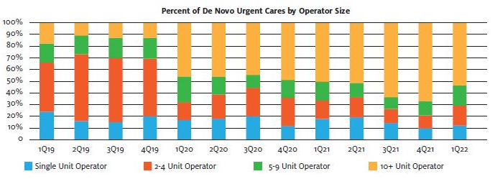
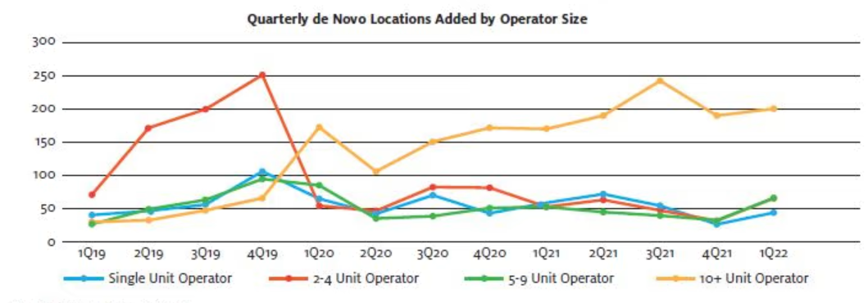
Pandemic and Post-Pandemic Growth
Equity vs. debt funding
New investment sources
Provider cash on hand
De novo growth engines
”Corporatization”
  25% of UCs owned by PE
  Project >10% rooftop growth
”Hospitalization”
  40% of UCs owned by hospitals
  20% of hospital UCs in JVs
  Growth to 45% by 2026

Slide 6
Urgent Care Growth Trends, cont’d.
Industry Headwinds and Tailwinds
Pre-Pandemic Concerns
Saturation
Commoditization
Case Rate Contracts
Acuity Degradation
Hospital Referrals
Telemedicine → AI
COVID-19 Response
Adapted quickly to patient needs
Improved operational efficiency
Drove throughput w/technology
Innovative thinking to seize opportunities
Realized our place in the healthcare ecosystem
Post-COVID Hangover
High-Volume COVID Testing
Shift to Digital Marketing
Operating at Capacity
Staff Shortages/Burnout
X-Ray Availability
Novice NP Skillset
Wage Inflation
Reimbursement Challenges
Private Equity Investment Theses
Arbitrage
Multiple Expansion
Cash Flow
Revenue and EBITDA Growth

Slide 7
Post-COVID Growth Theses
Healthcare resiliency (vs. consumer discretionary)
  Attractive to investors
  Attractive to landlords
COVID patient retention
  Pandemic utilization up >25%
  66% intend to return vs. 75% pre-COVID
  Average patient returns 1.7 to 2.1x/year
Consolidation
  30% of UCs are independents (1-2 centers)
  40% of UCs are “chains” (11+ centers)
  PE sponsors and hospitals account for 75% of transactions
  Hospitals/health systems on a local level
  PE-backed platforms merging with one another
New geographies (urban, rural health clinics)
  17% of US counties have population to support a UC but don’t yet have one

Slide 8
Post-COVID Growth Theses, cont’d.
New Patients
  Millions introduced to urgent care during the pandemic, 2/3 of which will return
New Locations
  Rooftop expansion continues, although more corporate, less hospital activity
  Resurgence of independent operators
New Geographies
  Shift from the affluent suburbs to underserved rural and urban markets
  Strategic real estate – intercepting, flanking and boxing in competitors

Slide 9
Post-COVID Growth Theses, cont’d.
New Payers
  Medicaid expansion and privatization
  Value-based care and population health
New Services
  Specialist services
  Occupational medicine
  Behavioral health
  Primary care
  Specialty urgent care

Slide 10
Convergence of Urgent and Primary Care
Driven by a growing shortage of primary care providers relative to an aging and increasingly co-morbid population
Parallel line of business
Separate contracts (Tax ID)
Scheduled appointments vs. walk-in
Dual flow; different throughput measures
Distinct providers
Standard definitions needed as to what capabilities constitute primary care in an urgent care setting
Specialist
Emergency Department
Complexity of Illness
Primary
Care
Urgent
Care
Acuity of Illness

Slide 11
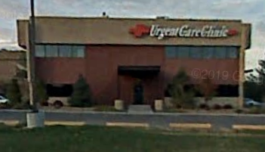
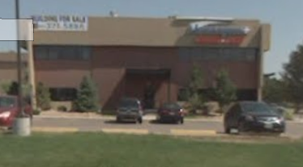
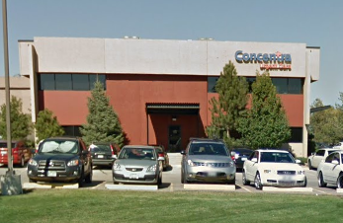
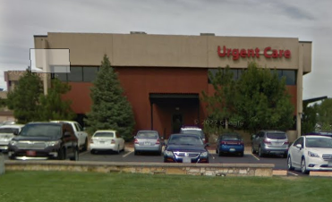
Creating a Branded Patient Experience Destination
Vs. a commodity doctors office
Patients loyal to a location or provider not a “brand”
Loyal patients have more frequent utilization, positive word-of-mouth
Think of “differentiated” retail experiences:
  Chick-fil-a
  Starbucks
  Apple Store

Slide 12
Urgent Care Economics 101
Revenue = Volume x Rate
Population Density and Demographics
Market Saturation
Availability of Viable Real Estate
Closed or Limited Networks
Unfavorable Reimbursement
Market Study
Payer Study

Slide 13
Business Plan Elements
Revenue Formula
Expense Categories
+ Patient Charges for Medical Services
Contractual Allowances
Bad Debt Expense
= Net Revenue (per visit)
+ Dispensing Revenue
+ Occ Med (EPS) Revenue
+ Misc. Fees and Charges
Labor
  Staffing Model (MDs vs. PAs/NPs, MAs, RTs)
  Staffing Efficiencies to Patient Volume
  Increase Staffing as Volume Grows
Technology and Billing Services
Supplies
Rent and Occupancy Expenses
Marketing
  Grassroots, Paid Advertising
  Website, SEO, Digital Tactics
Purchased Services

Slide 14
Start-up Critical Path and Timelines
Securing site: 3-4 months
Obtaining funding: 2-3 months
Commencing build-out: 4-6 months
C&C and getting in-network with major payers: 10-12 months
Clinic set-up, supplies, hiring, training,
technology configuration, compliance, etc.
Opening Day – 12 to 14 months

Slide 15
Urgent Care Capital Requirements
Buildout costs $ * Square footage >>> $500-600K
FF&E >>> $250K
One-time Startup Expenses >>> $150K
Working Capital >>> $300K
Total: $1.2+ M

Slide 16
Urgent Care Development Obstacles
Finding the “right” location
Payer contract availability and reimbursement rates
Having a physician on board (State CPOM laws, payer requirements)
Ability to obtain financing (SBA loan, savings, friends/family)
Vendor relationships (supplies, x-ray, lab) with urgent care experience
Attention to detail – workplan of required tasks
Facility floorplans and construction requirements
Policies and procedures, job descriptions

Slide 17
Adding Value to Urgent Care Operations
Patients per hour per provider
  Volume-driven business
    Flow-through margin of incremental visits
    Skeletal labor as a fixed cost
    Problem of adding incremental provider capacity
  Leverage labor as the greatest expense
  Staff according to patient per hour expectation
  Pace arrivals according to staff capacity
  Eliminate non-value added tasks to increase efficiency
More locations in a market valued more per center
  Scale economies are local
    Staffing bench flexibility
    Mass marketing
  Payer leverage — network effect
Value-engineering the delivery model

Slide 18
Urgent Care Start-up Mistakes
Mistakes in Ownership Structure
Not having a physician on paper (if needed)
  CPOM; APP collaboration; Payer medical director requirement; SBA Loan Guarantor
Not understanding operations beyond the medicine
  “Retail” elements of the business; CC (not hospital, not independent); Costs of doing business

Slide 19
Urgent Care Start-up Mistakes, cont’d.
Mistakes in Financial Planning
Planning too little for capital expenditures
  Build-out, X-ray, other supplies and equipment
Not planning for adequate working capital
  Non-operational carrying costs
  Operational costs > revenue in early weeks/months due to volume ramp up and delay A/R maturation

Slide 20
Urgent Care Start-up Mistakes, cont’d.
Mistakes in Site Selection
Not considering known indicators for success
  Ideal market benchmarks
  Site positioning

Slide 21
Urgent Care Start-up Mistakes, cont’d.
Mistakes in Operating Systems Execution and Utilization
Not deploying appropriate resources to support operations
  Urgent care-specific platforms and service providers that can manage the nuances of urgent care:
    Fluctuations in hourly, daily, and seasonal visit volumes
    Episodic presentation v. scheduled visits
    Efficient supportive services – reference labs, supply ordering, x-ray over-reads, etc.

Slide 22
Urgent Care Start-up Mistakes, cont’d.
Mistakes in Operations
Not knowing what you don’t know
  Cash-only
  Compliance
  Flexibility
  Referring out good revenue
  Ancillary income
  Growing too quickly

Slide 23
Urgent Care Start-up Mistakes, cont’d.
Mistakes in Marketing
Not investing in and deploying successful marketing strategies
  Relying on word-of-mouth and referrals for volume v. site visibility/awareness, SEO, etc.
  Not putting urgent care first; promoting ancillary services over urgent care as core business
  Not diversifying strategies across multiple medium (digital, print, grassroots)

Slide 24
Questions and Answers

Slide 25

Contact Information
Alan A. Ayers, MBA, MAcc
alan.ayers@experityhealth.com
(614) 519-1221 Cell/Text
http://www.alanayersurgentcare.com
https://www.linkedin.com/in/alanayers/

