Slide 1
Start-up Success in the Post-COVID Environment
Alan A. Ayers, President
Heather Real, Senior Consultant
Experity Consulting

Slide 3
What is Urgent Care?
Broad spectrum of illness, injury and disease
Licensed medical provider on-site during all hours of operation
X-ray available during all hours of operation
Laboratory services including point-of-care testing, collection and send-out
EKG read and interpret during all hours of operation
Ability to provide minor procedures on-site (I&D, laceration repair, splinting)
AED, oxygen, ambubag/oral airway, ability to call 911
7-day hours of operation, minimum daily hours (removed from UCA criteria)

Slide 4
Urgent Care vs. Primary Care
Urgent Care
Transactional
Acute
Episodic/Referral
Focus on Chief Complaint
Focus on Throughput/Productivity
Primary Care
Relations
Chronic
Longitudinal
Wellness/Prevention
Scheduled Appointments

Slide 5
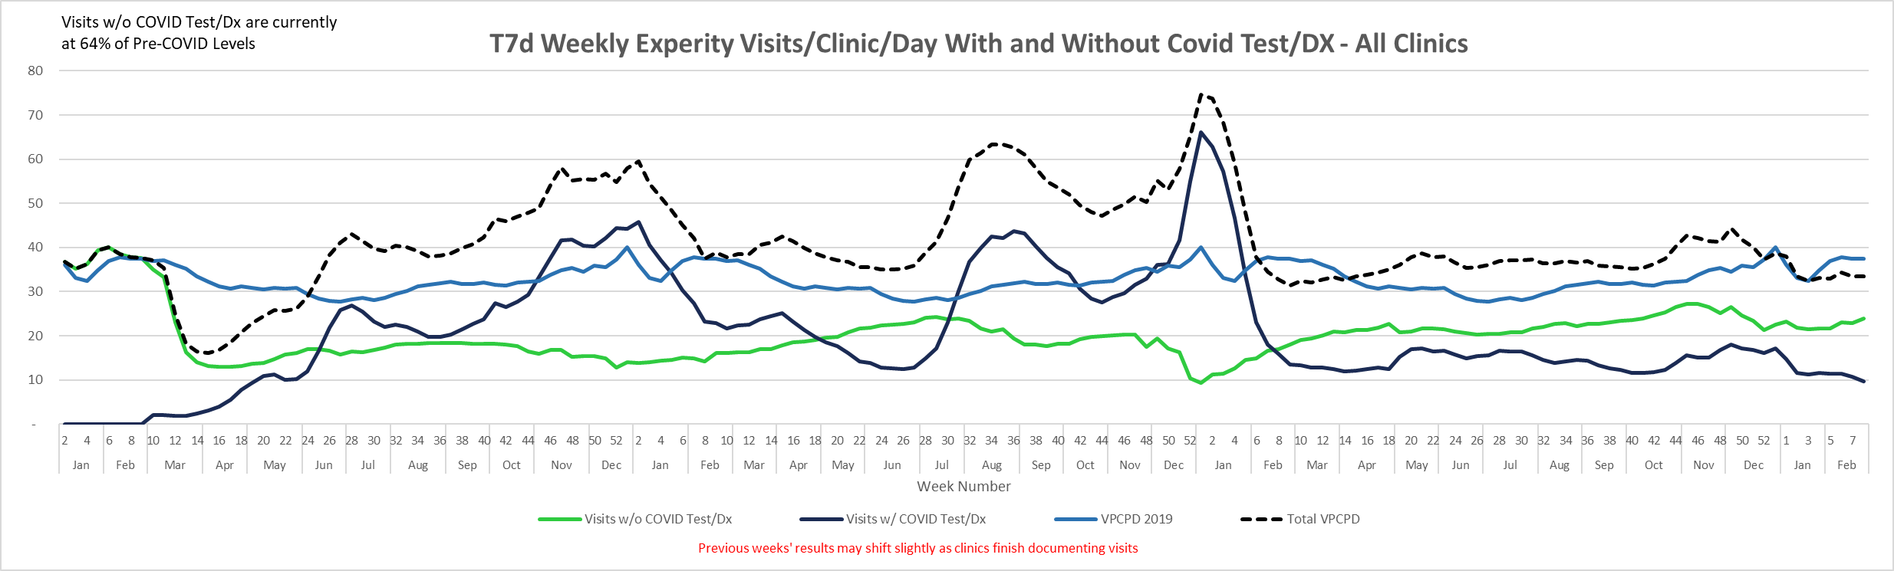
COVID Impact on Urgent Care
Historically the challenge for urgent care profitability has been the occurrence and strength of a three-month “cold and flu” season.

Slide 6
Flexibility is What Differentiates Urgent Care
Urgent care can adapt quickly to market opportunities
  Implementing and marketing new services in response to patient needs
  Identifying new revenue streams
  Aligning workflows, staffing and processes
  Throughput facilitated by technology
Urgent care is the “front door” that draws new patients in
  Develop relationships with local health systems and specialists
  Develop relationships with local employers (Occ Med)
  Downstream service capture including specialist, wellness and primary care services

Slide 7
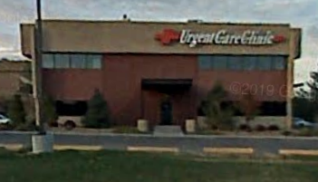
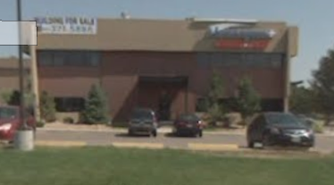
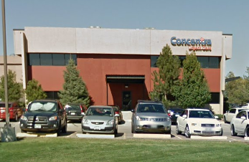
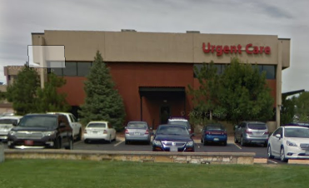
Developing a Meaningful Brand
A “commodity” in the “sea of sameness”
Loyal to a location or provider not a “brand”
Loyal patients have more frequent utilization
Think of “differentiated” retail experiences:
  Chick-fil-a
  Starbucks
  Apple Store

Slide 8
The Post-COVID Growth Thesis for Urgent Care
New Patients
  Millions introduced to urgent care during the pandemic, 2/3 of which will return
New Locations
  Rooftop expansion continues, although more corporate, less hospital activity
  Resurgence of independent operators
New Geographies
  Shift from the affluent suburbs to underserved rural and urban markets
  Strategic real estate – intercepting, flanking and boxing in competitors

Slide 9
The Post-COVID Growth Thesis, cont’d.
New Payers
  Medicaid expansion and privatization
  Value-based care and population health
New Services
  Specialist services
  Occupational medicine
  Specialty urgent care

Slide 10
Economics of Starting an Urgent Care Center
Revenue = Volume x Rate
Population Density and Demographics
Market Saturation
Availability of Viable Real Estate
Closed or Limited Networks
Unfavorable Reimbursement
Market Study
Payer Study

Slide 11
Business Plan Elements
Revenue Formula
Expense Categories
+ Patient Charges for Medical Services
Contractual Allowances
Bad Debt Expense
= Net Revenue (per visit)
+ Dispensing Revenue
+ Occ Med (EPS) Revenue
+ Misc. Fees and Charges
Labor
  Staffing Model (MDs vs. PAs/NPs, MAs, RTs)
  Staffing Efficiencies to Patient Volume
  Increase Staffing as Volume Grows
Technology and Billing Services
Supplies
Rent and Occupancy Expenses
Marketing
  Grassroots, Paid Advertising
  Website, SEO, Digital Tactics
Purchased Services

Slide 12
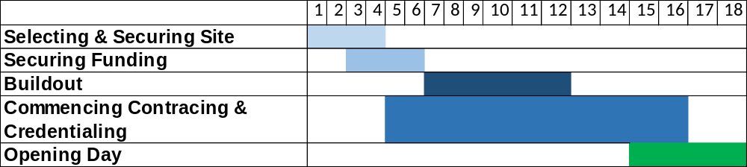
Urgent Care Development: Critical Timelines
Securing site – 3-4 months
Obtaining funding – 2-3 months
Commencing build-out - 4-6 months
CC and getting in-network with major payers – 10-12 months
Clinic set-up, supplies, hiring, training,
technology configuration, compliance, etc.
Opening Day – 12 to 14 months

Slide 13
Urgent Care Development: Capital Required
Buildout costs $ * Square footage >>> $500-600K
FF&E >>> $250K
One-time Startup Expenses >>> $150K
Working Capital >>> $300K
Total: $1.2+ M

Slide 14
Obstacles to Starting an Urgent Care Center
Finding the “right” location
Payer contract availability and reimbursement rates
Having a physician on board (State CPOM laws, payer requirements)
Ability to obtain financing (SBA loan, savings, friends/family)
Vendor relationships (supplies, x-ray, lab) with urgent care experience
Attention to detail – workplan of required tasks
Facility floorplans and construction requirements
Policies and procedures
Job descriptions

Slide 15
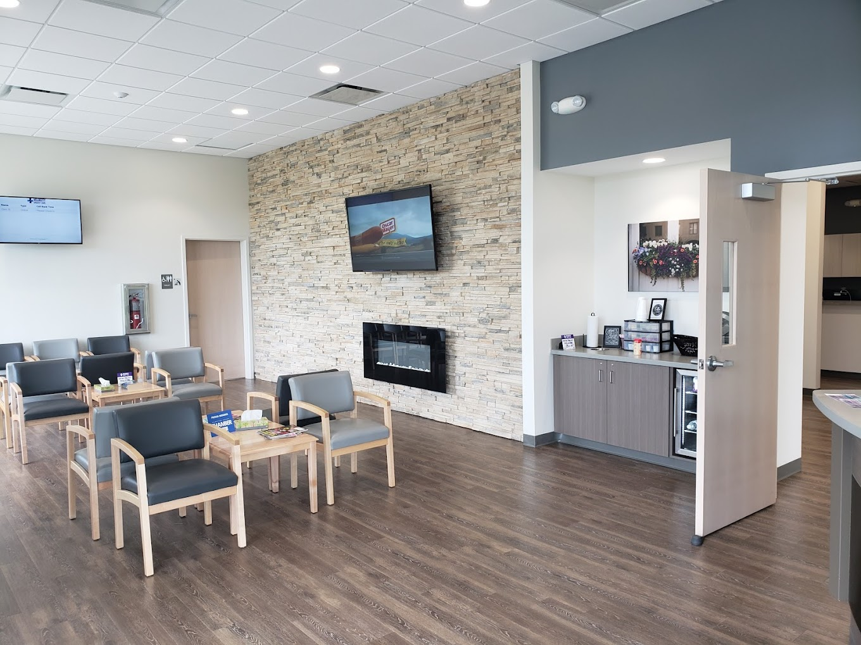
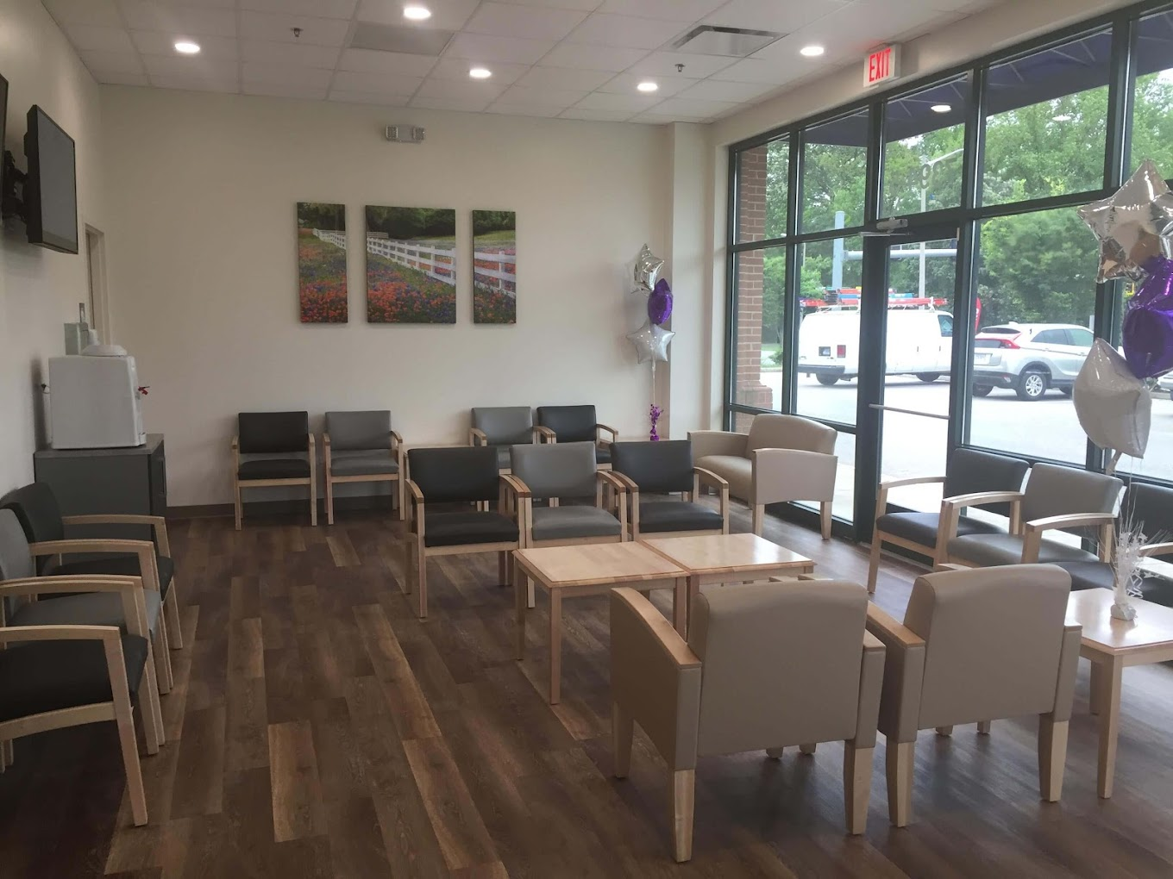
Value-Engineering Urgent Care Centers

Slide 16
Top Mistakes of Urgent Care Start-ups
Mistakes in Ownership Structure
Not having a physician on paper (if needed)
  CPOM; APP collaboration; Payer medical director requirement; SBA Loan Guarantor
Not understanding operations beyond the medicine
  “Retail” elements of the business; CC (not hospital, not independent); Costs of doing business

Slide 17
Top Mistakes of Urgent Care Start-ups, cont’d.
Mistakes in Financial Planning
Planning too little for capital expenditures
  Build-out, X-ray, other supplies and equipment
Not planning for adequate working capital
  Non-operational carrying costs
  Operational costs > revenue in early weeks/months due to volume ramp up and delay A/R maturation

Slide 18
Top Mistakes of Urgent Care Start-ups, cont’d.
Mistakes in Site Selection
Not considering known indicators for success
  Ideal market benchmarks
  Site positioning

Slide 19
Top Mistakes of Urgent Care Start-ups, cont’d.
Mistakes in Operating Systems Execution and Utilization
Not deploying appropriate resources to support operations
  Urgent care-specific platforms and service providers that can manage the nuances of urgent care:
    Fluctuations in hourly, daily, and seasonal visit volumes
    Episodic presentation v. scheduled visits
    Efficient supportive services – reference labs, supply ordering, x-ray over-reads, etc.

Slide 20
Top Mistakes of Urgent Care Start-ups, cont’d.
Mistakes in Operations
Not knowing what you don’t know
  Cash-only
  Compliance
  Flexibility
  Referring out good revenue
  Ancillary income
  Growing too quickly

Slide 21
Top Mistakes of Urgent Care Start-ups, cont’d.
Mistakes in Marketing
Not investing in and deploying successful marketing strategies
  Relying on word-of-mouth and referrals for volume v. site visibility/awareness, SEO, etc.
  Not putting urgent care first; promoting ancillary services over urgent care as core business
  Not diversifying strategies across multiple medium (digital, print, grassroots)

Slide 22
Questions and Answers

Slide 23
Takeaway one
Takeaway two
Takeaway three

