Slide 1
WELCOME

Slide 2
Honing Your Occupational Medicine Strategy for Optimal Returns

Slide 3


SPEAKERS
Alan Ayers
President of Experity Consulting
Experity
Jim Devitt
Vice President, Business Development
Emergency One

Slide 4
Occupational Medicine Services
​
PHYSICALS FOR ​
COMPLIANCE AND DUTY
​
DRUG SCREENING
WORKERS COMPENSATION
Pre-employment
Post Incident
Randoms
Regulated and Non-regulated
With Breath Alcohol Testing
Consortium Services
MRO Services
DOT /CDL
Police/Fire
Air/Rail/Maritime
OSHA Specific
Multi-component including:
  Pulmonary Function/ Respirator Fit
  Audiometry
  Titmis/Vision
  EKG
  Functional Capacity Exams
  Specialized Lab Testing
First Report of Injury
Injury Treatment & Follow-up
Injury Case Management
Specialist Referral
Independent Medical Exams
Physical Therapy
Chiropractic
Acupuncture
TB TESTING
Hep A/B, Tetanus, Influenza, Rabies

Slide 5






High Utilization Industries

Slide 6


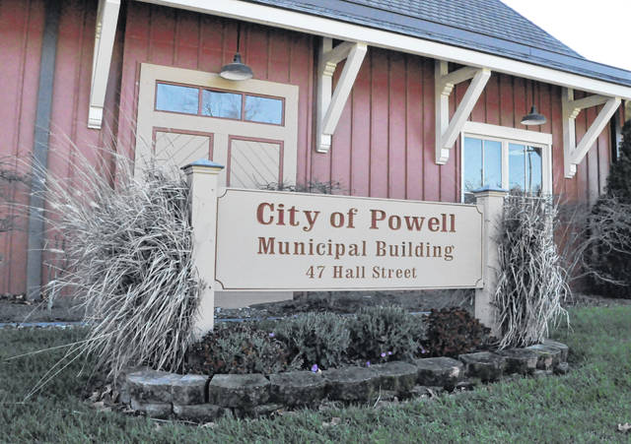
National vs. Local and Municipal Accounts
2x the private sector injury rate
RFP compliance needs:
  Police/Sheriff
  Fire/EMS
  Public Schools
  Parks & Recreation
  Public Sanitation
  Animal Control
  Public Transit
  Housing Authority
  Municipal Utilities

Slide 7
Benefits to Adding OccMed to Urgent Care
Incremental fee revenue
Contra-seasonality
Ability to schedule in excess capacity
Cash or employer NET/15 billing
Services provided by Advanced Practice Providers
Marketing exposure to local employees
Strong WC reimbursement in some states

Slide 8
Challenges with OccMed
Medical skepticism – employer not patient is the “customer”
Many services are regulated
Light/modified duty and OSHA recordables
Competition for “national accounts” and “national TPAs”
Employer preference for one-stop-shop
Scope of services including workers comp and physical therapy
Expense of sales effort to local employers
Low fees on “commodity” EPS services
Physician required by workers comp payers
Ongoing staff training for low volume services
Staff turnover

Slide 9
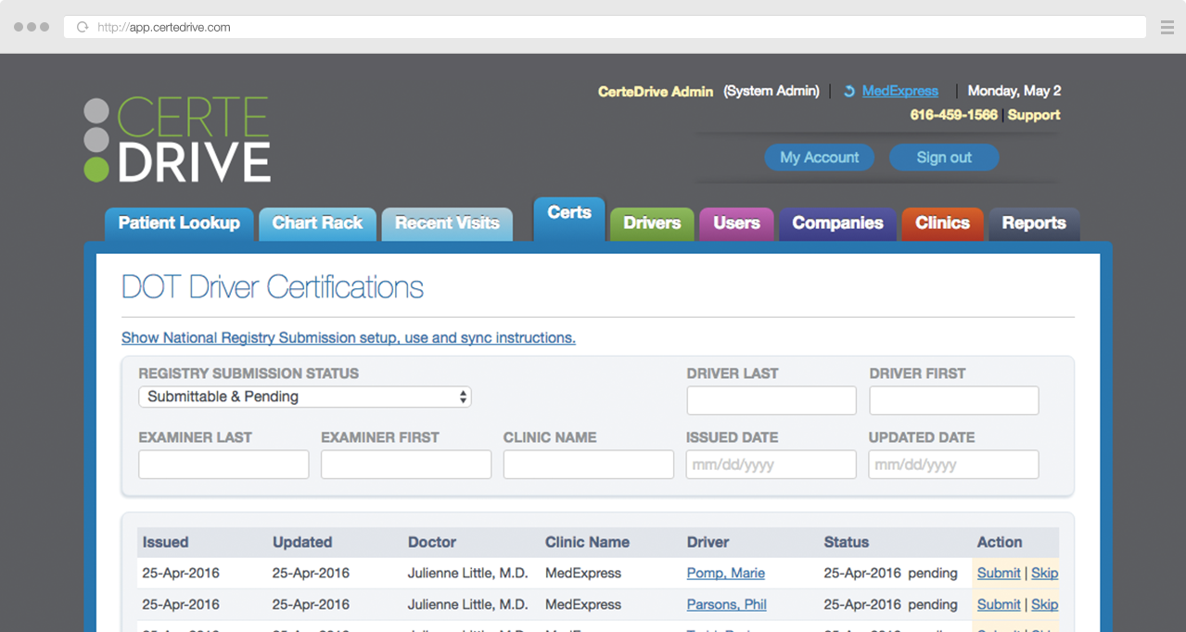

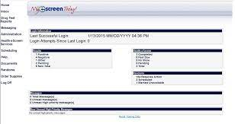



Proliferation of Employer Paid Services TPAs
Queuing/
eReg
PM
EMR

Slide 10
Historic EPS Workflow (High Level)
Staff Reports Results to Employer
Employer Contracts for Services w/Clinic
(Creates Protocol)
Employer Authorizes Employee to Receive Services
Employee Registers at Clinic
Staff Consults Protocol for Authorized Services
Staff Performs and Documents Services
Clinic Bills Employer for Services
EPS Workflow with EPS TPAs
Employer Contracts for Services w/TPA
TPA Reports Results to Employer
Employer Authorizes Services in TPA Portal
Employee Registers at Clinic
(CW/PM)
Staff Consults TPA Portal for Authorized Services
Staff Performs and Documents Services in TPA Portal
TPA Contracts with Clinics to Provide Services to Employers
TPA Pays Clinic for Services

Slide 11
THANK YOU

