Slide 1
Winning in Urgent Care
Alan Ayers, MBA, MAcc
President, Experity Consulting
Senior Editor, The Journal of Urgent Care Medicine

Slide 2

Alan Ayers, MBA, MAcc
Alan Ayers has ~20 years’ experience in strategic planning, business development, clinical operations, sales/marketing and customer service for urgent care, occupational medicine, and primary care facilities.
Currently, Ayers serves as President of Experity Consulting, responsible for helping clients identify and cultivate new revenue streams while supporting the company's strategic growth initiatives. Ayers has consulted with independent, PE-backed, and hospital-affiliated platforms representing well over 1,000 units. He has also served as an expert witness in landlord-tenant litigation involving urgent care.
From 2017 to 2021, while still part of Experity, Ayers served as Chief Executive Officer of Velocity Urgent Care, a venture of Sentara Healthcare, growing the company from 7 to 15 locations building a complete operating and administrative infrastructure, assembling leadership and management teams, migrating systems, optimizing the staffing model, acquiring the hospital's occ med practice, and implementing a values-based culture. In 2020, Velocity Urgent Care became the leading provider of COVID19 test services in its markets.
A prolific and award-winning writer, Ayers is Senior Editor of The Journal of Urgent Care Medicine (JUCM), and has contributed hundreds of original articles, blog entries and presentations on urgent care-related subjects. In 2018 he was co-author of The Health Care Executives’ Guide to Urgent Care and Freestanding EDs, Second Edition.
Ayers has served as Chief Operating Officer of OhioHealth Urgent Care and spent eight years in executive positions at Concentra including VP of Corporate Development responsible for acquisitions, divestitures, de novos, relocations, and major renovations.
For eight years, Ayers served the Board of Directors of the national Urgent Care Association (UCA), providing expertise and guidance on emerging issues; identifying market and regulatory trends; defining content, planning educational programs, and speaking at industry events. In 2019, he received UCA’s prestigious Lifetime Membership Award.
Ayers graduated Phi Beta Kappa from the University of North Carolina, has an MBA from the University of Mississippi, and a Masters of Accounting from The Ohio State University graduating first in his class.

Slide 3
8% Average Annual Rooftop Growth Past 10 Years
Thousands of urgent care rooftops.
+8.0% p.a.
14.1
14.4
13.3
12.4
11.5
10.5
9.6
8.7
8.0
7.2
2014
2015
2016
2017
2018
2019
2020
2021
2022
2023

Slide 4
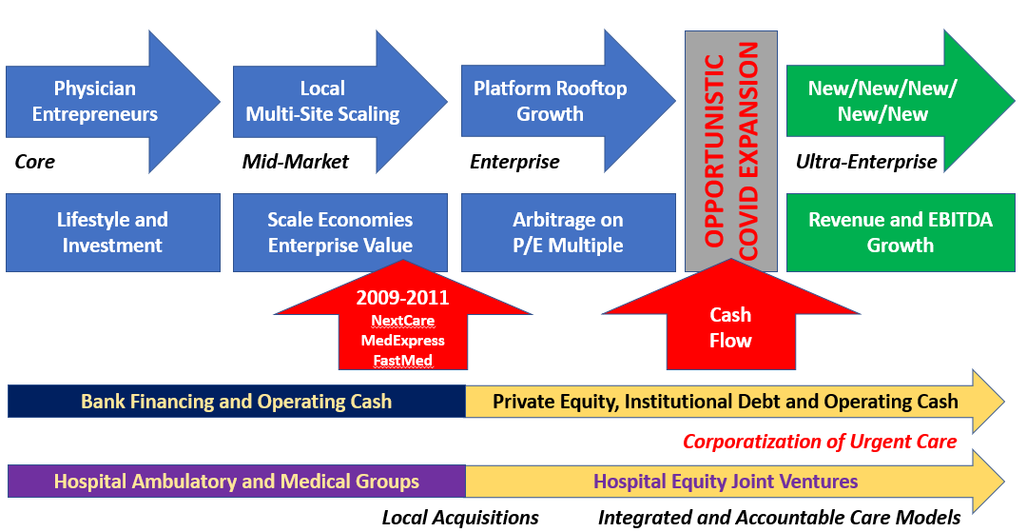
25 Years of Profitable Urgent Care Growth

Slide 5
Urgent Care Headwinds and Tailwinds
Pre-Pandemic Concerns
Saturation
Commoditization
Case Rate Contracts
Acuity Degradation
Hospital Referrals
Telemedicine → AI
COVID-19 Response
Adapted quickly to patient needs
Improved operational efficiency
Drove throughput w/technology
Innovative thinking to seize opportunities
Realized our place in the healthcare ecosystem
Post-COVID Hangover
High-Volume COVID Testing
Shift to Digital Marketing
Operating at Capacity
Staff Shortages/Burnout
X-Ray Availability
Novice NP Skillset
Wage Inflation
Reimbursement Challenges
Bad Debt
Private Equity Investment Theses
Arbitrage
Multiple Expansion
Cash Flow
Revenue and EBITDA Growth

Slide 6
Basic Economics of Urgent Care
Revenue = Volume x Rate
Rate is limited by third-party payers
Labor entails 75-85% of expenses making skeletal labor a “fixed” cost
“Volume driven” means once fixed costs are covered, each additional visit accrues to the bottom line
Profitability comes from maximizing provider and staff efficiency (patients per hour)
Profitability
VISIT COUNTS
LABOR COSTS

Slide 7
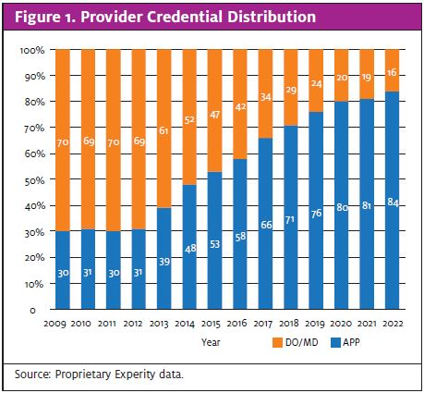
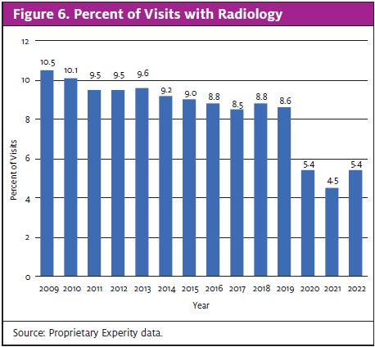
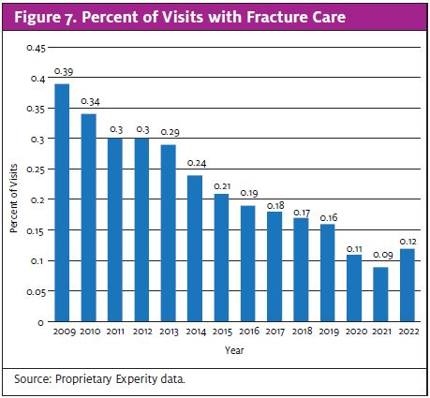
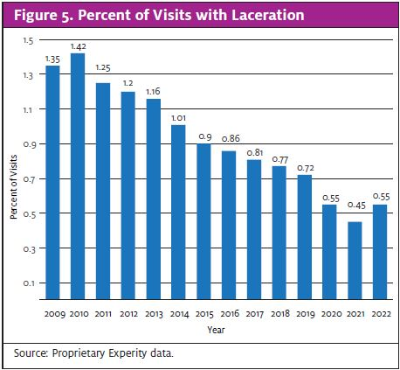
Long-Term Acuity Degradation
Insurance case rates and a focus on patient-per-hour productivity have degraded the scope of care offered and diminished the value proposition of “cost savings vs. the ER.”

Slide 8
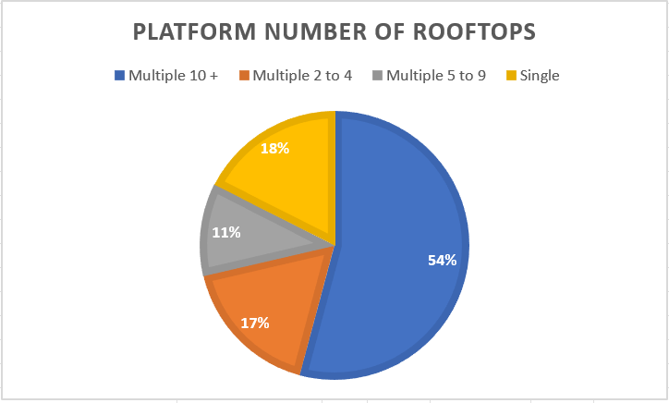
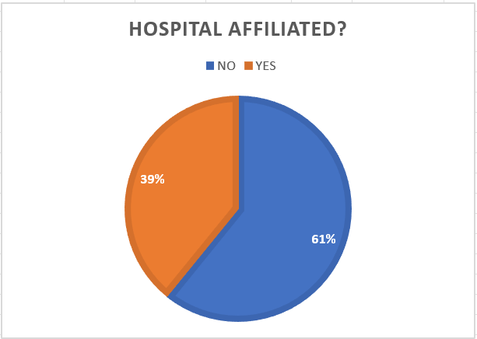
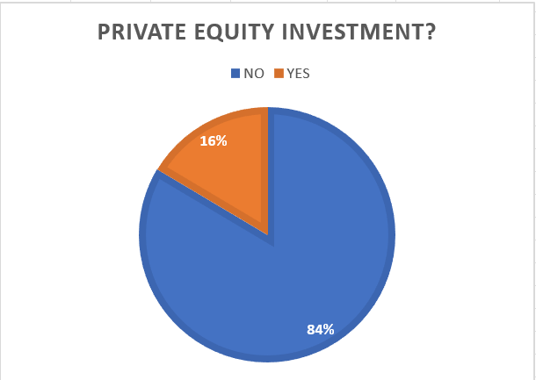
14,360 Urgent Care Centers in the United States
Source: National Urgent Care Realty, 6/26/2024.

Slide 9
2023-2024 Volumes Tracking to 2019 Levels
Decline from 2021:
  Lifting of COVID restrictions, decline in demand for testing
  Home testing, COVID fatigue, waiting out self-limiting conditions
  Work-from-home, household debt, inflation
  Telemedicine adoption (through existing PCP relationships)
Estimated average urgent care visits per clinic per day
# of visits
COVID-related visits
Non-COVID related visits
47
39
-28%
38
32
33
34
2019
20
21
22
23
2024 Q1
Source: Experity Health – Urgent Care Visit Data

Slide 10
Post-COVID Growth Theses
New Patients:
  Millions new introduced to UC during pandemic.
  New populations (i.e. focus on Pediatric Urgent Care).
New Payers:
  Medicaid privatization and expansion.
  Cost savings from Medicaid ER diversion.
New Rooftops:
  Continued de novo growth of enterprise accounts.
  Continued growth of core operators.
  Need to upgrade and relocate first generation centers.
New Geographies:
  Rural and urban fill-in.
  Risk of hitting a wall--scale economies lost moving West
  Set-up for value-based care innovation
New Services
  Primary care and specialist integration
  Ancillary services not relevant to the UC presentation
NEW/NEW/NEW/NEW/NEW

Slide 11
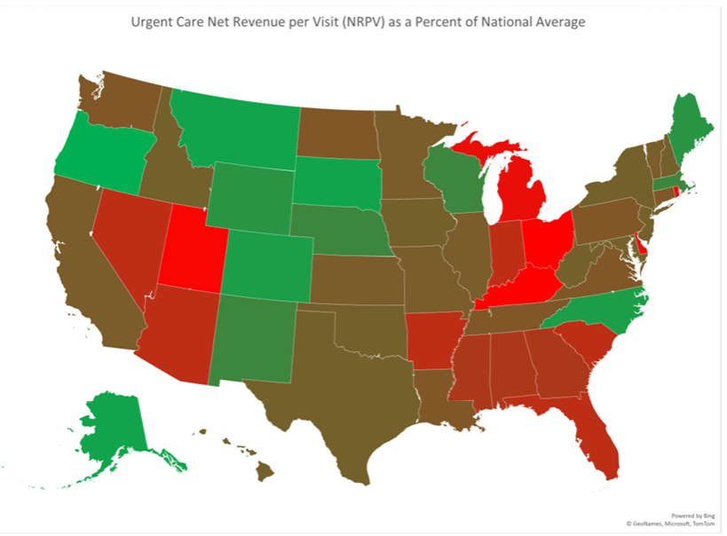
Urgent Care Reimbursement Models
Net revenue per visit ranges from ~$100 (Ohio, Kentucky) to >$200 (Oregon, Alaska) due to factors unrelated to operating costs.
The national average is ~$140 (states) or ~$144 (visits).
Factors that affect reimbursement include hospital vs. private ownership, payer mix, case rate vs. fee-for-service, privatized or State Medicaid participation, age of contracts, and network saturation…among others.

Slide 12
Fee for Service
Generally govt payers (Medicare, Medicaid, Tricare) and single-state BCBS non-profits.
Payer fee schedule or percent of Medicare fee schedule (year specified)
Frequent reductions or exclusions like a 15-30% discount for NPs/PAs or 50% E/M reduction when billing a procedure.
CPT may be excluded or payment may be less than overhead cost.
Case Rate
Generally national payers (Aetna, Cigna, UHC, Humana and Anthem), IPAs and Medicaid TPAs.
One flat rate per patient encounter (w/ E/M) regardless of services performed. Carve-outs are uncommon.
Diagnostics (imaging and lab) are unrecoverable practice overhead.
Incentivizes less care and higher throughput thus degrading acuity over time.
Pay-vider
Integrated health systems (Kaiser, Intermountain, Providence, CoreWell, et. al.)
System incurs total cost of patient care. Urgent care valued as “loss avoidance.”
In-house, high-acuity urgent care reduces out-of-network ED utilization.
“ER-lite” capabilities (CT, observation, STAT labs) in a lower-cost setting.
Rural Health Clinic
Select Fast Pace, Access Medical, Xpress Wellness, MyTown Health locations
All-inclusive Medicare rate at the lesser of actual costs or $138 cap (2024) per visit ($190 by 2028)
Requires upgraded lab capability for metabolic panels, blood chemistries, CBCs in primary care
Disincentives high efficiency and throughput but rather, rewards maximizing costs within the parameters

Slide 13
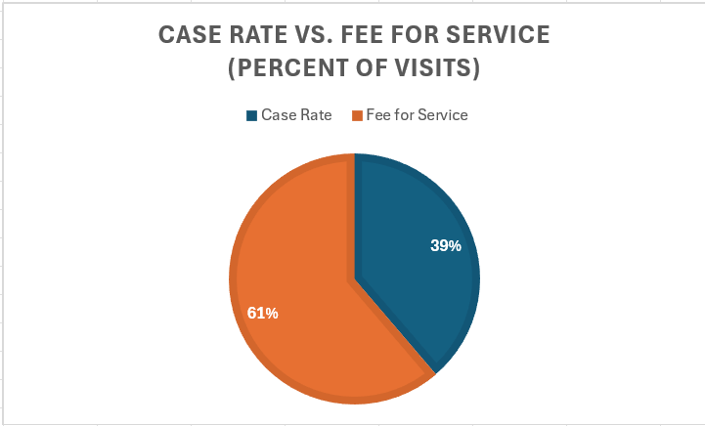
Reimbursement Model Distribution
Place of Service Billing:
--20 Urgent Care Center: 83% $145 NRV
--11 Physicians Office (PCP): 15% $133 NRV
--72 Rural Health Clinic: 2% $123 NRV
Case Rate vs. Fee For Service Distribution:
--Case rate payers range from <15% to >75% of covered lives depending on a state’s payer landscape, center payer mix, center place of service, age of contracts, etc.

Slide 14
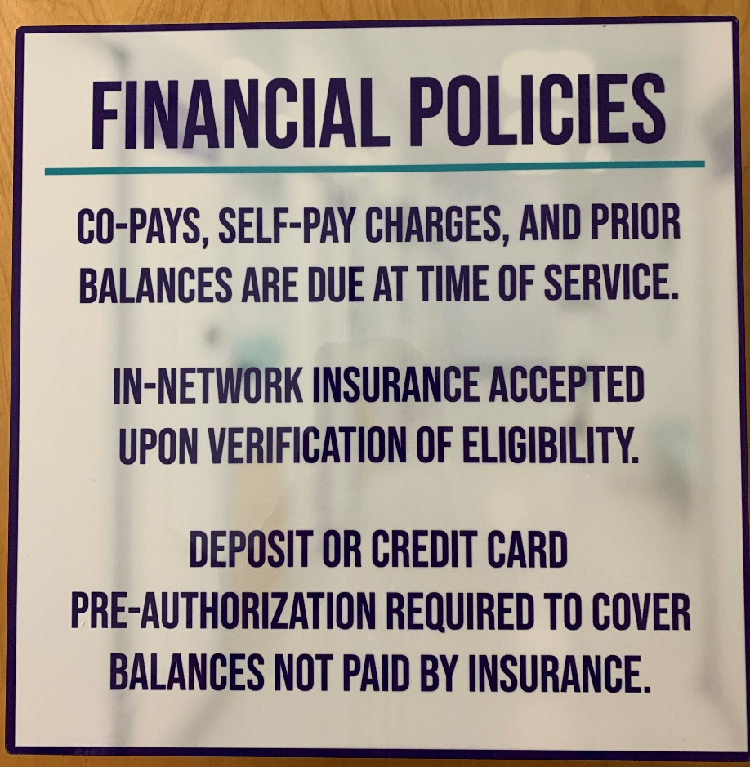
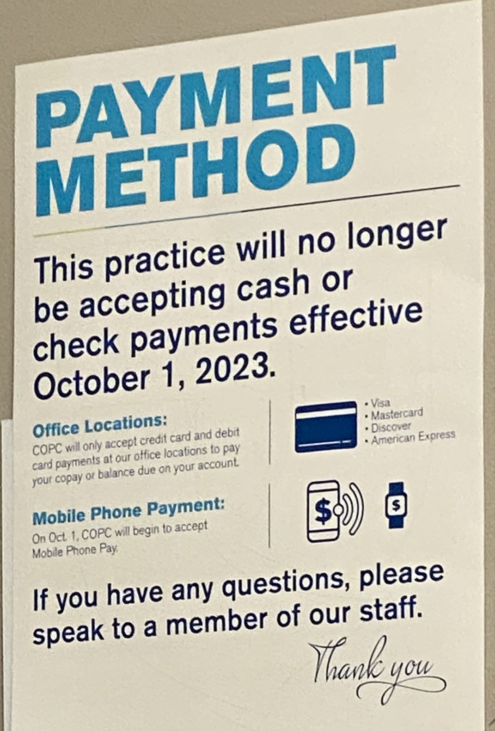
CFPB Regulation Prohibiting Credit Reporting of Medical Bad Debt <$500
Real-time eligibility does not provide a reliable “good faith estimate” especially when co-pays and deductibles are involved.
Enrollment in high deductible health plans is up to 65% of commercial enrollees.
Unmet deductible should be collected at the time of service.
CCOF provides a “catch-all” when patient financial responsibility cannot be determined.

Slide 15
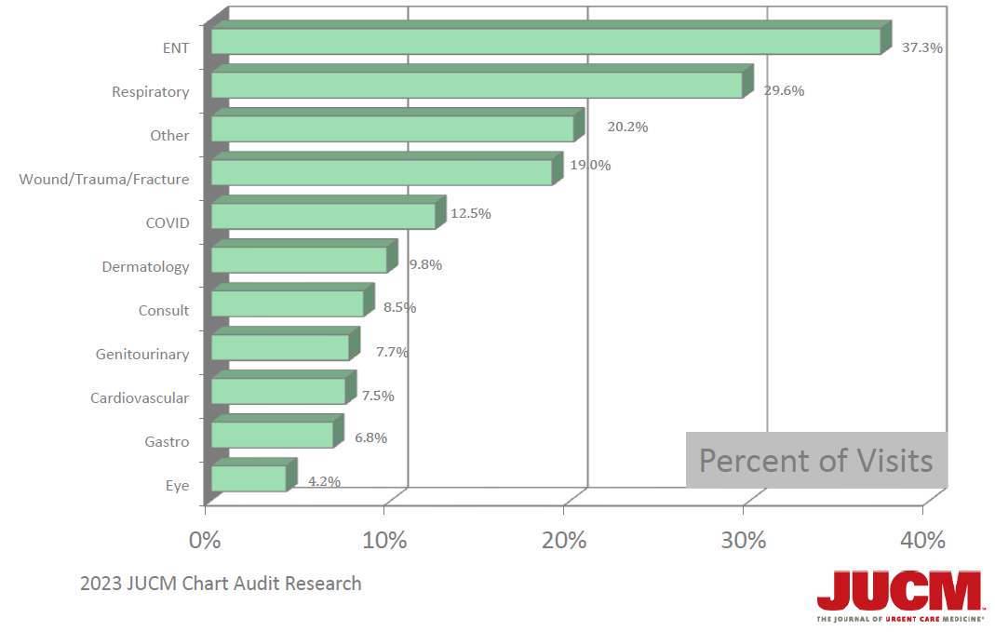
Diagnostic Code Groupings
Acuity degradation has resulted in a highly seasonal business, emphasizing upper respiratory, dependent on viral activity.

Slide 16
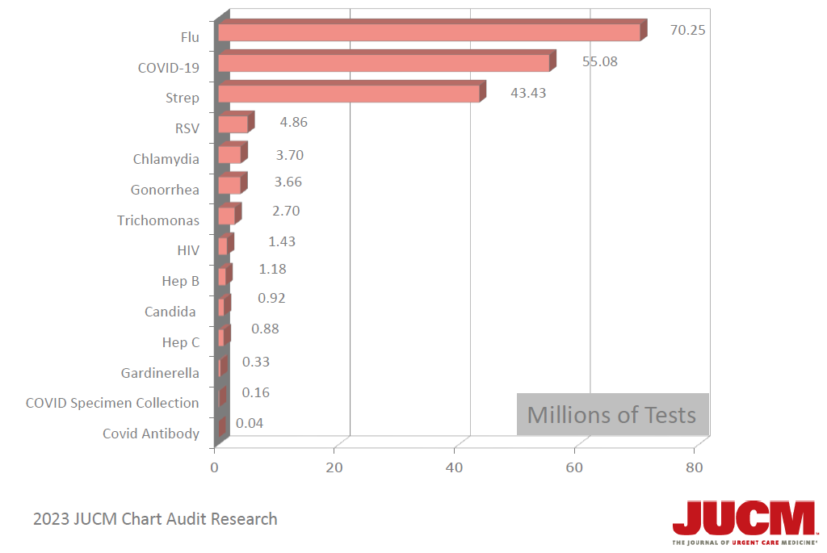
Respiratory Testing
The COVID-19 pandemic solidified urgent care’s positioning as “test and treat.”

Slide 17
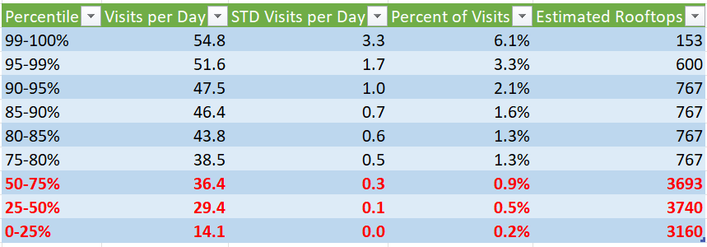
Rapid STI Testing Upside Opportunity

Slide 18
Urgent Care and Value-Based Care
“Urgent care” is transactional and episodic.
VBC is a primary care medical home concept.
Current VBC options for conventional urgent care are:
  Joint venture with health systems to participate in their ACO or shared savings contracts
  Clinically integrated network participation including Epic Community Connect
Urgent care with PCP (or vice versa) options are:
  Traditional VBC contracts through ACOs or directly with payors.
  Partnership with payors to provide primary care to all members.
To truly benefit from value-based care, an urgent care must incorporate a scope of primary care.

Slide 19
Urgent Care
Transactional
Acute
Episodic/Referral
Focus on Chief Complaint
Walk-in/Same Day
Case Rate/Facility-Based Contracts
Lab/X-Ray/Vaccines as Overhead
Emergency Medicine and Primary Care Specialties
Primary Care
Relational
Chronic
Longitudinal/Follow-up
Focus on Wellness/Prevention
Scheduled Appointments
Fee-for-Service: New (Annual Wellness Physicals) vs. Established (Rechecks)
Pediatrics, Family Medicine, Internal Medicine

Slide 20
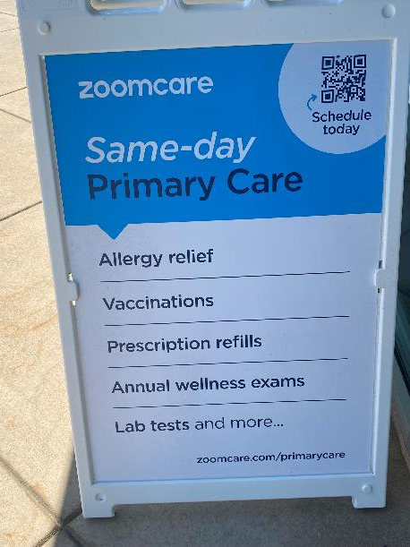

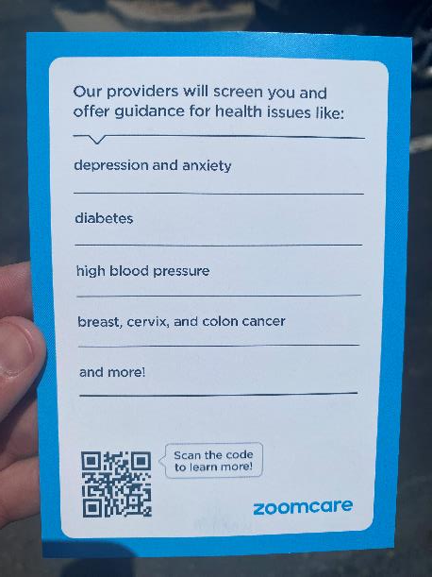
Primary Care “Lite” in an Urgent Care Setting

Slide 21
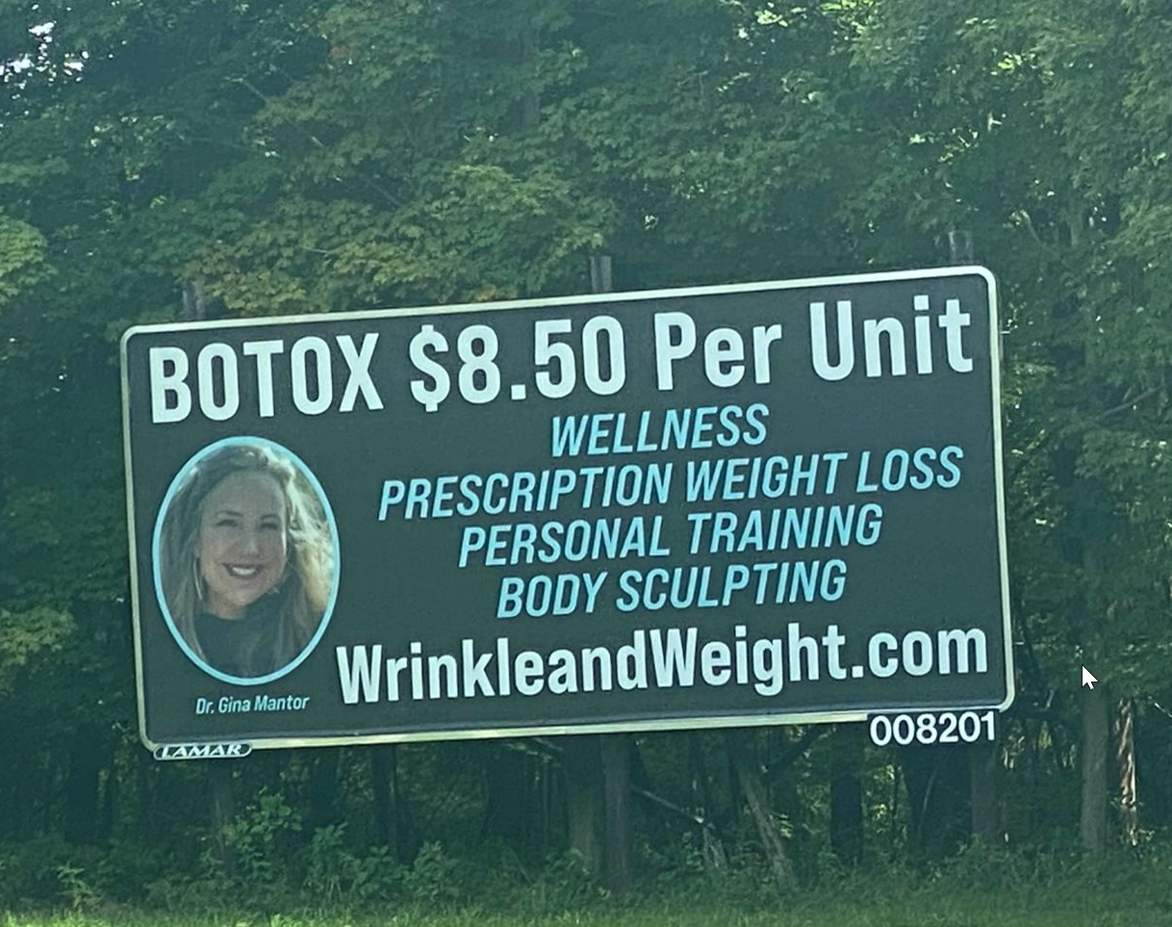
Challenge with Discretionary Services
Requires capital (debt) thus increasing risk, distracts management, complicates operations, and siphons marketing funds
Urgent care rarely as invested as well as focused, pureplay providers
Lowest cost provider by definition also means the least profitable provider.
Discretionary income limited by high inflation
Botox 40-50 units per session:
$6.22 per unit supply cost
$12.00 per unit average price
Range: $10.00 to $15.00

Slide 22
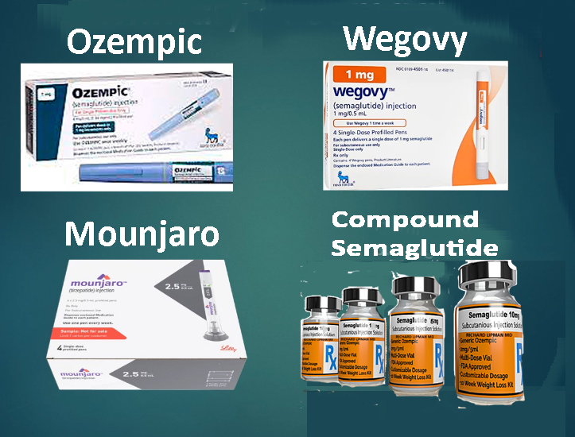
Weight Loss Drugs
Expensive medications not covered by insurance without co-morbid (diabetes) diagnosis.
Unreliable compounding pharmacy supply chain requiring more than one pharmacy relationship.
Pharma cease-and-desist against those using brand names.
Expensive pay-per-click PPC due to adword saturation from pharma, PCPs, diet clubs, out-of-state telemed providers, et. al.
Google flagging and suppressing websites, hurting the organic search of core urgent care services.
Social media algorithms flagging and suppressing mention of it.

Slide 23
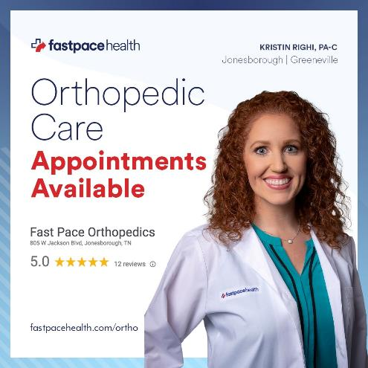
Specialist Services
Integrated behavioral health, dermatology, orthopedics, allergy
vs.
Behavioral health urgent care
Orthopedic urgent care
Dermatology urgent care
GI urgent care

Slide 24
Urgent Care Industry Takeaways
Rooftop growth in urgent care continues albeit it at a slower pace, more corporatized, and in rural markets
Payer case rates have resulted in a degradation of acuity and focus on provider efficiency
The result is a highly seasonal, volume-driven “test and treat” business model
Post-pandemic volumes have been flat, despite 20% wage inflation and collections challenges including COVID claw-backs, pre- and post-payment audits and increasing bad debt
Urgent care is challenged to fill excess capacity without disrupting throughput
Medicaid expansion and privatization brings back the original value proposition of “cost savings vs. ER”
Consumer-discretionary services have limited interest and competition from primary care, specialty and national telemedicine providers
The convergence of primary and urgent care will usher in new, value-based care payment models

