Slide 2
WELCOME
Revitalizing Business Through a Look at the Past

Slide 3

SPEAKER
Alan Ayers
President, Experity Consulting
Senior Editor, The Journal of Urgent Care Medicine

Slide 4
25 Years of Profitable Urgent Care Growth
Physician
Entrepreneurs
Local
Multi-Site Scaling
Platform Rooftop
Growth
OPPORTUNISTIC
COVID EXPANSION
New/New/New/
New/New
Core
Mid-Market
Enterprise
Ultra-Enterprise
Lifestyle and Investment
Scale Economies
Enterprise Value
Arbitrage on
P/E Multiple
Revenue and EBITDA
Growth
2009-2011
NextCare
MedExpress
FastMed
Cash
Flow
Private Equity, Institutional Debt and Operating Cash
Bank Financing and Operating Cash
Corporatization of Urgent Care
Hospital Equity Joint Ventures
Hospital Ambulatory and Medical Groups
Local Acquisitions
Integrated and Accountable Care Models

Slide 5
Post-COVID Growth Theses
New Patients
  Millions introduced to urgent care during the pandemic
  2/3 said they would return
New Locations
  Rooftop expansion continues
    More corporate, less hospital activity
  Resurgence of independent operators
New Geographies
  Fill-in of underserved rural and urban markets
  Strategic real estate — intercepting, flanking, boxing in competitors

Slide 6
Post-COVID Growth Theses, cont.
New Payers
  Medicaid expansion and privatization
  Value-based care and population health
New Services
  Specialist services
  Behavioral health
  Primary care
  Specialty urgent care
  Pediatric urgent care
  Occupational medicine

Slide 7
Today’s Challenges
REVENUE
Revenue = Volume x Rate
Payer reimbursement flat
Volume-driven business
Productivity vs. acuity
Respiratory dependence
High seasonal variance
LABOR
85%+ of operating costs
Fixed cost of skeletal staffing
20%+ wage inflation
Labor shortages (RTs)
Recruiting/retention challenges
Changing labor force (MAs/NPs)

Slide 8
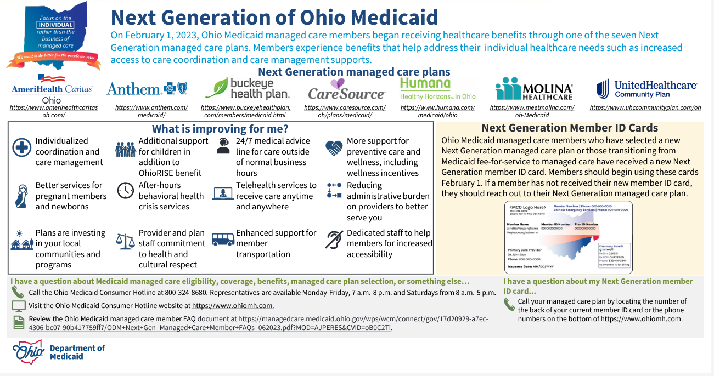
Back to the Future: Value Proposition
Urgent care started by Emergency Medicine physicians
85% duplicative of the emergency department
Cost savings to patients and payers
Case rate driving acuity degradation
Urgent care more expensive than:
  Primary care
  Telemedicine (85% duplicative??)
  OTC/self-care (self-limiting conditions)
Cost savings to Medicaid populations

Slide 9
Back to the Future: General Practice
Allergy
Primary Care: Manages chronic conditions and preventive wellness for a finite patient panel, based on a comprehensive history and physical.
General Practice: Diagnoses and treats common health conditions, referring to primary care and specialists as appropriate.
Urgent care refers millions in downstream revenue
  Sometimes “vapor,” for hospitals “contribution”
  Focus on referrals exacerbates acuity degradation
Urgent care instead as a “one stop shop”
  Integrating specialists
  Integrating primary care
  Integrating diagnostics
Behavioral Health
Dermatology
Orthopedics
Physical Therapy
Primary Care

Slide 10
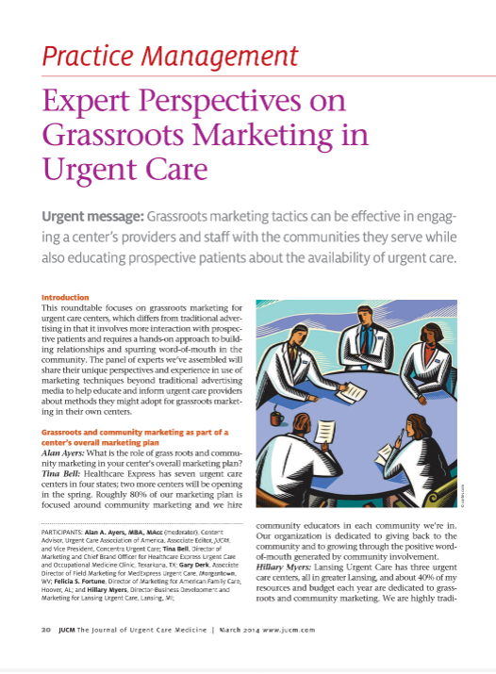
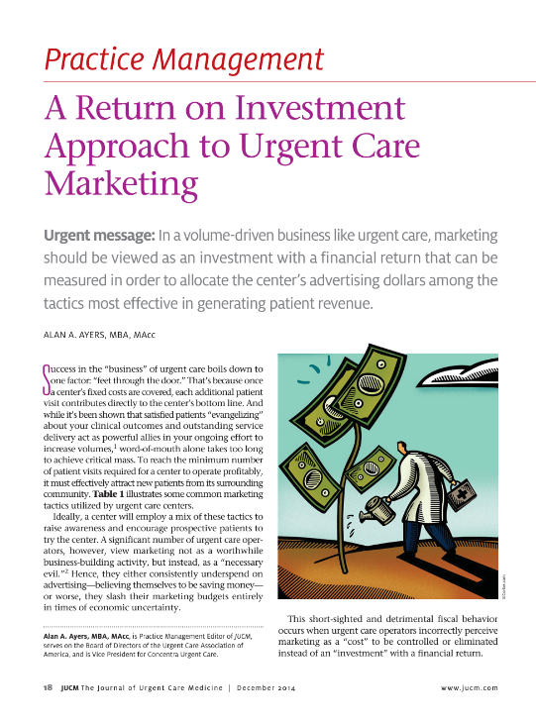
Back to the Future: Grassroots Marketing
Marketing is a scale economy in a large media market
Urgent care started with grassroots marketing
Targeted digital should level the playing field
Pandemic stay-at-home orders shifted marketing spend to digital
Bid-up of pay-per-click (SSM) by health systems, drug chains, national telemedicine providers, etc.
Return to highly localized tactics (events, sponsorships, billboards, etc.

Slide 11
Back Office Lead
Back to the Future: Staffing and Culture
Limited Scope X-Ray
Certified Medical Assistant
Issues recruiting and retaining MAs reduces provider productivity and culture.
“Unlicensed personnel” are not regulated — states enable physician ”delegation of medical tasks” unless otherwise specified.
MAs used to be developed by physicians, who hired selectively and developed over years of on-the-job training.
CMA qualification after attending accredited career college and externship or 2-3 years on the job and passing the national exam.
Vitals and Rooming
Front Desk

Slide 13


