Slide 1
WELCOME
2024 Urgent Care
Start-up Experience

Slide 2
START-UP DAY 1: Monday, February 12, 2024
11:00am Registration Opens (North Foyer) 12:00pm Day 1 Start-up Track Begins (Manchester G) 2:30pm-2:45pm Afternoon Break (Snacks, Soft Drinks) 5:00pm Day 1 Adjourns ALAN AYERS, PRESIDENT, EXPERITY CONSULTING heather real, senior consultant, EXPERITY CONSULTING Defining and Differentiating Urgent Care Services Evolution of the Urgent Care Industry Basic Economics of Urgent Care Centers Urgent Care Business Plan Development Urgent Care Pro Forma Financial Planning Recruiting and Scheduling Providers and Staff Urgent Care Considerations for X-Ray and Lab Occupational Medicine and Other Ancillary Services Grassroots, Online and Media Marketing Strategies Top Mistakes and Obstacles for Urgent Care Operators “Five News”: Planning for Urgent Care’s Future
START-UP DAY 2: Tuesday, February 13, 2024
10:00am Highly Effective Providers in Urgent Care BEN BARLOW, MD, CHIEF MEDICAL OFFICER, EXPERITY 11:00am Payer Contracting Process and Timelines BERNARD KINDELL, VICE PRESIDENT, CONTRACTING & CREDENTIALLING, EXPERITY 12:00pm LUNCH – MANCHESTER A/B 1:00pm Coding and Billing Fundamentals PHYLLIS DOBBERSTEIN, RCM COMPLIANCE MANAGER, EXPERITY 2:00pm Data-Driven Approaches to Site Selection JIM GARRETT, VICE PRESIDENT, NATIONAL URGENT CARE REALTY 3:00pm Lessons Learned in 30+ Years of Urgent Care DAVID STERN, MD, CHIEF EXECUTIVE OFFICER, EXPERITY 4:00pm START-UP TRACK ADJOURNS

Slide 3


Alan Ayers
President, Experity Consulting
Senior Editor, The Journal of Urgent Care Medicine
Heather Real
Senior Consultant,
Experity

Slide 4
Alan Ayers, MBA, MAcc
President, Experity Consulting
Alan Ayers has 18 years’ experience in strategic planning, business development, clinical operations, sales/marketing, and customer service for urgent care, occupational medicine, and primary care facilities.
Currently, Ayers serves as President of Experity Consulting, responsible for helping clients identify and cultivate new revenue streams while supporting the company's strategic growth initiatives. Ayers has consulted with independent, PE-backed, and hospital-affiliated platforms representing well over 1,000 units. He has also served as an expert witness in a landlord-tenant litigation involving urgent care.
From 2017 to 2021, while still part of Experity, Ayers served as Chief Executive Officer of Velocity Urgent Care, a venture of Sentara Healthcare, growing the company from 7 to 15 locations building a complete operating and administrative infrastructure, assembling leadership and management teams, migrating systems, optimizing the staffing model, acquiring the hospital's occ med practice, and implementing a values-based culture. In 2020, Velocity Urgent Care became the leading provider of COVID19 test services in its markets.
A prolific and award-winning writer, Ayers is Senior Editor of The Journal of Urgent Care Medicine (JUCM), and has contributed hundreds of original articles, blog entries and presentations on urgent care-related subjects. In 2018 he was co-author of The Health Care Executives’ Guide to Urgent Care and Freestanding EDs, Second Edition.
Ayers has served as Chief Operating Officer of OhioHealth Urgent Care and spent eight years in executive positions at Concentra including VP of Corporate Development responsible for acquisitions, divestitures, de novos, relocations, and major renovations.
For eight years, Ayers served the Board of Directors of the national Urgent Care Association (UCA), providing expertise and guidance on emerging issues; identifying market and regulatory trends; defining content, planning educational programs, and speaking at industry events. In 2019, he received UCA’s prestigious Lifetime Membership Award.
Ayers graduated Phi Beta Kappa from the University of North Carolina, has an MBA from the University of Mississippi, and a Masters of Accounting from The Ohio State University graduating first in his class.

Slide 5
Heather Real,
Senior Consultant
Heather Real has been helping operators startup their own urgent cares for over 10 years. She has contributed to over 250 rooftop projects all over the country.
Heather entered the urgent care industry as a consulting services assistant and quickly learned the intricacies of the urgent care industry. She leaned on her background in retail business management, client services, and operations optimization to assume primary responsibility for market research, financial planning, and preparing business plans.
Throughout the years, and having contributed to hundreds of unique projects, Heather has become an expert in urgent care development and operations. Today, she guides enthusiastic entrepreneurs through the journey of starting an urgent care, from site selection through financing, build-out, operations set-up and post-opening. She also assists with due diligence projects, and provides operational assessments and growth strategy development for existing businesses.
Heather has also contributed several articles to the Journal of Urgent Care Medicine on topics related to starting an urgent care. In 2023, Heather spoke at the Urgent Care Association Conference, analyzing the nuances of starting an urgent care in a new, post-pandemic environment.

Slide 6
Urgent Care History and Trends

Slide 7
25 Years of Profitable Urgent Care Growth
Physician
Entrepreneurs
Local
Multi-Site Scaling
Platform Rooftop
Growth
OPPORTUNISTIC
COVID EXPANSION
New/New/New/
New/New
Core
Mid-Market
Enterprise
Ultra-Enterprise
Lifestyle and Investment
Scale Economies
Enterprise Value
Arbitrage on
P/E Multiple
Revenue and EBITDA
Growth
2009-2011
NextCare
MedExpress
FastMed
Cash
Flow
Private Equity, Institutional Debt and Operating Cash
Bank Financing and Operating Cash
Corporatization of Urgent Care
Hospital Equity Joint Ventures
Hospital Ambulatory and Medical Groups
Local Acquisitions
Integrated and Accountable Care Models

Slide 8
Post-COVID Growth Theses
New Patients
  Millions introduced to urgent care during the pandemic, 2/3 of which will return
New Locations
  Rooftop expansion continues, although more corporate, less hospital activity
  Resurgence of independent operators
New Geographies
  Shift from the affluent suburbs to underserved rural and urban markets
  Strategic real estate — intercepting, flanking, boxing in competitors

Slide 9
Post-COVID Growth Theses, cont’d.
New Payers
  Medicaid expansion and privatization
  Value-based care and population health
New Services
  Specialist services
  Behavioral health
  Primary care
  Specialty urgent care
  Pediatric urgent care
  Occupational medicine

Slide 10
Urgent Care De Novo Growth

Slide 11
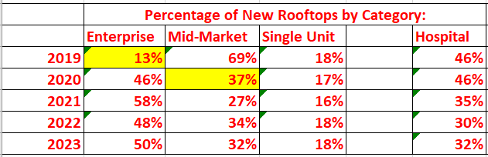
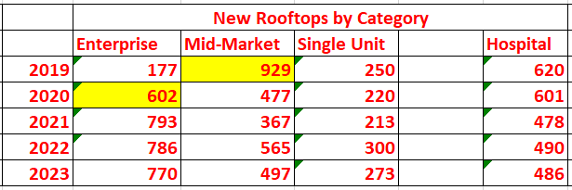
2023 Rooftops Added
1,540 new rooftops added in 2023
  50% are enterprise operators
    Since 2019, 10+ unit operators have driven urgent care growth
  32% are hospital affiliated
    Slowed post-pandemic but then stable (478-490/year) for the last 3-years
  18% of which are start-ups (new single unit operators added)
    Very stable as a percentage (16-18%) or ~250/year

Slide 12
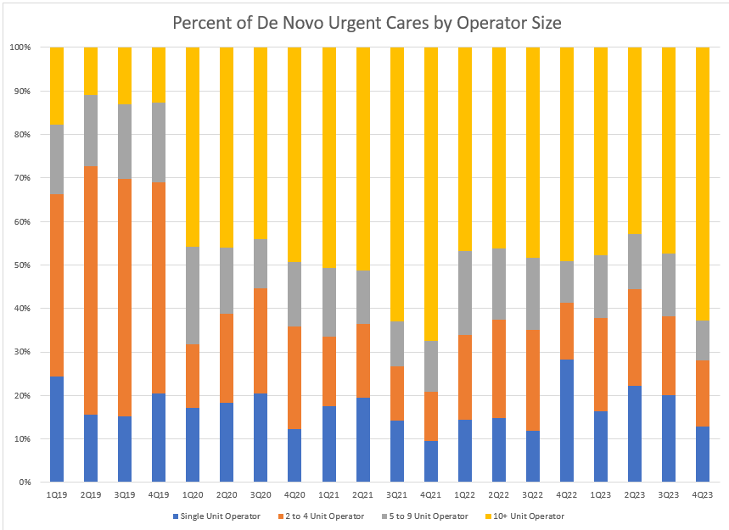
Year-Over-Year Change in New Rooftops
Enterprise has led de novo growth since 2020 although some reclassification of mid-market may have occurred as:
  Mid-market grew organically into enterprise
  Mid-market was acquired by enterprise
Structural shift from mid-market to enterprise as the industry growth driver was a one-time event in 2020 (not something that happened slowly over time)
  Mid-market more likely than enterprise to struggle with wage inflation, staffing challenges, flat reimbursement/payer audits and clawbacks, SEO competition, etc.
  Mid-market operations are large enough to have complex business challenges but too small to have functional expertise

Slide 13
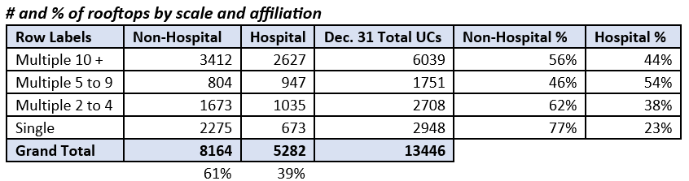
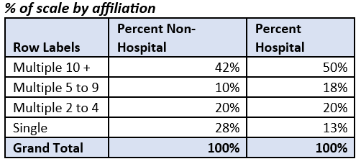
Percent and Count by Health System Affiliation
    NUCR Database (1/31/2024):
    5,282 of 13,446 traditional/limited UC rooftops are affiliated with health systems
      39% of total rooftops
    Hospital UC growth is proportionally less than physician and commercial operators
      2022 50% of US hospitals lost money
      32% of new rooftops in 2023 vs. 46% in 2019
    Hospital operators tend to have more locations than non-hospital operators

Slide 14
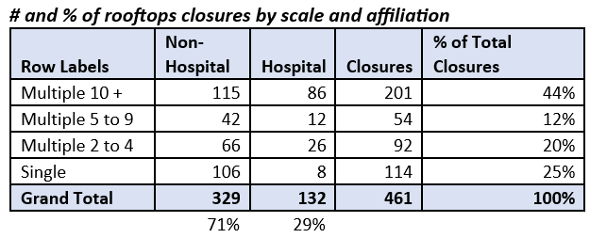
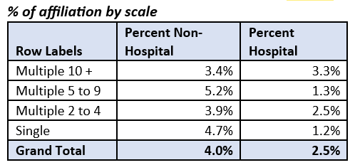
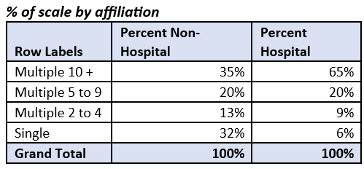
Urgent Care Closures
In 2023, 4.7% of non-hospital, single unit operators closed (only 25% of all UC closures)
Every year, D and F-grade urgent cares have closed
Data wasn’t tracked well prior to 2022
Closures slowed during the pandemic
Reasons for 2023 closures:
Enterprise M&A and rightsizing
Undercapitalized mid-market platforms
COVID opportunistic businesses
“Catch up” of D/F centers

Slide 15

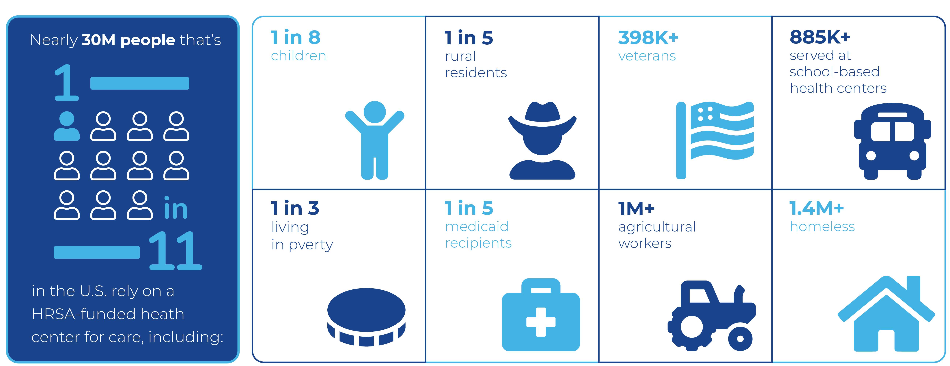
FQHCs and Urgent Care
Benefits
Expanding care to existing populations
Opening care to the community
Considerations
Attracting privately-insured patients along with underserved populations
Accessing grants and other funding opportunities to off-set startup capital

Slide 16
Post-COVID Hangover

Slide 17
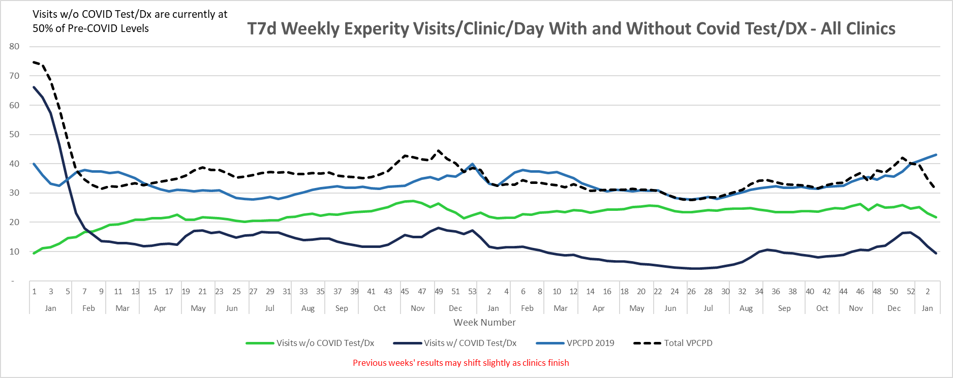
3-Year Volume Trends

Slide 18
 | “COVID Care” | “Urgent Care”
Strategic Focus | Must “bootstrap” operations back to pre-COVID performance with reduced revenues. | High-volume COVID testing augmented but did not replace “core” urgent care services.
Operating Hours | Reduced total hours of operations, particularly on weekends, due to staffing challenges. | Maintained “regular” operating hours.
Clinical Capabilities | “Downsized” services to focus on high-volume COVID19 testing. Turned away “higher touch” patients including those who may need an x-ray. | Retained full capabilities including laceration repair and non-surgical ortho. Found ways to assure x-ray was always available (PRN, on-call, travel RT.)
Clinical Staffing | Recruited “green” NPs with limited experience in procedures and uncomfortable with moderately acute patients. Attrition of rad techs without backfill leading to no x-ray during most hours of operation. Remained siloed in job duties. | Maintained “regular” staffing models (augmenting w/agencies when required) despite hiring difficulties and wage inflation. “Team” approach — cross-trained MAs to cover front desk. Providers willing to do MA work (i.e., intake, vitals, rapid tests.)
Marketing | Discontinued grassroots marketing to focus on SEO and AdWords for “COVID test near me.” | Continued marketing “core” services during the pandemic w/early return to grassroots marketing.
Occ Med | Discontinued sales of occupational medicine including maintenance of previous accounts. | Utilized rapid COVID testing as a way to establish new employer relationships.

Slide 19
Summary of Operational Differentiators
Strong operators who are highly involved, aware and visible in clinics
Maintained full “urgent care” capabilities and hours through the pandemic
Creatively staffing x-ray during all shifts, even when short-handed
Accepts patients up until posted closing hours with short visit times
Accepts all insurance including Medicaid to serve local covered lives
Pediatric focus appealing to “mom” as the decision-maker
Aggressive community marketing w/grassroots focus on schools
Brand conscious including conventional brand-building advertising
Follows population growth patterns for opportunistic rooftop growth

Slide 20
Urgent Care Economic Model

Slide 21
How to Make Money in Urgent Care
Run an Efficient Clinic (to Keep Staffing Costs Down)
See Lots of Patients

Slide 22
Basic Revenue Equation: Volume x Rate
Revenue = Volume x Rate
Rate = Reimbursement
  Some discretion in coding and services provided
  Rates largely set by BUCA payers (UC as an economic “price taker”)
  Case rates equalize reimbursement across visits
    but…may also reduce level of service
Volume = Daily visits
Controllable factors: real estate, marketing, patient ratings
Non-controllable factors: flu/COVID incidence, weather, market saturation

Slide 23
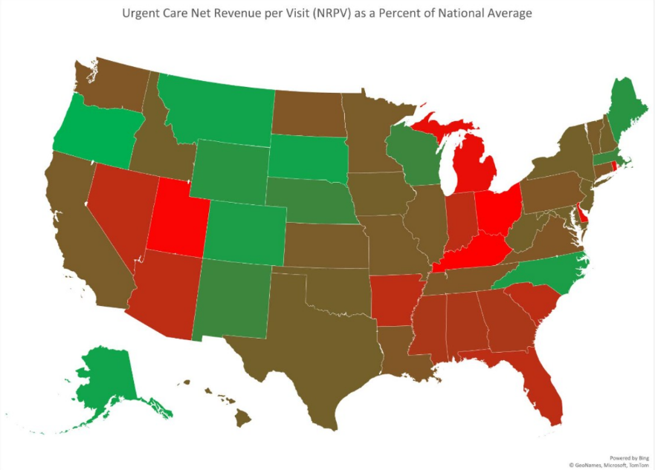
Net Revenue Per Patient: State Rankings

Slide 24
Urgent Care Economics: Staffing as a Fixed Cost
Variable costs — incurred only if a patient is seen
  Supplies
  Lab tests
  X-ray over-reads
  EMR
Operating Costs
  Fixed costs — incurred if no patients seen (levered across all patients)
  Labor, benefits, and payroll taxes are >75% of operating costs
  Center cannot operate without a skeletal crew (labor functions as a fixed cost)

Slide 25
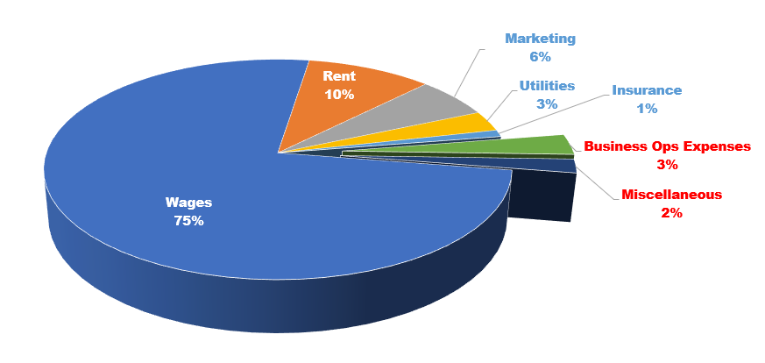

Slide 26
Urgent Care Economics: Volume-Driven Business
Once labor cost is covered, each incremental visit flows to the bottom line
Profitability is maximized by leveraging fixed costs across greater revenue
KPI is patients per staff member per hour
  Providers: 4 patients/hour
  Medical assisting: 2 patients/hour
  Front desk: 4 patients/hour
Most urgent care centers are operating well below capacity

Slide 27
Urgent Care Economic Considerations
Volume depends on strength, timing and duration of flu season
Prices are set by health insurance companies
High proportion of costs are subject to wage inflation
Excess labor capacity due to minimum staffing models
Excess labor capacity due to “on demand” ebb/flow (vs. appointments)
Excess labor capacity due to incremental labor problem

Slide 28
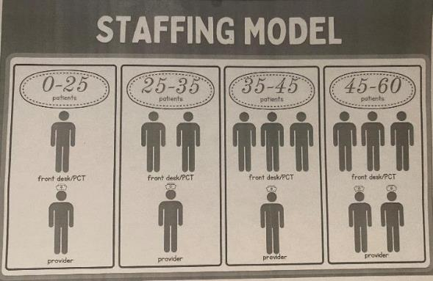
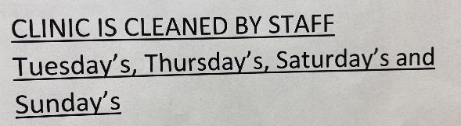
Lean Operations Start w/Labor
Patients register themselves (eReg)
Front desk “special projects” during off-hours (marketing, denials)
Cross-training front/back office
Utilize EMR to maximize provider efficiency
Providers do their own MA work

Slide 29
Urgent Care Business Plan Development

Slide 30
Economics of Starting an Urgent Care Center
Revenue = Volume x Rate
Population density and demographics
Market saturation
Availability of viable real estate
Closed or limited networks
Unfavorable reimbursement
Market study
Payer study

Slide 31
Pro Forma Elements
Revenue Formula
Expense Categories
+ Patient Charges for Medical Services
Contractual Allowances
Bad Debt Expense
= Net Revenue (per visit)
+ Dispensing Revenue
+ Occ Med (EPS) Revenue
+ Misc. Fees and Charges
Labor
  Staffing Model (MDs vs. PAs/NPs, MAs, RTs)
  Staffing Efficiencies to Patient Volume
  Increase Staffing as Volume Grows
Technology and Billing Services
Supplies
Rent and Occupancy Expenses
Marketing
  Grassroots, Paid Advertising
  Website, SEO, Digital Tactics
Purchased Services

Slide 32
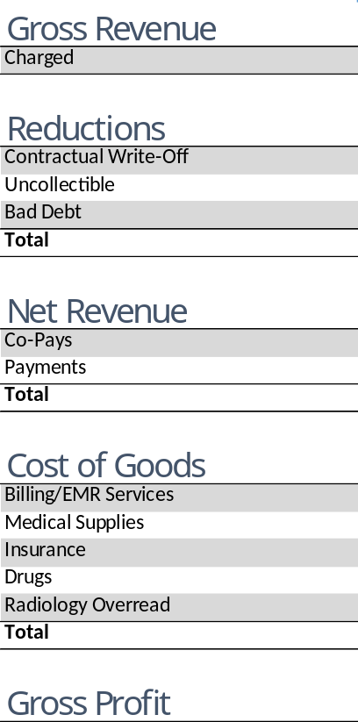
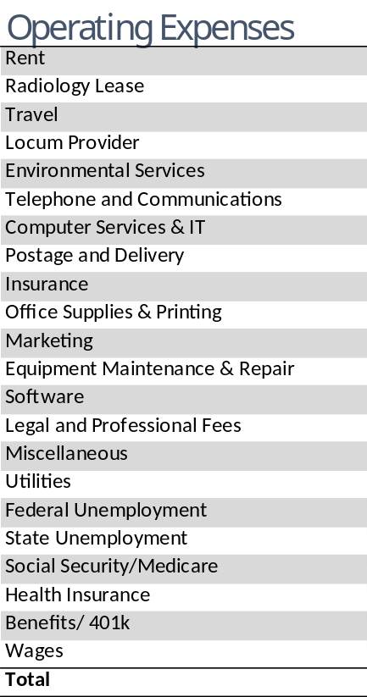
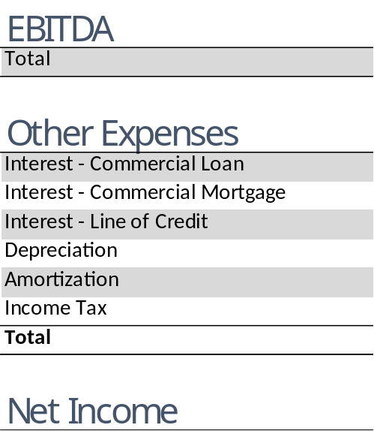
Pro Forma Assumptions

Slide 33
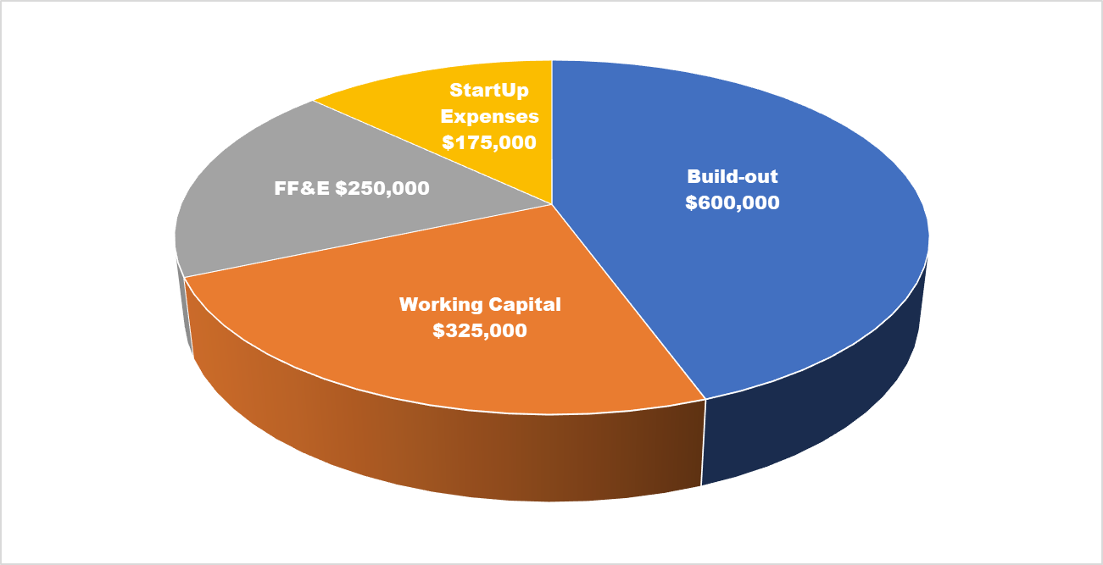

Slide 34
Urgent Care Development: Capital Required
Buildout costs $ * Square footage >>> $500-600K
FF&E >>> $250K
One-time startup expenses >>> $150K
Working capital >>> $300K
Total: $1.2+ M

Slide 35
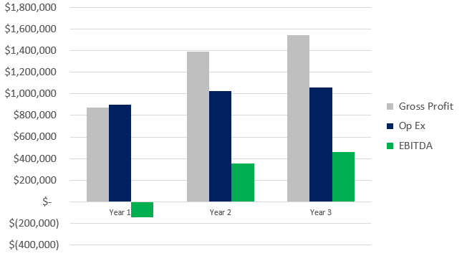

Slide 36
Urgent Care Development Process

Slide 37
Experity Consulting Phases
Contracting and Credentialling
Revenue=
Volume x Rate
Market Analysis
Site Selection
Pro Forma
Business Plan
Architect
Build-out
Clinic Set-up
Operations
Algorithm
Payer Landscape
Operating Model
Staffing Plan
Cash Flow Modeling
Bank Financing
X-Ray
Network Phone/Internet
Furnishings Fixtures & Equipment
Lab
Policies & Procedures
Supplies and Services
EMR/RCM
Recruiting and Onboarding

Slide 38
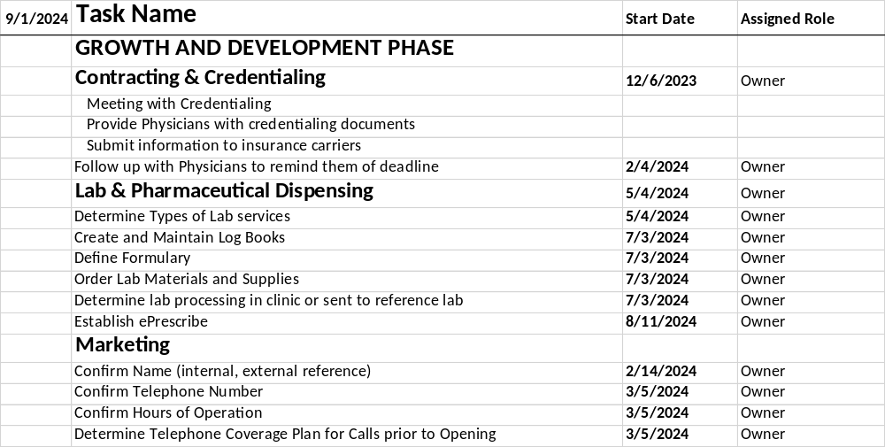
Start-up Pro

Slide 39
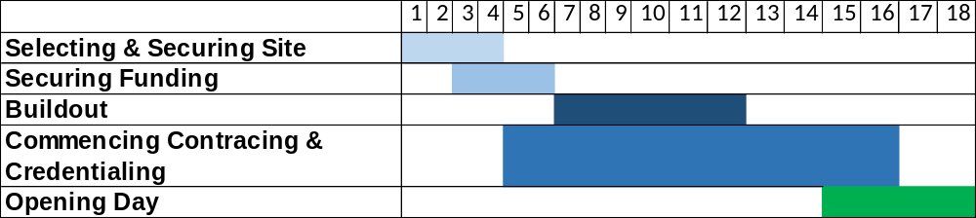
Start-up Critical Path and Timelines
Securing site: 3-4 months
Obtaining funding: 2-3 months
Commencing build-out: 4-6 months
C&C and getting in-network with major payers: 10-12 months
Clinic set-up, supplies, hiring, training,
technology configuration, compliance, etc.
Opening Day — 12 to 14 months

Slide 40
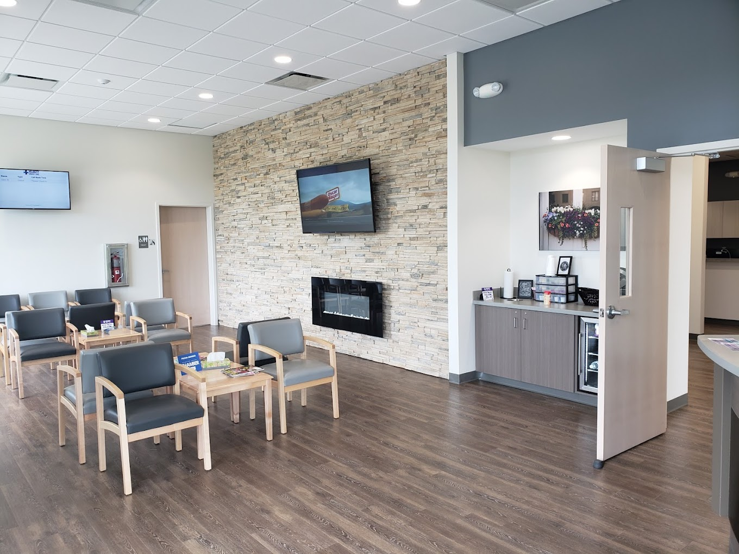
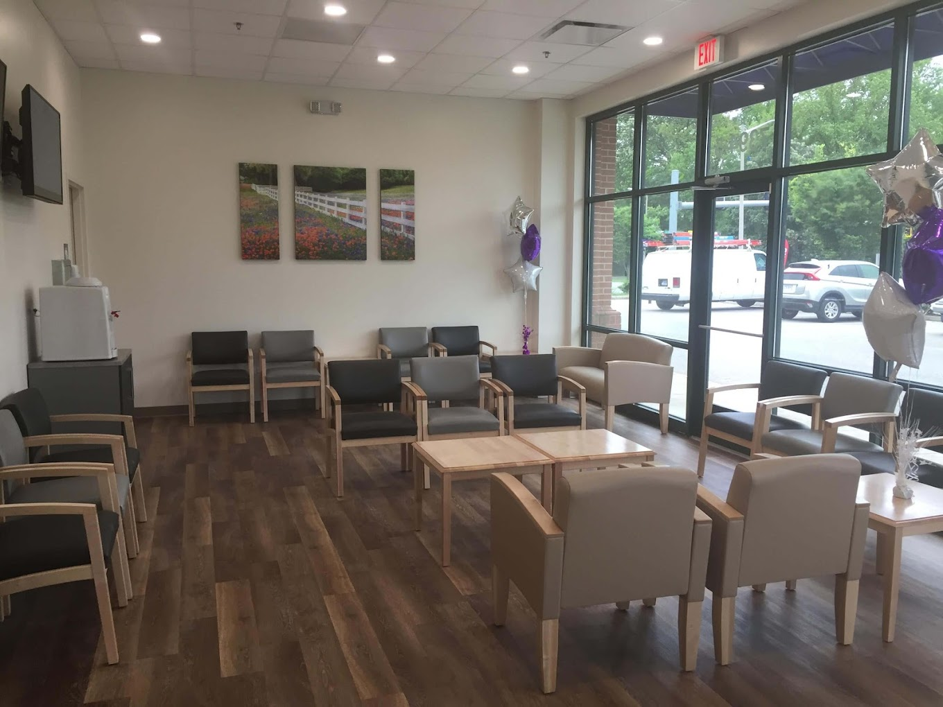
Value-Engineering Urgent Care Centers

Slide 41
Urgent Care Services and Acuity

Slide 42
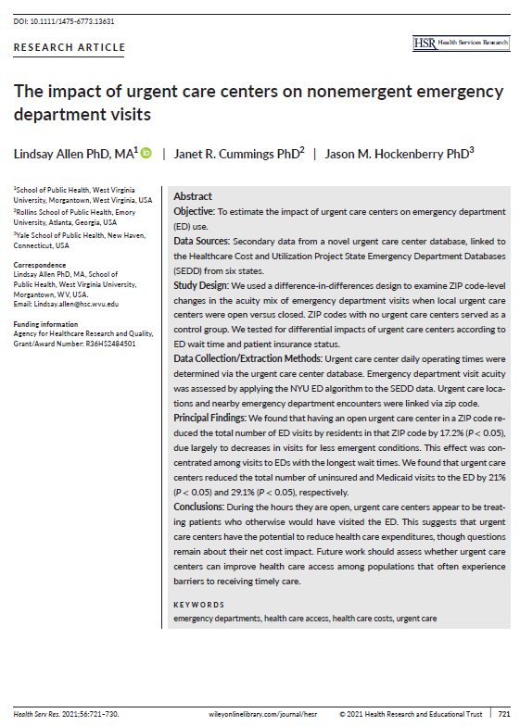
Urgent Care Impact on Nonemergent ER Visits
When urgent care is present in a ZIP code, it;
Reduces Medicaid utilization of the ED by 30%
Effect is magnified by a factor of 10 when the ED has long wait times
Greatest cost savings of UC (vs. ED visits) is with Medicaid and uninsured populations.
The ”new drivers” of UC revenue would be:
  A shortage of local PCP access
  Longer-than-average wait times at the local ED
  A prevalence of Medicaid populations
  Adequate reimbursement of UC visits by Medicaid

Slide 43
Degradation of Acuity in Urgent Care
Confuses patients as to services offered
Makes urgent care more dependent on flu seasonality
Reduces value proposition of urgent care to payers
Makes urgent care less competitive vs. other options

Slide 44
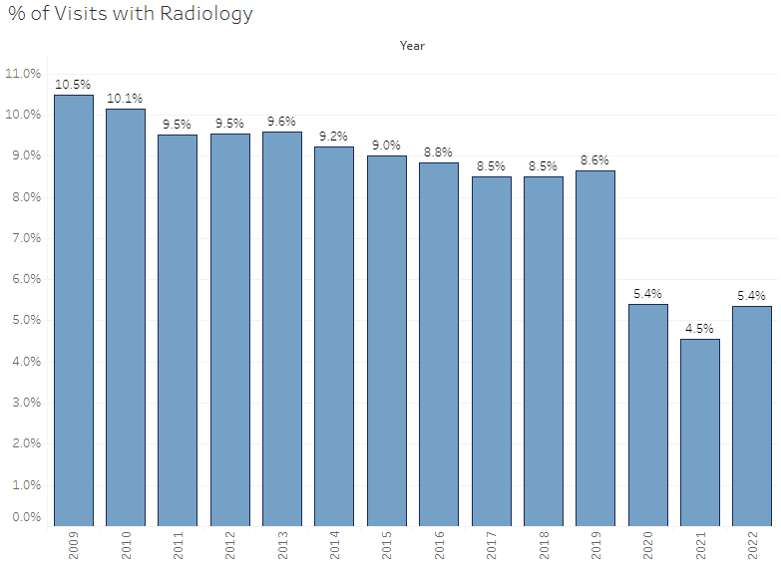
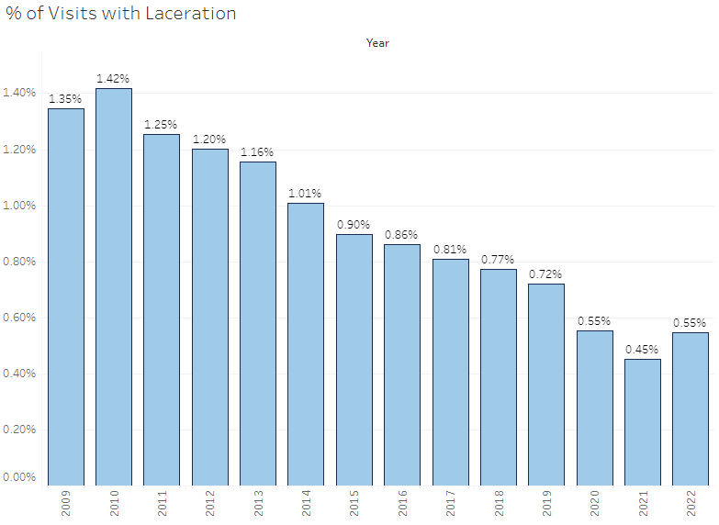
Acuity Degradation: Radiology and Laceration

Slide 45
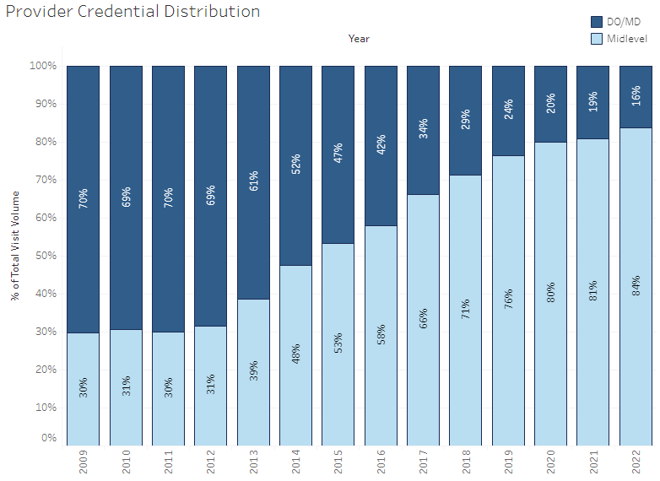
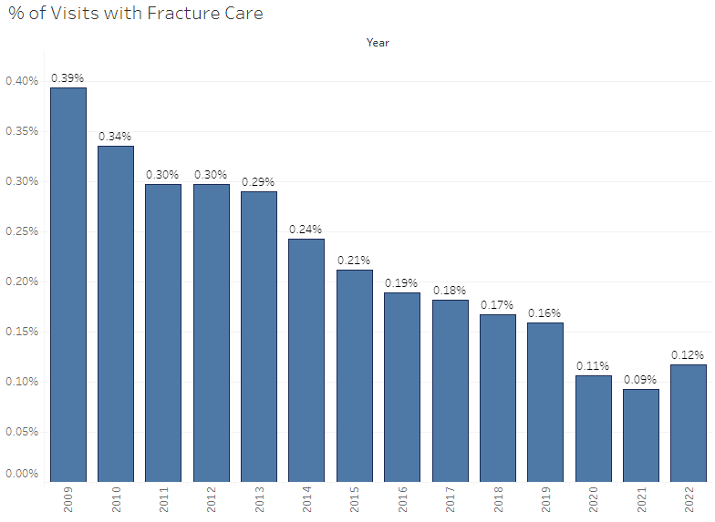
Acuity Degradation: Provider Type and Fracture Care

Slide 46
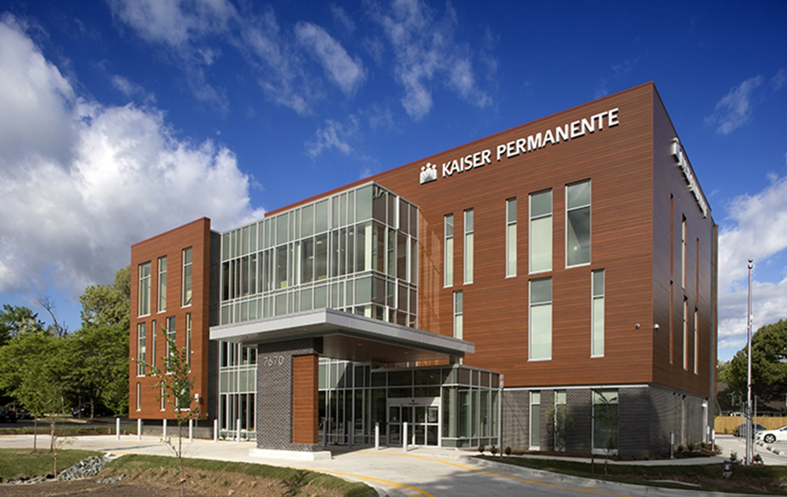
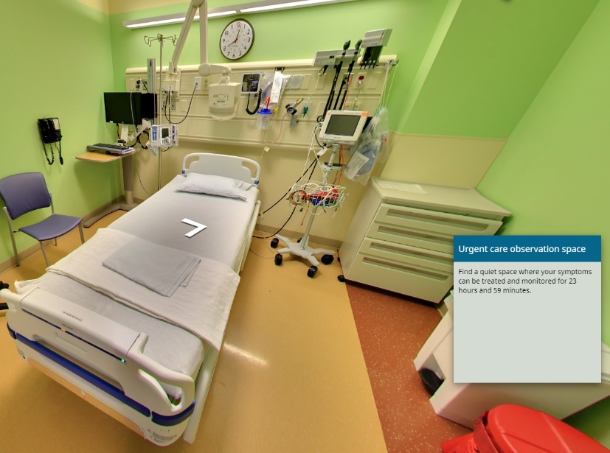
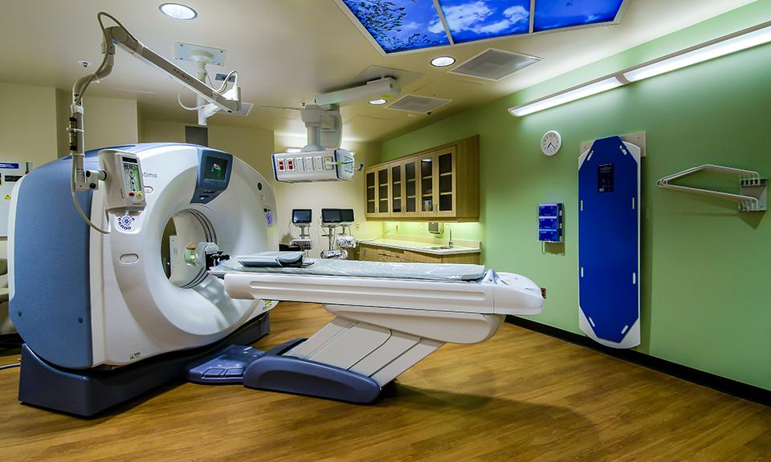
High Acuity Urgent Care
Shift in focus from maximizing fee revenue to preserving the premium dollar.

Slide 47
Primary Care and Urgent Care

Slide 48
Core Operator Positioning
General Practice NOT Primary Care
Primary Care
Pediatric and Medicare populations
Micromanaged by insurance
Form and protocol-driven
Gatekeeper for coordinated care
Risk/capitation models
General Practice
“Whatever ails you”
Consumer-driven “front door”
Specialist and facility referrals w/out follow-up
Fee-for-service reimbursement

Slide 49
Urgent Care
Transactional
Acute
Episodic/referral
Focus on chief complaint
Walk-in/same day
Case rate/Facility-based contracts Lab/X-ray/vaccines as overhead
Emergency medicine and primary care specialties
Primary Care
Relational
Chronic
Longitudinal/follow-up
Focus on wellness/prevention
Scheduled appointments
Fee-for-service: New (annual wellness physicals) vs. established (rechecks)
Pediatrics, family medicine, internal medicine

Slide 50
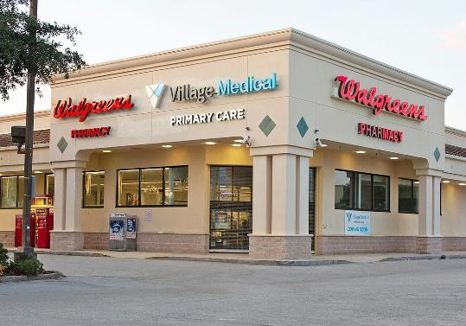
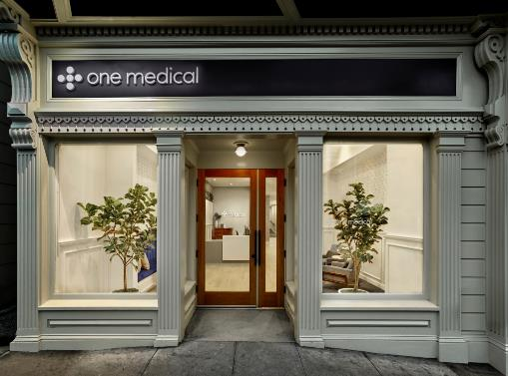
Primary Care
Parallel but separate line of business
Separate tax ID
Separate providers
Separate payer contracts
  Participation in managed care “risk”
  Capitation for carrying the chart
Scheduled appointments vs. on-demand
Defined as:
  Annual wellness exams
  Re-checks on chronic issues
  Preventive services
Requires connectivity to specialists and facilities
Everything else is “urgent care”

Slide 51
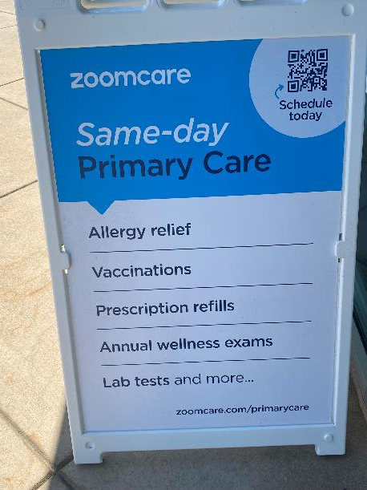
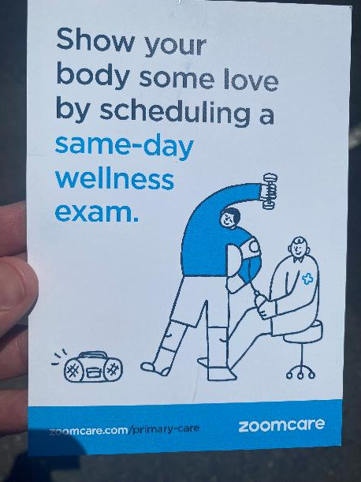
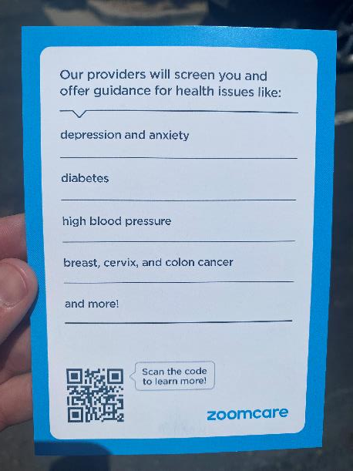
Primary Care in the Urgent Care Setting

Slide 52
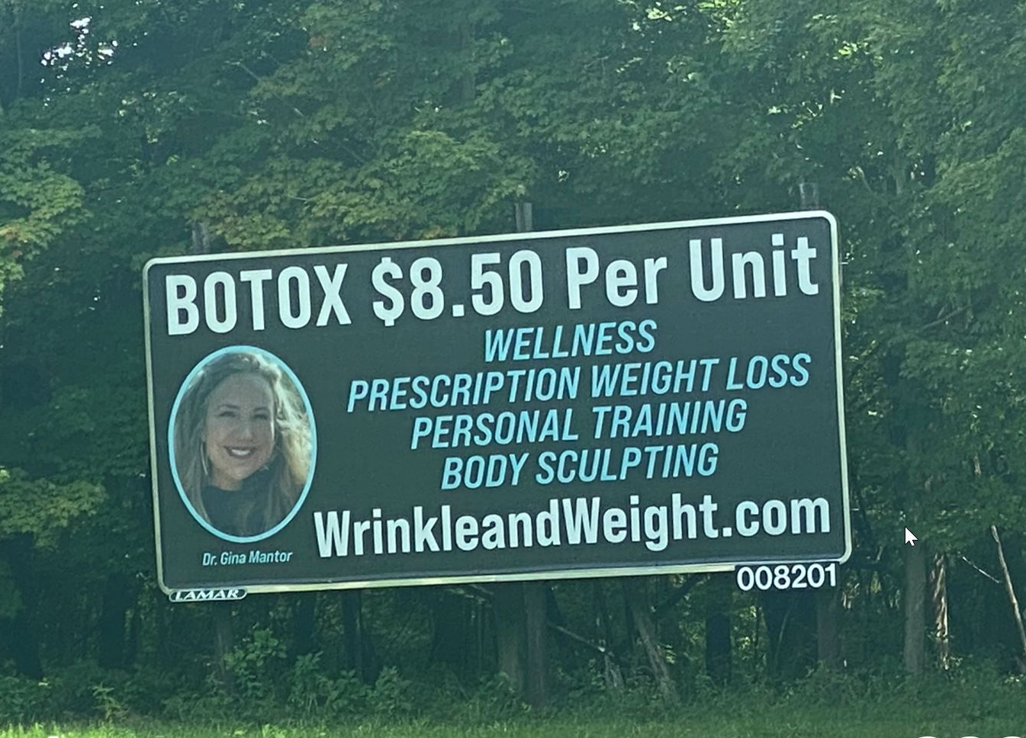
Challenge with Discretionary Services
Botox 40-50 units per session:
$6.22 per unit supply cost
$12.00 per unit average price
Range: $10.00 to $15.00
Lowest cost provider by definition also means the least profitable provider.

Slide 53
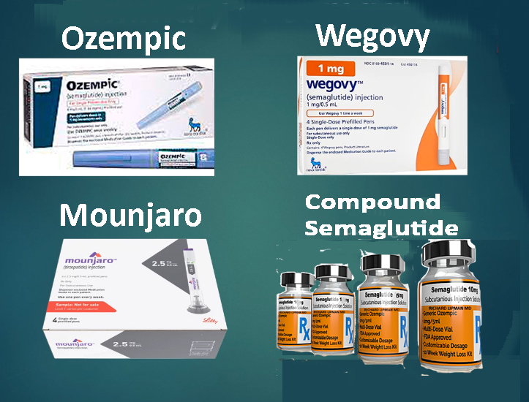
Weight Loss
— Compounding pharmacies are, in fact, having difficulty getting the ingredients, thus making supply unreliable and requiring a relationship with more than one pharmacy
— Lilly and Nordisk are cracking down on unauthorized use of their brand names including issuing cease-and-desist letters. According to the video, they've also tried (unsuccessfully) to sue the compounding pharmacies, which may be leading to the shortages above
— Google ad words have become saturated because of all the doctors offices, diet clubs, out-of-state telemed providers, et. al. competing for search, meaning that pay-per-click has become extremely expensive
— Google could flag and suppress your website if it has any mention of it, hurting the organic search of your core urgent care services. Social media algorithms reportedly likewise flag and suppress mention of it

Slide 54
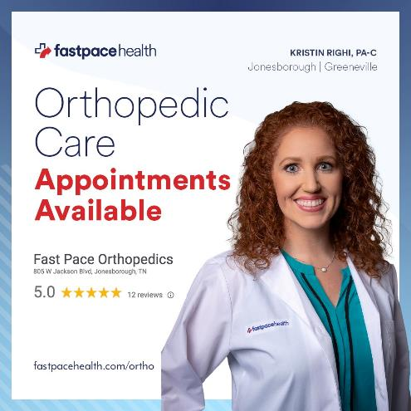
Specialist Services
Integrated behavioral health, dermatology, orthopedics, allergy
vs.
Behavioral health urgent care
Orthopedic urgent care
Dermatology urgent care
GI urgent care

Slide 55
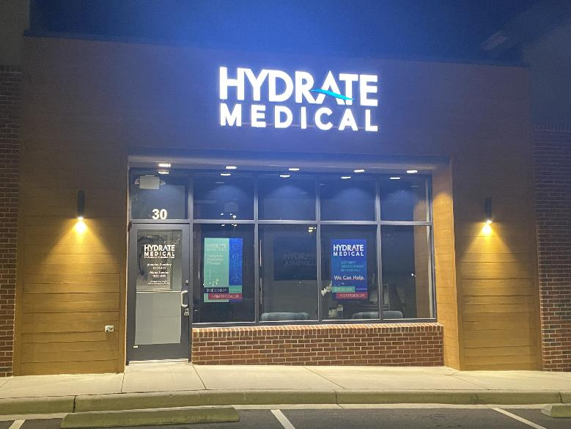
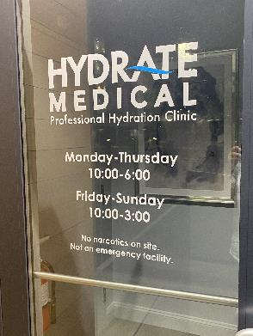
IV Services
Medical hydration*
Vanity/vitamin blends
Ketamine
Hydration for hangover or endurance
Pharmaceutical infusions
*Required per UCA Certification

Slide 56
Urgent Care Operations

Slide 57
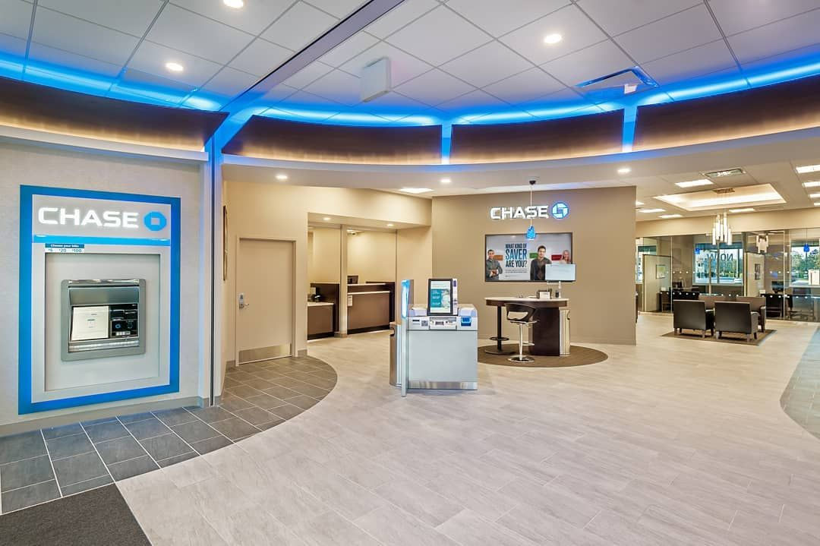
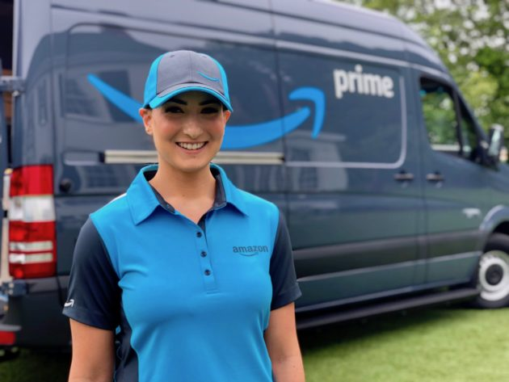
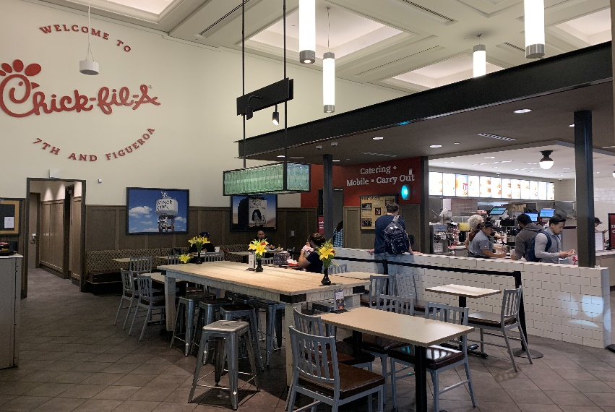
Patient Experience
Urgent care’s “reference point” is not the doctor’s office or emergency room.
Patients demand the same level of:
  Access
  Convenience
  Price transparency
  Transactional ease
  Employee interaction
as they get with all other service providers.

Slide 58
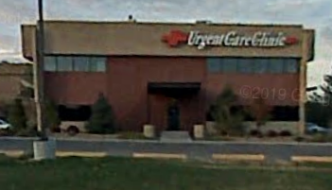
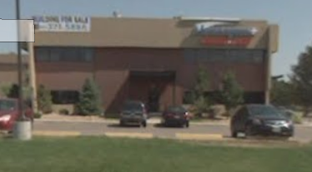
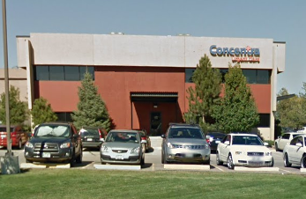
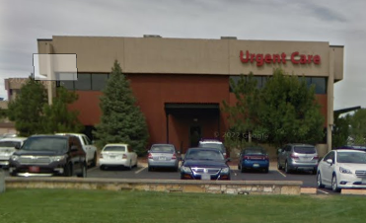
Developing a Meaningful Brand
A “commodity” in the “sea of sameness”
Loyal to a location or provider not a “brand”
Loyal patients have more frequent utilization
Think of “differentiated” retail experiences:
  Chick-fil-a
  Starbucks
  Apple Store

Slide 59
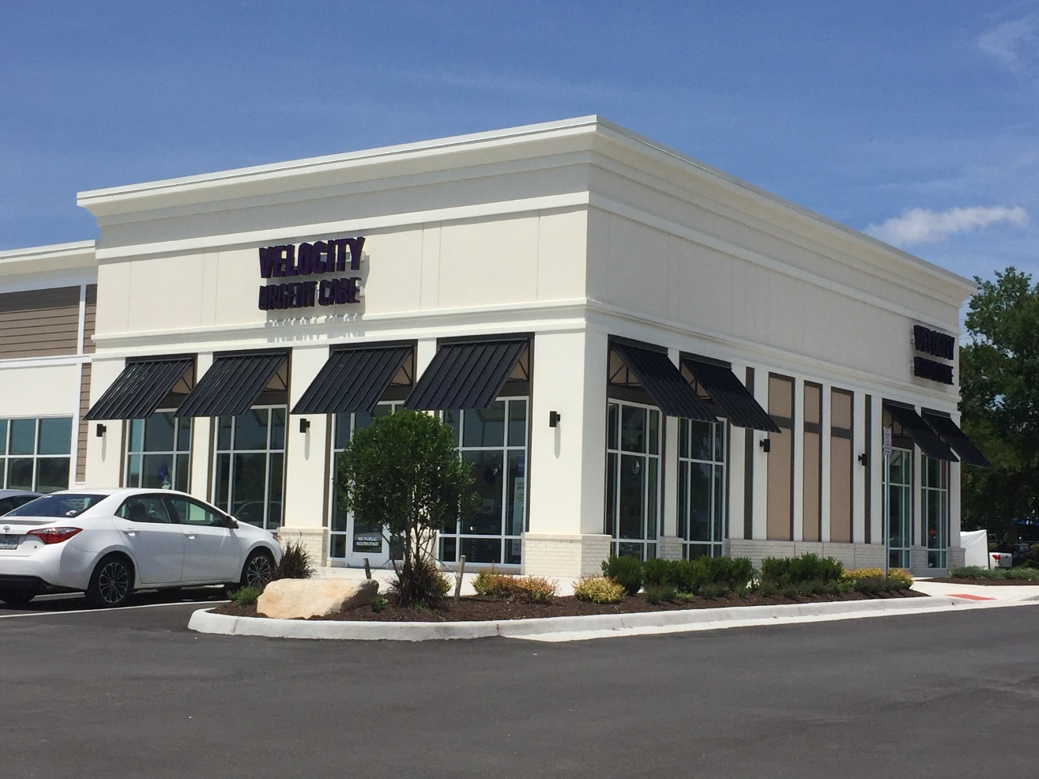
Operational Excellence
Guiding principles:
  No wait
  No waste
  No hassle
Achieved through highly optimized processes
  Boosting patient throughput
  Eliminating unnecessary administrative burden
  Identifying and correcting errors, friction points, and bottlenecks

Slide 60

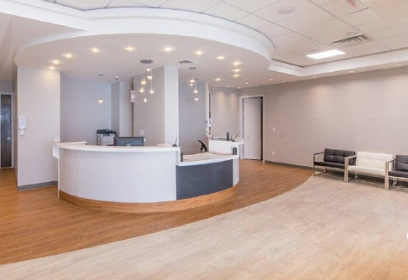
Branded Patient Experience Destinations
Scalable and Predictable Operating Model:
Consistent (every day, every patient, every provider, every site)​
Repeatable (process-driven, standardized operating procedures, facilitated by technology)​
Measurable (KPI focused with incentives)​
Accountable (team-oriented with shared values and culture)
Predictable (pro forma and budget are reliable)

Slide 61


Continuous Improvement
Focus on getting it right the first time to eliminate costly and timely re-work
Realize that processes become “jury-rigged” over time
Utilize key performance indicators to identify changes in underlying processes
Constantly engage the team in:
  Making the operation more efficient
  Removing non-value-added tasks
  Upgrading the level of patient experience

Slide 62


Employee Engagement
Start with the “right” people who are “bought in” to the company’s purpose and culture
Define the “values” — frames how all business decisions are viewed
Cultivate “bottoms-up” ownership with opportunity to share opinions, insights and ideas
Tie “rewards,” including formal incentive programs and informal recognition (gratitude,) to desired business outcomes

Slide 63

Focusing on the “Right Things”
Differentiation on what’s important to the patient
  “Being different” doesn’t matter if the patient doesn’t realize it or care
Engagement around the patient, providing quality care and moving patients through quickly
  Engagement” with the team or organization doesn’t matter if it doesn’t manifest in patient interactions
Technology that reduces friction and creates efficiency leading to better patient experiences and outcomes
  “Technology” should seek to solve a business problem, not the other way around

Slide 64
Front Office Policies

Slide 65


Slide 66
Cash-only Urgent Care?

Slide 67

Cashless Urgent Care?

Slide 68

Credit Card Pre-Authorization
Enrollment in high deductible health plans is up to 65% of commercial enrollees
Unmet deductible should be collected at the time of service
CCPA provides a “catch-all” when patient financial responsibility cannot be determined
Enables third party to pre-approve a charge amount for a set period of time
Is not a “hold,” doesn’t entail storing credit card information, and does not affect available credit
Accelerates collections while saving patients the hassle of writing and mailing a check

Slide 69
Urgent Care Marketing

Slide 70
Pre- and Grand Opening Marketing
Selecting a name
  C&C – “urgent care”
  Legal vs. d/b/a
  URL
  SEO
  Signage
Designing a logo
Developing a website
Google Business Profile and social media
  Set-up and maintenance
Direct mail
Chamber of Commerce
  Ribbon cutting
  Opening “family event”
Press release

Slide 71
Marketing and Advertising
Emphasis on guerilla and grassroots tactics versus a “digital only” strategy.
Deployed grassroots marketing (community liaisons) before anyone else including community events
“Guerilla” tactics like handing out flyers door-to-door and at a “temporarily closed” competitor
Outreach to school districts — athletic directors, school nurses, and special needs departments.
“Get in front of moms” — mom groups, social media, family events — focus on opinion leaders
Return to conventional advertising media like direct mail, billboards and TV advertising (SuperBowl)
Re-branding to become more contemporary and better stand out

Slide 72
Urgent Care Marketing Tactics
Brand Building | Patient Journey
Traditional ad tactics to achieve “top-of-mind awareness” for whenever a future medical need occurs. | Intervenes when a patient identifies a medical need, searches online for solutions, compares options, and leaves online feedback afterwards.
Billboards and transit ads Digital and analog radio ads Streaming video ads TV commercials Direct mail Print publications Email newsletters Social media engagement Text message marketing School and community events | Search Engine Optimization Robust website – keywords and content Google algorithm – focus on mobile and voice Google Adwords Gmail campaigns Facebook boosts Pay-per-click Remarketing platforms Geofencing campaigns Patient experience survey
Mix of digital, conventional media and grassroots tactics. | Primarily all digital tactics.

Slide 73

Integration of Digital & Non-Digital Tactics

Slide 76
Lab, X-ray and IT

Slide 77

Lab
CLIA Certification
Clinical Laboratory Improvement Amendments – federal regulations
Certificate of Waiver
  POC tests with “insignificant risk of erroneous result”
Costs and revenue of lab services
Managing equipment, tests, and testing supplies:
  Inventory levels
  Expiration dates
  Contracts and minimums
  Equipment
  Quality Controls
    Calibration and documentation requirements
Test types need to match certification level
  Research payer contracts to understand reimbursement

Slide 78
X-Ray
Required service for urgent cares
$50,000-$60,000+ for standard DR equipment
Wiring and lead-shielding - $40,000-$50,000
Understanding Reimbursement
Radiology services will not be independently profitable
Consider reimbursement, staffing expenses, and services spectrum for added modalities, i.e. ultrasound, CT

Slide 79
IT Requirements
Network/desktop/email/IT security support
  Internet runs into the center via cable
  Cable and Wi-Fi routers
  VoIP phones, camera and alarm systems
SaaS EMR/PM
SaaS Patient Engagement: Queuing, eReg, Survey
PACS for x-ray (teleradiology EMR integration)
HRIS or payroll provider, EE scheduling app
QuickBooks

Slide 80
Top Mistakes of Urgent Care Start-ups

Slide 81
Urgent Care Development Obstacles
Finding the “right” location
Payer contract availability and reimbursement rates
Having a physician on board (State CPOM laws, payer requirements)
Ability to obtain financing (SBA loan, savings, friends/family)
Vendor relationships (supplies, x-ray, lab) with urgent care experience
Attention to detail – workplan of required tasks
Facility floorplans and construction requirements
Policies and procedures, job descriptions

Slide 82
Urgent Care Start-up Mistakes
Mistakes in ownership structure
Not having a physician on paper (if needed)
  CPOM; APP collaboration; payer medical director requirement; SBA loan guarantor
Not understanding operations beyond the medicine
  “Retail” elements of the business; CC (not hospital, not independent); costs of doing business

Slide 83
Urgent Care Start-up Mistakes, cont’d
Mistakes in financial planning
Planning too little for capital expenditures
  Build-out, x-ray, other supplies and equipment
Not planning for adequate working capital
  Non-operational carrying costs
  Operational costs > revenue in early weeks/months due to volume ramp up and delay A/R maturation

Slide 84
Urgent Care Start-up Mistakes, cont’d
Mistakes in site selection
Not considering known indicators for success
  Ideal market benchmarks
  Site positioning

Slide 85
Urgent Care Start-up Mistakes, cont’d
Mistakes in operating systems execution and utilization
Not deploying appropriate resources to support operations
  Urgent care-specific platforms and service providers that can manage the nuances of urgent care:
    Fluctuations in hourly, daily, and seasonal visit volumes
    Episodic presentation v. scheduled visits
    Efficient supportive services — reference labs, supply ordering, x-ray over-reads, etc.

Slide 86
Urgent Care Start-up Mistakes, cont’d
Mistakes in operations
Not knowing what you don’t know
  Cash-only
  Compliance
  Flexibility
  Referring out good revenue
  Ancillary income
  Growing too quickly

Slide 87
Urgent Care Start-up Mistakes, cont’d
Mistakes in marketing
Not investing in and deploying successful marketing strategies
  Relying on word-of-mouth and referrals for volume v. site visibility/awareness, SEO, etc.
  Not putting urgent care first; promoting ancillary services over urgent care as core business
  Not diversifying strategies across multiple medium (digital, print, grassroots)

