Slide 1
Growing Profitable Revenues in a Maturing Urgent Care Industry

Slide 2

Alan Ayers
Presented by
President
Urgent Care Consultants

Slide 3
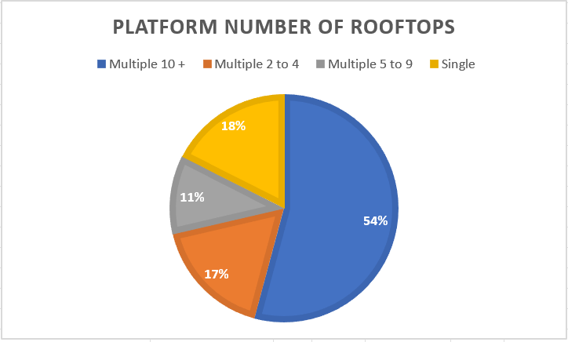
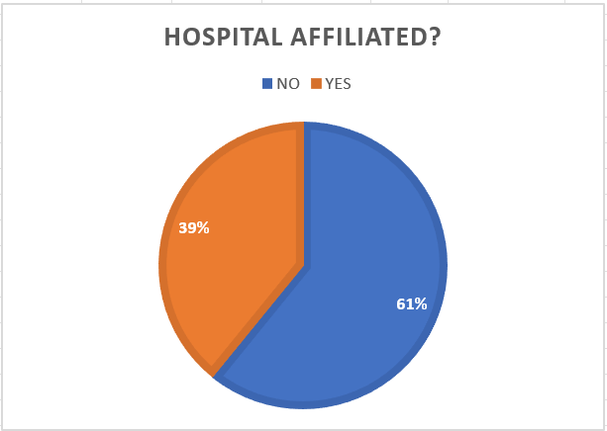
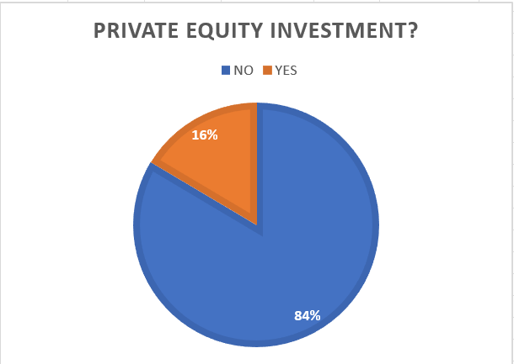
14,360 Urgent Care Centers in the United States
Source: National Urgent Care Realty, 6/26/2024

Slide 4
Urgent Care Investors Expect Revenue Growth
New Patients:
  Millions “new” introduced to urgent care during pandemic
  New populations (esp. pediatrics, rural)
New Payers:
  Medicaid privatization and expansion
  Cost savings from Medicaid ER diversion
  Rural Health Center designation
New Services:
  Primary care and specialist integration
  Set-up for value-based care innovation
  Ancillary services not relevant to the UC presentation
New Rooftops:
  Continued de novo growth (enterprise)
  Continued start-ups (independents)
  Need to relocate first generation centers
New Geographies:
  Rural and urban fill-in
  Changing traffic patterns and trade area definitions

Slide 5
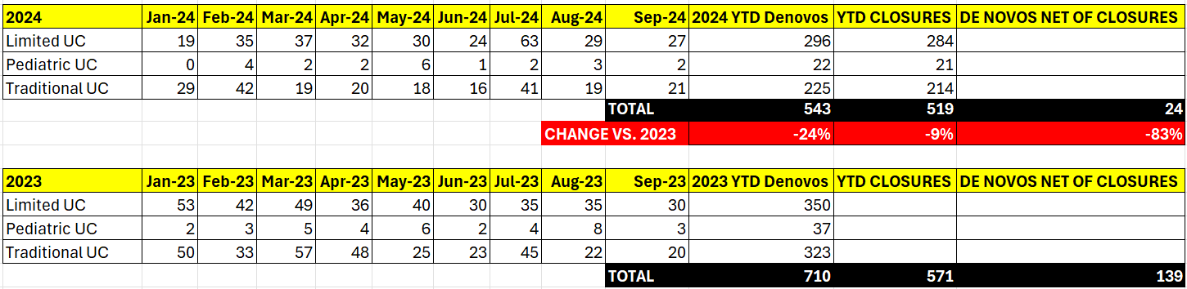
2024 YTD Urgent Care De Novo Growth
543 De Novos YTD in 2024 vs 710 in 2023.
2024 YTD De Novos are down 24% vs. 2023.
De Novos Net of Closures are 24 in 2024 vs. 139 in 2023.
2024 YTD De Novos Net of Closures are down 83% vs. 2023.
Source: National Urgent Care Realty, 9/30/2024

Slide 6
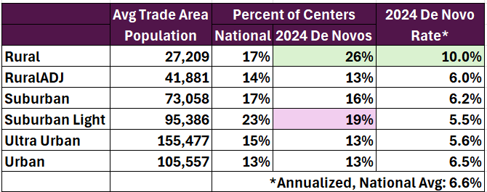
Rooftop Growth: First Generation Struggles, Rural Growth Leads
Changing retail trade areas and market saturation threaten first generation providers:
Up to 1/4 of first-generation urgent care centers could be considered for relocation
Understanding population growth patterns and shifts in traffic patterns and retail trade areas to add or relocate centers
Increasing need to flank, intercept, box in, and/or out-position competition
Rural urgent care is adding rooftops 40% faster than suburban while urban growth lags.
1/1 – 6/30/2024 National Urgent Care Realty Data

Slide 7
Growing Revenues Without Growing Profits is Simply Working Harder,
Not Smarter

Slide 8
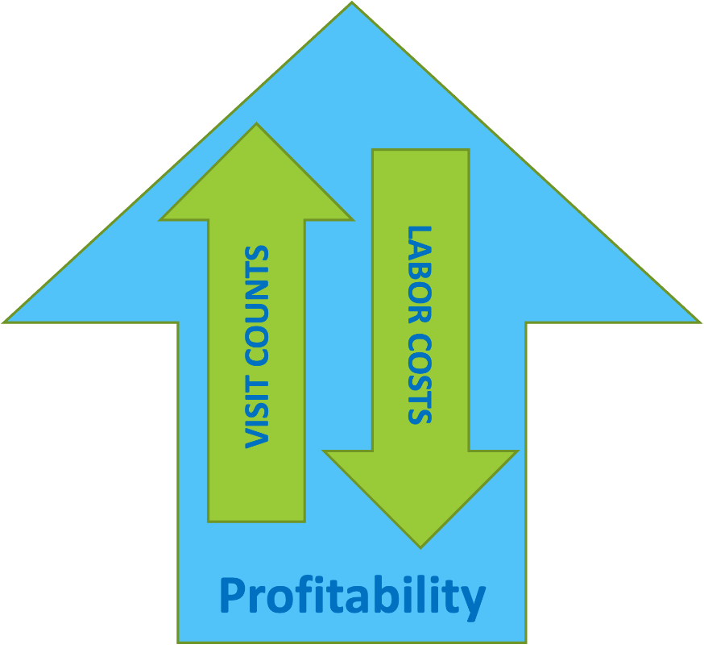
Basic Economics of Urgent Care
Revenue = Volume x Rate
Rate is limited by third-party payers
Labor entails 75-85% of expenses making skeletal labor a “fixed” cost
“Volume-driven” means once fixed costs are covered, each additional visit accrues to the bottom line
Profitability comes from maximizing provider and staff efficiency (patients per hour)
Greatest unreported cost is unused labor capacity

Slide 9
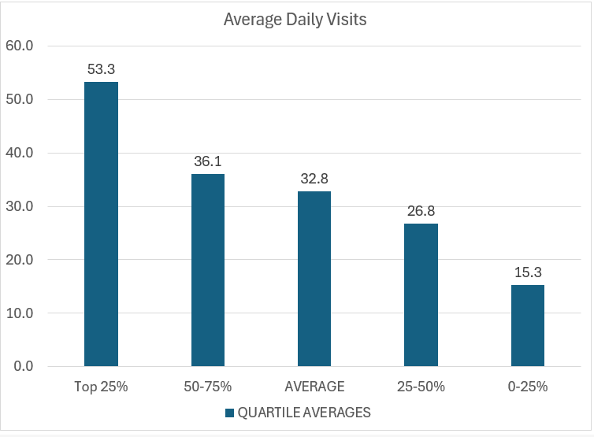
Surplus (Unutilized) Provider Capacity is the #1 Expense of Urgent Care Centers
Incremental scheduling conundrum.
(Patients per Hour per Provider)

Slide 10
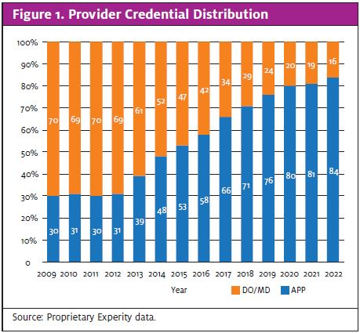
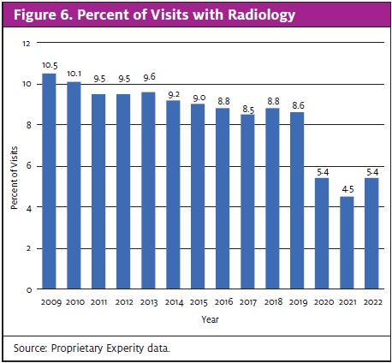
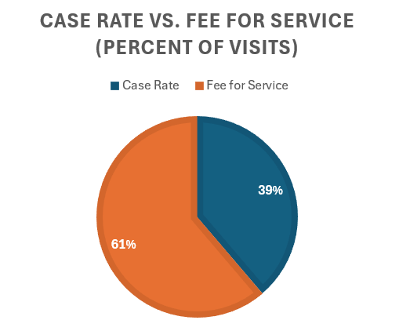
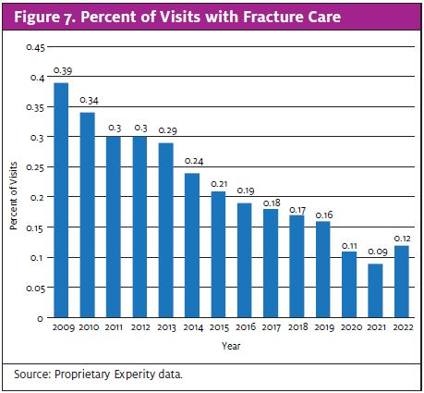
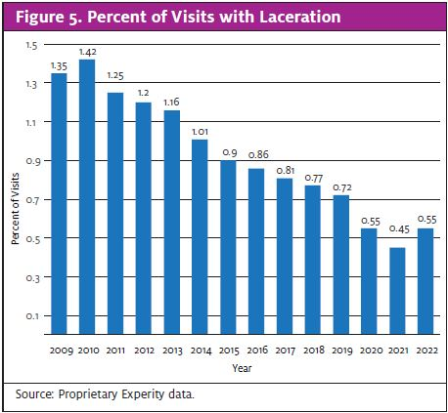
Case Rate Reimbursement and Acuity Degradation
Insurance case rates and a focus on patient-per-hour productivity have degraded the scope of care offered and diminished the value proposition of “cost savings vs. the ER.”
Case rate payers range from <15% to >75% of covered lives depending on a state’s payer landscape, center payer mix, center place of service, age of contracts, etc.

Slide 11
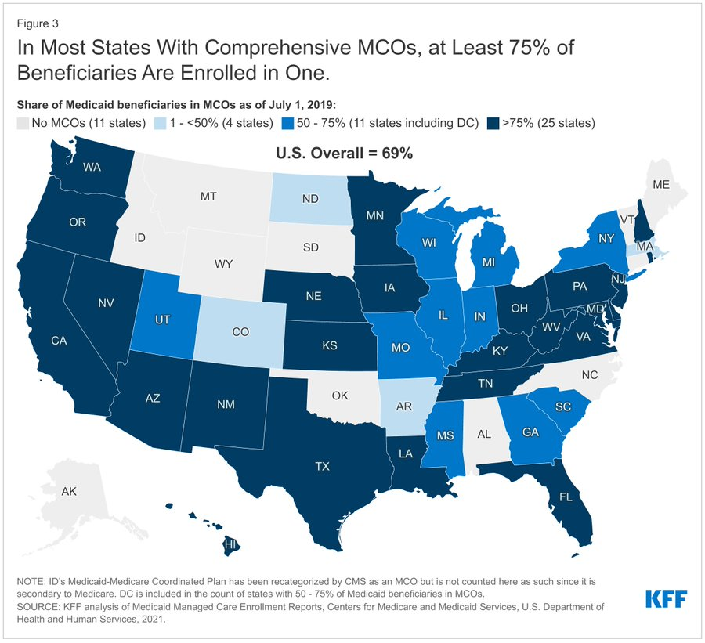
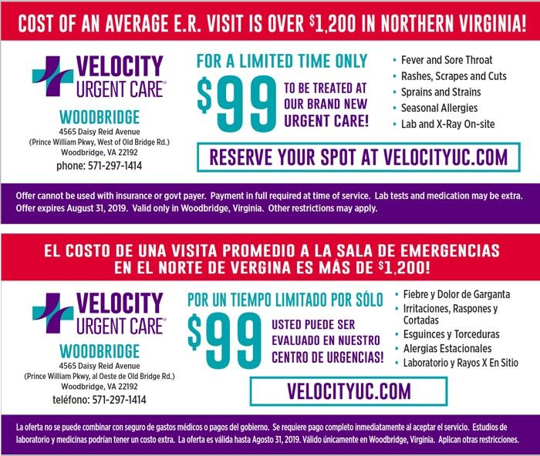
New Patients: Latinos Account 70% of U.S. Population Growth
Medicaid Expansion and Privatization:
By 2060, the US Hispanic population will reach 111M or 28% of the total.
In 2023, 58.5% of Latino children were covered by Medicaid and 19% of the US Hispanic population was uninsured.

Slide 12
Executing Well in the Urgent Care Business

Slide 13
Maintaining Full Urgent Care Capabilities and Hours
Augmented urgent care with COVID testing vs. redefining as high-throughput test-and-treat
Continued to treat higher acuity, procedures, ortho
Found ways to remain fully staffed and assure x-ray was always available
  Took a team approach to staffing
  Providers doing their own MA work (intake, vitals, rapid testing)
  Cross-training between front and back
COVID testing built occ med employer relationships
Grassroots marketing vs. sole reliance on digital

Slide 14
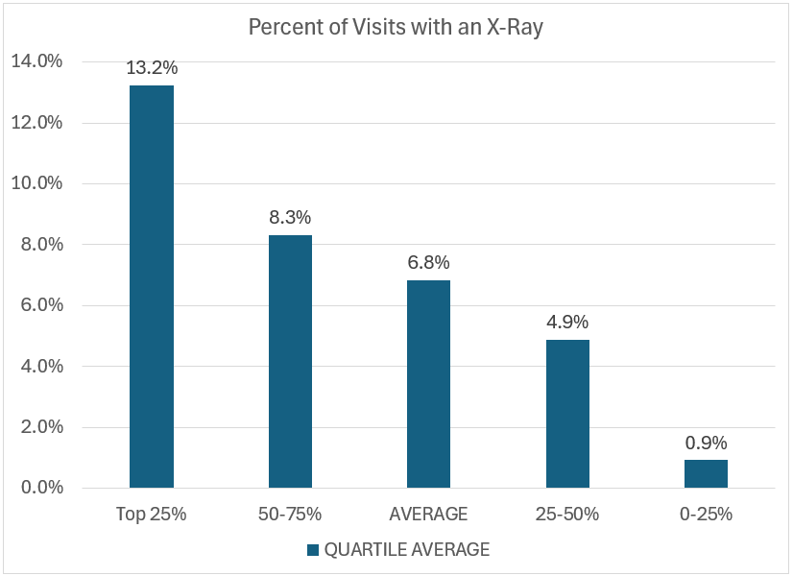
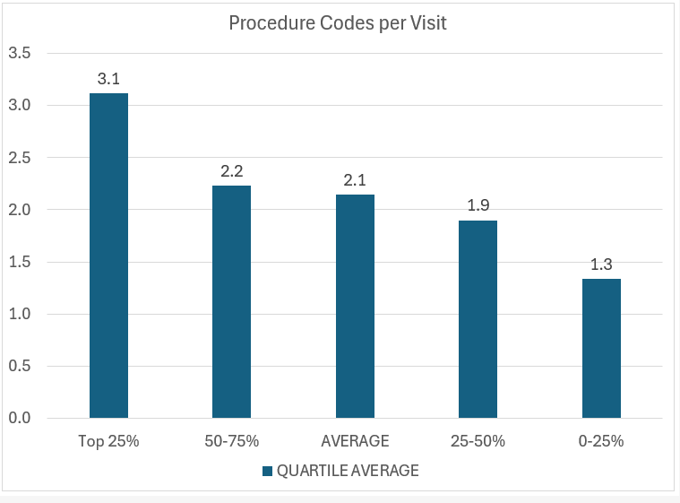
Percent of Visits w/X-ray, Procedure Codes per Visit
Source: Experity Data, October 2024

Slide 15
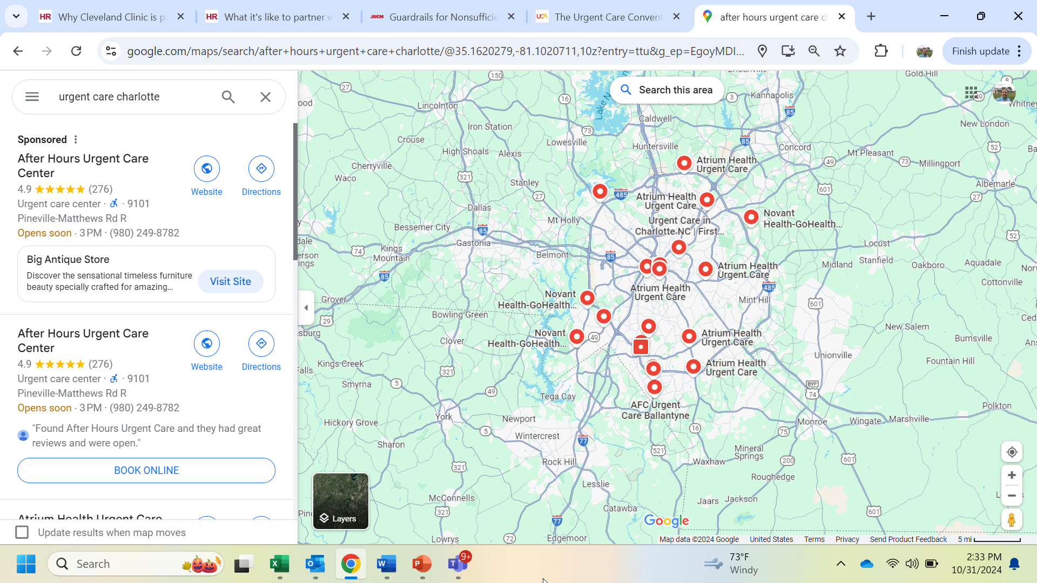
Outspending Competitors on Advertising
SEO is becoming more expensive and less effective
Digital hypes a consistent “patient journey” always starting online
Digital tactics reinforce (but don’t replace) visibility in the community
Aggressive, guerilla grassroots tactics, especially targeting moms
Use of conventional media (Billboards, direct mail, cable/streaming)

Slide 16
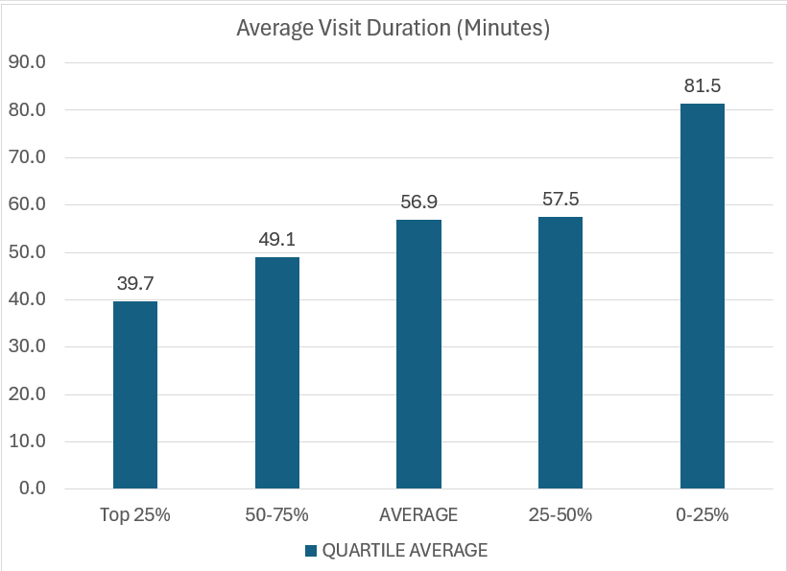
Solid Leadership with a Patient Experience Focus
Highly involved owners and managers aware of what's going on in their centers (at all times)
Culture of “speed” realizing high throughput expands capacity and increases satisfaction
Accept patients up until posted closing with short visit times all day
47 Min

Slide 17
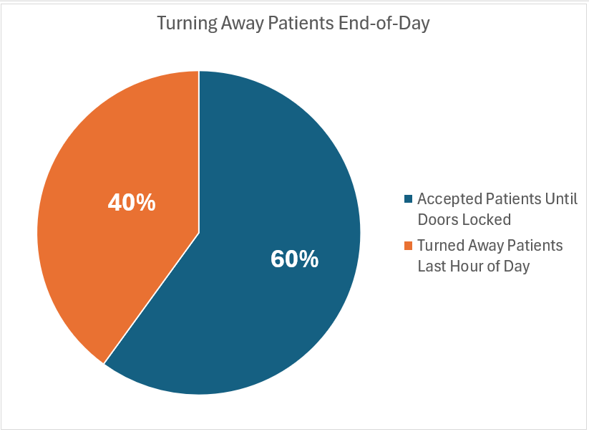
40% of centers surveyed turned away patients during the last hour of the day
The last 2-3 patients of the day can be the difference between profitability (or not).

Slide 18
Urgent Care Draws Patients In

Slide 19
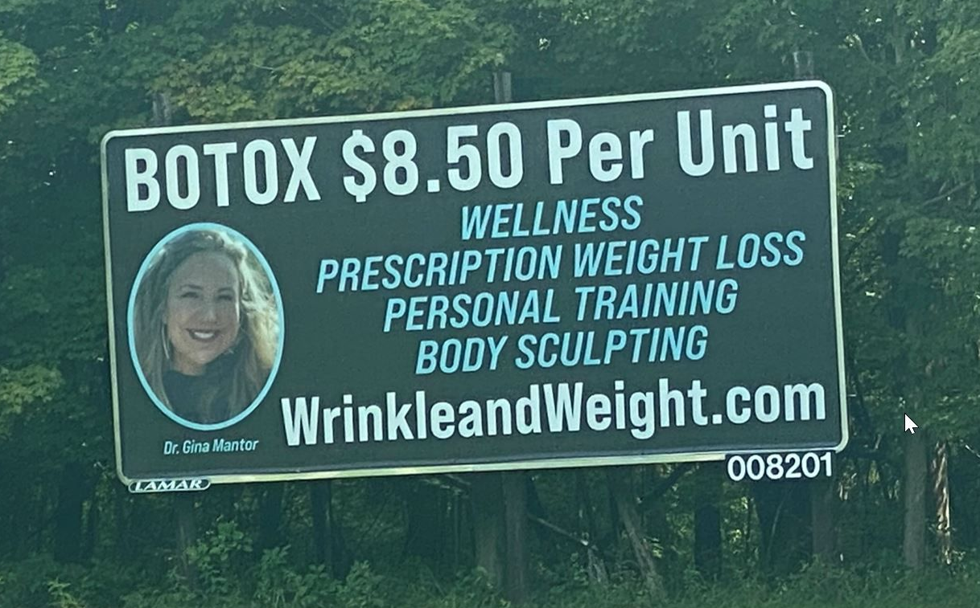
Build Volume by Leading w/Core Urgent Care Services
Avoid Chasing “Fads” and “Fashion”:
Divides management attention
Dilutes marketing spend
Consumer discretionary is fickle and fading in inflationary times
Often more competitive than urgent care
Urgent care lacks focus of pureplay providers
Undermines credibility of medical services
Lowest cost provider by definition means thin margins
Botox 40-50 units per session:
$6.22 per unit wholesale supply cost
$12.00 per unit average retail price
Range: $10.00 to $15.00

Slide 20
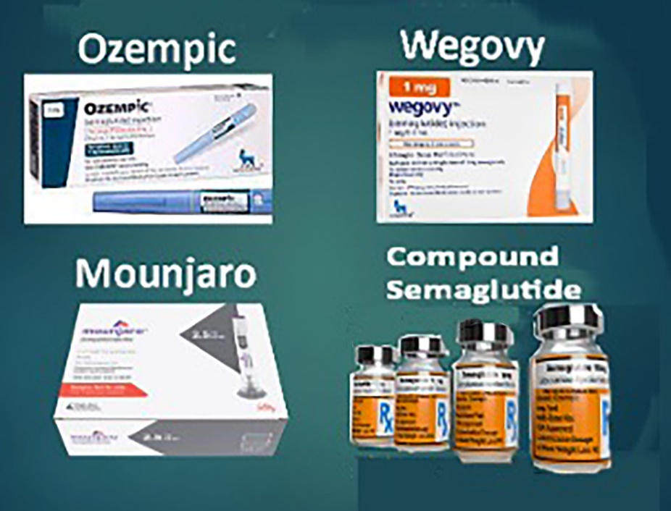
Weight Loss Drugs: Extensive Competition, Limited Market
Expensive medications not covered by insurance without co-morbid (diabetes) diagnosis
Unreliable compounding pharmacy supply chain requiring more than one pharmacy relationship
Pharma cease-and-desist against those using brand names
Expensive pay-per-click PPC due to AdWords saturation from pharma, PCPs, diet clubs, out-of-state telemed providers, et. al.
Google flagging and suppressing websites, hurting the organic search of core urgent care services
Social media algorithms flagging and suppressing mention of it

Slide 21
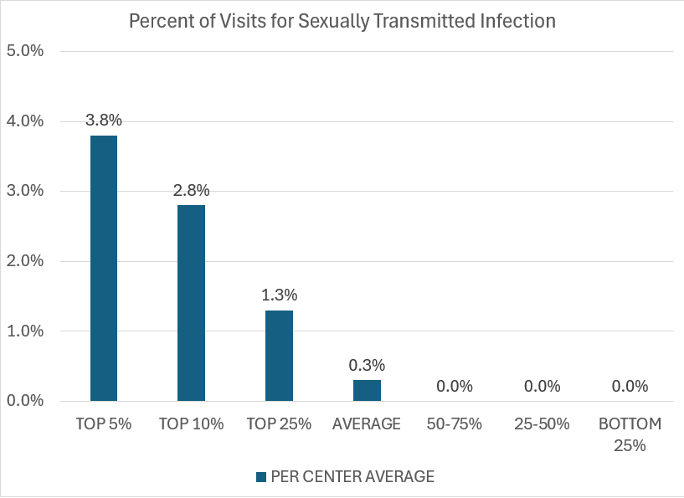
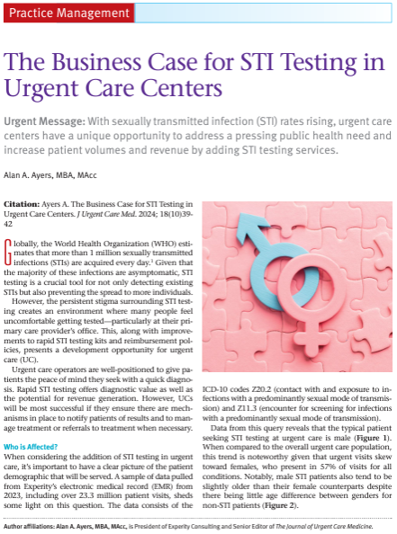
Building on Core Services: Rapid STI/STD Testing

Slide 22
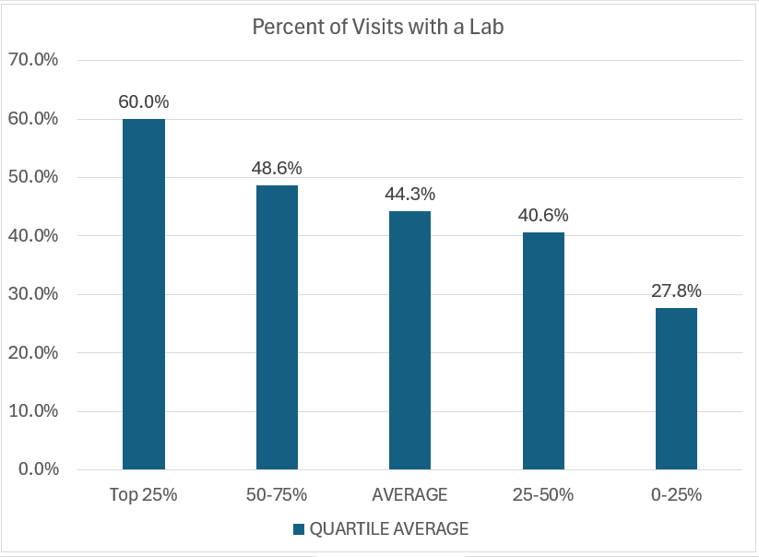
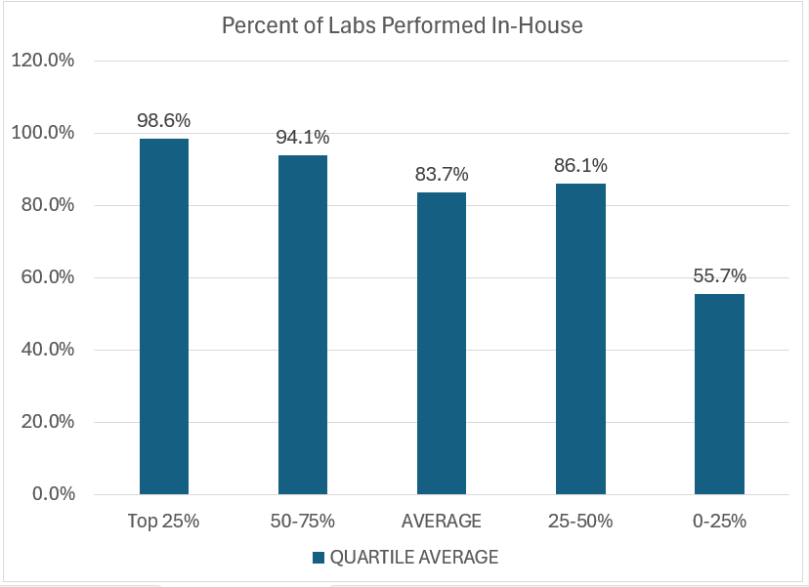
Capturing a Greater Share of Lab Revenue In-House

Slide 23
Occupational Medicine: Contra-Seasonal Incremental Revenue
Employer Paid Services
Workers Compensation
High Value
Multi-Component Physicals
Police/Fire Contracts
FAA, Merchant Marine, HAZWOP Compliance
OSHA Baseline and Periodic Surveillance Testing
End-to-end injury management, coordination of imaging, specialists, physical therapy
Light/Modified Duty, Return-to-Work Evaluations
Ergometric, ADA, Injury Prevention Consulting
Impairment / MMI Evaluations
Low Value
Drug Screens (eScreen)
DOT Physicals (FormFox, CerteDrive)
First report of low acuity, no time off, recordable injuries w/limited rechecks

Slide 24

Municipal Employment: 2x Injury Rate of Private Sector (~3%)

Slide 25
Take-Home Points: Respect the Basic Economics of Urgent Care
Majority of expense inside of four walls
  Scale economies pertain to marketing, functional expertise, SOPs and labor utilization
  Lean operations control cost and cross-utilize staff
High throughput increases capacity and patient satisfaction
  Under-utilized labor is the greatest operating cost
  Wait times is the top determinant of patient satisfaction
Drive year-round volume
  Maintain (expand upon) full urgent care capabilities
  Pediatric focus appealing to moms
  Accept patients until doors locked
  Find opportunity in trade area and demographic shifts
Maximize reimbursable services
  Understand contracts and capture all charges
  Utilize in-house services as clinically appropriate
  Add services relevant to the urgent care presentation

Slide 26

Let’s keep in touch!
Alan Ayers, President
Urgent Care Consultants
aayers@urgentcareconsultants.com

