Slide 1
Welcome
Start-up Success in Urgent Care
Alan Ayers, President
Heather Real, Senior Consultant
Urgent Care Consultants

Slide 2

Urgent Care Overview, Trends,
Differentiators and Economics

Slide 3
25 Years of Profitable Urgent Care Growth
Physician
Entrepreneurs
Local
Multi-Site Scaling
Platform Rooftop
Growth
OPPORTUNISTIC
COVID EXPANSION
New/New/New/
New/New
Core
Mid-Market
Enterprise
Ultra-Enterprise
Lifestyle and Investment
Scale Economies
Enterprise Value
Arbitrage on
P/E Multiple
Revenue and EBITDA
Growth
2009-2011
NextCare
MedExpress
FastMed
Cash
Flow
Bank Financing and Operating Cash
Private Equity, Institutional Debt and Operating Cash
Corporatization of Urgent Care
Hospital Ambulatory and Medical Groups
Hospital Equity Joint Ventures
Local Acquisitions
Integrated and Accountable Care Models

Slide 4
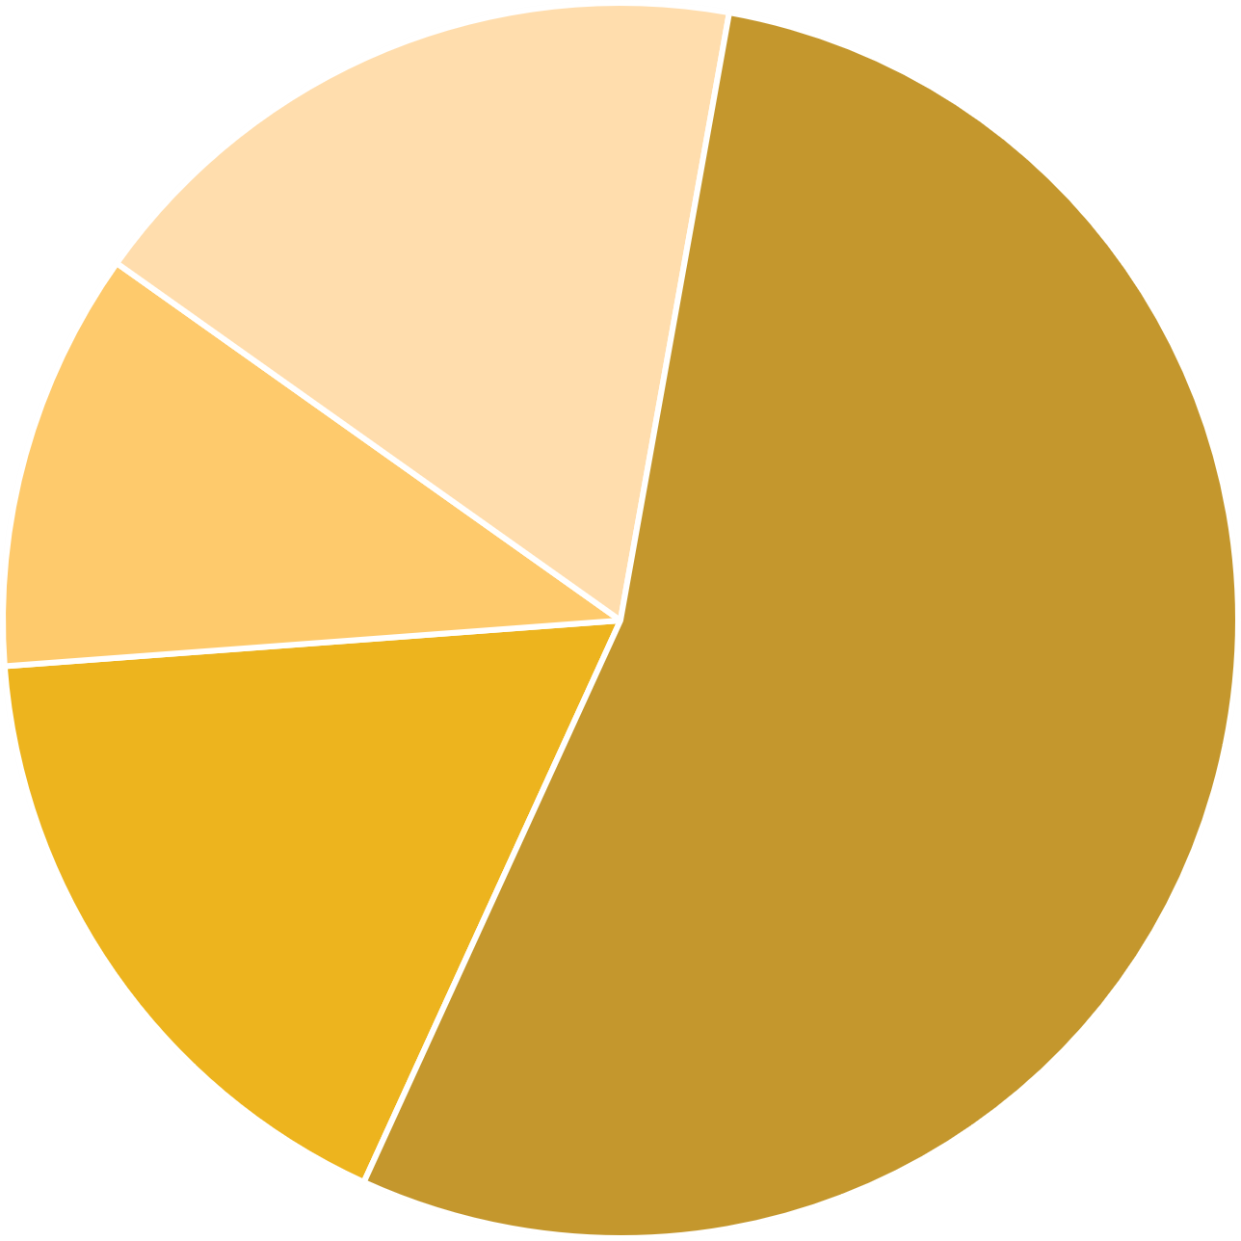
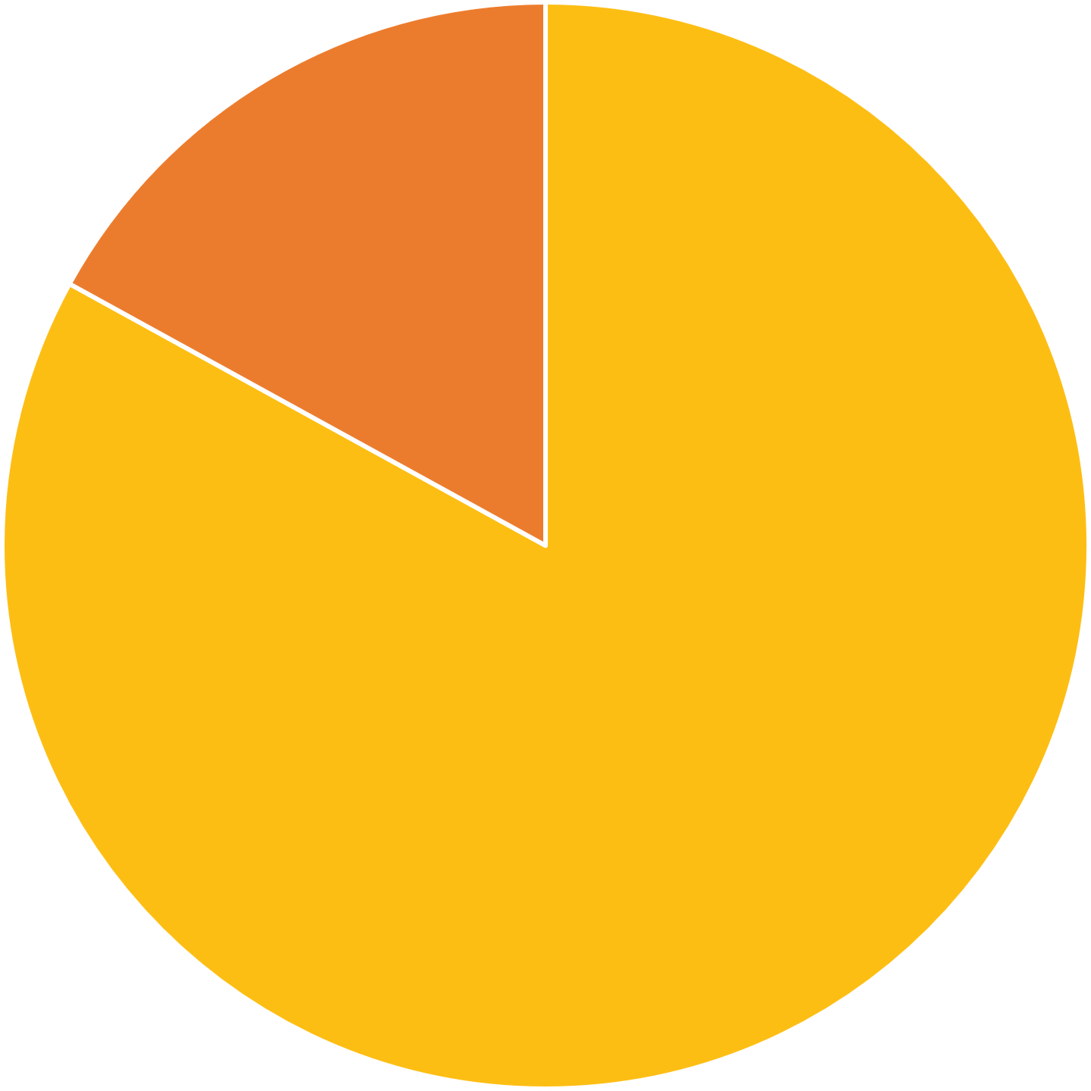
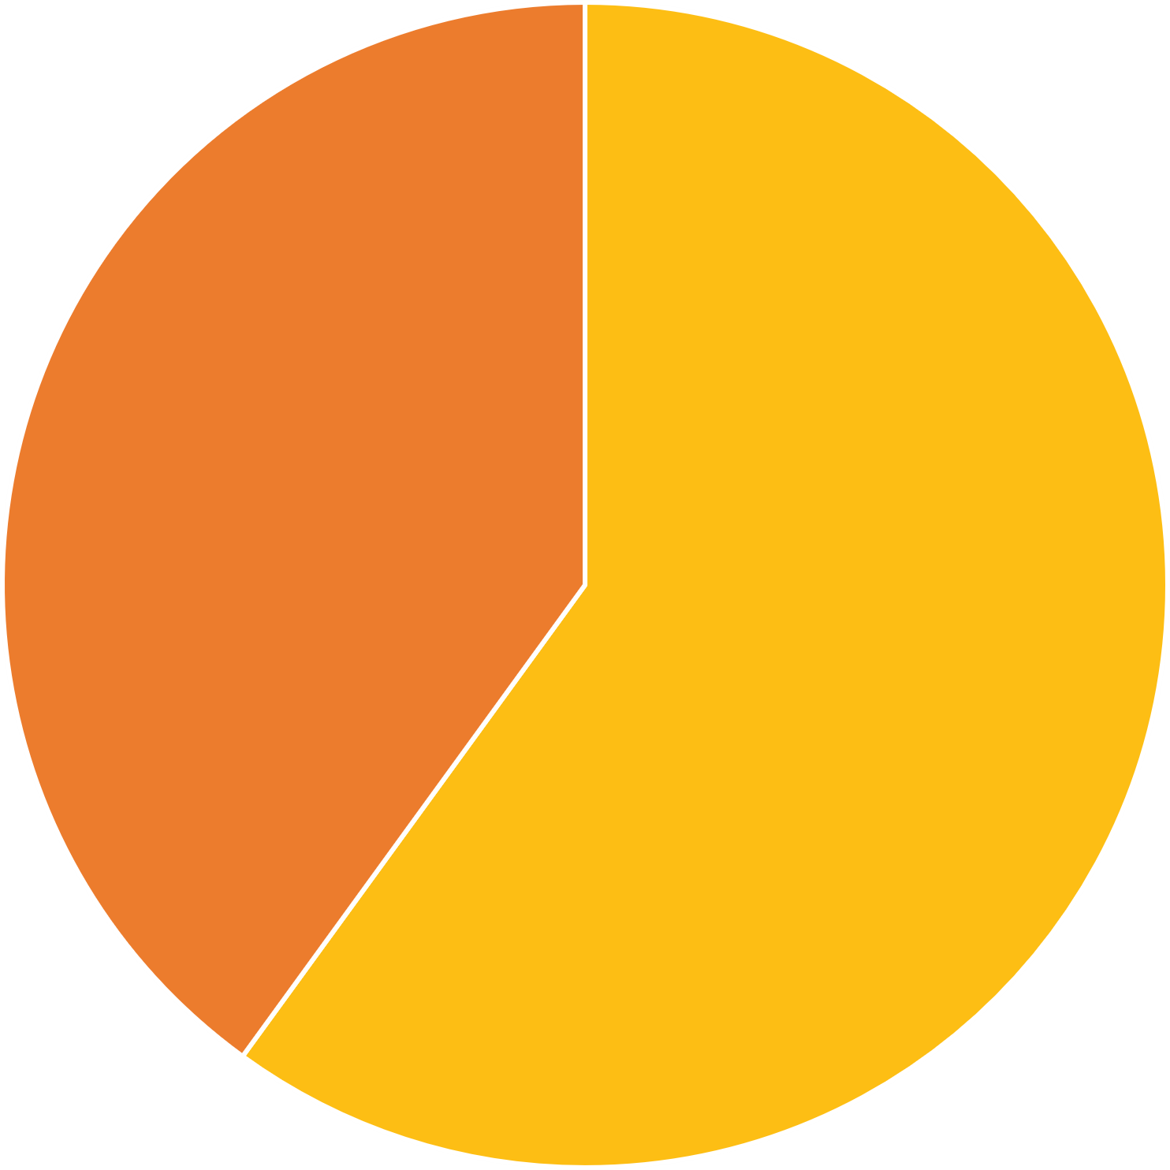
14,356 Urgent Care Centers in the United States
Urgent Care Rooftops by Size of Organization
Private Equity Ownership of Urgent Care Centers
Hospital Affiliation
Single Location
2,505 17%
Private Equity
2,497
17%
Hospital Affiliated
5,698
40%
2-4 Locations
1,568 11%
10+ Locations
7,765
54%
Not Hospital Affiliated
8,658
60%
5-9 Locations
2,518
18%
Not Private Equity
11,859
83%

Slide 5
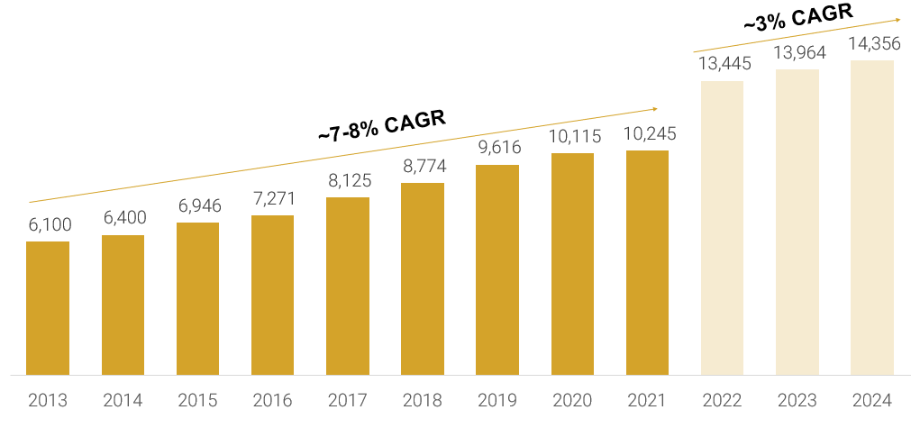
2014-2024 Year-Over-Year Urgent Care Rooftop Growth

Slide 6


Rooftop Growth: First Generation Struggles, Rural Growth Leads
Changing retail trade areas and market saturation threaten first generation providers:
Up to 1/4 of first-generation urgent care centers could be considered for relocation
Understanding population growth patterns and shifts in traffic patterns and retail trade areas to add or relocate centers
Increasing need to flank, intercept, box in, and/or out-position competition
Rural urgent care is adding rooftops 40% faster than suburban while urban growth lags.

Slide 7
Growing Revenues Without Growing Profits is Simply Working Harder, Not Smarter

Slide 8
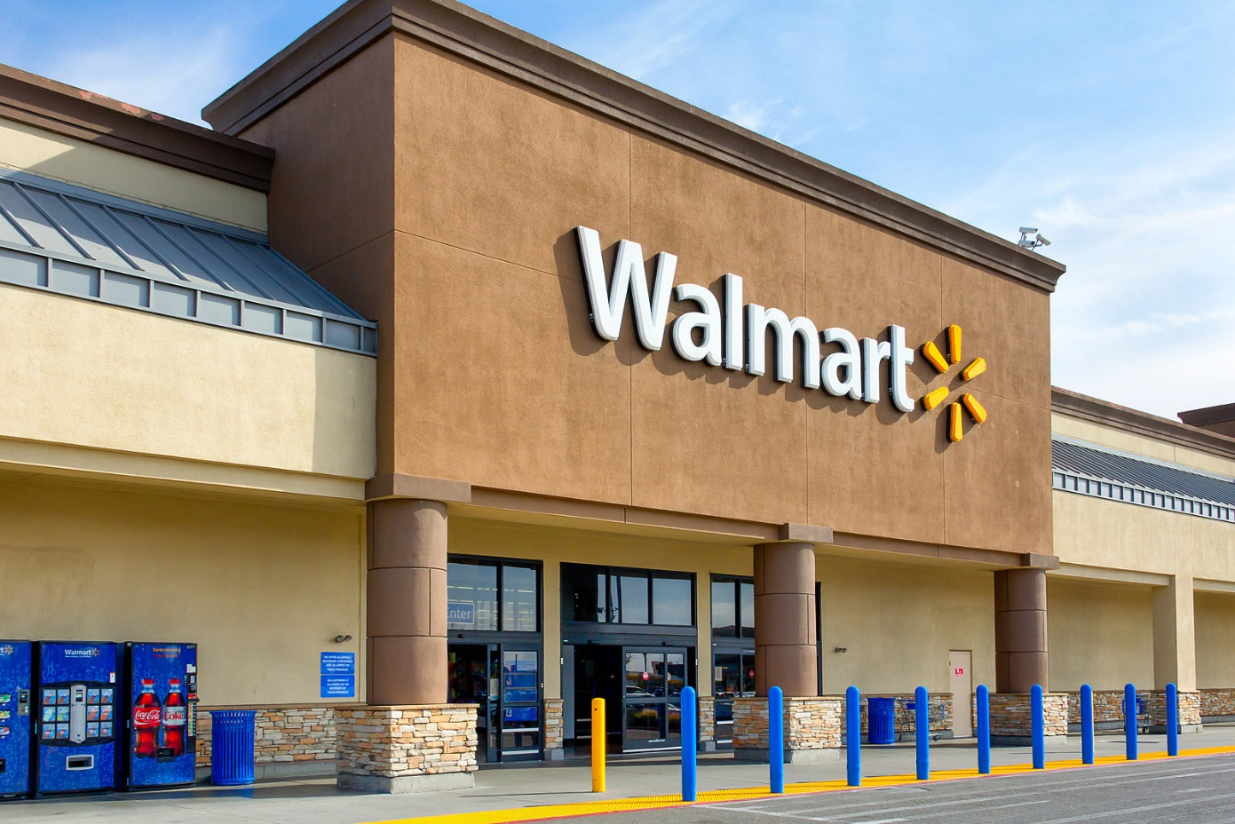
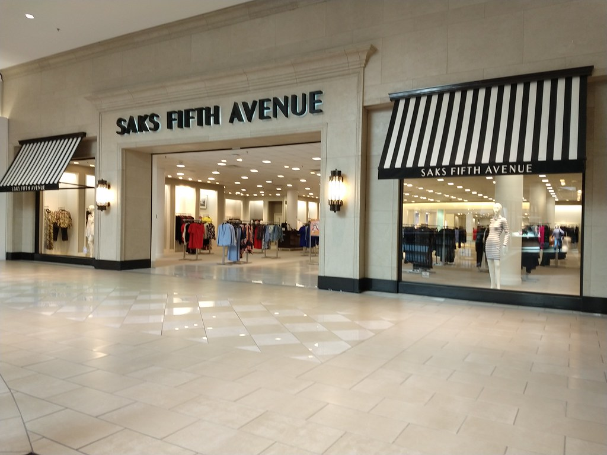
Revenue Equation: Volume x Rate
Mass Retail: Sells More for Less
Specialty Retail: Sells Less for More

Slide 9
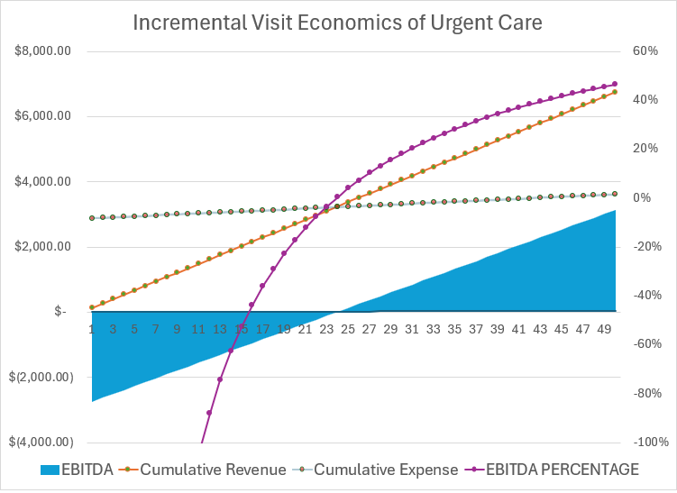
Incremental Revenue vs. EBITDA

Slide 10
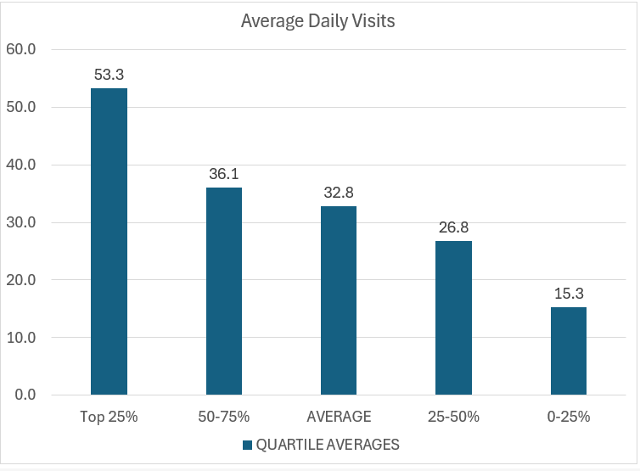
Surplus Provider Capacity is the #1 Expense of Urgent Care Centers
Provider Patient per Hour Capacity
*For the 85% of urgent cares seeing <50 visits per day.

Slide 11
Take-Home Points: Respect the Basic Economics of Urgent Care
Majority of expense inside of four walls
  Scale economies pertain to marketing, functional expertise, SOPs and labor utilization
  Lean operations control cost and cross-utilize staff
High throughput increases capacity and patient satisfaction
  Under-utilized labor is the greatest operating cost
  Wait times is the top determinant of patient satisfaction
Drive year-round volume
  Maintain (expand upon) full urgent care capabilities
  Pediatric focus appealing to moms
  Accept patients until doors locked
  Find opportunity in trade area and demographic shifts
Maximize reimbursable services
  Understand contracts and capture all charges
  Utilize in-house services as clinically appropriate
  Add services relevant to the urgent care presentation

Slide 12
Urgent Care Business Planning, Development Process

Slide 13
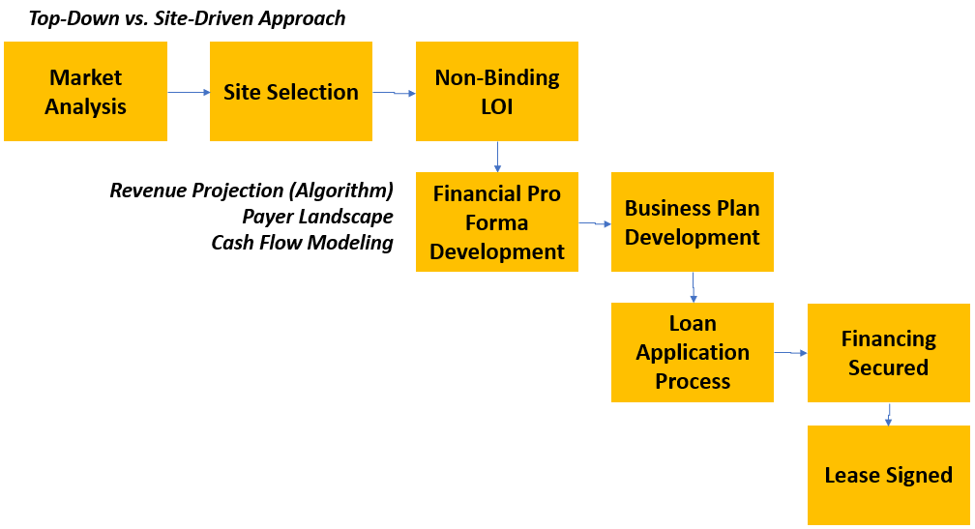
Urgent Care Development Process

Slide 14
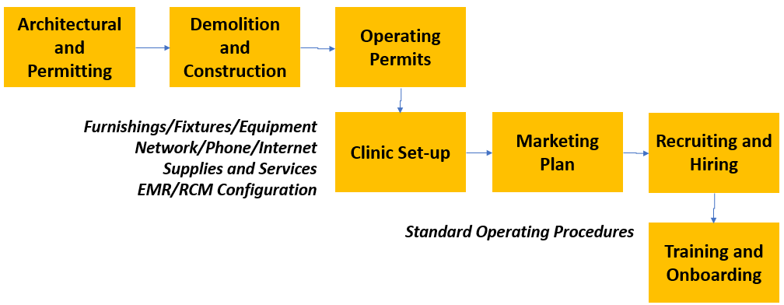
Urgent Care Development Process, cont’d.

Slide 15
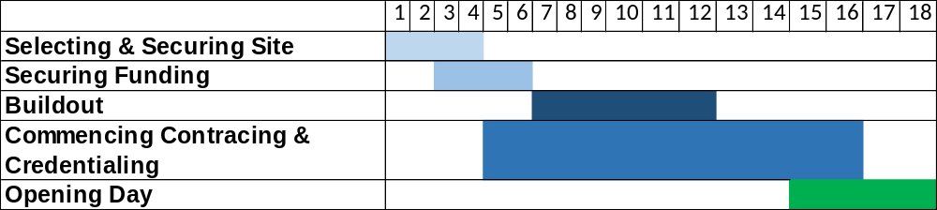
Start-up Critical Path and Timelines
Securing site: 3-4 months
Obtaining funding: 2-3 months
Commencing build-out: 4-6 months
C&C and getting in-network with major payers: 10-12 months
Clinic set-up, supplies, hiring, training, technology configuration, compliance, etc.
Opening Day – 12-14 months

Slide 16
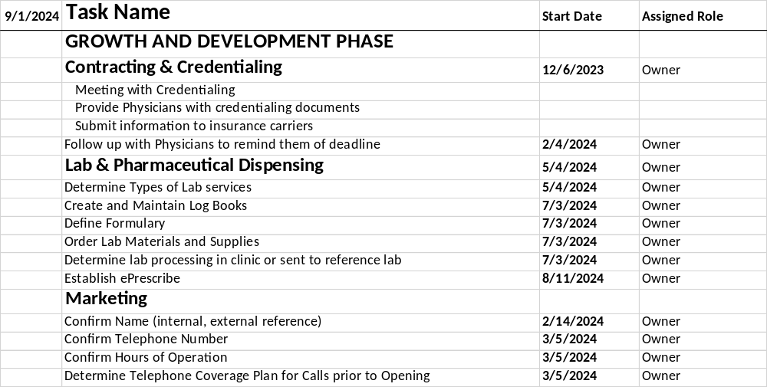
Start-up Pro®

Slide 17
Urgent Care Financial Pro Forma Review

Slide 18
Typical Lending Options
SBA Lending
Most common form of lending for new UC operators
Generally requires 10-20% equity injection
Will require 80-90% collateralization through other assets
  Equity in primary residence is not eligible for SBA Loan collateral
Loans for Physician’s by Physician’s
Niche loan programs in which groups of physicians provide loans for other physicians starting new practices
May finance up to 100% of the project

Slide 19
Pro Forma Elements
Revenue Formula
Expense Formula
+ Patient Charges for Medical Services
Contractual Allowances
Bad Debt Expense
= Net Revenue (per visit)
+ Dispensing Revenue
+ Occ Med (EPS) Revenue
+ Misc. Fees and Charges
Labor
  Staffing Model (MDs vs. PAs/NPs, MAs, RTs)
  Staffing Efficiencies to Patient Volume
  Increase Staffing as Volume Grows
Technology and Billing Services
Supplies
Rent and Occupancy Expenses
Marketing
  Grassroots, Paid Advertising
  Website, SEO, Digital Tactics
Purchased Services

Slide 20
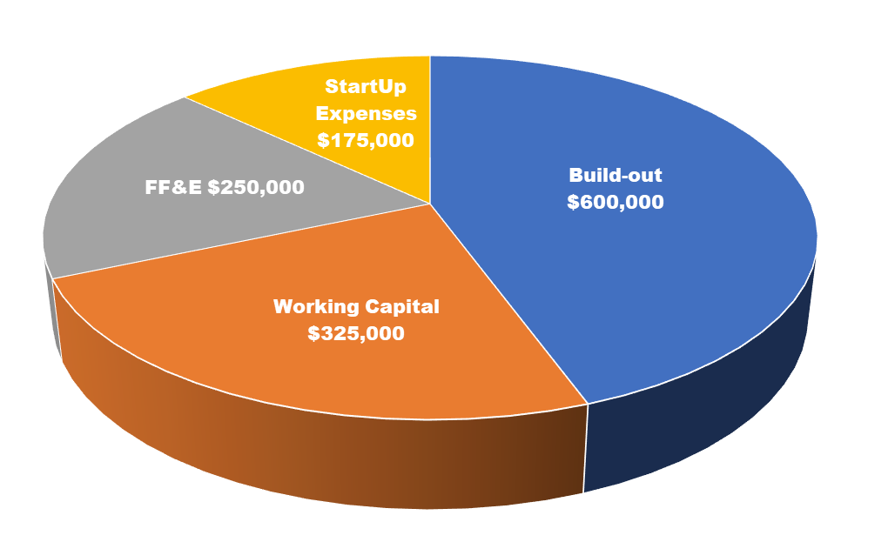
Investment Breakdown

Slide 21
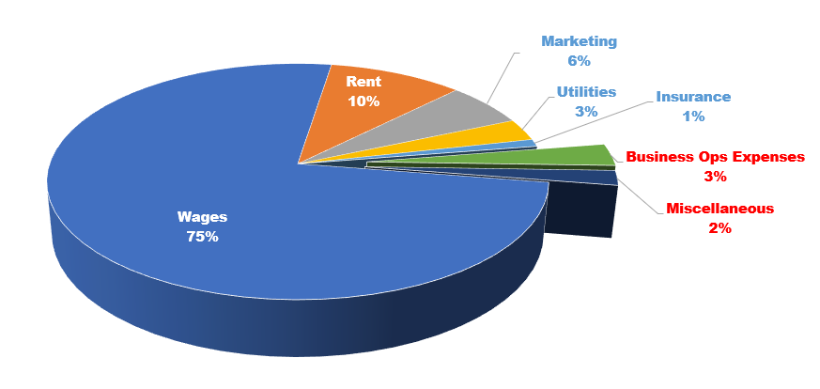
Business Expense Breakdown

Slide 22
Urgent Care Development: Capital Required
Buildout costs $ * Square Footage >>>
$600K
FF&E >>>
$250K
One-time Startup Expenses >>>
$175K
Working Capital >>>
$325K
Total:
$1.4M+

Slide 23
Three Year Financials

Slide 24
Thank you!

