Slide 1
Welcome
Welcome
2025 Urgent Care
Startup Experience
2025 Urgent Care
Startup Experience

Slide 2
UCC Startup Experience—Agenda
Tuesday, March 4th
8:00am | Breakfast
9:00am | Opening Keynote: David Stern
10:00am | Break
10:20am | Urgent Care Overview, Trends, Differentiators & Economics
11:05am | Break
11:20am | Data Driven Approaches to Site Analysis
12:05pm | Lunch
1:05pm | Urgent Care Business Planning & Development Process
1:50pm | Break
2:05pm | Life of a Claim, C&C, RCM Compliance
2:50pm | Break
3:15pm | Urgent Care Financial Pro Forma Review
4:00pm | Break
4:15pm | General Assembly: Client Panel
5:15pm | Welcome Reception
Wednesday, March 5th
8:00am | Breakfast
9:00am | Guest Keynote: Dr. Harvey Castro
10:00am | Break
10:20am | Urgent Care Marketing & Ancillary Services
11:05am | Break
11:20am | Practicing Urgent Care Medicine
12:05pm | Lunch
1:05pm | Urgent Care Operations, Staffing, Lab & X-Ray
1:50pm | Break
2:05pm | Experiences Learned in 35+ Years of Ownership
2:50pm | Break
3:15pm | Avoiding the Top Mistakes of Urgent Care Startups
4:00pm | Break
4:15pm | General Assembly: Closing Keynote & Roadmap
6:00pm | Closing Party @ The Slugger Museum

Slide 3
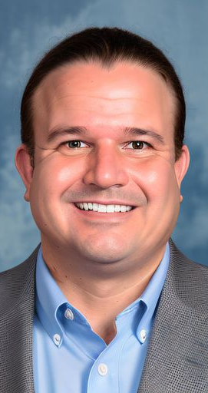
Alan Ayers, MBA, MAcc
President, Urgent Care Consultants
Alan Ayers has 18 years’ experience in strategic planning, business development, clinical operations, sales/marketing and customer service for urgent care, occupational medicine, and primary care facilities.
Currently, Ayers serves as President of Experity Consulting, responsible for helping clients identify and cultivate new revenue streams while supporting the company's strategic growth initiatives. Experity is a leading service provider to ~5,000 urgent care centers offering a proprietary electronic medical record and practice management platform as well as contracting and credentialing, billing, and teleradiology services.
Ayers has consulted with independent, PE-backed, and hospital-affiliated platforms representing well over 1,000 units. He has also served as an expert witness in landlord-tenant litigation involving urgent care.
From 2017 to 2021, while still part of Experity, Ayers served as Chief Executive Officer of Velocity Urgent Care, a venture of Sentara Healthcare, growing the company from 7 to 17 locations building a complete operating and administrative infrastructure, assembling leadership and management teams, migrating systems, optimizing the staffing model, acquiring the hospital's occ med practice, and implementing a values-based culture. In 2020, Velocity Urgent Care became the leading provider of COVID19 test services in its markets.
A prolific and award-winning writer, Ayers is Senior Editor of The Journal of Urgent Care Medicine (JUCM), and has contributed well over 650 original articles, blog entries and presentations on urgent care-related subjects. In 2018 he was co-author of The Health Care Executives’ Guide to Urgent Care and Freestanding EDs, Second Edition.
Ayers has served as Chief Operating Officer of OhioHealth Urgent Care and spent eight years in various executive positions at Concentra including VP of Corporate Development responsible for acquisitions, divestitures, de novos, relocations, and major renovations. For eight years, Ayers served the Board of Directors of the national Urgent Care Association (UCA), providing expertise and guidance on emerging issues; identifying market and regulatory trends; defining content, planning educational programs, and speaking at industry events. In 2019, he received UCA’s prestigious Lifetime Membership Award. Ayers graduated Phi Beta Kappa from the University of North Carolina, has an MBA from the University of Mississippi, and a Masters of Accounting from The Ohio State University graduating first in his class.
3

Slide 4
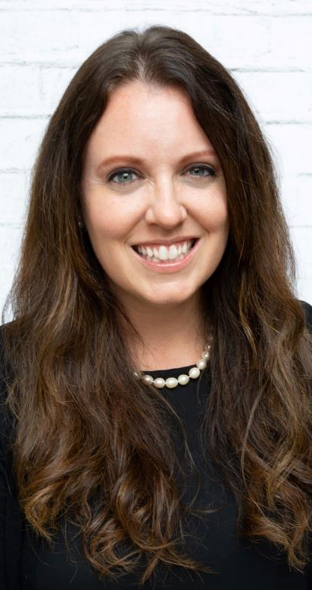
Heather Real
Senior Consultant
Heather Real has been helping operators startup their own urgent cares for nearly 12 years. She has contributed to over 250 rooftop projects all over the country.
Heather entered the urgent care industry as a consulting services assistant and quickly learned the intricacies of the urgent care industry. She leaned on her background in retail business management, client services, and operations optimization to assume primary responsibility for market research, financial planning, and preparing business plans.
Throughout the years, and having contributed to hundreds of unique projects, Heather has become an expert in urgent care development and operations. Today, she guides enthusiastic entrepreneurs through the journey of starting an urgent care, from site selection through financing, build-out, operations set-up and post-opening. She also assists with due diligence projects, and provides operational assessments and growth strategy development for existing businesses.
Heather has also contributed several articles to the Journal of Urgent Care Medicine on topics related to starting an urgent care. Heather has spoken at the Urgent Care Association Conference in 2023 and 2024,, analyzing the nuances of starting an urgent care in today’s competitive market.
4

Slide 5
Urgent Care Overview, Trends, Differentiators and Economics

Slide 6
25 Years of Profitable Urgent Care Growth
Physician
Entrepreneurs
Local
Multi-Site Scaling
Platform Rooftop
Growth
OPPORTUNISTIC
COVID EXPANSION
New/New/New/
New/New
Core
Mid-Market
Enterprise
Ultra-Enterprise
Lifestyle and Investment
Scale Economies
Enterprise Value
Arbitrage on
P/E Multiple
Revenue and EBITDA
Growth
2009-2011
NextCare
MedExpress
FastMed
Cash
Flow
Private Equity, Institutional Debt and Operating Cash
Bank Financing and Operating Cash
Corporatization of Urgent Care
Hospital Equity Joint Ventures
Hospital Ambulatory and Medical Groups
Local Acquisitions
Integrated and Accountable Care Models

Slide 7
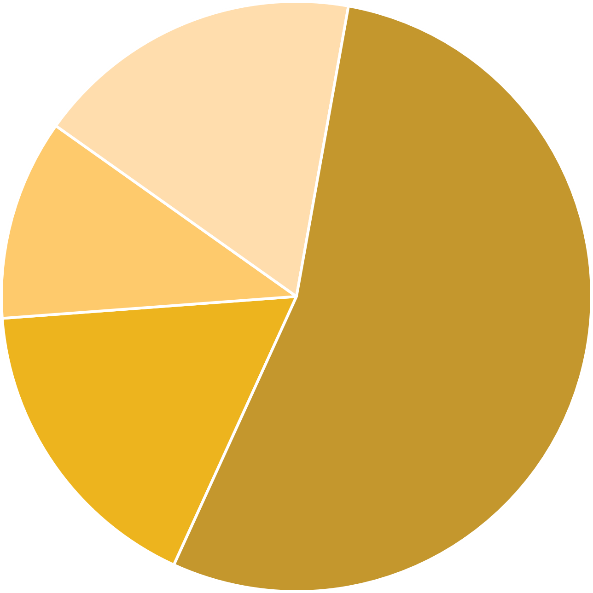
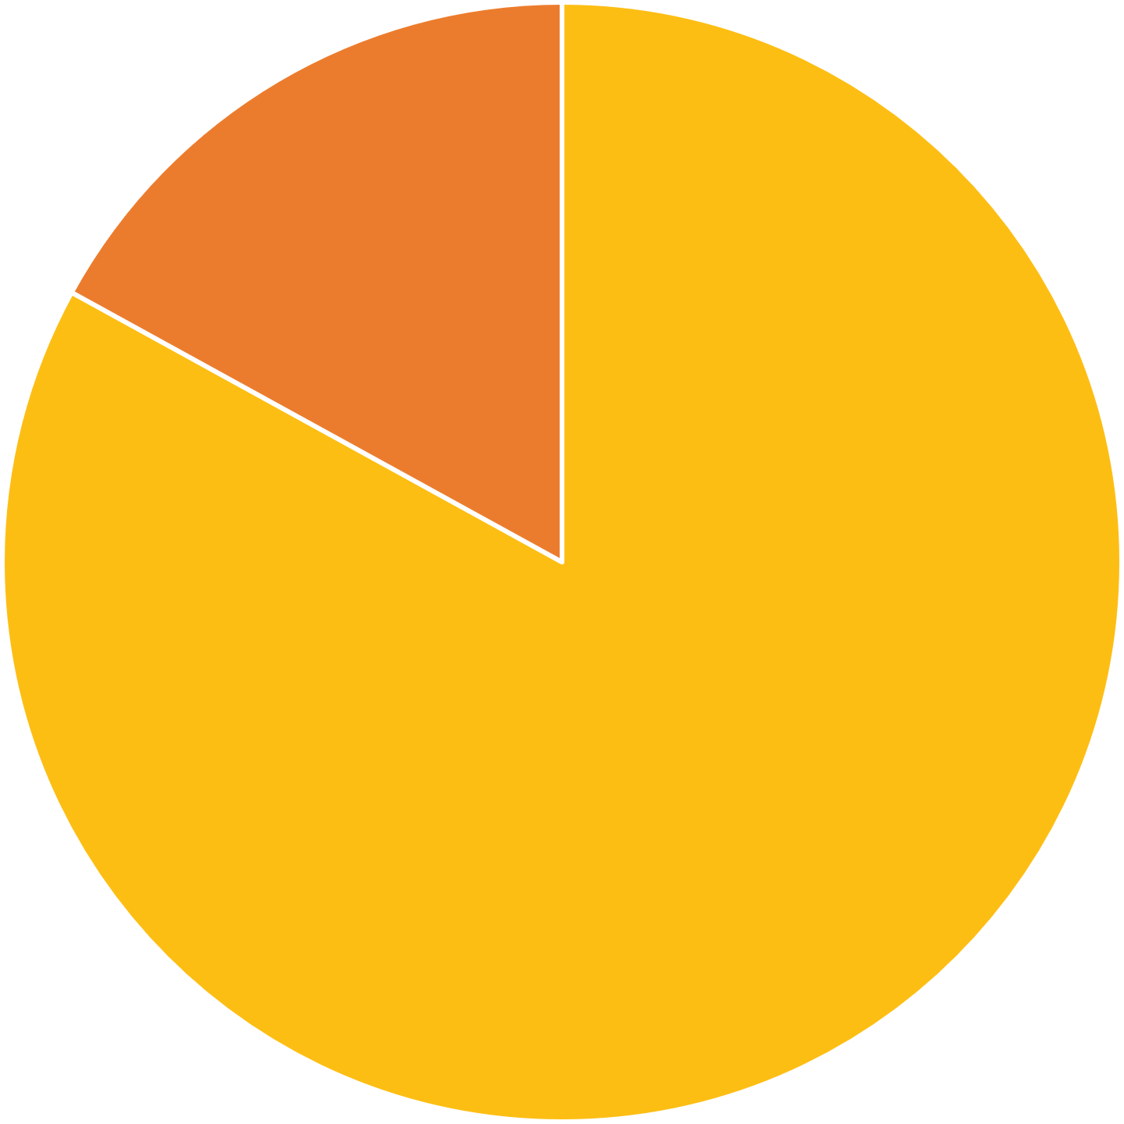
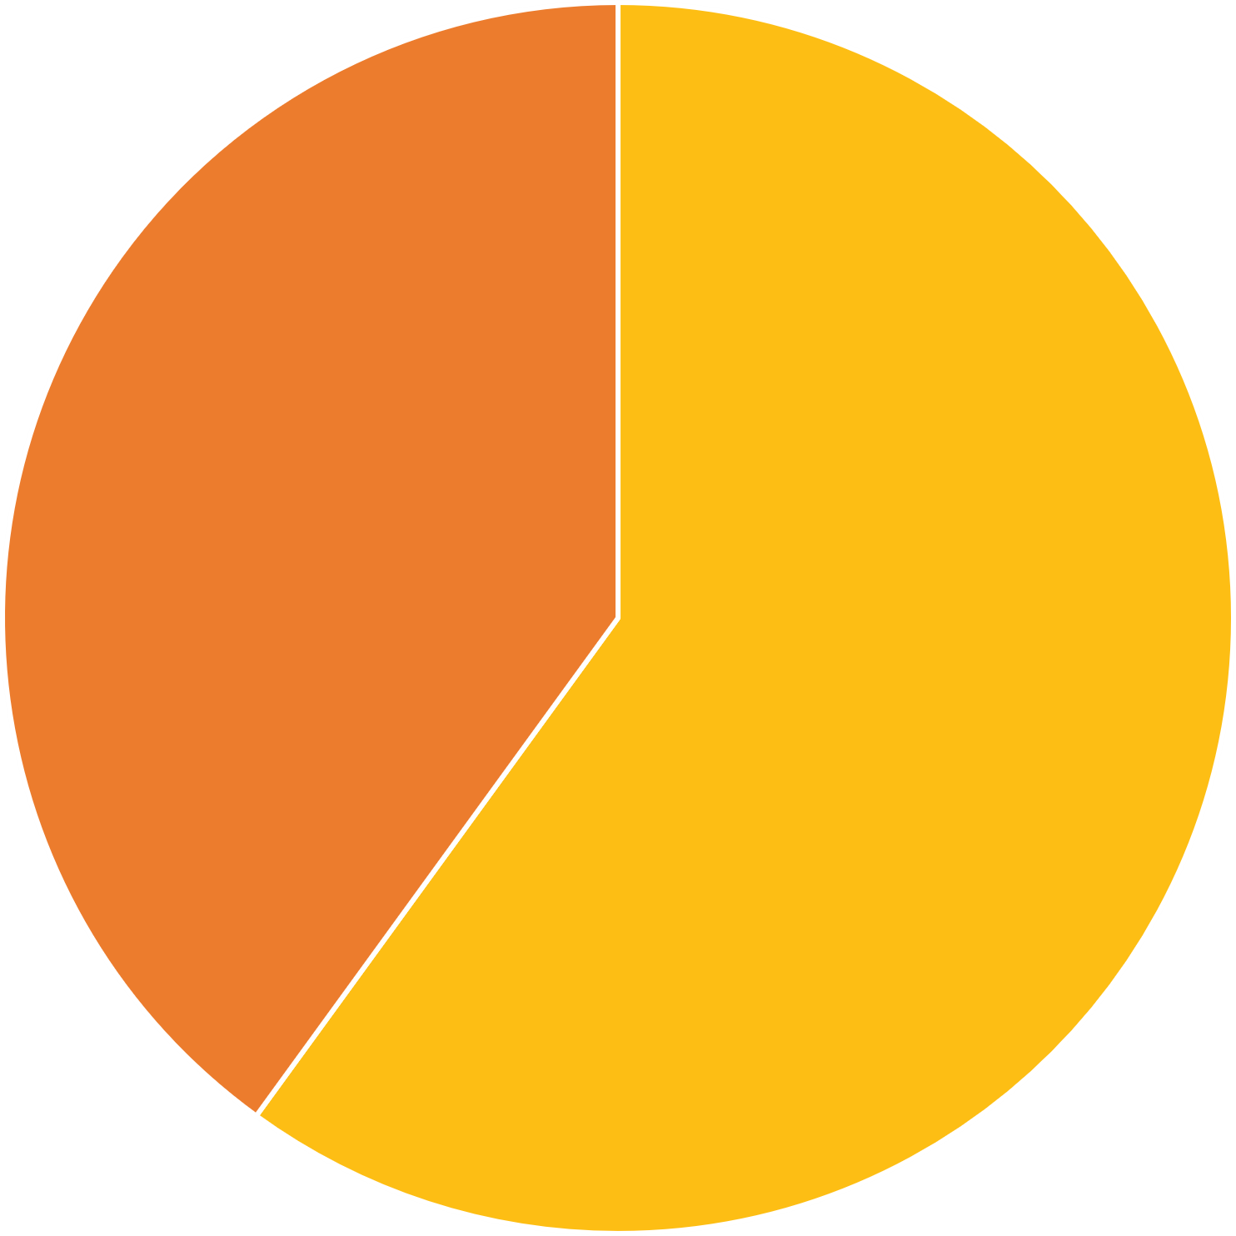
14,356 Urgent Care Centers in the United States
Urgent Care Rooftops by Size of Organization
Private Equity Ownership of Urgent Care Centers
Hospital Affiliation
Single Location
2,505 17%
Private Equity
2,497
17%
Hospital Affiliated
5,698
40%
2-4 Locations
1,568 11%
10+ Locations
7,765
54%
Not Hospital Affiliated
8,658
60%
5-9 Locations
2,518
18%
Not Private Equity
11,859
83%

Slide 8
Urgent Care Investors Expect Revenue Growth
New Patients:
  Millions “new” introduced to urgent care during pandemic
  New populations (esp. pediatrics, rural)
New Payers:
  Medicaid privatization and expansion
  Cost savings from Medicaid ER diversion
  Rural Health Center designation
New Services:
  Primary care and specialist integration
  Set-up for value-based care innovation
  Ancillary services not relevant to the UC presentation
New Rooftops:
  Continued de novo growth (enterprise)
  Continued start-ups (independents)
  Need to relocate first generation centers
New Geographies:
  Rural and urban fill-in
  Changing traffic patterns and trade area definitions

Slide 9
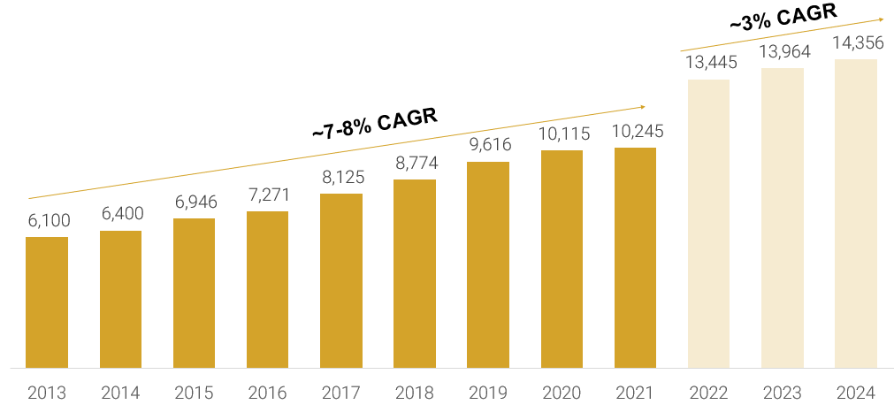
2014-2024 Year-Over-Year Urgent Care Rooftop Growth

Slide 10

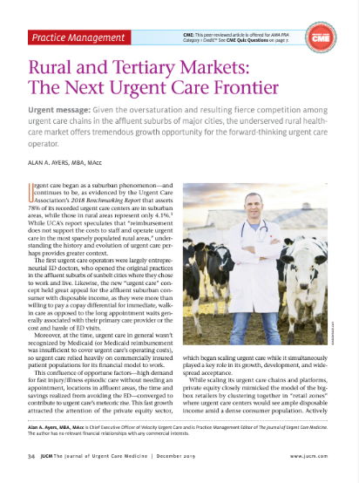
Rooftop Growth: First Generation Struggles, Rural Growth Leads
Changing retail trade areas and market saturation threaten first generation providers:
Up to 1/4 of first-generation urgent care centers could be considered for relocation
Understanding population growth patterns and shifts in traffic patterns and retail trade areas to add or relocate centers
Increasing need to flank, intercept, box in, and/or out-position competition
Rural urgent care is adding rooftops 40% faster than suburban while
urban growth lags.

Slide 11
Growing Revenues Without Growing Profits is Simply Working Harder, Not Smarter

Slide 12
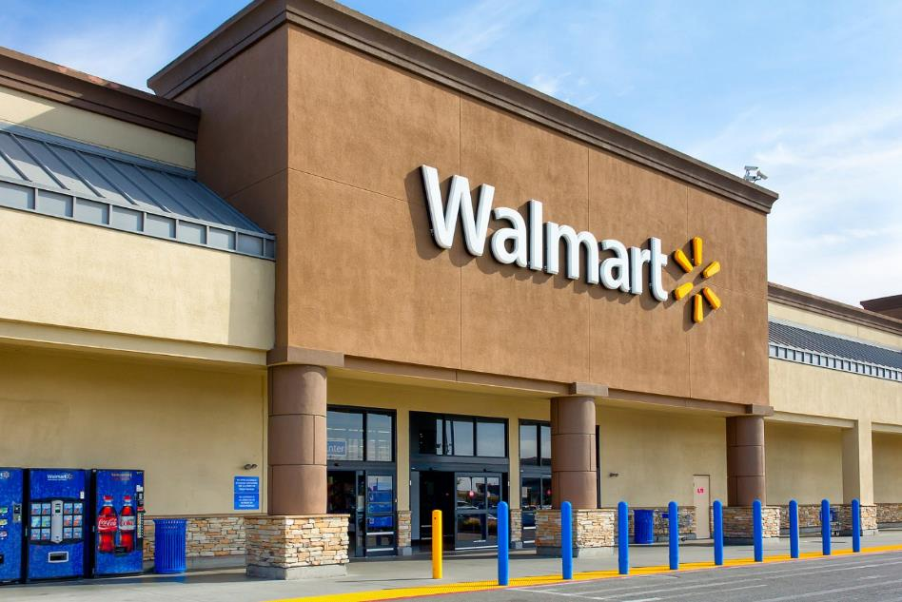
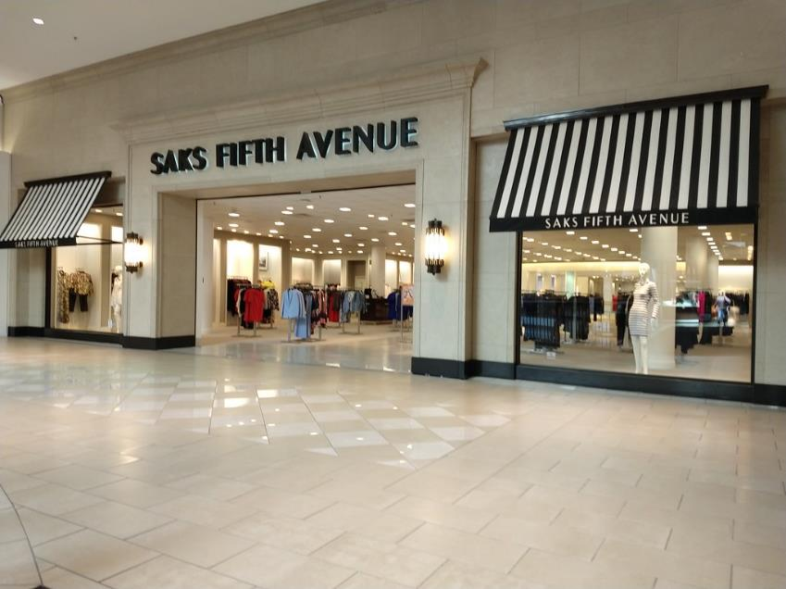
Revenue Equation: Volume x Rate
Mass Retail: Sells More for Less
Specialty Retail: Sells Less for More

Slide 13
Basic Economics of Urgent Care
Revenue = Volume x Rate
Rates are set by third parties
36-39% of contracts are case rate
Volume is the primary revenue driver
Labor functions as a fixed cost
KPI is patients per hour per provider
Excess or unutilized capacity is the biggest issue in urgent care

Slide 14
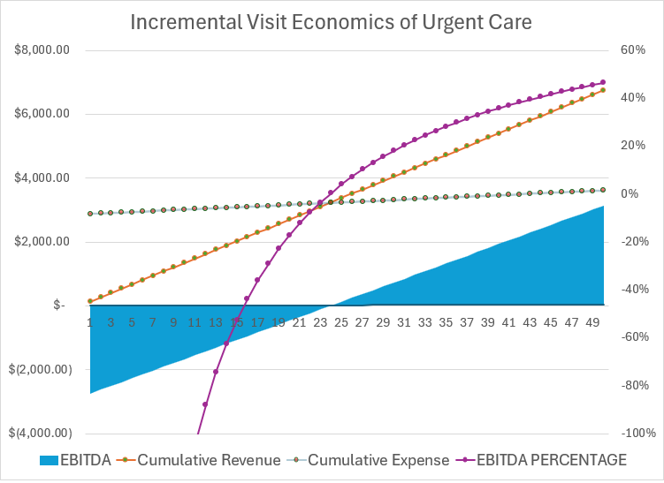
Incremental Revenue vs. EBITDA

Slide 15
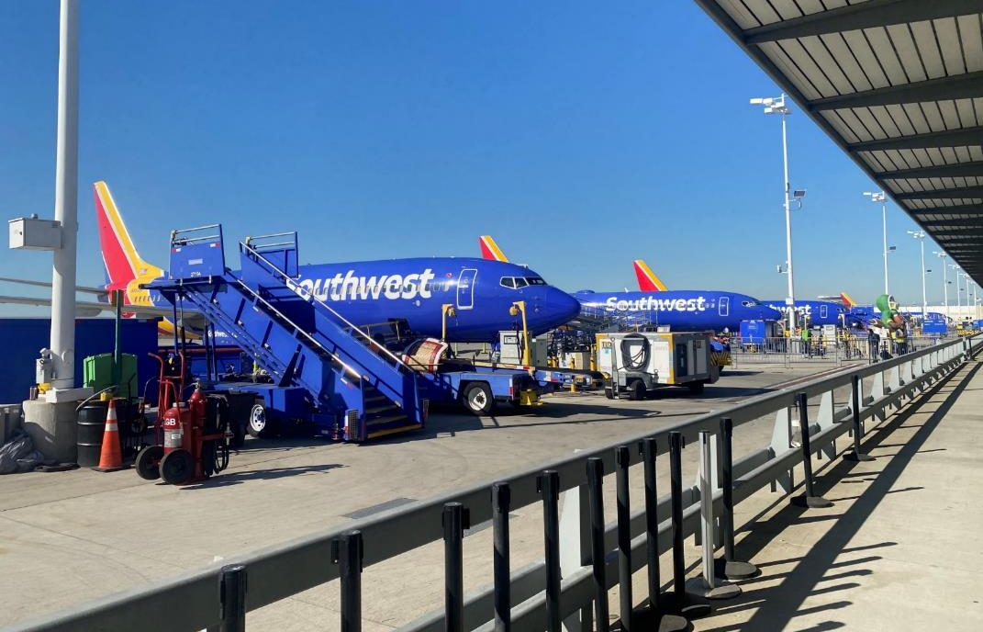
Adding Capacity Without Utilization in Service Industries
Provider Patient per Hour Capacity
*For the 85% of urgent cares seeing <50 visits per day.
Despite 60 years of focus on operational efficiency, Southwest now lags major carriers in load factor, or available seat miles sold.

Slide 16
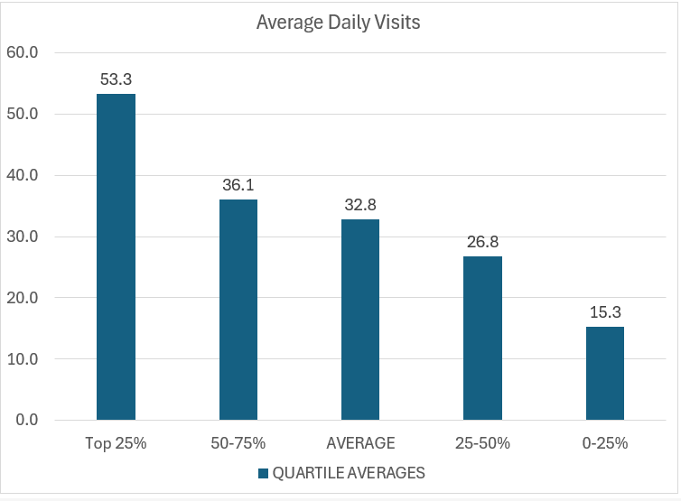
Surplus (Unutilized) Provider Capacity is the #1 Expense of Urgent Care Centers

Slide 17
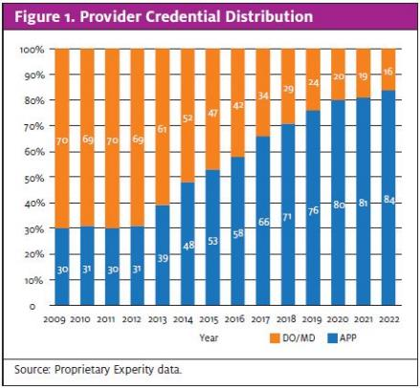
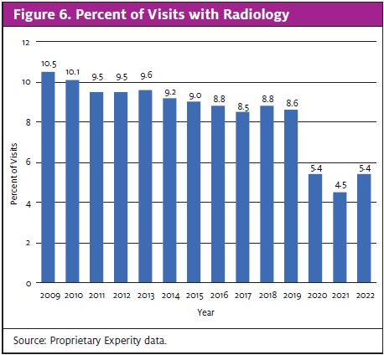
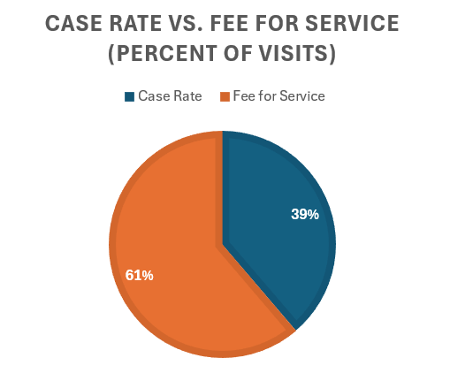
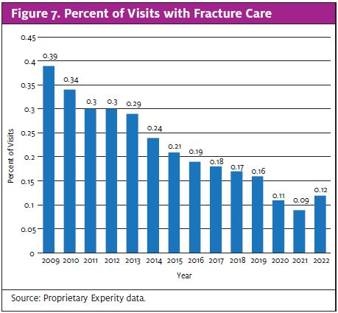
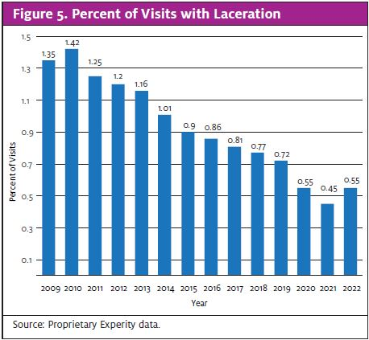
Case Rate Reimbursement and Acuity Degradation
Insurance case rates and a focus on patient-per-hour productivity have degraded the scope of care offered and diminished the value proposition of “cost savings vs. the ER.”
Case rate payers range from <15% to >75% of covered lives depending on a state’s payer landscape, center
payer mix, center
place of service, age
of contracts, etc.

Slide 18
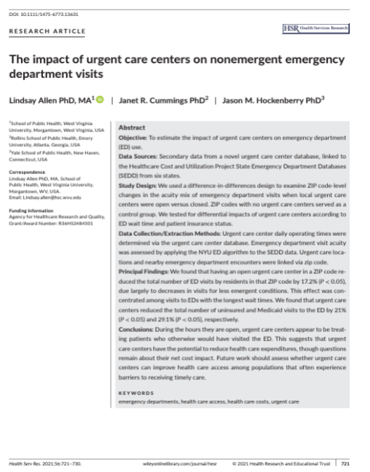
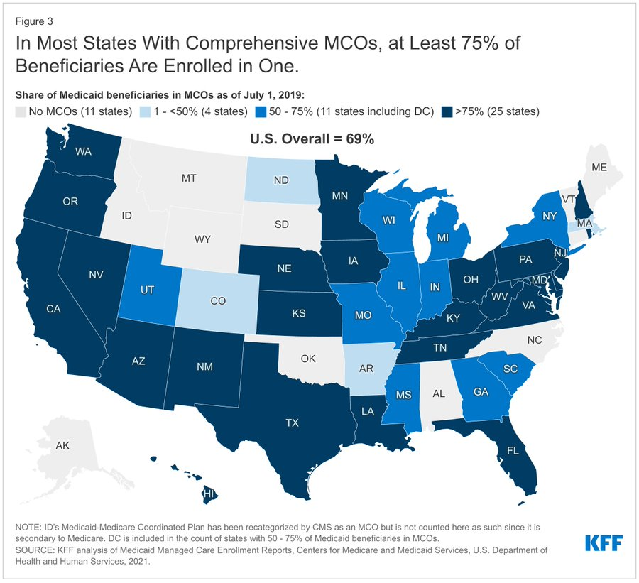
Urgent Care Value Proposition: Medicaid Expansion and Privatization
Medicaid Managed Care:
Research indicates that anywhere from 13% up to 50% of the 137 million annual US ED visits could be treated at a care site other than the ED.

Slide 19
Traits of Centers with Sustained Growth Pre- and Post-Pandemic
Maintained full urgent care capabilities and hours
Augmented urgent care with COVID testing vs. redefining as high-throughput test-and-treat
Continued to treat higher acuity, procedures, ortho
Found ways to remain fully staffed and assure x-ray was always available
  Took a team approach to staffing
  Providers doing their own MA work (intake, vitals, rapid testing)
  Cross-training between front and back
COVID testing built occ med employer relationships
Grassroots marketing vs. sole reliance on digital

Slide 20
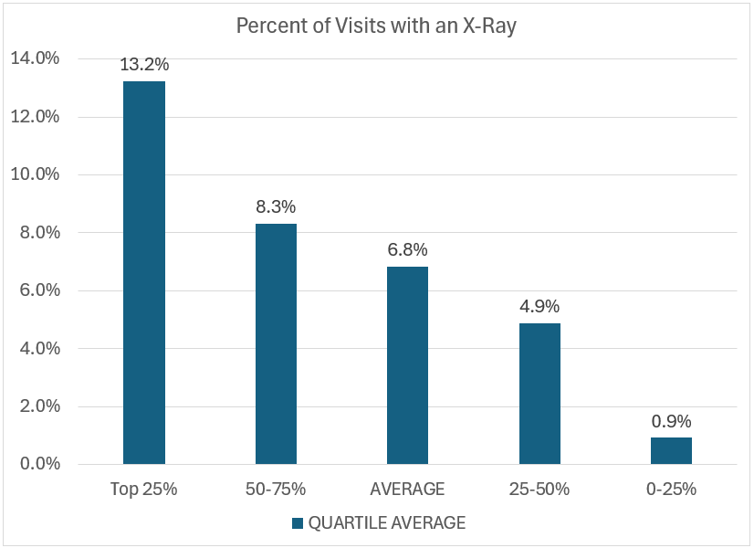
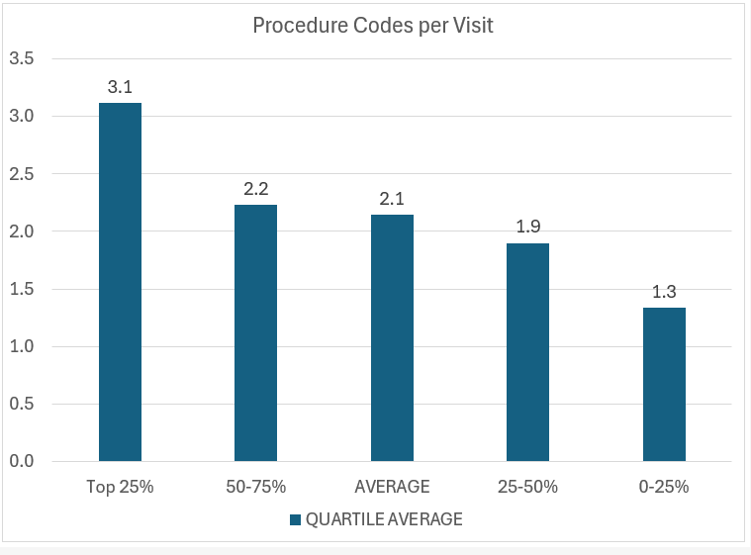
Percent of Visits w/X-ray, Procedure Codes per Visit

Slide 21
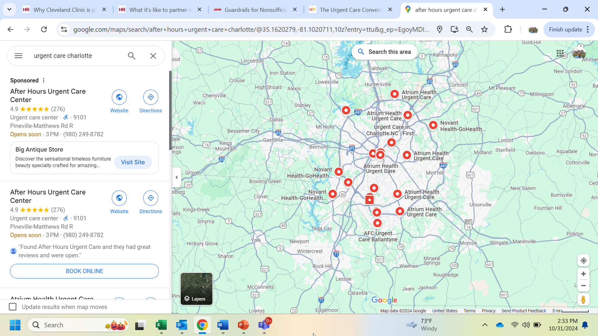
Outspending Competitors on Advertising
SEO is becoming more expensive and less effective
Digital hypes a consistent “patient journey” always starting online
Digital tactics reinforce (but don’t replace) visibility in the community
Aggressive, guerilla grassroots tactics, especially targeting moms
Use of conventional media (Billboards, direct mail, cable/streaming)

Slide 22
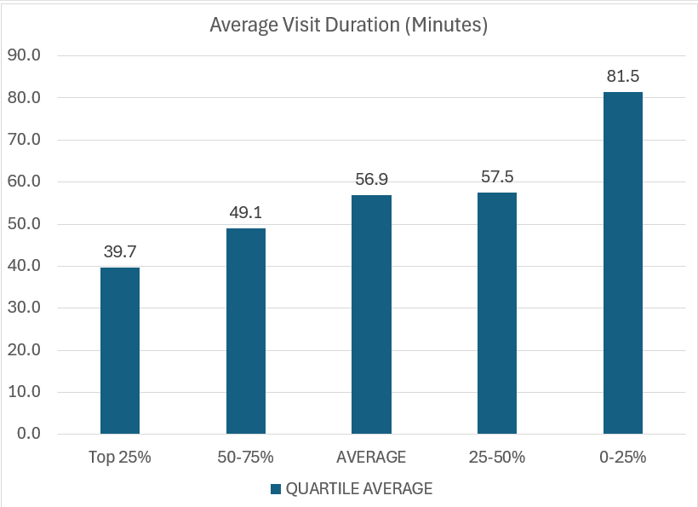
Solid Leadership with a Patient Experience Focus
Highly involved owners and managers aware of what's always going on in their centers
Culture of “speed” realizing high throughput expands capacity and increases satisfaction
Accept patients up until posted closing with short visit times all day
47 Min

Slide 23
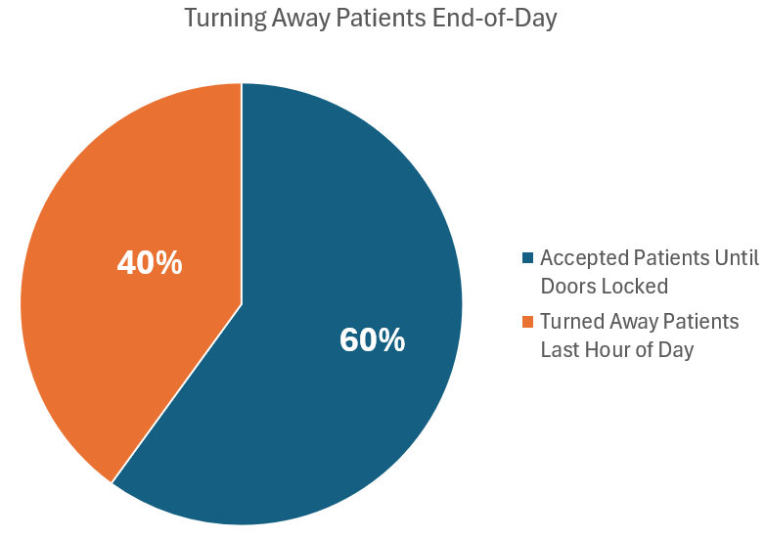
40% of centers surveyed turned away patients during the last hour of the day
The last 2-3 patients of the day can be the difference between profitability (or not).

Slide 24
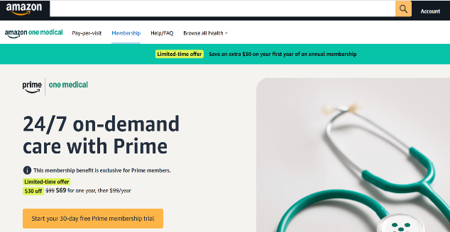
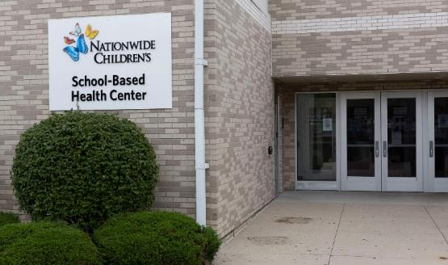
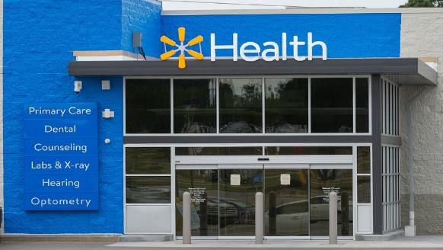
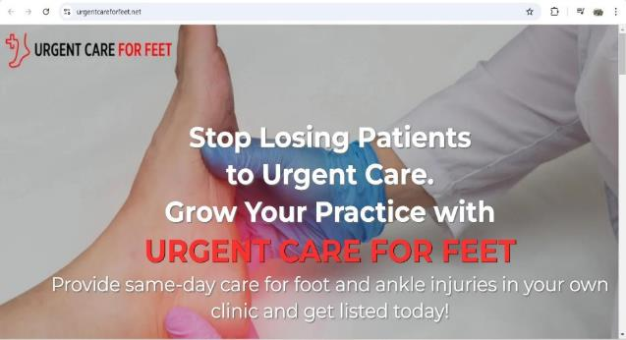
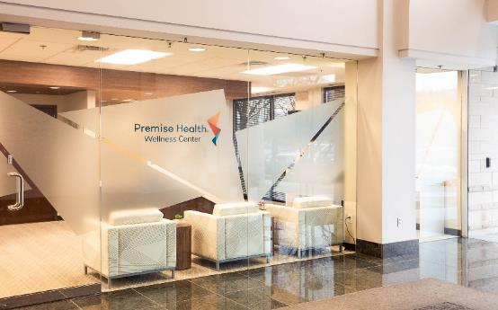

Death by 1,000 cuts? Consider every option available to consumers.

Slide 25
Take-Home Points: Respect the Basic Economics of Urgent Care
Majority of expense inside of four walls
  Scale economies pertain to marketing, functional expertise, SOPs and labor utilization
  Lean operations control cost and cross-utilize staff
High throughput increases capacity and patient satisfaction
  Under-utilized labor is the greatest operating cost
  Wait times is the top determinant of patient satisfaction
Drive year-round volume
  Maintain (expand upon) full urgent care capabilities
  Pediatric focus appealing to moms
  Accept patients until doors locked
  Find opportunity in trade area and demographic shifts
Maximize reimbursable services
  Understand contracts and capture all charges
  Utilize in-house services as clinically appropriate
  Add services relevant to the urgent care presentation

Slide 26
Next Session:
Data Driven Approaches to Site Analysis
with Jim Garrett, NUCR

Slide 27
Urgent Care Business Planning, Development Process

Slide 28
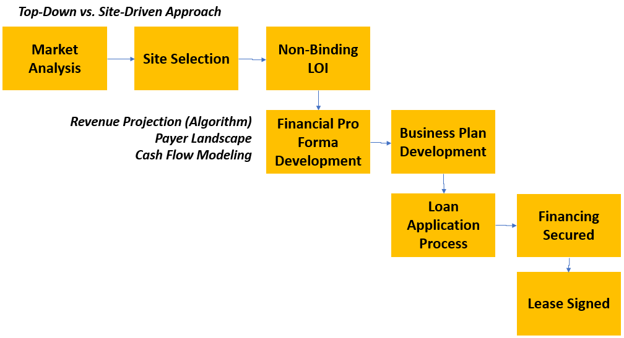
Urgent Care Development Process

Slide 29
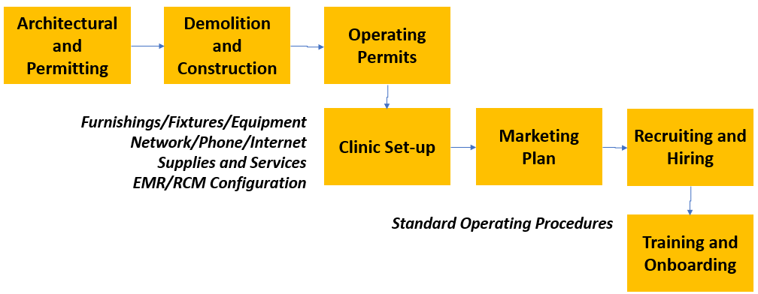
Urgent Care Development Process, cont’d.

Slide 30
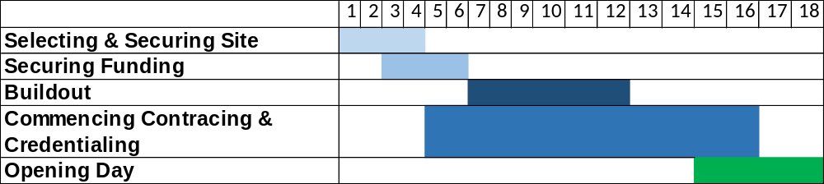
Start-up Critical Path and Timelines
Securing site: 3-4 months
Obtaining funding: 2-3 months
Commencing build-out: 4-6 months
C&C and getting in-network with major payers: 10-12 months
Clinic set-up, supplies, hiring, training, technology configuration, compliance, etc.
Opening Day – 12-14 months

Slide 31
Contracting & Credentialing Considerations
Payer Networks: Open/Closed/Narrow
Other than Urgent Care Contracts
  Primary Care
  Multispecialty
Physician Medical Director and Board Certification
  Most payers still require a physician to be named as the medical director
  Emergency Medicine – NOTE: Will not qualify to be medical director for Primary Care Contracts
  Family Medicine
  Internal Medicine

Slide 32
Opening Without Payer Contracts in Place
Marketing
  This can leave a bad impression with new patients hoping to utilize services
  “Once Out-of-Network, Always Out-of-Network”
    Consumers have long memories. This is true for patients in urgent care, as well

Slide 33
Opening Without Payer Contracts in Place
Interim Financial Policies
Accept Co-pay and write-off remaining balance
  This is only recommended if the out-of-network status is known to be for a short period
Submit Out-of-Network Claim
  Higher patient responsibility, as this will trigger OON benefits
  Time-consuming for staff to manage claim between payer and patient
  Leads to delayed collections; negatively impacts cash-flow
Patient Pays Self-Pay Rate
  Removes complexities of OON process and generates same-day revenue for services provided
See patient, but hold claim and retro date submission to payer
  This is generally only acceptable for government payers (i.e. Medicare, Medicaid). Most commercial payers will NOT allow this practice.
33

Slide 34
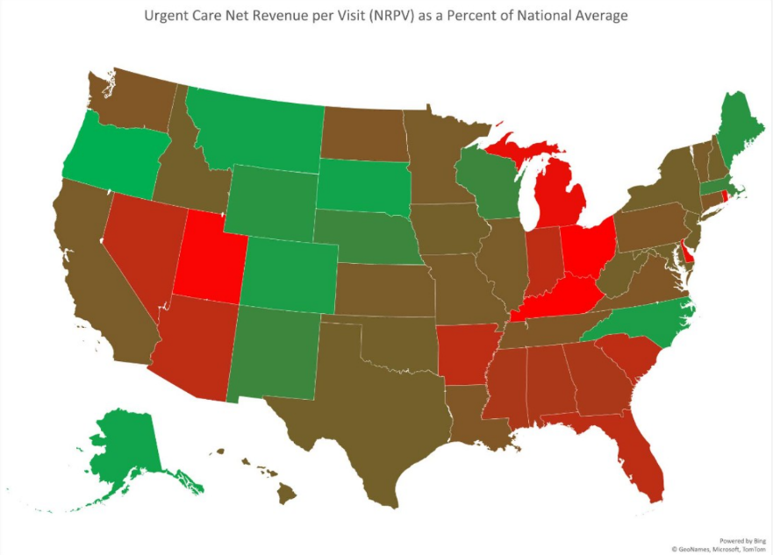
Net Revenue Per Patient: State Rankings

Slide 35
Payer Mix by State
State | Commercial | Health Exchange | Managed Medicaid | Medicare | State Medicaid | Medical Lives
Alabama | 54% | 7% | 1% | 19% | 19% | 100%
Alaska | 41% | 5% | 0% | 13% | 41% | 100%
Arizona | 46% | 5% | 26% | 17% | 6% | 100%
Arkansas | 40% | 6% | 0% | 24% | 30% | 100%
California | 35% | 3% | 56% | 5% | 2% | 100%
Colorado | 51% | 4% | 4% | 17% | 24% | 100%
Connecticut | 54% | 4% | 0% | 19% | 24% | 100%
District of Columbia | 88% | 0% | 7% | 5% | 0% | 100%
Delaware | 54% | 5% | 24% | 13% | 4% | 100%
Florida | 42% | 21% | 16% | 15% | 6% | 100%
Georgia | 47% | 11% | 20% | 15% | 6% | 100%
Hawaii | 56% | 1% | 28% | 15% | 0% | 100%
Idaho | 45% | 9% | 0% | 14% | 32% | 100%
Illinois | 37% | 2% | 27% | 18% | 15% | 100%
Indiana | 57% | 4% | 25% | 11% | 2% | 100%
Iowa | 65% | 4% | 22% | 8% | 1% | 100%
Kansas | 57% | 7% | 16% | 20% | 0% | 100%

Slide 36
Payer Mix by State
State | Commercial | Health Exchange | Managed Medicaid | Medicare | State Medicaid | Medical Lives
Kansas | 57% | 7% | 16% | 20% | 0% | 100%
Kentucky | 41% | 2% | 34% | 20% | 3% | 100%
Louisiana | 56% | 3% | 22% | 19% | 0% | 100%
Maine | 51% | 4% | 0% | 24% | 21% | 100%
Maryland | 54% | 3% | 28% | 14% | 1% | 100%
Massachusetts | 42% | 7% | 21% | 9% | 22% | 100%
Michigan | 26% | 6% | 33% | 18% | 17% | 100%
Minnesota | 61% | 2% | 19% | 14% | 4% | 100%
Mississippi | 45% | 10% | 18% | 20% | 6% | 100%
Missouri | 58% | 6% | 21% | 13% | 2% | 100%
Montana | 41% | 8% | 0% | 24% | 28% | 100%
Nebraska | 50% | 8% | 22% | 20% | 0% | 100%
Nevada | 60% | 3% | 21% | 10% | 7% | 100%
New Hampshire | 51% | 6% | 17% | 26% | 0% | 100%
New Jersey | 57% | 4% | 22% | 16% | 1% | 100%
New Mexico | 40% | 3% | 35% | 20% | 3% | 100%
New York | 55% | 7% | 27% | 9% | 2% | 100%

Slide 37
Payer Mix by State
State | Commercial | Health Exchange | Managed Medicaid | Medicare | State Medicaid | Medical Lives
North Carolina | 37% | 12% | 25% | 22% | 4% | 100%
North Dakota | 64% | 5% | 4% | 16% | 11% | 100%
Ohio | 54% | 4% | 22% | 18% | 3% | 100%
Oklahoma | 43% | 8% | 0% | 19% | 30% | 100%
Oregon | 45% | 3% | 34% | 14% | 4% | 100%
Pennsylvania | 56% | 3% | 22% | 19% | 0% | 100%
Rhode Island | 48% | 3% | 25% | 18% | 5% | 100%
South Carolina | 23% | 6% | 23% | 34% | 14% | 100%
South Dakota | 59% | 7% | 0% | 22% | 12% | 100%
Tennessee | 52% | 8% | 21% | 19% | 0% | 100%
Texas | 50% | 16% | 20% | 12% | 1% | 100%
Utah | 60% | 13% | 10% | 14% | 3% | 100%
Vermont | 42% | 5% | 0% | 24% | 29% | 100%
Virginia | 56% | 5% | 20% | 18% | 1% | 100%
Washington | 67% | 3% | 18% | 10% | 2% | 100%
West Virginia | 34% | 4% | 34% | 28% | 0% | 100%
Wisconsin | 52% | 4% | 23% | 17% | 4% | 100%
Wyoming | 44% | 11% | 0% | 25% | 20% | 100%

Slide 38
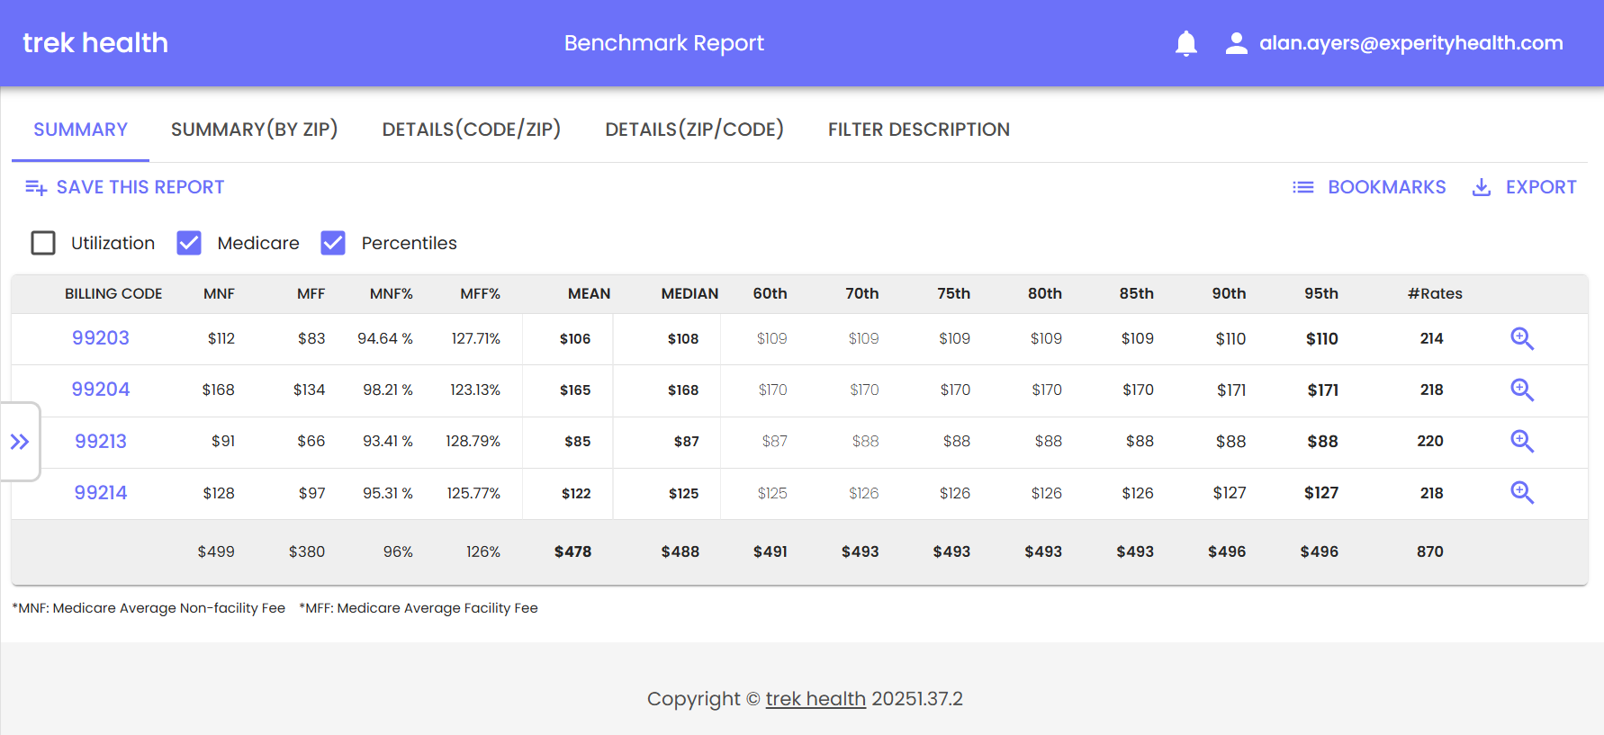
Payer Transparency Data

Slide 39
Factors That Determine Contractual Rate
Year contracts first put into place
Original terms or renegotiations
Fee-for-service or case rate
Network access and saturation
Competition willing to take rates
Value payer puts on urgent care
Aspiration for steerage – ED overutilization; diversion to payer-owned facilities (i.e. Kaiser)

Slide 40
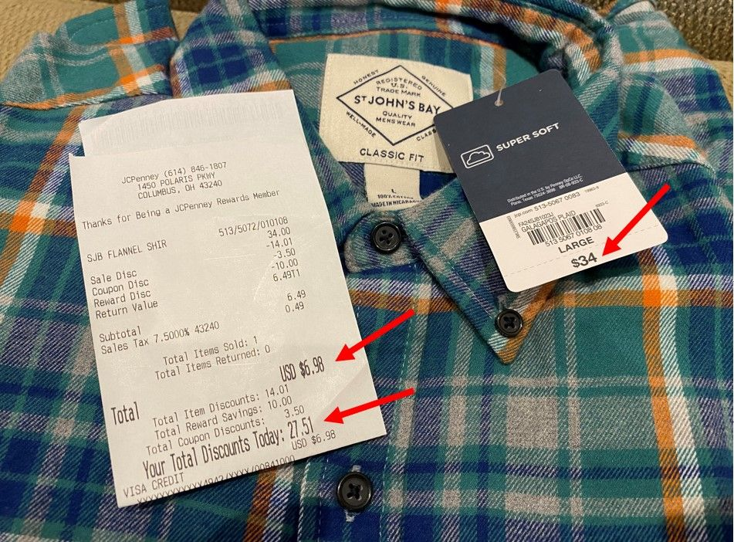
The Price is Never “Right”: Understanding Insurance Adjustments
Physician Office Fee Schedule
Claims Verification and Edit Process
Provider Reference Manual Rules
Provider Contract Terms
Patient Policy Benefits Coverage

Slide 41
POS 11 vs. POS 22
To bill POS 11, a physician must be from a primary care specialty (family practice, internal medicine, or pediatrics). Insurance won't credential an emergency medicine physician as a PCP unless dual-boarded. This means POS 11 is out-of-reach for the 50% of urgent care doctors who come from emergency medicine.
Contracts may be with the individual providers who get listed in the payer directory--i.e. listing Dr. John Smith, Nancy Smith, NP--thus losing the marketing value of being listed as an "urgent care”.
Office visit co-pays (11) are lower than "urgent care" (20) reducing cash collected at time of service. Patients, however, may prefer an office over an urgent care because of this lower co-pay.
FFS reimbursement is generally the same by CPT for both contract types but because of the reduction on "established" vists--POS 20 case rates can be better for repeat visits.

Slide 42
POS 11 vs. POS 22
Sometimes there is a flat fee paid ($.50 to $3.00 per month) for carrying the chart. This a pre-cursor to value-based care which can add up to $20 to NRPV.
Under POS 11 there is an expectation you will actually be the patients PCP. What's the cost of stocking vaccines? Referral relationships for mammograms and colonoscopies? Time to follow-up with the results? Chronic care management? Annual wellness physicals can pay well but are time-consuming. How do you manage flow of four urgent care visits per hour when you need to take 60 minutes out to do an annual physical and med reconciliation?
Typically what we see is POS 11 contracts when POS 20 is simply unavailable due to closed networks. Otherwise if they're running a PCP office parallel to the UC, it's a separate practice, by scheduled appointment only, for wellness/preventive visits and rechecks for established patients, separate provider (although the same provider may also work on the UC side during different shifts), etc.

Slide 43
Contracting & Credentialing Complexities
Payer Name | Entity Contract Status | Entity Contract Effective Date
Aetna | Pending Effective Date from Payer
Aetna Better Health Illinois | Does Not Meet Cred Req
Ambetter of Illinois | Ap in Process at Plan Level
American Choice Provider Network | Effective/Completed | 7/11/2024
BlueCross Blue Shield Illinois | Effective/Completed | 5/17/2024
Cigna HealthCare of Illinois | Ap in Process at Plan Level
Department of Labor | Effective/Completed | 5/17/2024
Devoted Health | Pending Internal Review
First Health Network | Sub Contract
Healthlink | Network Closed
Humana | Effective/Completed | 8/15/2024
Medicare DME | Pending Medicare
Medicare Illinois | Effective/Completed | 5/30/2024
Meridian Health Plan of Illinois | Sub Contract
Molina Healthcare of Illinois | Effective/Completed | 8/1/2024
Oscar Health Insurance Co. | Contract Signed Unexecuted
Railroad Medicare Illinois | Ap in Process at Plan Level
SEIU - Local 4 | Network Closed
Tricare Humana Military | Effective/Completed
United Healthcare | Network Closed
VA Community Care Network - Optum | Effective/Completed | 9/1/2024
WellCare of Illinois | Sub Contract

Slide 44
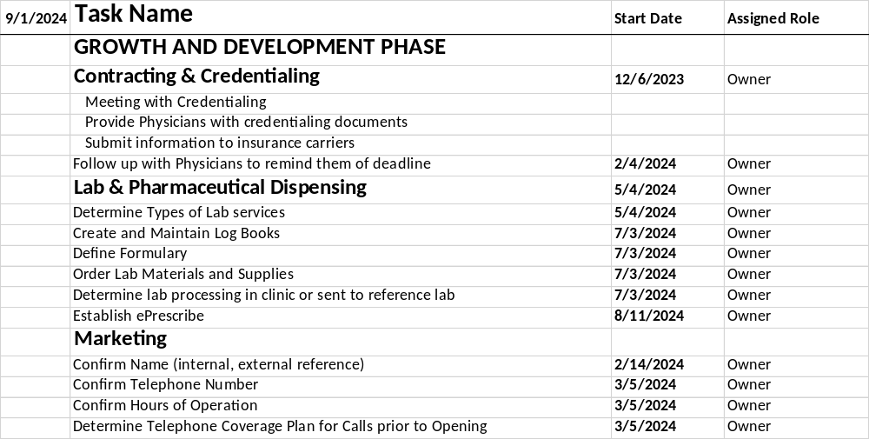
Start-up Pro®

Slide 45
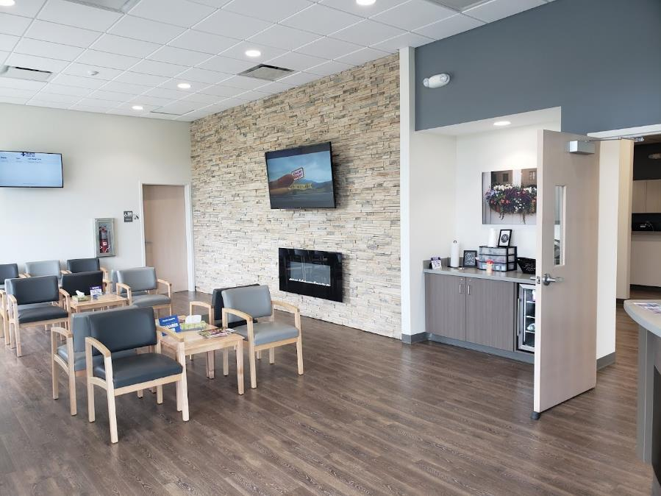
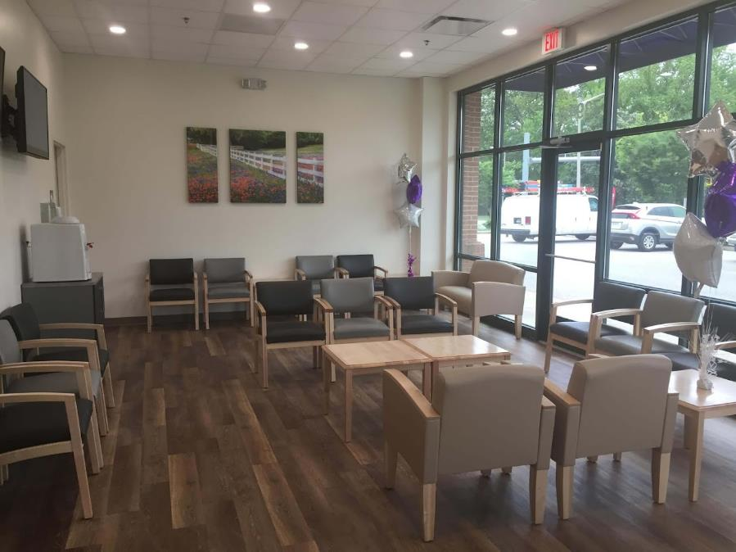
Value-Engineering Urgent Care Centers

Slide 46
Urgent Care Financial Pro Forma Review

Slide 47
Typical Lending Options
SBA Lending
Most common form of lending for new UC operators
Generally requires 10-20% equity injection
Will require 80-90% collateralization through other assets
  Equity in primary residence is not eligible for SBA Loan collateral
Loans for Physician’s by Physician’s
Niche loan programs in which groups of physicians provide loans for other physicians starting new practices
May finance up to 100% of the project

Slide 48
Pro Forma Elements
Revenue Formula
Expense Formula
+ Patient Charges for Medical Services
Contractual Allowances
Bad Debt Expense
= Net Revenue (per visit)
+ Dispensing Revenue
+ Occ Med (EPS) Revenue
+ Misc. Fees and Charges
Labor
  Staffing Model (MDs vs. PAs/NPs, MAs, RTs)
  Staffing Efficiencies to Patient Volume
  Increase Staffing as Volume Grows
Technology and Billing Services
Supplies
Rent and Occupancy Expenses
Marketing
  Grassroots, Paid Advertising
  Website, SEO, Digital Tactics
Purchased Services

Slide 49
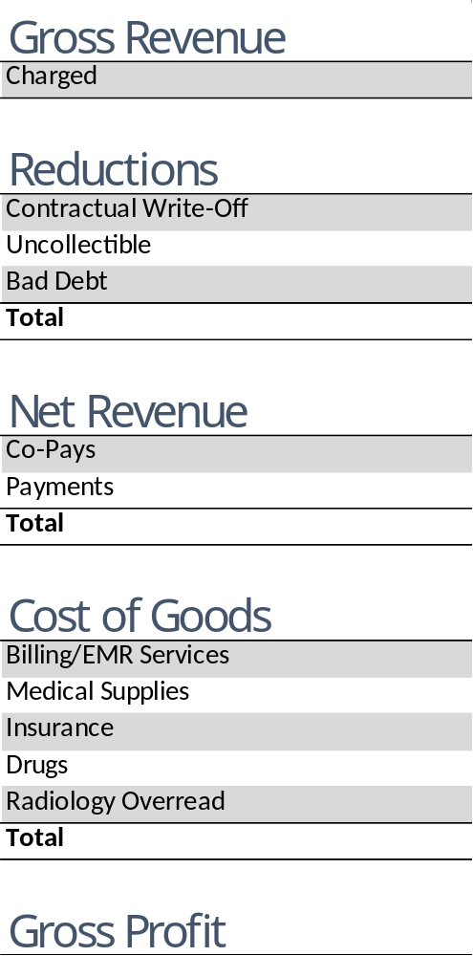
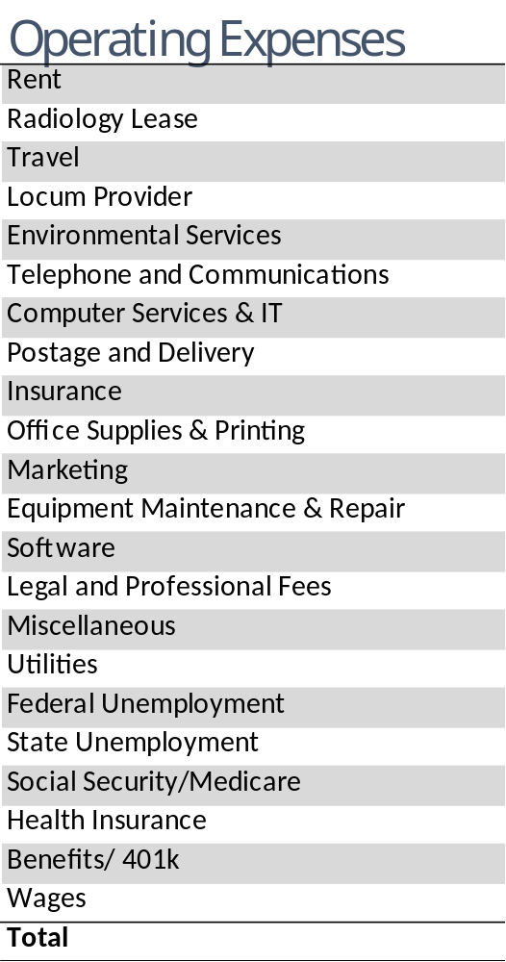
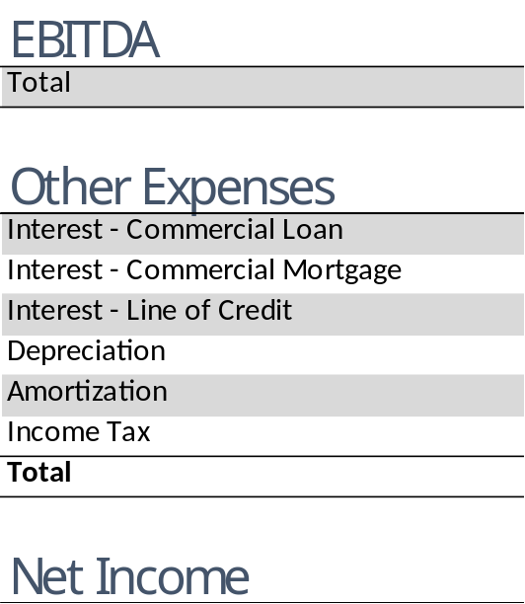
Pro Forma Assumptions

Slide 50
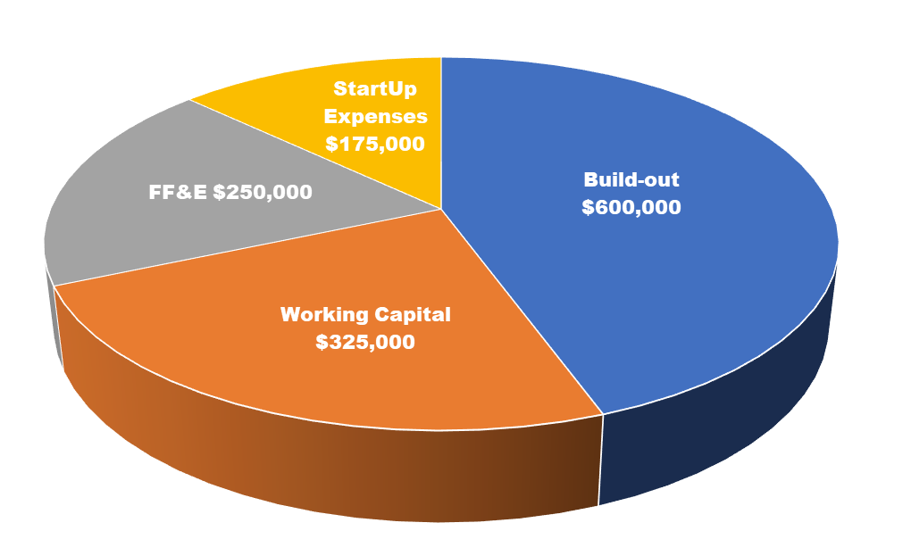
Investment Breakdown

Slide 51
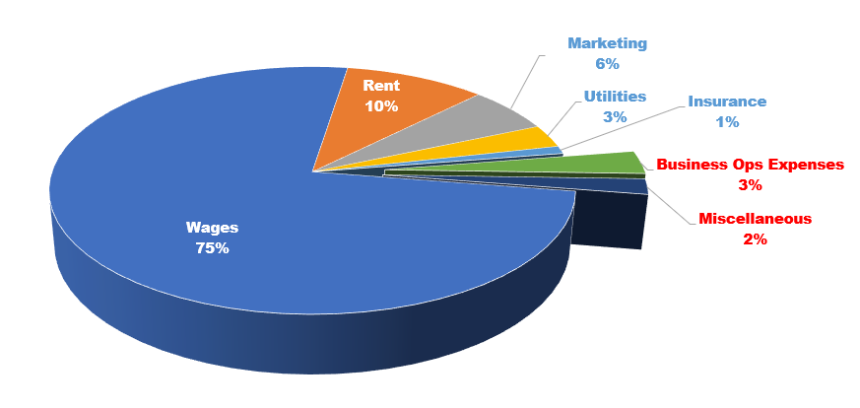
Business Expense Breakdown

Slide 52


Urgent Care Development: Capital Required
Buildout costs $ * Square Footage >>>
$600K
FF&E >>>
$250K
One-time Startup Expenses >>>
$175K
Working Capital >>>
$325K
Total:
$1.4M+

Slide 53
Three Year Financials

Slide 54
How to Make Money in Urgent Care
Volume depends on strength, timing and duration of flu season
Prices are set by health insurance companies
High proportion of costs are subject to wage inflation
Excess labor capacity due to minimum staffing models
Excess labor capacity due to “on demand” ebb/flow (vs. appointments)
Excess labor capacity due to incremental labor problem
Run an efficient clinic (to keep staffing costs down)
See lots of patients

Slide 55
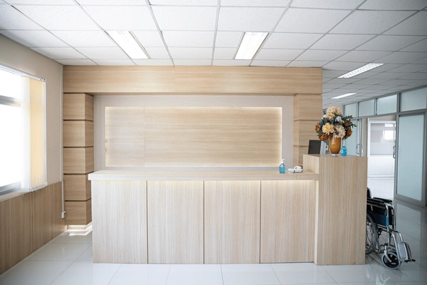

How to Make Money in Urgent Care
Cash is the lifeblood of business. Labor expenses are incurred on the date of service.
Working capital is the financing cost incurred when cash outflows precede cash inflows.
Many urgent care centers unintentionally offer no/no/no consumer financing, without any retail benefits.
This occurs when the patient is prepared to pay at the time of service but:
  Financial policy is not clearly presented
  Front desk does not verify insurance eligibility, co-pays, co-insurance, deductibles, etc.
  There is no requirement to pay financial responsibility at time of service, put down a deposit, or credit card on file
Post-CFPB action on medical debt, collections efforts are becoming less effective.

Slide 56
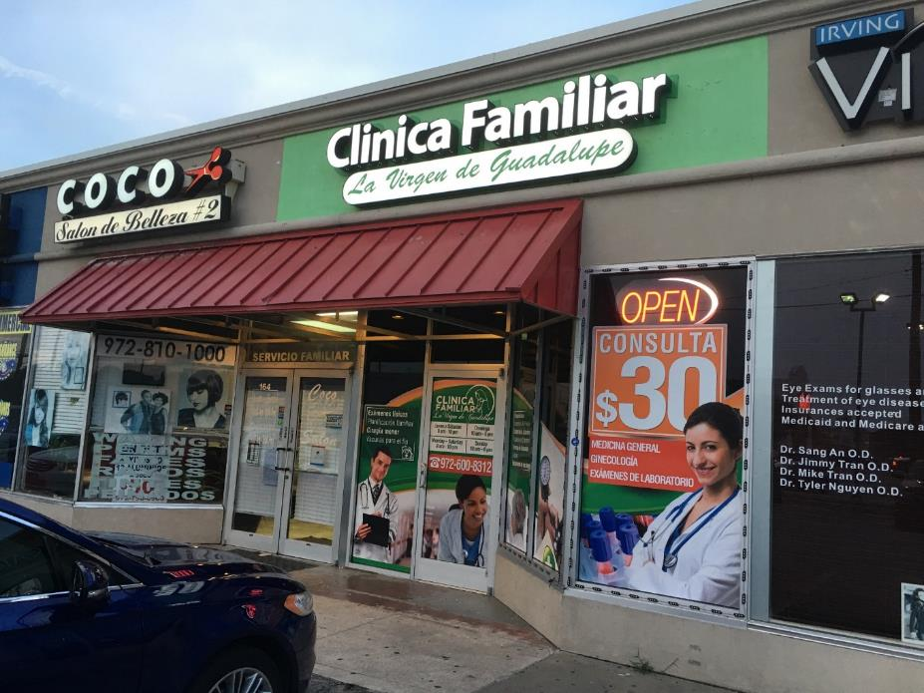
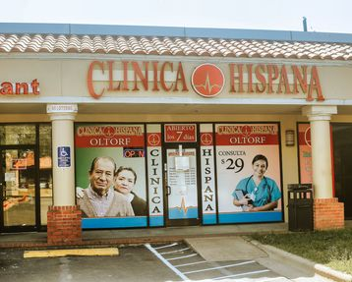
Cash-only Urgent Care?

Slide 57
Cash Pay Options
Payment Process | Advantages | Disadvantage
Prompt Pay Percentage Discount off Office Fee Schedule | Easy to process in billing alongside insurance claims. Assures payment for all services performed. | Price can’t be advertised and isn’t known until after all services have been performed. Chargemaster or other manual process to assure all charges captured.
Single Self-Pay Rate (w/ or w/o carve outs and add-ons) | Strong marketing messaging. Functions like insurance case rates in which E/M is paid but ancillary codes are zero’d out. | Setting the price fairly so not to lose significantly on high-acuity visits but also remain competitive vs. telemedicine and other low cost options.
Tiered Rate Menu Board | Tiers correspond to services provided (i.e. rapid test, x-ray, procedures) to avoid over- or under-charging for services provided. | Patients do not have the option of picking and choosing among tiers. Does not tie to CPT codes adding complexity in RCM.
Membership Plan | Creates affinity as the patient’s “provider of first resort”. Generates monthly recurring revenue from membership dues. | Administrative costs including enrollment, verification, reporting, collections, etc. High rate of churn, credit card denials and chargebacks. If not structured correctly, can lose money on frequent users.

Slide 58
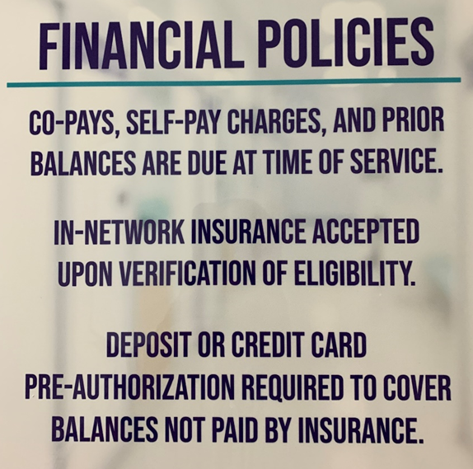
Credit Card Pre-Authorization
Enrollment in high deductible health plans is up to 65% of commercial enrollees
Unmet deductible should be collected at the time of service
CCPA provides a “catch-all” when patient financial responsibility cannot be determined
Enables third party to pre-approve a charge amount for a set period of time
Is not a “hold”, doesn’t entail storing credit card information, and does not affect available credit
Accelerates collections while saving patients the hassle of writing and mailing a check

Slide 59
Urgent Care Marketing and Ancillary Services

Slide 60
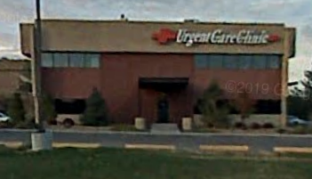
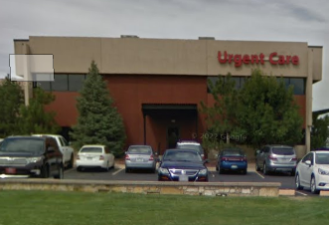
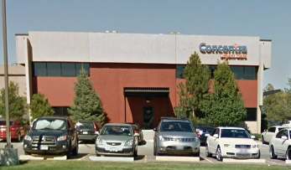

Developing a Meaningful Brand
A “commodity” in the “sea of sameness”
Loyal to a location or provider, not a “brand”
Loyal patients have more frequent utilization
Think of “differentiated” retail experiences

Slide 61


Slide 62

Pre- and Grand Opening Marketing
Selecting a name
  C&C – “urgent care”
  Legal vs. d/b/a
  URL
  SEO
  Signage
Designing a logo
Developing a website
Google Business Profile and social media
  Set-up and maintenance
Direct mail
Chamber of Commerce
  Ribbon cutting
  Opening “family event”
Press Release

Slide 63


Marketing and Advertising
Emphasis on guerilla and grassroots tactics versus a “digital only” strategy.
Deployed grassroots marketing (community liaisons)
“Guerilla” tactics like handing out flyers door-to-door and at a “temporarily closed” competitor
Outreach to local school districts – athletic directors, school nurses, and special needs departments
“Get in front of moms” – mom groups, social media, family events – focus on opinion leaders
Return to conventional advertising media like direct mail, billboards and TV advertising (Superbowl)
Re-branding to become more contemporary and better stand out

Slide 64





Slide 65



Slide 66
Urgent Care Marketing Tactics
Brand Building | Patient Journey
Traditional ad tactics to achieve “top-of-mind-awareness” for whenever a future medical need occurs. | Intervenes when a patient identifies a medical need, searches online for solutions, compares options, and leaves online feedback afterwards.
Billboards and transit ads Digital and analog radio ads Streaming video ads TV commercials Direct mail Print publications Email newsletters Social media engagement Text message marketing School and community events | Search Engine Optimization Robust website – keywords and content Google algorithm – focus on mobile and voice Google Adwords GMail campaigns Facebook boosts Pay-per-click Remarketing platforms Geofencing campaigns Patient experience survey
Mix of digital, conventional media and grassroots tactics. | Primarily all digital tactics.

Slide 67

Integration of Digital & Non-Digital Tactics

Slide 68

Google Places
Ranking determined by:
Geographic Proximity
Transactional Capability (Online Scheduling)
Quantity and Quality of Reviews

Slide 69

Build Volume by Leading w/ Core Urgent Care Services
Avoid Chasing “Fads” and “Fashion”:
Divides management attention
Dilutes marketing spend
Consumer discretionary is fickle and fading in inflationary times
Often more competitive than urgent care
Urgent care lacks focus of pureplay providers
Undermines credibility of medical services
Lowest cost provider by definition means thin margins
Botox 40-50 units per session:
$6.22 per unit wholesale supply cost
$12.00 per unit average retail price
Range: $10.00 to $15.00

Slide 70

Weight Loss Drugs: Extensive Competition, Limited Market
Expensive medications not covered by insurance without co-morbid (diabetes) diagnosis
Unreliable compounding pharmacy supply chain requiring more than one pharmacy relationship
Pharma cease-and-desist against those using brand names in marketing
Expensive pay-per-click PPC due to AdWords saturation from pharma, PCPs, diet clubs, out-of-state telemed providers, et.al
Google flagging and suppressing websites, hurting the organic search of core urgent care services
Social media algorithms flagging and suppressing mention of it
Ozempic
Wegovy
Mounjaro
Compound Semaglutide

Slide 71

Specialist Services
Integrated behavioral health, dermatology, orthopedics, allergy
vs.
Behavioral Health urgent care
Orthopedic urgent care
Dermatology urgent care
GI urgent care

Slide 72


IV Services
Medical hydration*
Vanity/vitamin blends
Ketamine
Hydration for hangover or endurance
Pharmaceutical infusions
*Required per UCA Certification

Slide 73


Building on Core Services: Rapid STI/STD Testing

Slide 74


Capturing a Greater Share of Lab Revenue In-House

Slide 75
Occupational Medicine: Contra-Seasonal Incremental Revenue
 | Employer Paid Services | Workers Compensation
High Value | Multi-Component Physicals Police/Fire Contracts FAA, Merchant Marine, HAZWOP Compliance OSHA Baseline and Periodic Surveillance Testing | End-to-end injury management, coordination of imaging, specialists, physical therapy Light/Modified Duty, Return-to-Work Evaluations Ergometric, ADA, Injury Prevention Consulting Impairment/MMI Evaluations
Low Value | Drug Screens (eScreen) DOT Physicals (FormFox, CerteDrive) | First report of low acuity, no time off, recordable injuries w/ limited rechecks

Slide 76

Municipal Employment: 2x Injury Rate of Private Sector (~3%)

Slide 77
Next Session: Practicing Urgent Care Medicine
with Dr. Andrea Giamalva

Slide 78
Urgent Care Operations, Staffing, Lab and X-Ray

Slide 79

Operational Excellence
Guiding principles:
No wait
No waste
No hassle
Achieved through highly optimized processes
Boosting patient throughput
Eliminating unnecessary administrative burden
Identifying and correcting errors, friction points, and bottlenecks

Slide 80

Branded Patient Experience Destinations
Scalable and Predictable Operating Model:
Consistent (every day, every patient, every provider, every site)
Repeatable (process-driven, standardized operating procedures, facilitated by technology
Measurable (KPI-focused with incentives
Accountable (team-oriented with shared values and culture)
Predictable (pro forma and budget are reliable)

Slide 81

Continuous Improvement
Focus on getting it right the first time to eliminate costly and timely re-work
Realize that processes become “jury-rigged” over time
Utilize key performance indicators to identify changes in underlying processes
Constantly engage the team in:
  Making the operation more efficient
  Removing non-value-added tasks
  Upgrading the level of patient experience

Slide 82


Focusing on the “Right Things”
Differentiation on what’s important to the patient
  “Being different” doesn’t matter if the patient doesn’t realize it or care
Engagement around the patient, providing quality care and moving patients through quickly
  Engagement with the team or organization doesn’t matter if it doesn’t manifest in patient interactions
  Technology that reduces friction and creates efficiency leading to better patient experiences and outcomes
    “Technology” should seek to solve a business platform, not the other way around

Slide 83
Standard Operating Hours for Urgent Care
UCA no longer prescribes minimum operating hours for Accreditation or Certification
  In the past it was 3,000 per year, open 7 days a week for at least 4 hours/day
Some payers may mandate minimum hours in provider contracts
  Especially when the objective is to augment primary care and reduce non-emergent ER utilization
Hours are determined by a variety of factors including:
  Competition
  Patient Expectations and Behavior
  Ebb-and-flow and Seasonality
  Provider and Staff Availability
  Operational Consistency

Slide 84

Days of Week Open
Standard Operating Hours
24% of centers have the same daily hours, 7 days a week
The most common operating hours are, by percent of all centers:
8am to 8pm, 7 Days a Week (15%)
M-F 8am to 8pm (7%)
M-F 8am to 8pm, S-S 8am-5pm (4%)
M-F 8am to 8pm, S-S 9am-5pm (4%)
M-F 8am to 8pm, S-S 8am-4pm (2%)
M-F 8am to 8pm, S-S 8am-6pm (2%)
Nationally…
79 centers are open 24/7
8 centers are open until 1:00am
Analysis of 14,301 centers in National Urgent Care Realty database as of 2/12/2025.
An immaterial number of centers Wednesdays (~0.2%) and Fridays )~0.6%)

Slide 85


Weekday Opening and Closing Hours
Percent of all Urgent Care Centers; National Urgent Care Realty Database, February 12, 2025; N=14,405

Slide 86


Saturday Opening and Closing Hours
Percent of all Urgent Care Centers; National Urgent Care Realty Database, February 12, 2025; N=14,405

Slide 87
Sunday Opening and Closing Hours
Percent of all Urgent Care Centers; National Urgent Care Realty Database, February 12, 2025; N=14,405

Slide 88

Percent of Patient Arrivals by Hour of Day
https://www.jucm.com/patient-arrival-times-in-urgent-care/ July 1, 2024

Slide 89
Urgent Care Staffing Efficiencies
Position | Patients Per Hour
Front Desk | 4
Medical Assistant/X-Ray Tech | 2
Physician/Physician Assistant/Nurse Practitioner | 4

Slide 90

Sample Volume-Based Staffing Models

Slide 91
Urgent Care Pay Rates
Position | Patients Per Hour
Front Desk | $17.59
Medical Assistant/X-Ray Tech | $20.84
Physician Physician Assistant Nurse Practitioner | $116.89 $62.51 $61.78

Slide 92


Teamwork, Cross-Training, Cross-Utilization
A provider can take x-rays and do their own MA work…
MA’s can cover the front desk, spot-clean the center, and perform administrative tasks…

Slide 93


Lab
CLIA Certification
Clinical Laboratory Improvement Amendments – federal regulations
Certificate of Waiver
  POC tests with “insignificant risk of erroneous result”
Costs and revenue of lab services
Managing equipment, tests, and testing supplies:
  Inventory levels
  Expiration dates
  Contracts and minimums
  Equipment
  Quality Controls
    Calibration and documentation requirements
  Test types need to match certification level
    Research payer contracts to understand reimbursement

Slide 94


X-Ray
Required service for urgent cares
$50,000-$60,000+ for standard DR equipment
Wiring and lead-shielding- $40,000-$50,000
Understanding Reimbursement
Radiology services will not be independently profitable
Consider reimbursement, staffing expenses, and services spectrum for added modalities, i.e. ultrasound, CT

Slide 95

State Limited Scope X-Ray Laws
X-Ray Regulations by State

Slide 96
IT Requirements
Network/desktop/email/IT security support
  Internet runs into the center via cable
  Cable and Wi-Fi routers
  VoIP phones, camera and alarm systems
SaaS EMR/PM
SaaS Patient Engagement: Queuing, eReg, Survey
PACS for x-ray (teleradiology EMR integration)
HRIS or payroll provider, EE scheduling app
QuickBooks

Slide 97
Next Session: Experiences Learned in 35+ Years of Ownership
with David Stern, Experity CEO

Slide 98
Avoiding the Top Mistakes of Urgent Care Startups

Slide 99
Urgent Care Development Obstacles
Finding the “right” location
Payer contract availability and reimbursement rates
Having a physician on board (State CPOM laws, payer requirements)
Ability to obtain financing (SBA loan, savings, friends/family)
Vendor relationships (supplies, x-ray, lab) with urgent care experience
Attention to detail – workplan of required tasks
Facility floorplans and construction requirements
Policies and procedures, job descriptions

Slide 100
Urgent Care Startup Mistakes
Mistakes in ownership structure
Not having a physician on paper (if needed)
  CPOM; APP collaboration; payer medical director requirement; SBA loan guarantor
Not understanding operations beyond the medicine
  “Retail” elements of the business; CC (not hospital, not independent); costs of doing business

Slide 101
Urgent Care Startup Mistakes, cont’d
Mistakes in financial planning
Planning too little for capital expenditures
  Build-out, x-ray, other supplies and equipment
Not planning for adequate working capital
  Non-operational carrying costs
  Operational costs > revenue in early weeks/months due to volume ramp up and delay A/R maturation

Slide 102
Urgent Care Startup Mistakes, cont’d
Mistakes in site selection
Not considering known indicators for success
  Ideal market benchmarks
  Site positioning

Slide 103
Urgent Care Startup Mistakes, cont’d
Mistakes in operating system execution and utilization
Not deploying appropriate resources to support operations
  Urgent care-specific platforms and service providers that can manage the nuances of urgent care:
    Fluctuations in hourly, daily, and seasonal visit volumes
    Episodic presentation vs. scheduled visits
    Efficient supportive services – reference labs, supply ordering, x-ray over-reads, etc.

Slide 104
Urgent Care Startup Mistakes, cont’d
Mistakes in operations
Not knowing what you don’t know
  Cash-only
  Compliance
  Flexibility
  Referring out good revenue
  Ancillary income
  Growing too quickly

Slide 105
Urgent Care Startup Mistakes, cont’d
Mistakes in marketing
Not investing in and deploying successful marketing strategies
Relying on word-of-mouth and referrals for volume vs. site visibility/awareness, SEO, etc.
Not putting urgent care first; promoting ancillary services over urgent care as core business
Not diversifying strategies across multiple medium (digital, print, grassroots)

Slide 106
Appendix:
Urgent Care vs. Primary Care

Slide 107
Urgent Care vs. Primary Care
Urgent Care
Transactional
Acute
Episodic/Referral
Focus on Chief Complaint
Walk-in/Same Day
Case Rate/Facility-Based Contracts, Lab/X-Ray/Vaccines as Overhead
Emergency Medicine and Primary Care Specialities
Primary Care
Relational
Chronic
Longitudinal/Follow-up
Focus on Wellness/Prevention
Scheduled Appointments
Fee-For-Service: New (Annual Wellness Physicals) vs. Established (Rechecks)
Pediatrics, Family Medicine, Internal Medicine

Slide 108


Primary Care
Parallel but separate line of business
Separate tax ID
Separate providers
Separate payer contracts
  Participation in managed care “risk”
  Capitation for carrying the chart
Scheduled appointments vs. on-demand
Defined as:
  Annual wellness exams
  Re-checks on chronic issues
  Preventative services
Requires connectivity to specialists and facilities
Everything else is “urgent care”

Slide 109



Primary Care in the Urgent Care Setting

Slide 110
Core Operator Positioning
General Practice NOT Primary Care
Primary Care
Pediatric and Medicare populations
Micromanaged by insurance
Form and protocol-driven
Gatekeeper for coordinated care
Risk/capitation models
General Practice
“Whatever ails you”
Consumer-driven “front door”
Specialist and facility referrals without follow-up
Fee-For-Service reimbursement

Slide 111
Thank you!

